Slide 1


Project Name: Decoding Gaming Behaviour
Name: Md Rakibul Islam
Batch Name: MIP-DA-02
Metorness Internship Program
Designation: Data Analyst Intern
Location: Remote

Slide 2

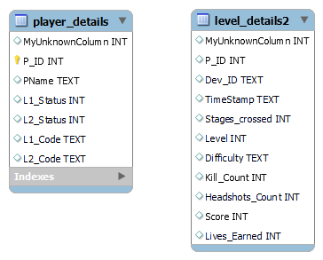
Data Set provided by the Program

Slide 3
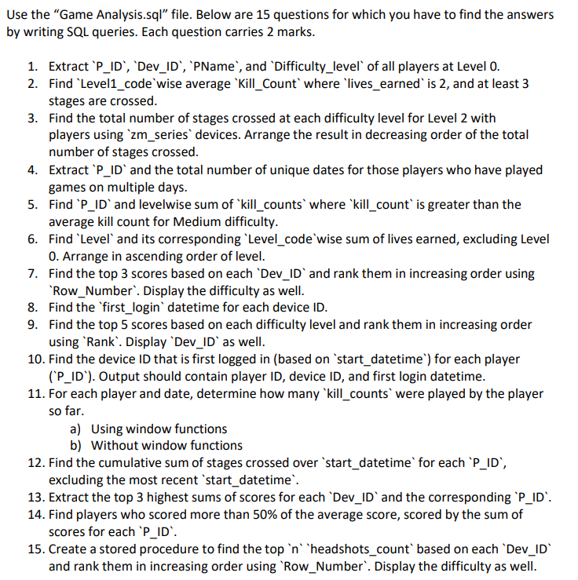
Problem Statement

Slide 4
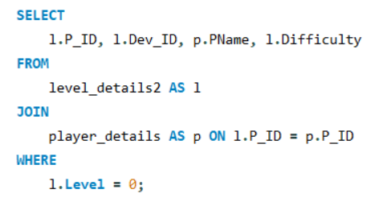
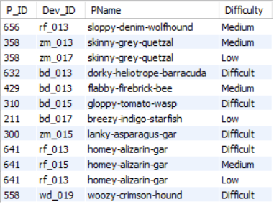
Question 1: Extract ‘P_ID’, ‘Dev_ID’, ‘Pname’, and ‘Difficulty_level’ of all players at Level 0
Query
Output

Slide 5
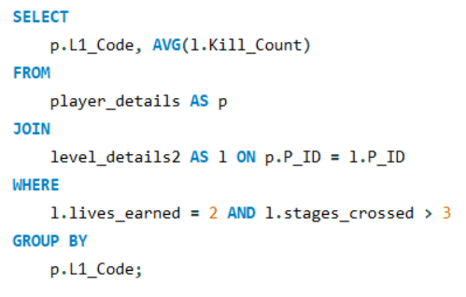
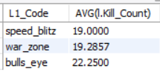
Question 2: Find ‘Level1_code’ wise average ‘Kill_Count’ where ‘lives_earned’ is 2, and at least 3 stages are crossed
Query
Output

Slide 6
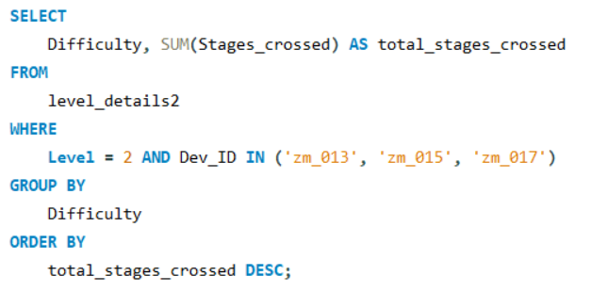
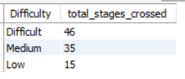
Question 3: Find the total number of stages crossed at each difficulty level for Level 2 with players using ‘zm_series’ devices. Arrange the result in decreasing order of the total number of stages crossed.
Query
Output

Slide 7
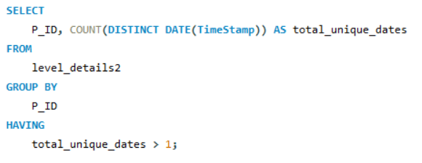
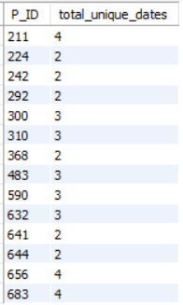
Question 4: Extract ‘P_ID’ and the total number of unique dates for those players who have played games on multiple days
Query
Output

Slide 8
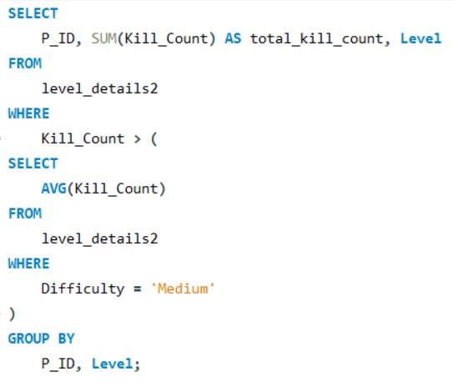
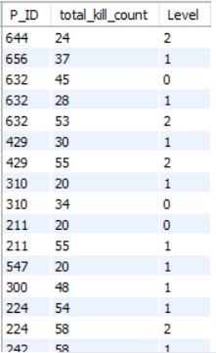
Question 5: Find ‘P_ID’ and levelwise sum of ‘kill_counts’ where ‘kill_count’ is greater than the average kill count for Medium difficulty
Query
Output

Slide 9
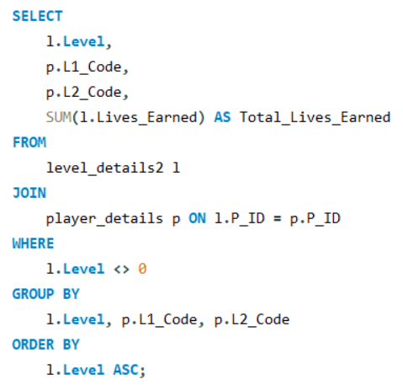
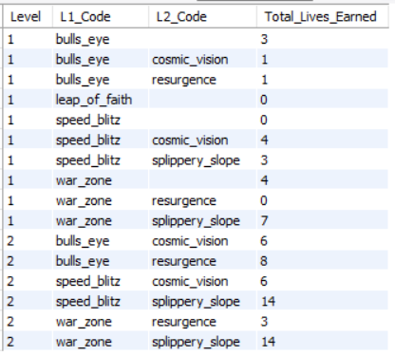
Question 6: Find ‘Level’ and its corresponding ‘Level_code’ wise sum of lives earned, excluding Level 0. Arrange in ascending order of level
Query
Output

Slide 10
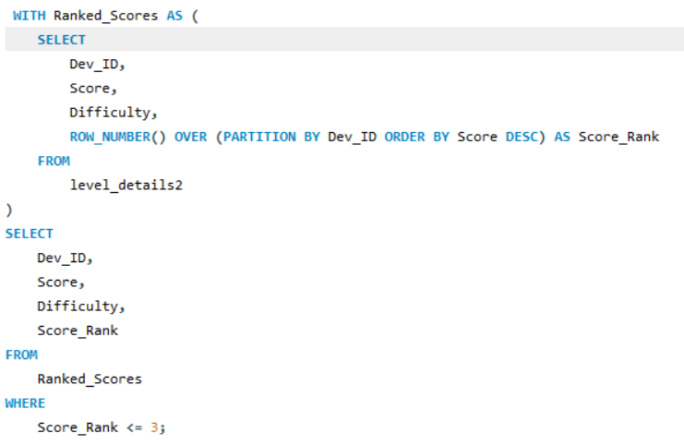
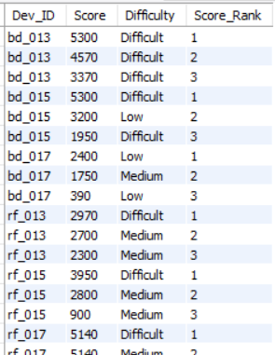
Question 7: Find the top 3 scores based on each ‘Dev_ID’ and rank them in increasing order using ‘Row_Number’. Display the difficulty as well
Query
Output

Slide 11
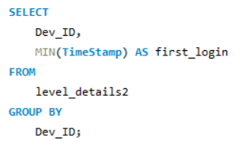
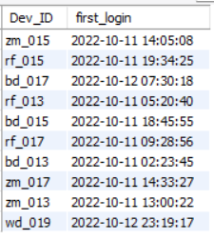
Question 8: Find the ‘first_login’ datetime for each device ID
Query
Output

Slide 12
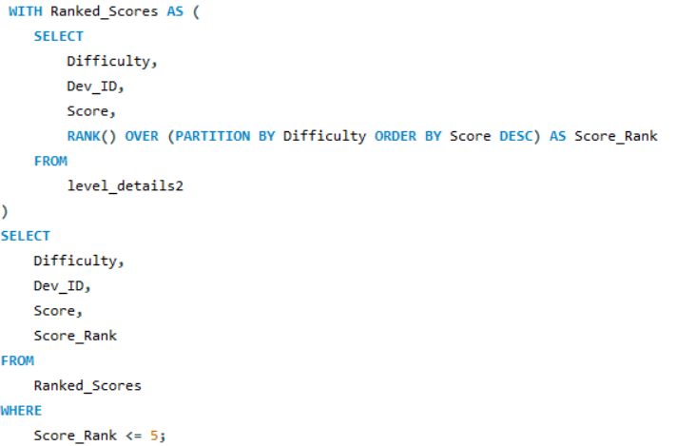
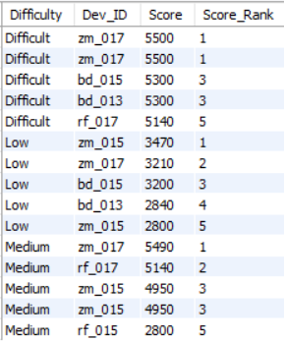
Question 9: Find the top 5 scores based on each difficulty level and rank them in increasing order using ‘Rank’. Display ‘Dev_ID’ as well
Query
Output

Slide 13
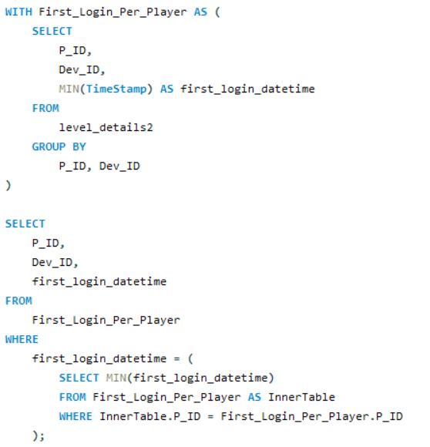
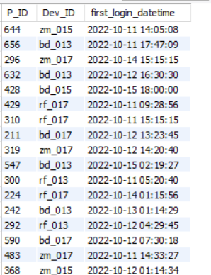
Question 10: Find the device ID that is first logged in (based on ‘start_datetime’) for each player (‘P_ID’). Output should contain player ID, device ID, and first login datetime
Query
Output

Slide 14
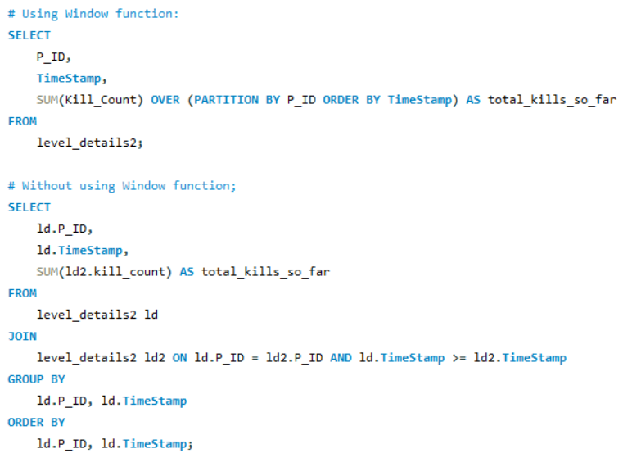
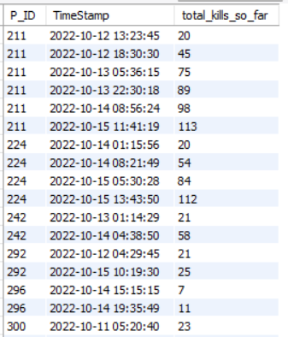
Question 11: For each player and date, determine how many ‘kill_counts’ were played by the player so far. a) Using window functions, b) Without window functions
Query
Output

Slide 15
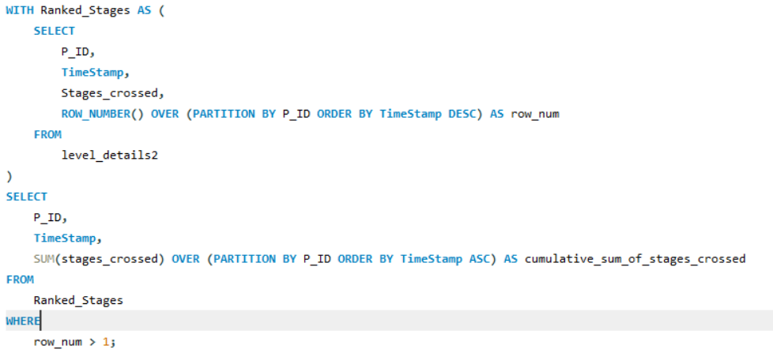
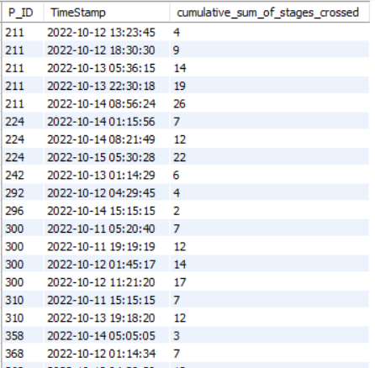
Question 12: Find the cumulative sum of stages crossed over ‘start_datetime’ for each ‘P_ID’, excluding the most recent ‘start_datetime’
Query
Output

Slide 16
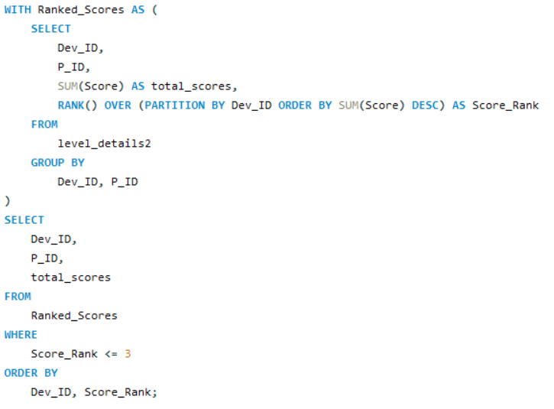
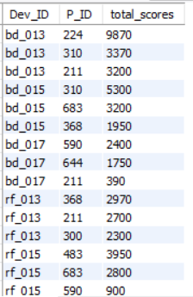
Question 13: Extract the top 3 highest sums of scores for each ‘Dev_ID’ and the corresponding ‘P_ID’
Query
Output

Slide 17
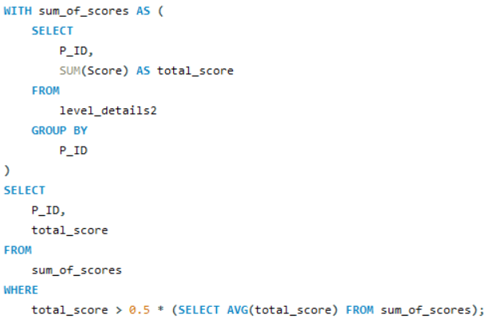
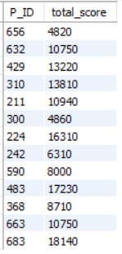
Question 14: Find players who scored more than 50% of the average score, scored by the sum of scores for each ‘P_ID’
Query
Output

Slide 18
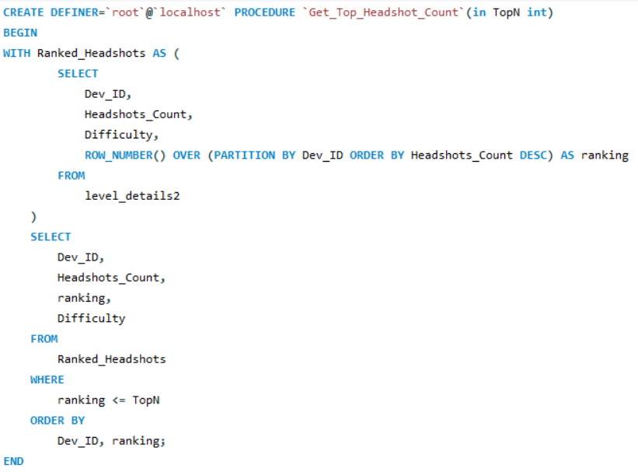
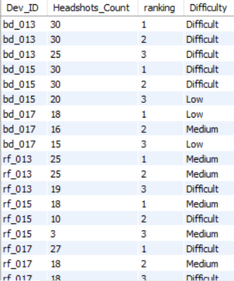

Question 15: Create a stored procedure to find the top ‘n’ ‘headshots_count’ based on each ‘Dev_ID’ and rank them in increasing order using ‘Row_Number’. Display the difficulty as well
Query
Output

Slide 19
THANK YOU

