Slide 1

Project Name: Global Terrorism Data Analysis
Name: Md Rakibul Islam
Intern Career Internship Program
Designation: Data Analyst Intern
Location: Remote

Slide 2
Objectives
Data Exploration, Cleaning , handling missing values and outliers.
Visualize terrorist attack over time and attack location on map.
Analyze trends in attack type and weapons used.
Compare casualties by region and year.

Slide 3
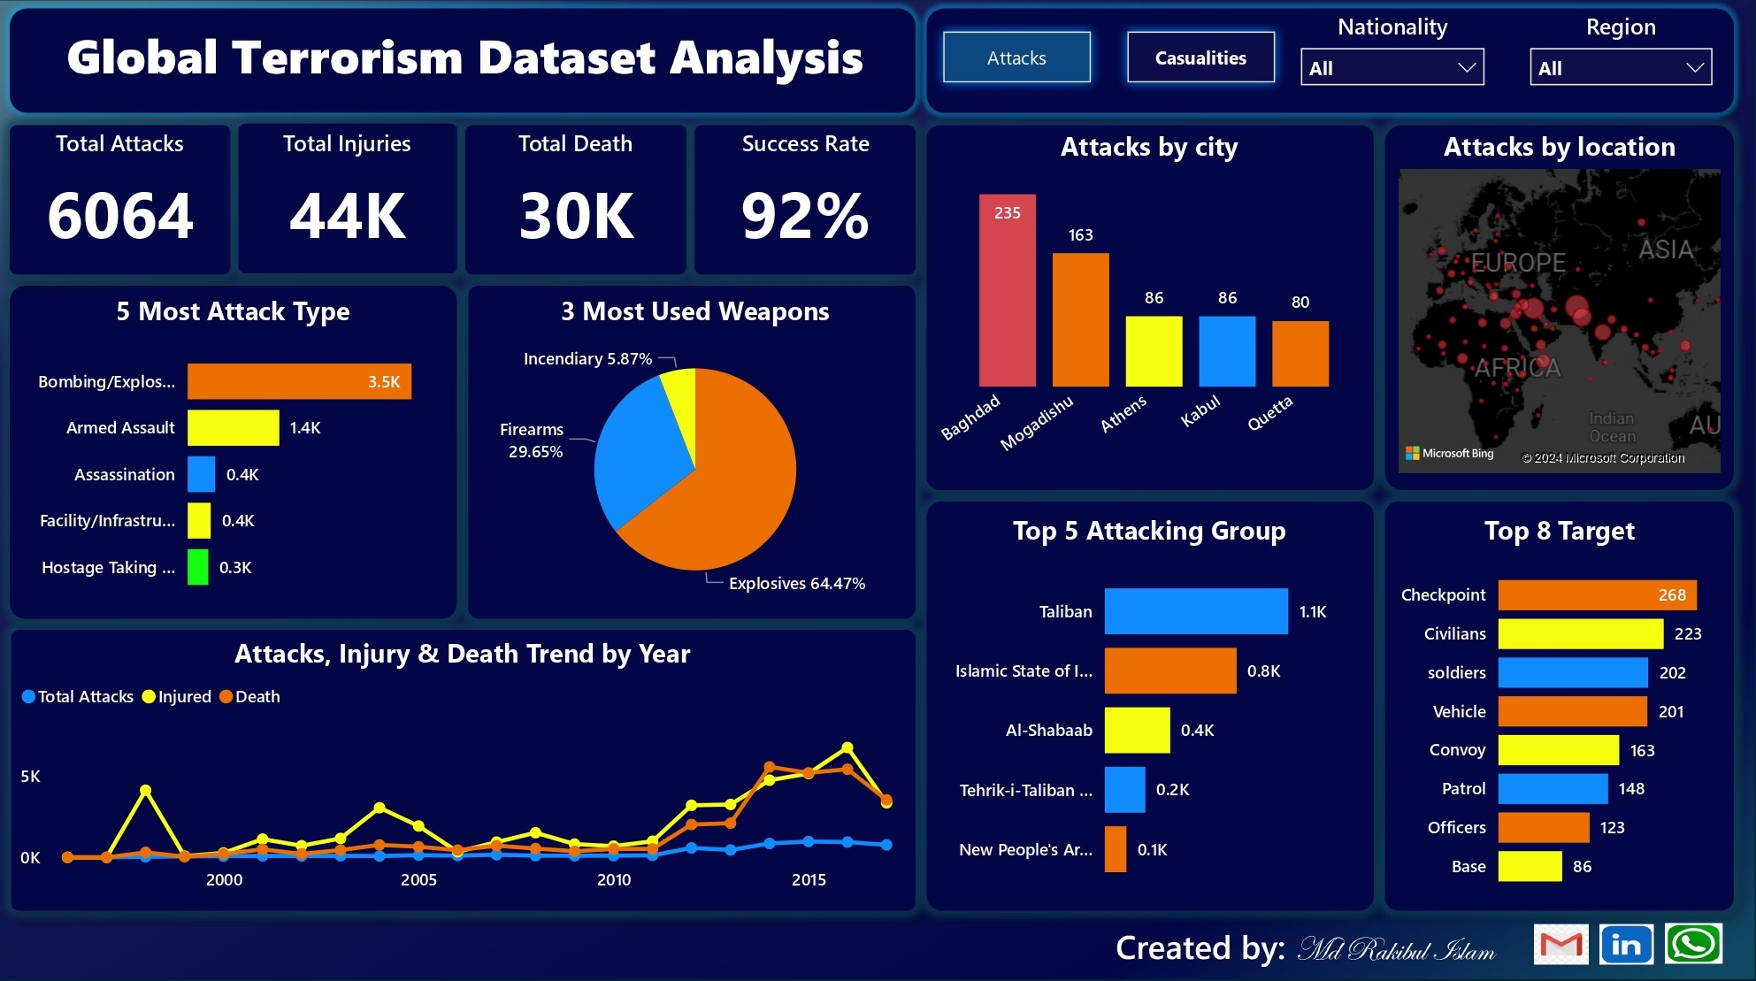

Slide 4
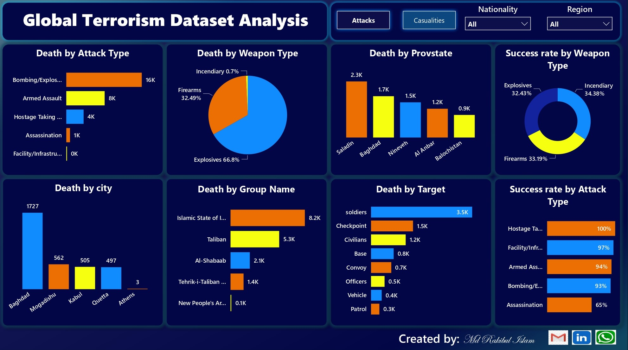

Slide 5
THANK YOU

