Slide 1


Project Name: YouTube Streamer Analysis
Name: Md Rakibul Islam
Intern Career Internship Program
Designation: Data Analyst Intern
Location: Remote

Slide 2
YouTube Streamer Analysis
Dataset: Top 1000 Youtubers Statistics
Description: This dataset contains valuable
information about the top YouTube streamers,
including their ranking, categories, subscribers, country, visits, likes, comments, and more. Your task is to perform a comprehensive analysis of the dataset to extract insights about the top YouTube content creators.

Slide 3
Objectives
Identify Popular Content Categories
Analyze Audience Engagement
Understand Regional Preferences
Evaluate Streamer Performance
Content Category Trends Over Time

Slide 4
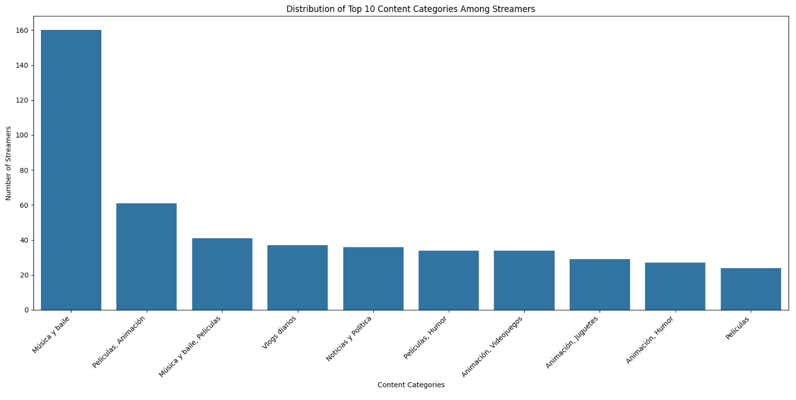
Problem
Identify trends among the top YouTube streamers. Which categories are the most popular
Insights: Musica Y baile is the top category among the Youtube Streamers.

Slide 5
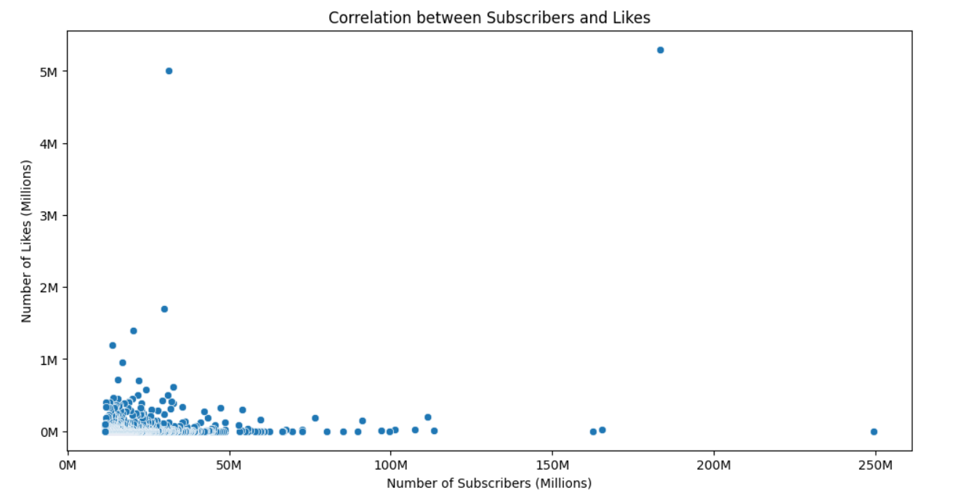
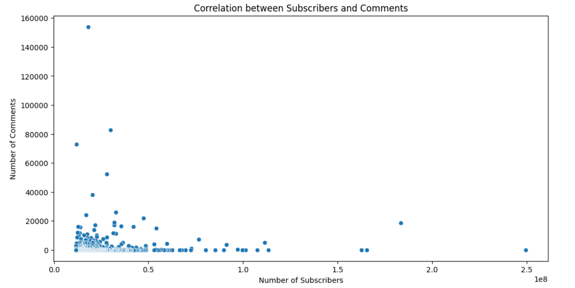
Problem
Is there a correlation between the number of subscribers and the number of likes or comments
Insights:
There is a weak positive correlation between 'Subscribers' and 'Likes' (0.21)
There is a very weak positive correlation between 'Subscribers' and 'Comments' (0.036)

Slide 6
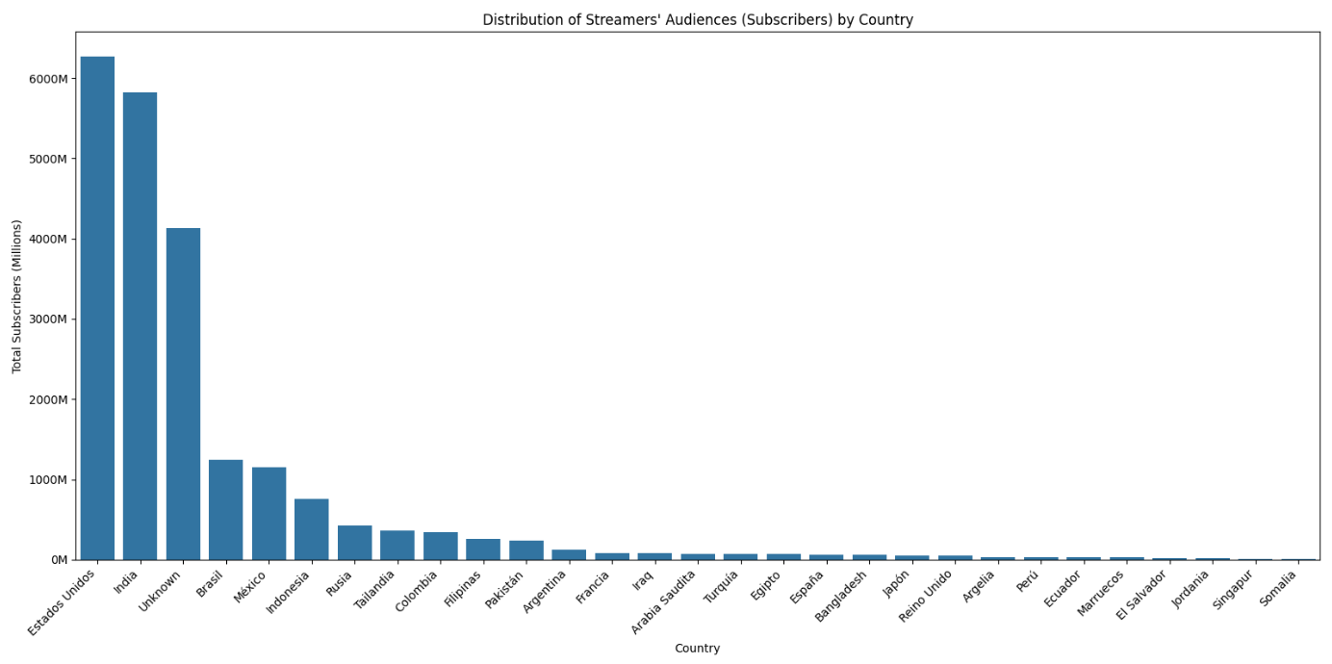
Problem
Analyze the distribution of streamers’ audiences by country
Insights: Estados Unidos and India have the most subscribers

Slide 7
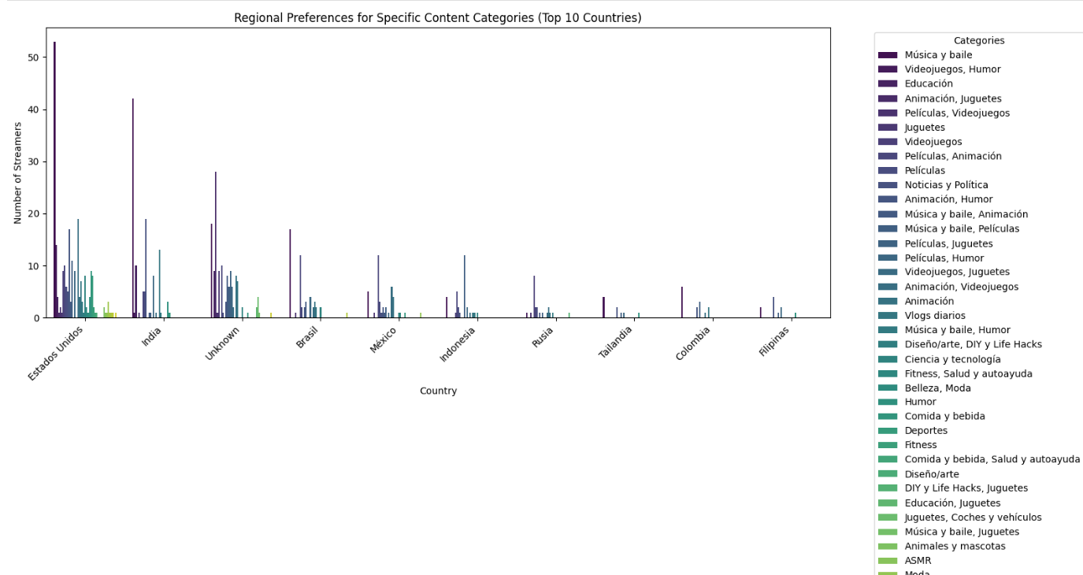
Problem
Are there regional preferences for specific content categories
Insights: Top 5 categories that I prefer are
Musica y baile,
Videojuegos, Humor
Education
Animacion, Juguetes
Peliculas, Videojuegos

Slide 8
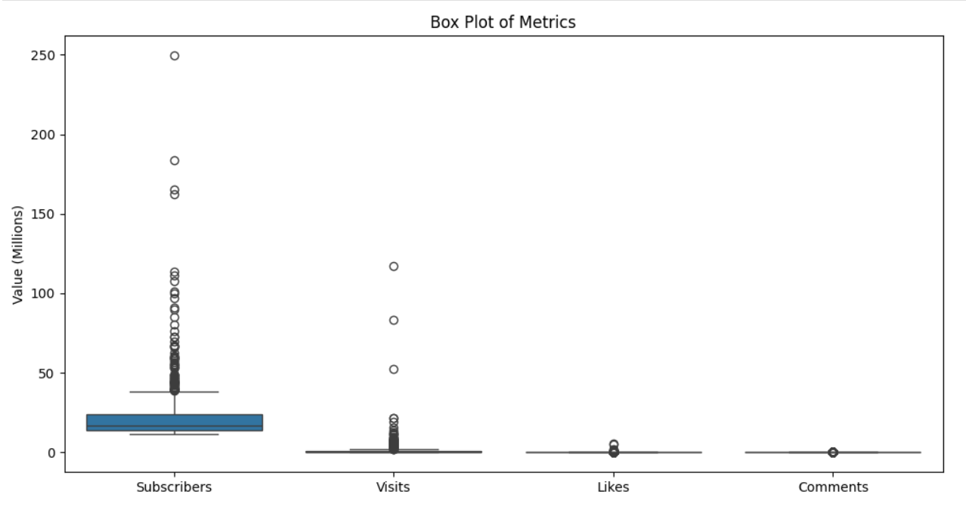

Problem
Calculate & Visualize the average number of subscribers, Visits, Likes and Comments
Are there patterns or anomalies in these metrics?
Average performance metrics
Insights: There are no patterns but anomalies in these metrics

Slide 9
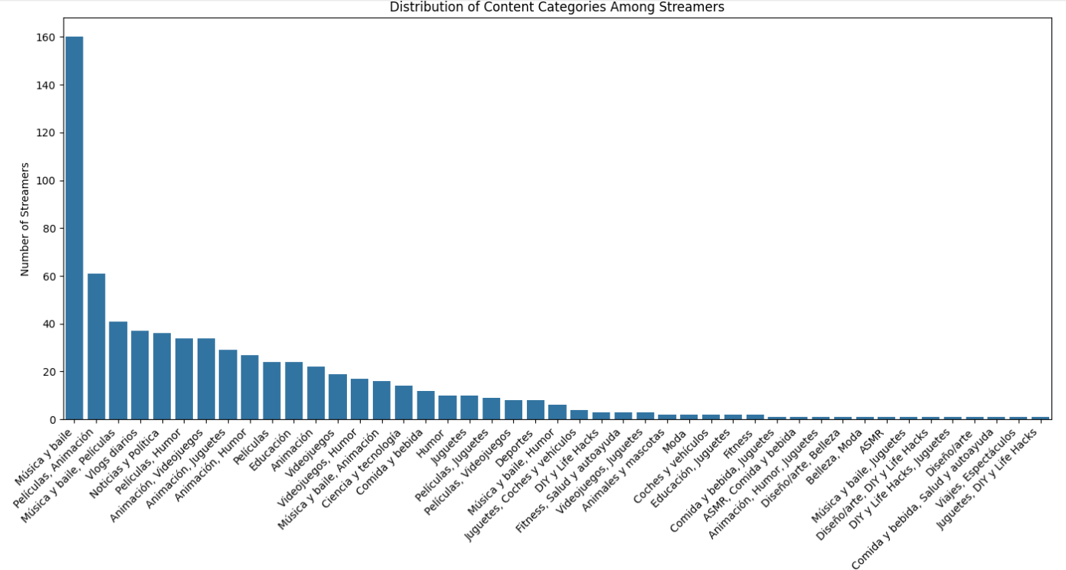
Problem
Explore the distribution of content categories, Which categories have the highest number of streamers
Insights: Musica y baile has the highest number of streamers

Slide 10
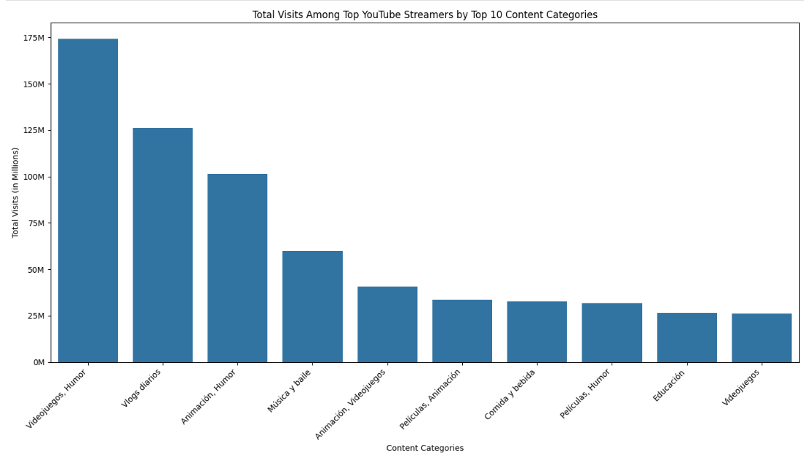
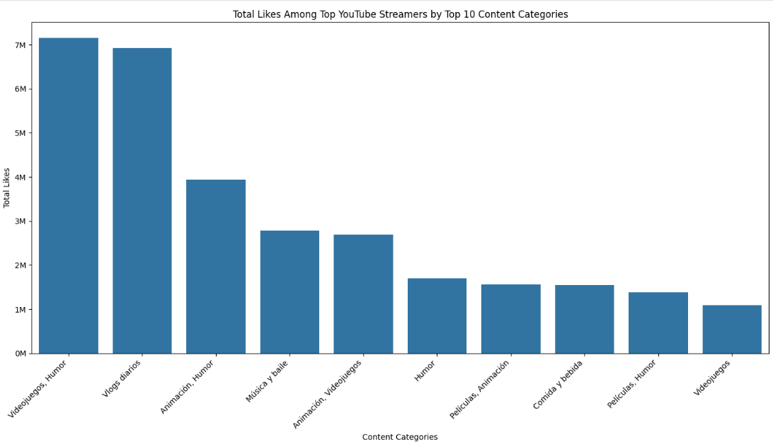
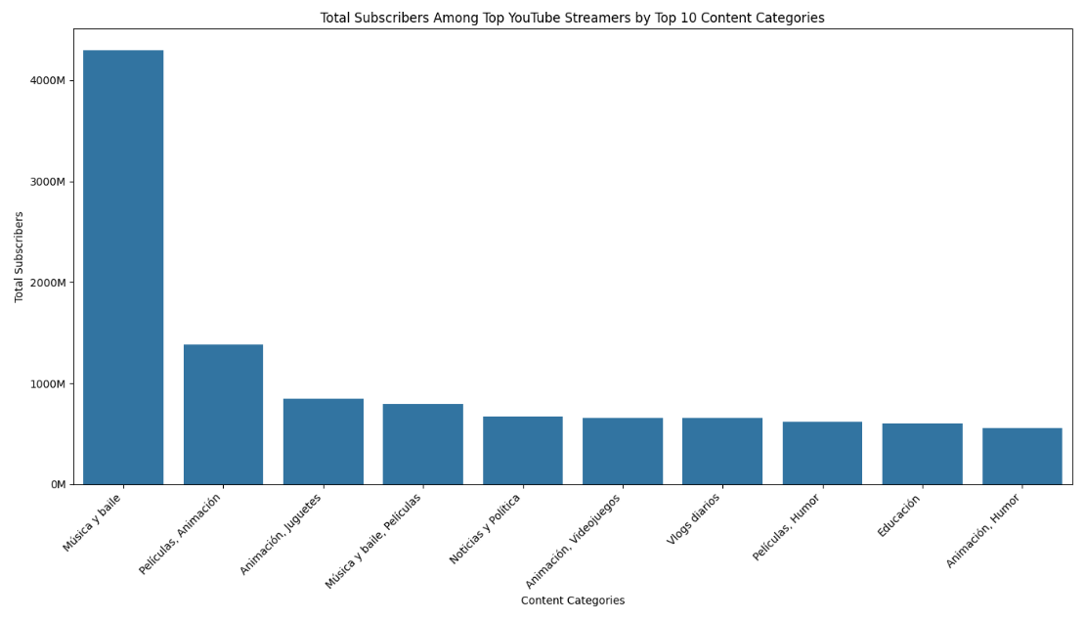
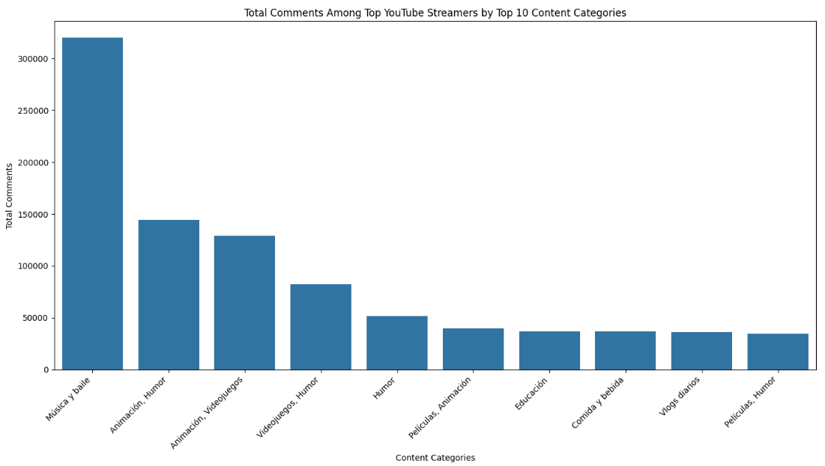
Problem
Are there specific categories with exceptional performance metrics (Subcribers, Visits, Likes, Comments)

Slide 11
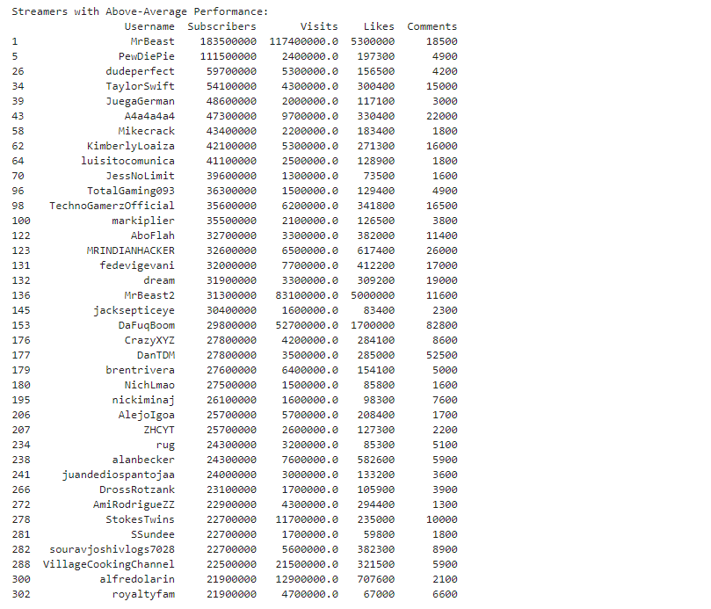
Problem
Identify streamers with above-average performance in terms of subscribers, visits, likes, comments
Insights: Streamers who have the Subscribers, Visits, Likes and comments above the average Subscribers, Visits, Likes and comments. And MrBeast, PewDiePie, dudeperfect, TaylorSwift are on top of that

Slide 12
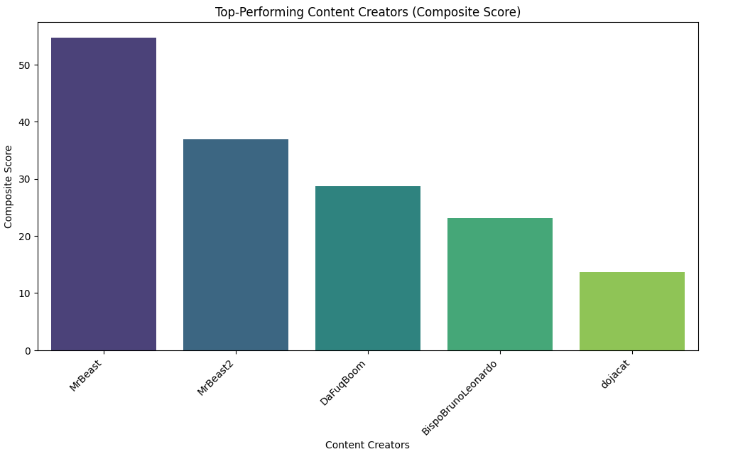
Problem
Who are the top-performing content creators
Insights: Top 5 Streamers according to the composite score (z-score)

Slide 13
Project Learnings
Exploratory data analysis using Python
Using several python packages including Pandas, Numpy, Matplotlib, Seaborn
Problem solving skills
Analytical skills

Slide 14
THANK YOU

