Slide 1

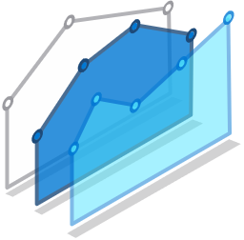
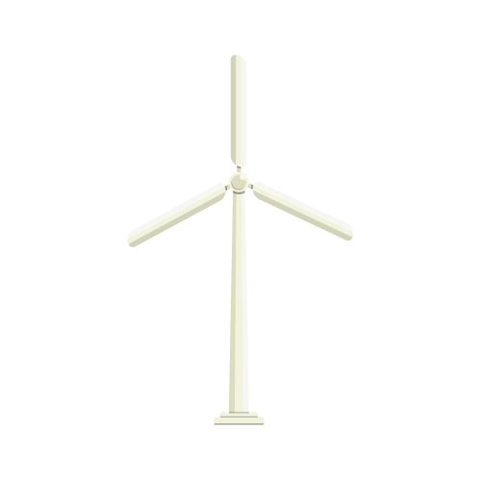



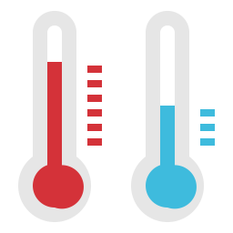



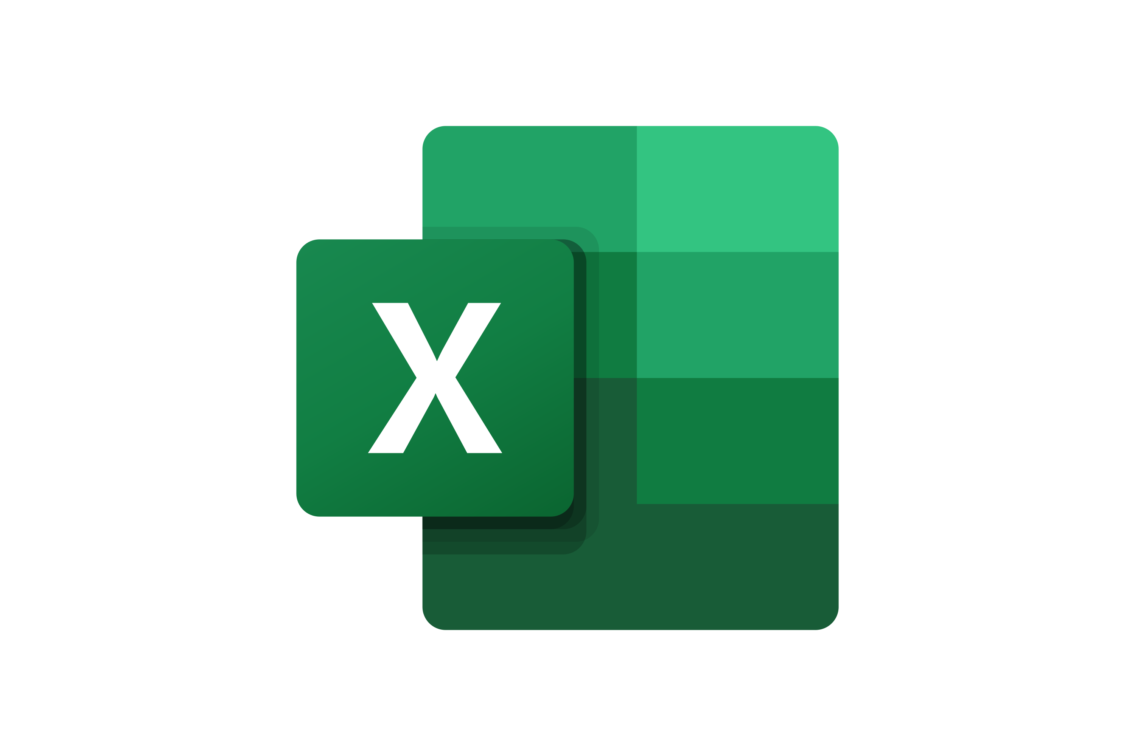



Demo Architecture
Included for comprehensiveness
Data Sources
Data Ingestion
Data Transformation
Analytics
On-Prem
Ad-hoc querying, Operational Reports
Visualization
Azure Data Explorer
Power BI
Data Broker
Real-Time Operation Reporting
BI Reporting
Simulator
Event Hubs
Kafka Broker
Stream processing
AI/ML
Windmills
Motor, Temp
Azure Databricks
Azure Databricks
Alarms
Data Engineering
Teams Channel
Alarm Rules
Cold Storage
Integration
Receive Alerts
Storage Explorer
Blob Storage
Trigger conditions
For Stream Processor
Can be API, or a stream
Write Once Access Often

Slide 2

Demo Architecture
Included for comprehensiveness
Data Sources
Data Ingestion
Data Transformation
Analytics
On-Prem
Ad-hoc querying, Operational Reports
Visualization
Azure Data Explorer
7
Power BI
5
Data Broker
Real-Time Operation Reporting
BI Reporting
Simulator
Event Hubs
Kafka Broker
Stream processing
AI/ML
Windmills
Motor, Temp
Azure Databricks
Azure Databricks
Alarms
Data Engineering
Teams Channel
Alarm Rules
Cold Storage
Integration
Receive Alerts
Storage Explorer
Blob Storage
Trigger conditions
For Stream Processor
Can be API, or a stream
Write Once Access Often
1
2
3
4
6

Slide 3

turbine_enriched
date
time_interval
deviceid
angle
rpm
temperature
humidity
windspeed
winddirection
turbine_raw
date
timestamp
deviceid
angle
rpm
turbine_agg
date
time_interval
deviceid
angle
rpm
Aggregations
Stream-Stream Join
APPEND
MERGE
MERGE
weather_raw
date
timestamp
temperature
humidity
windspeed
winddirection
weather_agg
date
time_interval
temperature
humidity
windspeed
winddirection
Aggregations
turbine_power
date
time_interval
deviceid
power_output
APPEND
MERGE
turbine_maintenance
date
deviceid
maintenance_type
200 ms
5 minutes
(we control this)
“BRONZE”
Granular readings
“SILVER”
Aggregated readings
“GOLD”
Enriched readings
Blob Storage

Slide 4



turbine_enriched
date
time_interval
deviceid
angle
rpm
temperature
humidity
windspeed
winddirection
feature_table
date
time_interval
deviceid
angle
rpm
temperature
humidity
windspeed
winddirection
power
age
power_6_hours_ahead
remaining_life
POWER OUTPUT
VIEW
turbine_power
date
time_interval
deviceid
power_output
Distributed model training
turbine_maintenance
date
deviceid
maintenance_type
REMAINING LIFE
“GOLD”
Enriched readings
Blob Storage

Slide 5
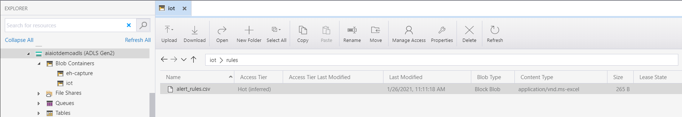
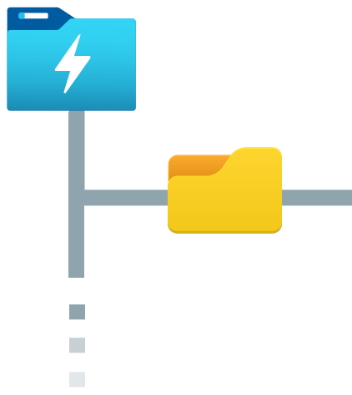
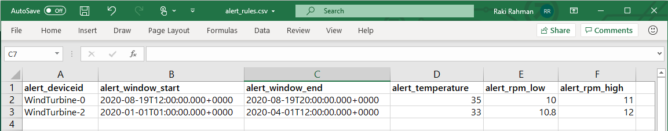

Data Lake
💡
alert_rules.csv
Alerting rules for triggering Alarm

Slide 6
💡
alert_rules.csv
Alerting rules for triggering Alarm

Slide 7





💡
alert_rules.csv
Alerting rules for triggering Alarm
turbine_enriched
date
time_interval
deviceid
angle
rpm
temperature
humidity
windspeed
winddirection
+
Static DataFrame
Streaming DataFrame
+
deviceid = alert_deviceid AND
temperature >= alert_temperature AND
rpm >= alert_rpm_low AND rpm < alert_rpm_high AND
window >= alert_window_start AND window <= alert_window_end
Join Conditions
=
alarmDF
Streaming DataFrame

Slide 8
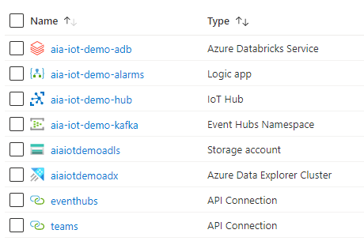
Note
Will host our Stream Transformation Pipelines
For sending Teams notifications by reading from Event Hub
Used by the device simulator for sending sensor data*
Event Hub used as a Kafka Topic/Message Broker
Azure Storage Account used as a Data Lake/Blob Store
Azure Data Explorer for operational queries
Logic App Connector that gets automatically created
Logic App Connector that gets automatically created

