Slide 1
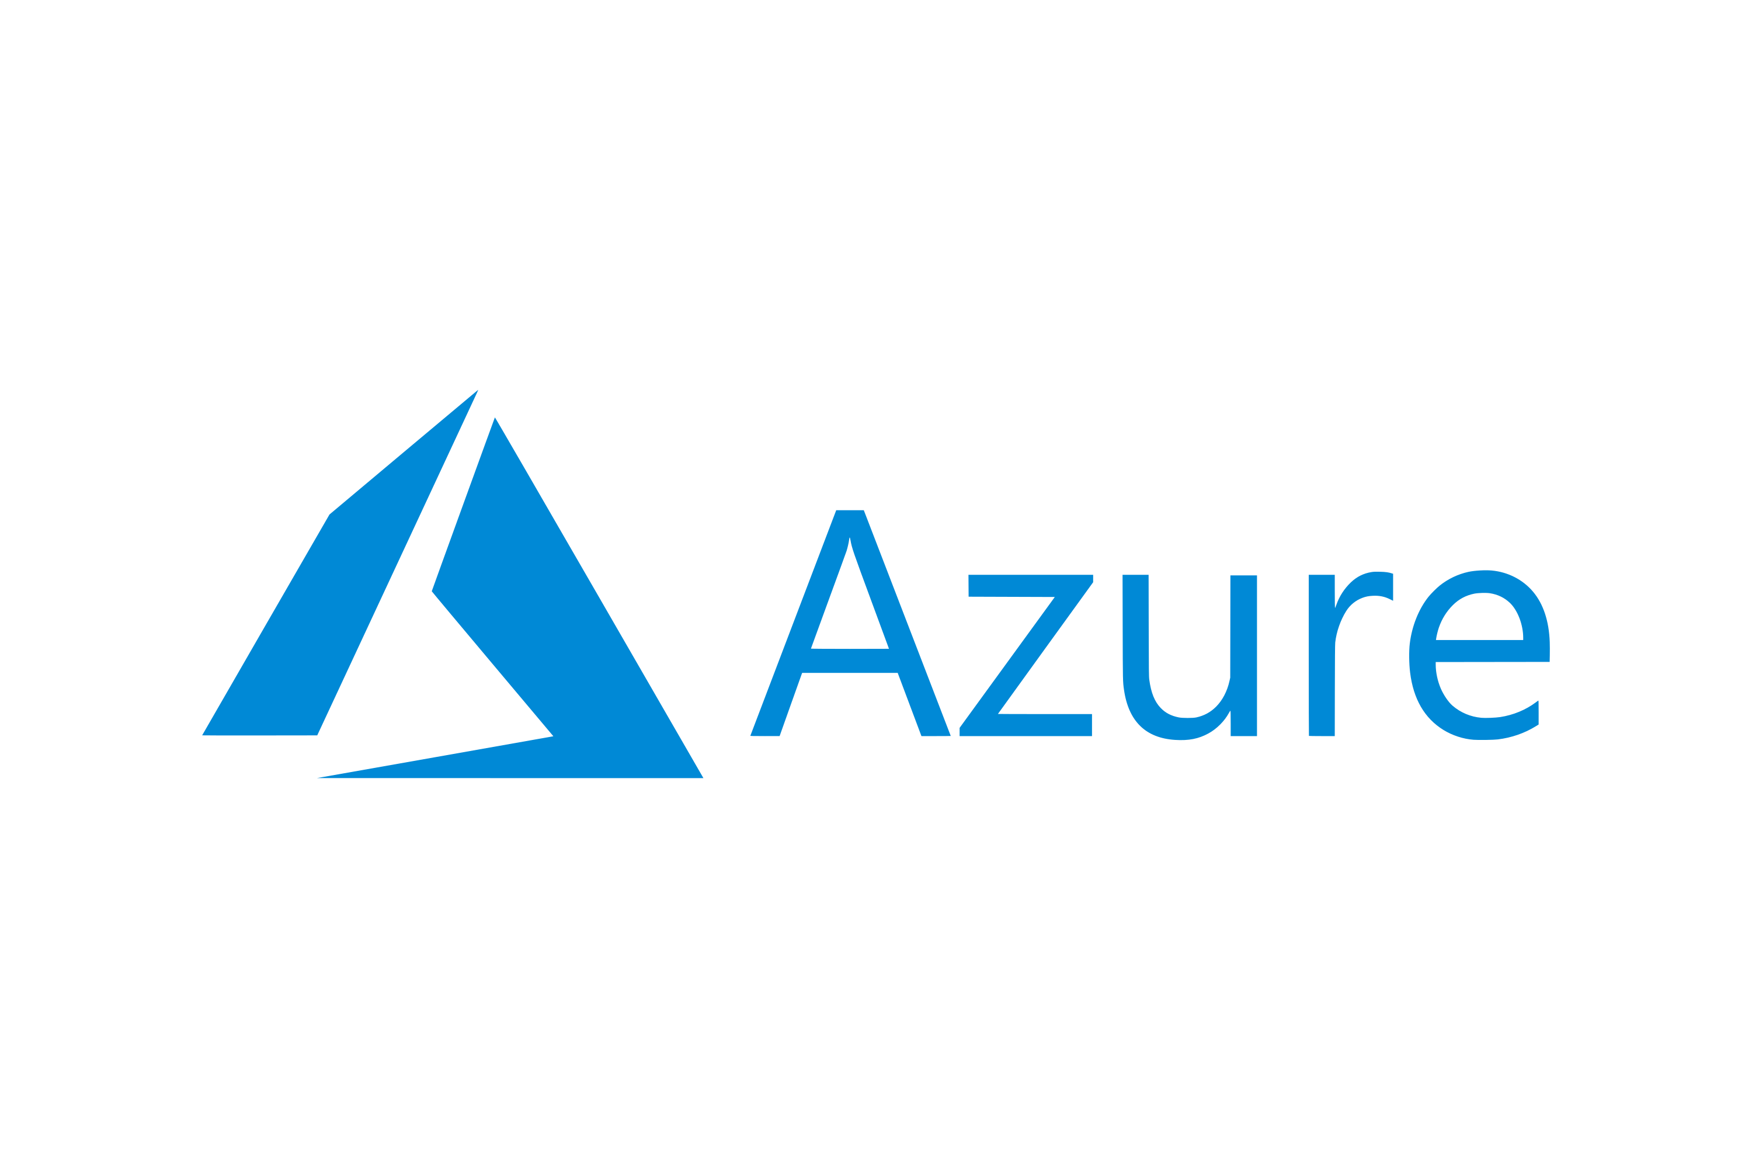

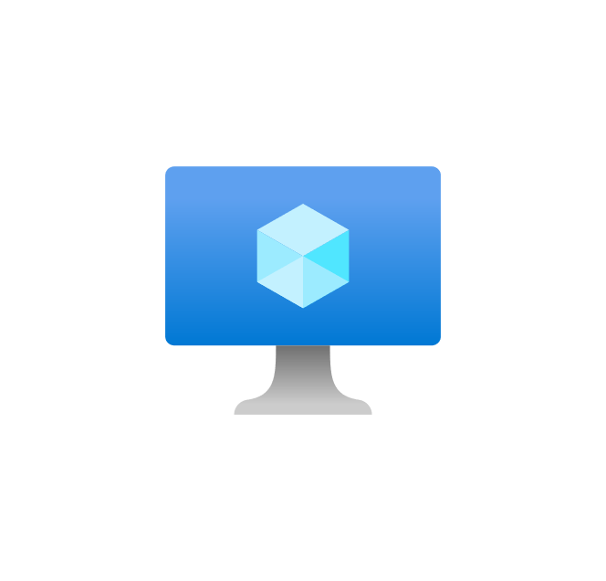


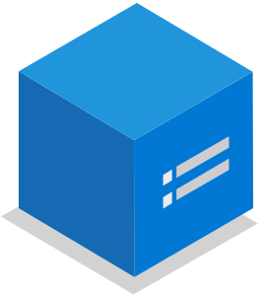
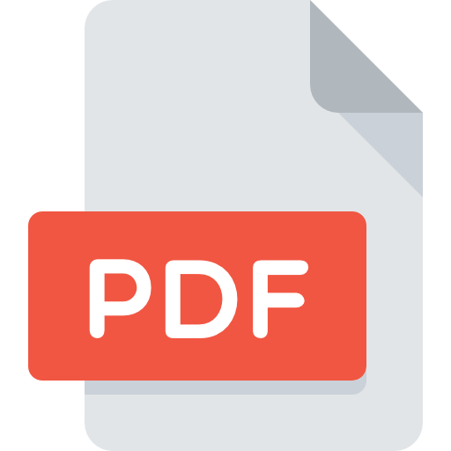

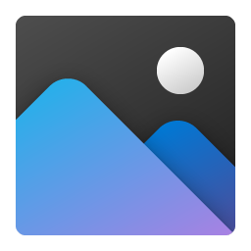






Reference Demo Architecture
Attachment Repository
File Source
Blob Storage
https://aiastorageacctpoc.blob.core.windows.net/
Parallel Sync operations via AzCopy
Can be over MPLS/Whitelisted IPs only
Note:
This method of Domain Masking is one of several ways we can achieve this pattern in Azure. CDN Profiles allows us to configure geo-filtering as well (e.g. block document access outside Canada). Note: this is different than IP filtering, which Blob Storage Firewall allows.
File Share
attachments
\\Share\CloudDropZone
1
PDF
CSV
PNG
{
"container":"attachments",
"blobName":“large.pdf",
"permissions":"Read",
"time":1
}
Container
PDF
CSV
PNG
Service Principal
🗝️ Use PsExec to Access UNC Path via Federated ID
File
🌍
Permission
Batch Upload Script
AzCopy sync and ⚡ Function call
Link Expiry Time
Azure Function
Serverless app ☁️ API helper (.NET Core 3.1)
2
SAS URL
On-Prem
Domain Masking
https://files.yourdomain.com/ ...
... attachments/large.pdf ...
... ?sv=..&sr=b&sig=hJ..&st=2021-02-03T20..&se=2021-02-03T21..&sp=r
Domain Masking
CDN Profile For SSL Termination
3
Store
https://aiafilesdemo.azureedge.net
File specific
Store
DNS Registrar Can be non-Azure
Link Expiry Time
Permission
https://files.yourdomain.com
Store
Store
4
Browser
Notes:
In the next 15 minutes...

