Slide 1


rakirahman.me
Hi, I’m Raki.
I build Big Data & AI Solutions on Microsoft Azure.

Slide 2

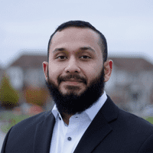
rakirahman.me
Hey look,
IT’S A BLOG!

Slide 3




rakirahman.me
BLOGGING WITH
on Azure

Slide 4
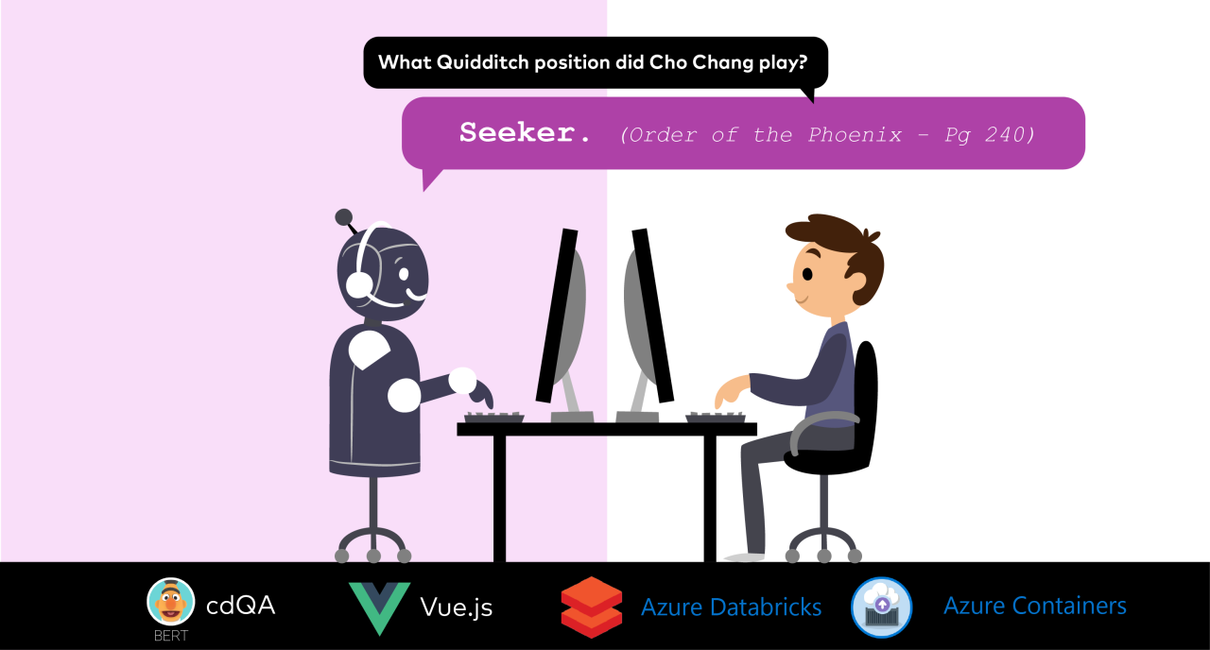
rakirahman.me

Slide 5


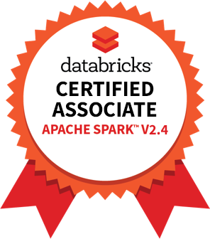

rakirahman.me
PART 1
COMPREHENSIVE
STUDY GUIDE

Slide 6
rakirahman.me
PART 2
COMPREHENSIVE
STUDY GUIDE

Slide 7

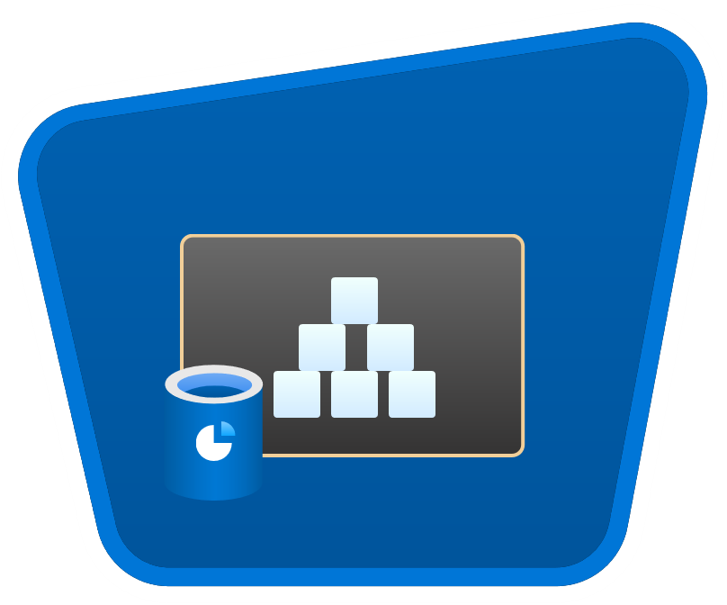




rakirahman.me
AUTOMATING
to Synapse
with Autoloader

Slide 8

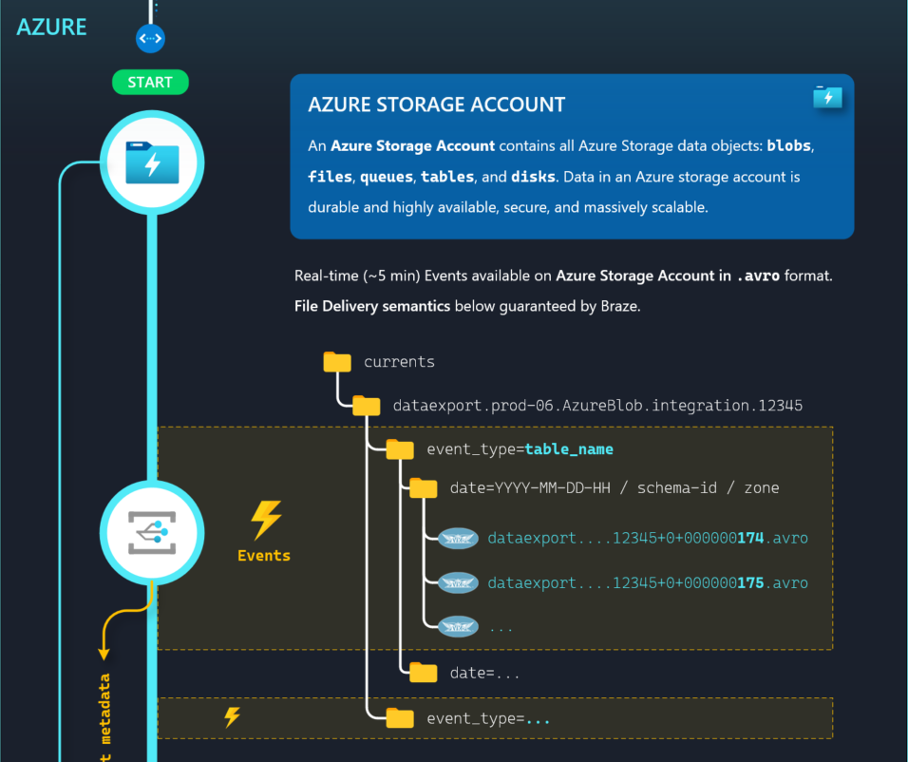
ILLUSTRATION
to Synapse
with Autoloader

Slide 9
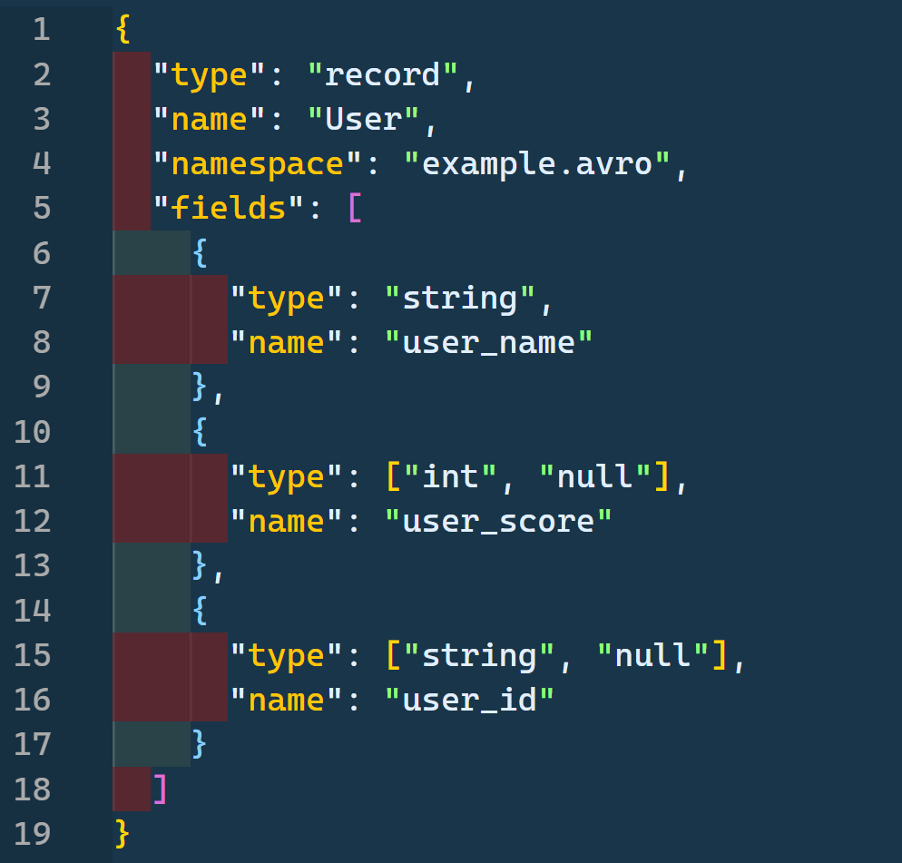

Exploring Azure Schema Registry with

