Slide 1



















ETL tool
Latency
1
Build a custom pipeline with Azure Data Factory.
varies by trigger
On-prem
Data Factory
Azure SQL
SQL Server
Integration Runtime
SQL DB
SQL MI
Azure SQL Data Sync
Latency
2
An Azure managed Web-Service with bi-directional sync capabilities to Azure SQL DB – no MI support yet.
5 min minimum
On-prem
SQL Data Sync
Azure SQL
SQL Server
Sync Agent
Sync App
Sync DB
SQL DB
SQL Server Replication
Latency
3
Uses SQL Replication Engine (transactionally consistent). 6 types available (choice differs for SQL DB or MI)
~seconds
Publisher & Distributor
Replication agents
Subscriber
On-Prem SQL Server
SQL DB
SQL MI
Publication
Subscription
Database Migration Service
Latency
4
Uses log-shipping of Full (.bak) and Trx (.trn) log backups to continuously ship and apply with the “online” option.
log backup frequency
On-prem
Backups
Azure SQL
SQL Server
SMB Folder
DMS Agent
DMS Service
.bak,.trn
Storage Acct.
SQL DB
SQL MI
3rd Party Products
Latency
5
Number of 3rd Party tools exist in the market – YMMV.
varies by product
And more...
Other hands-on, custom options exist, include SQL Server Service Broker (place writes on queue and send over), and Azure Event Hub (use as a message queue), and permutations thereof.

Slide 2


Replication Concepts
Publisher
Database that makes source data available
Articles
Tables, views, stored procs and other objects
Distributor
Database that stores and forwards changes
Publication
One or more Articles from Publisher
Subscriber
Database that receives replicated data
Subscription
Requested copy of a Publication
Replication Agents
Snapshot Agent
Prepares Snapshot Files – schema and data – of published tables and objects to Snapshot Folder.
Distribution Agent
Delivers initial Snapshot Files to Subscriber. Delivers Transactions from Distribution Database to Subscriber.
Log Reader Agent
Monitors transaction log of Publisher Databases. Copies transactions marked for replication to Distribution Database.
Merge Agent (Merge Replication only)
Merges incremental data changes that occurs at Publisher or Subscriber. Detects and resolves conflicts by set rule.
SQL Server Replication – all 6 types
Replication | SQL Server | SQL DB | SQL MI
1. Standard | ✔ | ✔* | ✔
2. Bi-directional | ✔ | ✖️ | ✔
3. Peer-to-Peer | ✔ | ✖️ | ✖️
4. Updatable | ✔ | ✖️ | ✖️
5. Merge | ✔ | ✖️ | ✖️
6. Snapshot | ✔ | ✔* | ✔
Transactional
*As Subscriber only
1. Standard
2. Bi-directional
Custom application
Built on Standard, except with each Server acting as both Publisher and Distributor.
Publisher
Begins with snapshot/backup
SQL Server
Articles
Log
Publication
Publication
Distributor
Log Reader Agent
Replication agents
70
Distribution database
Distribution Agent
SQL Server
Subscriber
Publication
Articles
Better performance than P2P, but this is 2 servers only - P2P is more.
Subscription
No Conflict detection/resolution – use P2P’s Conflict detection.
3. Peer-to-peer
4. Updatable
Built on Standard, for enabling multi-node (2+) read-scale. To enable write-scale, data must be partitioned by design to avoid conflicts.
❗ This feature is planned for removal after SQL 2016 - not recommended for new implementations.
Built on Standard, allows for updating data at both nodes with Conflict Detection and Resolution via 2 modes of updates – Immediate and Queued.
Custom application
P1
Load Balancer
Immediate Mode
Two-phase synchronous commit protocol. Publisher and Subscriber must be connected.
P2
P3
Read
Write
Repl.
Queued Mode
Asynchronous commits – conflicts can occur. Conflict Resolution needs to be configured.
Conflict detection monitors for conflicts and goes into error state.
For Conflict resolution capabilities, use Merge replication instead.
5. Merge
6. Snapshot
Custom application
Custom application
Custom application
Begins with snapshot/backup
Publisher
Publisher
Subscriber
Articles
Publication
Snapshot Agent
Change Tracking Tables
Merge Agent
Change Tracking Tables
Distributor
Snapshot Folder
History Data
Distribution Agent
History Data
Distribution database
Distribution database
Subscriber
Data must be partitioned by design to avoid conflicts. Merge Agent processes incremental changes, applies conflict resolution rules (e.g. Pub wins).
Articles
Subscription
Use when (small) data changes infrequently.

Slide 3
1. Standard
Sufficient for Data Replication and Read-Scale (not for Write-Scale).
Custom application
~seconds
Snapshot folder can be On-Prem File Share, or SMB mounted Azure File Share.
Begins with snapshot/backup
For a larger database, leverage Backup/Restore initiation on SQL MI.
Publisher
Configure On-Prem SQL Server as Publisher.
70
SQL MI can be a Distributor as well, in case of a SQL MI Publisher.
In our case, since we have an On-Prem Publisher, we proceed with an On-Prem Distributor, and consider this (MI + MI) for future patterns in Cloud.
Articles
Log
Publication
Distributor
Log Reader Agent
Distribution database
Distribution Agent
SQL MI will serve as the Subscriber. Pre-requisite will be for On-Prem Distributor to have Network (ExpressRoute/VPN) + DNS connectivity to Subscriber.
For Pilot, consider connecting to SQL MI’s Public Endpoint, to document setup steps. For Production, leverage DNS resolution via ExpressRoute (SQL MI Private IP).
Subscriber
Articles
Subscription

Slide 4

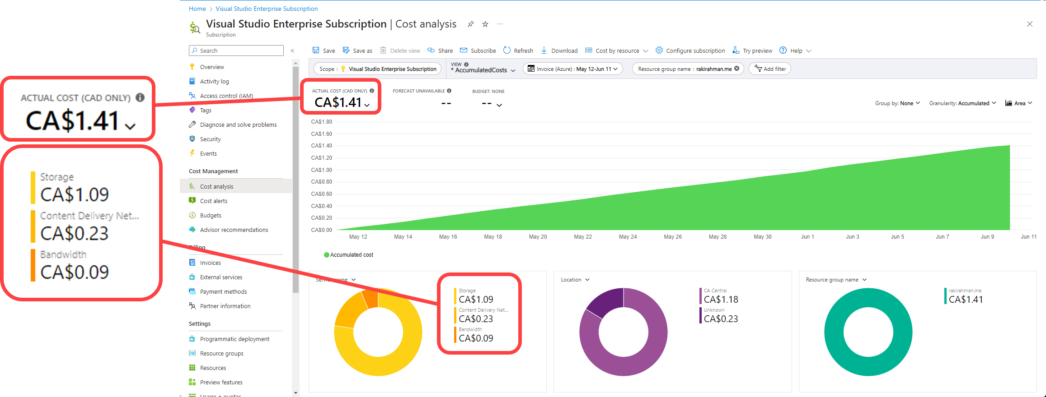

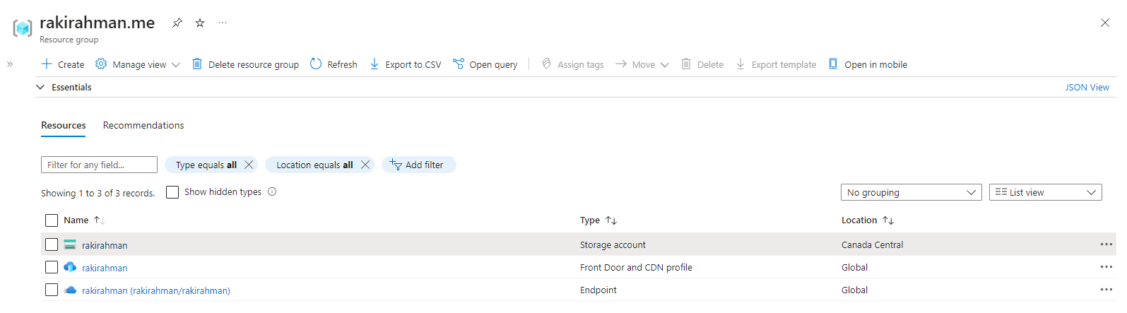
Azure Cost breakdown
In Canadian dollars
All Azure Resources
Minus DNS

Slide 5

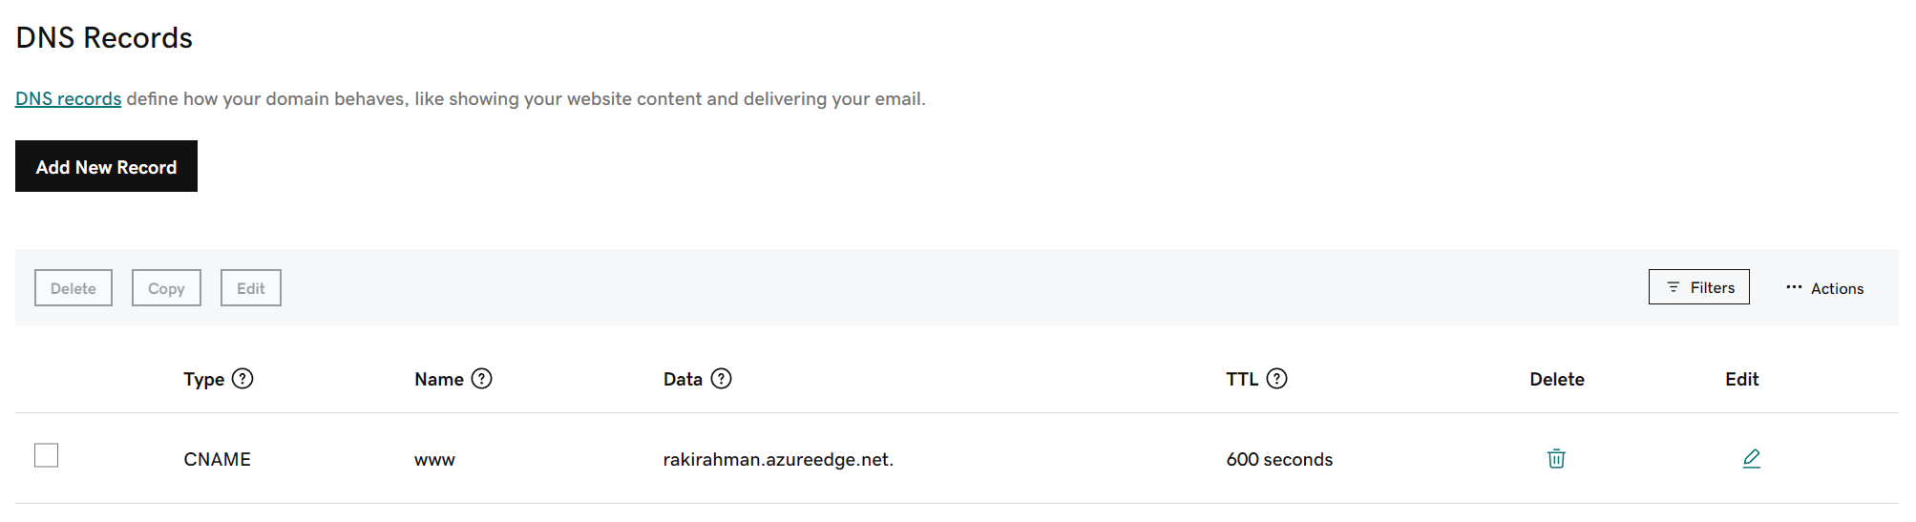
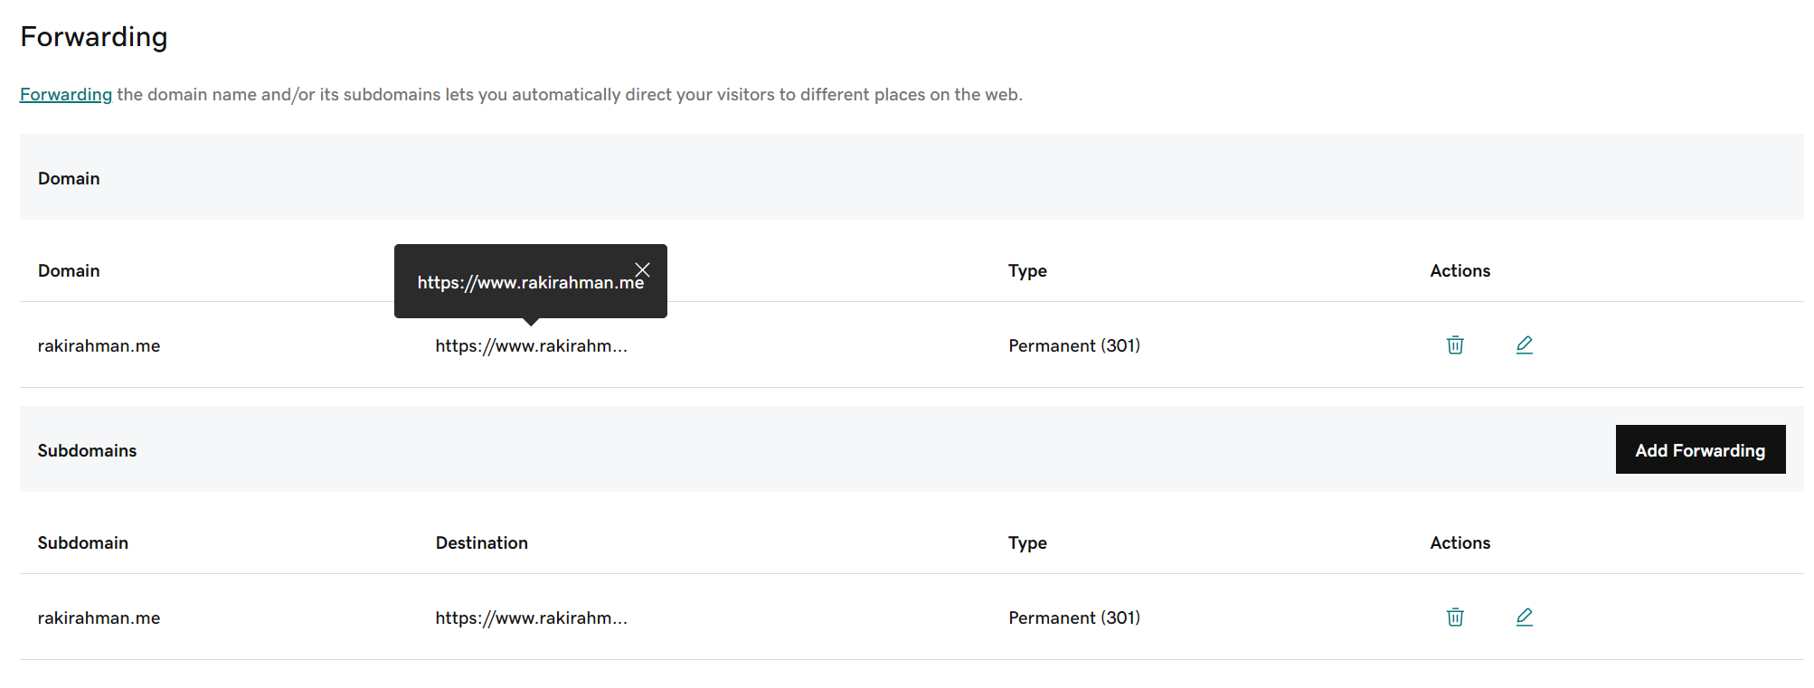
DNS forwarding
rakirahman.me to Azure CDN endpoint
Azure CDN
DNS forwarding
rakirahman.me to HTTPS

Slide 6

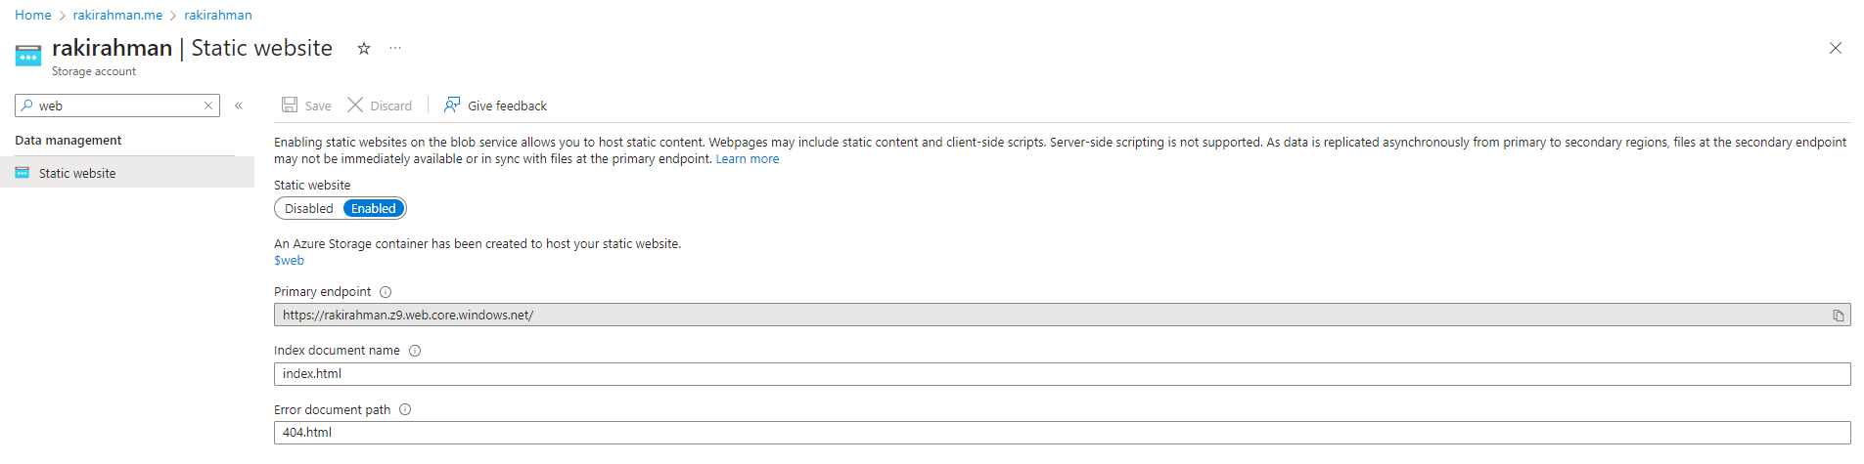
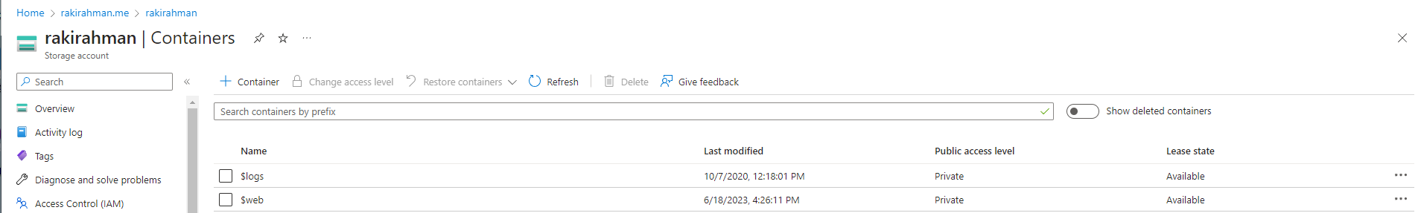

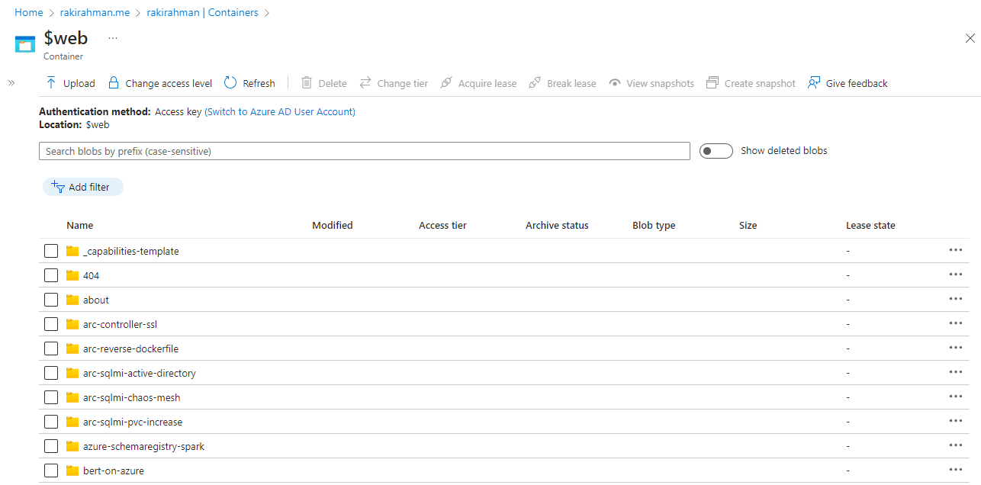
Azure Blob Storage
Turning on special container for Static Website
Provisions a special container
$web
Special container for static hosting
Contents replaced per commit
Website content
Uploaded from build pipeline

Slide 7

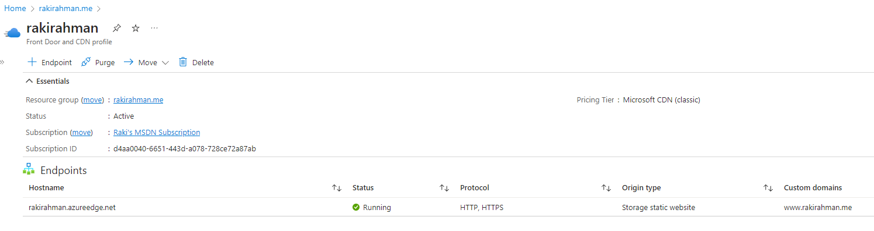
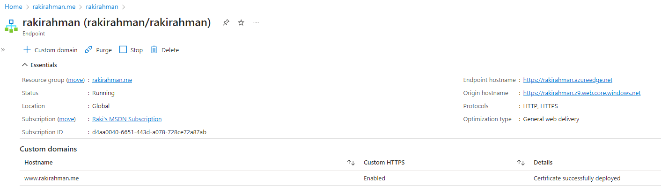

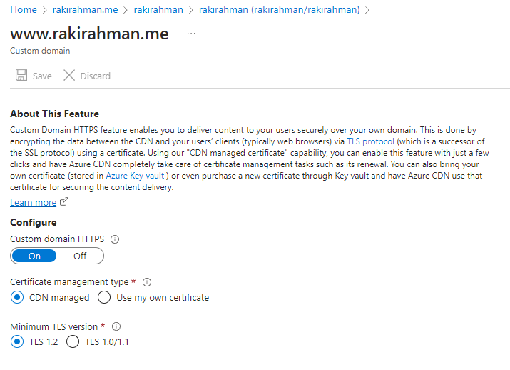
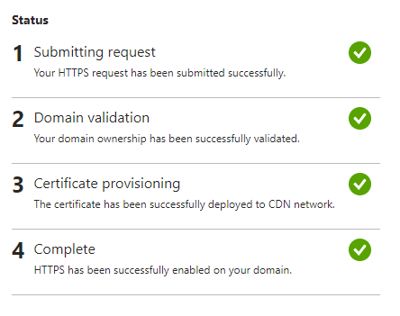
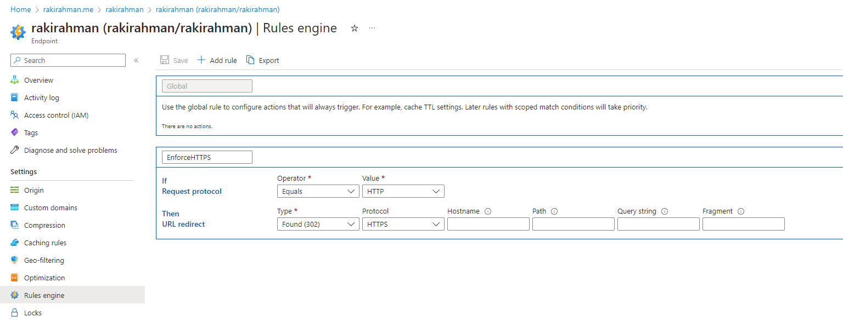
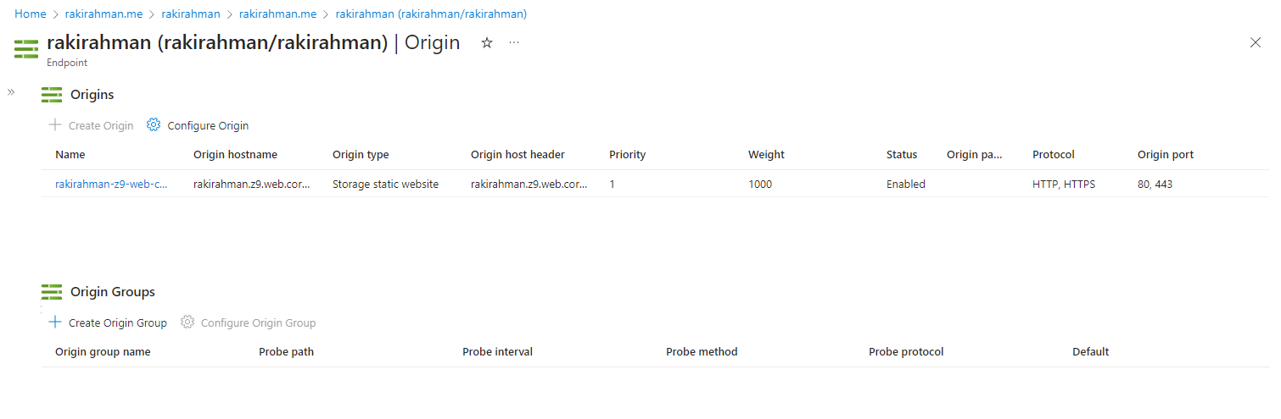
Azure Front Door and CDN
All relevant settings for managed cert setup
Managed cert
One-time SSL enablement
All relevant settings for managed cert setup
One-time SSL enablement
TXT record to into DNS to prove ownership
Enforce SSL
HTTP -> HTTPS
Linking content origin
Source of truth is Blob Storage

Slide 8

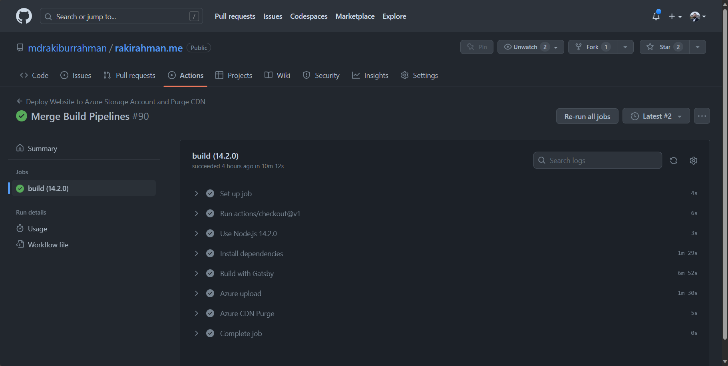

GitHub Workflows
CI/CD based on git commits into master
1. gatsby build
Compile static website
2. az storage blob upload-batch
Upload to Blob
3. az cdn endpoint purge
Purge CDN cache

Slide 9





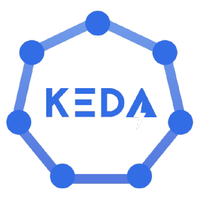









delta-dotnet Sink Architecture Horizontal autoscaling with KEDA
2
EventProcessor<Partition>
Event Hub (basically a Kafka topic)
Event Hub Nuget, has aggressive batching (too much so).
A single C# replica (e.g. a Kubernetes Pod)
0
1
2
99
3
4
5
Sink Transaction Provider
PARTITIONS
…
Memory Throttle Gate
Batch Orchestrator
Lock incoming events in the Delegate callback until Parquet buffer flushes, to avoid getting OOMKilled.
Registers Delegates with EventProcessor<T> for each partition (T). Invokes one or more sinks.
Stores a batch of events as a pending list of flush tasks, basically a receipt - for each Sink.
6
Sink Transaction Record
A list of Task<bool> represents the pending transactions per sink, before we checkpoint the offset.
8
Partition Checkpoint Provider
1
KEDA – Kubernetes Event Driven Autoscaler
Delta Lake Sink
Some Other Sink
0
Monitors Event Hub offset versus the persisted checkpoints for a given Consumer Group.
If the lag exceeds certain threshold, asks Kubernetes Horizontal Pod Autoscaler (HPA) to queue new replicas. Reduces replicas after cooldown period.
Along with Karpenter (Node autoscaling), provides a highly robust and cost effective autoscaling solution that can flush millions of events on burst, and scale to 0 right away.
A Task<bool> representing the pending Parquet Flush that we want to buffer.
A Task<bool> representing the pending Flush that will happen in future.
2
13
Flush timer
Focusing only on Delta Sink, not the other Sinks, although they work identically.
1. Next Task<bool> = true?
2. Checkpoint
Sink Buffer Provider
Delta Writer Client
Set TaskCompletionSource = True
Event Hub Checkpoint
10
Flushes buffer to parquet concurrently. Writes Transaction metadata to single Partition Event Hub, basically a FIFO queue that looks like a write-ahead-log.
Which lets the checkpoint provider know the offset is safe to checkpoint.
0
7
Set TaskCompletionSource = False
1
Flush timer
Something failed despite retries, e.g. OneLake outage (not very common) . Send to Dead-Letter-Queue.
.
.
.
9
1. Buffer length > max
2. Buffer latency
99
CONCURRENT flushes
12
Delta Tables on OneLake
Event Hub (basically a FIFO queue/WAL)
Delta Bulk Uploader
0
14
11
Concurrently flushed parquet from many replicas.
Contains metadata about the Parquet files that were flushed. For a given OneLake destination, this allows us to bulk update the Delta transaction log with zero chance of Delta retry storm – since this is a single partition topic, with a single consuming process.
The same classes as above, except, running a special Sink implementation that happens to update the Delta Transaction log, in bulk.
15
Delta JSON transaction log.
SERIALIZED bulk updates

