Slide 1






User Data Points gathered by Braze via SDK (or API).
SDK
SDK
Store
Intake and Aggregate Event Data
User Events and Message Engagement Events sent to Partner Storage with “Currents” – Braze managed delivery service.
1
BRAZE
Store
Send Event Data to a Data Lake
AZURE
Real-time (~5 min) Events available on Azure Storage in .avro format. Event Delivery semantics managed by Braze.
2
Onboard additional data sources and enable advanced analytics use-cases downstream.
Process Events Stream in real-time with Databricks (Auto Loader) and persist to Data Lake (downstream analysis) and Synapse (queryable and consumable).
Transform & Store in Queryable Storage
3
Use BI Tool to Manipulate / Visualize
Analyze data visually with Power BI and build Business Aligned data models and dashboards.
4

Slide 2
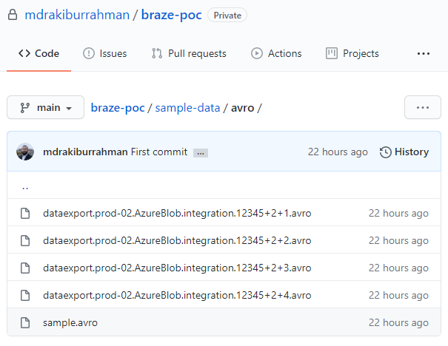
users.behaviors.Purchase
id
string
Unique id for this event
user_id
string
Braze user id of the user
app_id
string
Id for the app on which the user action occurred
time
int
UTC time of the event in seconds since the epoch
platform
string
Platform of the device (iOs, Android, Web, etc.)
os_version
string
OS Version of the device used for the action
device_model
string
Hardware model of the device
device_id
string
Id for the device on which the event occured
product_id
string
Id of the product purchased
price
float
Price of the purchase
currency
string
Three letter alpha ISO 4217 currency code
properties
string
JSON of the custom properties for this event

Slide 3
currents / dataexport.prod-02.AzureBlob.integration.12345 / event_type=users.behaviors.Purchase / date=2020-11-16-10 / 1 / A /
dataexport.prod-02.AzureBlob.integration.12345+2+1.avro
your-bucket-prefix
cluster-identifier
connection-type
integration-id
Store
Store
Store
Store
event-type
date
schema-id
zone
Store
Store
Store
Store
cluster-identifier
connection-type
integration-id
Store
Store
Store

Slide 4
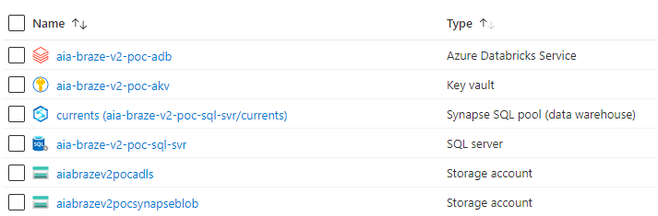
Note
Will host our Data Transformation logic
For hosting passwords/credentials
Will host ingested data in relational/queryable format
A logical server for Synapse (no functional role)
Landing zone for Braze Currents Data
A temporary staging Blob Account required for Synapse

Slide 5
currents / dataexport.prod-02.AzureBlob.integration.12345 / event_type=users.behaviors.Purchase / date=2020-11-16-10 / 1 / A /
dataexport.prod-02.AzureBlob.integration.12345+2+1.avro
Store

Slide 6
example.avro.User
user_name
string
user_score
int
user_id
string

Slide 7
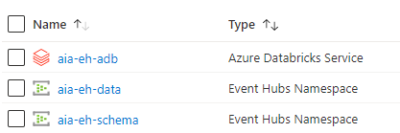
Note
Hosting Producer & Consumer applications
For sending Data to Event Hub/Topic
For registering Schema with Schema Registry

Slide 8
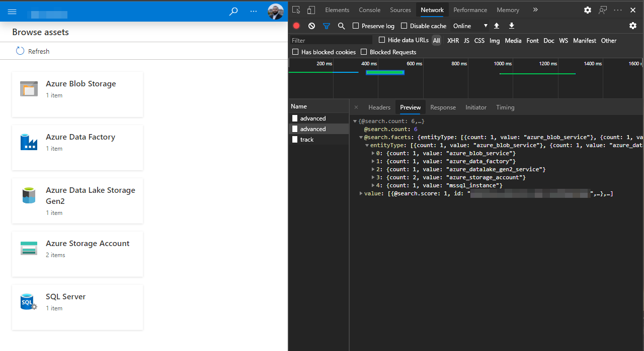


Authenticated user
API Requests
What happens
What we see

Slide 9



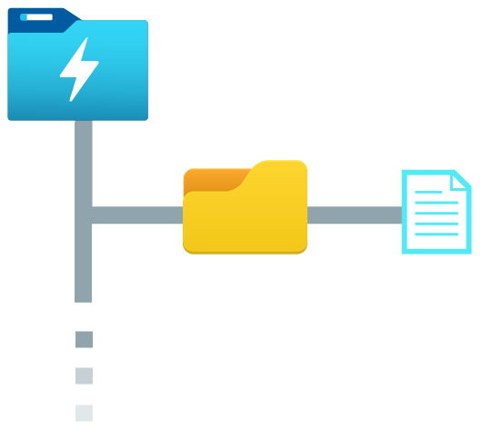




Python Script
Purview
Synapse
get-schema-purview.py
Data Lake
Column name
Classifications
filename
asset
schema
email
Email Address
CashFlow_01.csv
CashFlow_{N}.csv
0: email, PERSONAL.EMAIL
1: creditcard, FINANCIAL.CREDIT_C...
2: creditcardtype, NULL
3: amount, NULL
creditcard
Credit Card Number
REST API
CashFlow_01.csv
creditcardtype
amount
Sales_02.parquet
Sales_{N}.parquet
[["ip_address","PERSONAL.IPADDRES...
CashFlow_{N}.csv
Profit_01.json
Profit_{N}.json
"[["id",null],["IBAN",“FINANCIAL...
Spark DataFrame

Slide 10
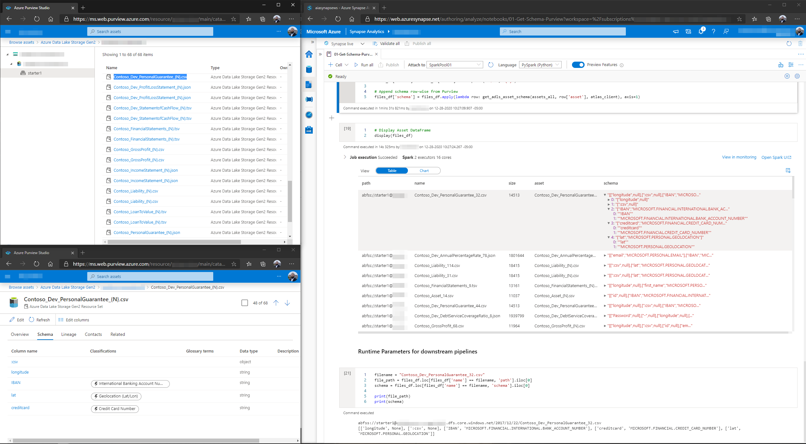

Purview
Synapse
Full asset list
Full asset list
Schema and classifications
Drill down
Drill down
Schema and classifications

Slide 11
https:// mystorageaccount.blob.core.windows.net / mycontainer / mynamespace / mytopic / 32 / 2021 / 01 / 05 / 03 / 03 / 17.avro
Storage Account
Capture Container
Store
Store
Event Hub Namespace
Event Hub Name
Partition
Year
Month
Day
Hour
Minute
Second
Store
Store
Store
Store
Store
Store
Store
Store
Store

Slide 12


Capture Schema (avro)
SequenceNumber:long
Offset:string
EnqueuedTimeUtc:string
SystemProperties:map
key:string
value:struct
member0:long
member1:double
member2:string
member3:binary
Properties:map
key:string
value:struct
member0:long
member1:double
member2:string
member3:binary
Body:binary
Our message payload (e.g. the original JSON, stored as binary)
SequenceNumber
Offset
EnqueuedTimeUtc
...
Body
0
0
1/3/2021 5:36:40 PM
...
eyJpZCI6ICJiYzllNzlhMy1lM2MyLTRlYTgtYWY1Yi00ZGRhN...
1
192
1/3/2021 5:36:40 PM
...
eyJpZCI6ICI5NTAyMzU3Mi1mNTgzLTRkM2YtYTRmMi1lNTBh...
2
384
1/3/2021 5:36:40 PM
...
eyJpZCI6ICJiMmUwNjJhNC1kYmM2LTRiYWUtYTVlOC00ZDliY...
3
576
1/3/2021 5:40:40 PM
...
eyJpZCI6ICI1OWQ0YzY0OS0wODNmLTQ0MDUtODhhYi1lOWVm...
4
768
1/3/2021 5:40:40 PM
...
eyJpZCI6ICI4NWIwMTlkZi03ZjdmLTRmMzEtOGJjNi0zYmRj...
avro
JSON (can be avro, csv etc.)
1
Capture Schema
2
Payload Schema

Slide 13
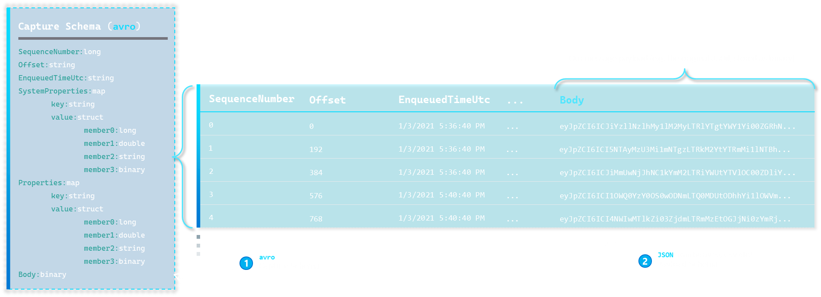

Slide 14
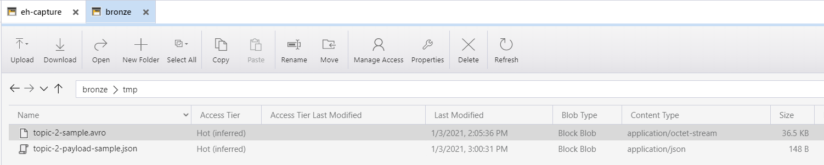

Data Lake
1
2
avro
1
Capture Schema
JSON (can be avro, csv etc.)
2
Payload Schema

