Slide 1


rakirahman.me
Hi, I’m Raki.
I build Big Data & AI Solutions on Microsoft Azure.

Slide 2

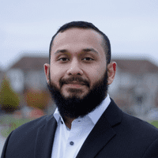
rakirahman.me
Hey look,
IT’S A BLOG!

Slide 3




rakirahman.me
BLOGGING WITH
on Azure

Slide 4
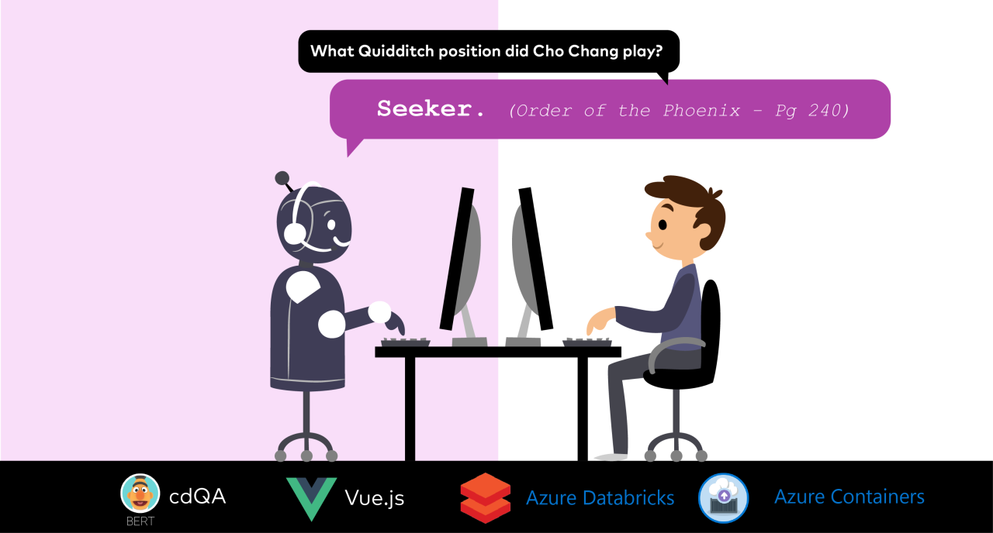
rakirahman.me

Slide 5


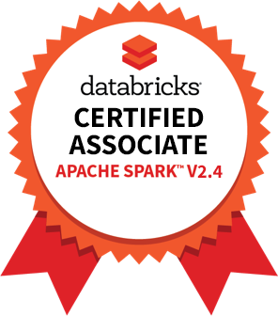

rakirahman.me
PART 1
COMPREHENSIVE
STUDY GUIDE

Slide 6
rakirahman.me
PART 2
COMPREHENSIVE
STUDY GUIDE

Slide 7

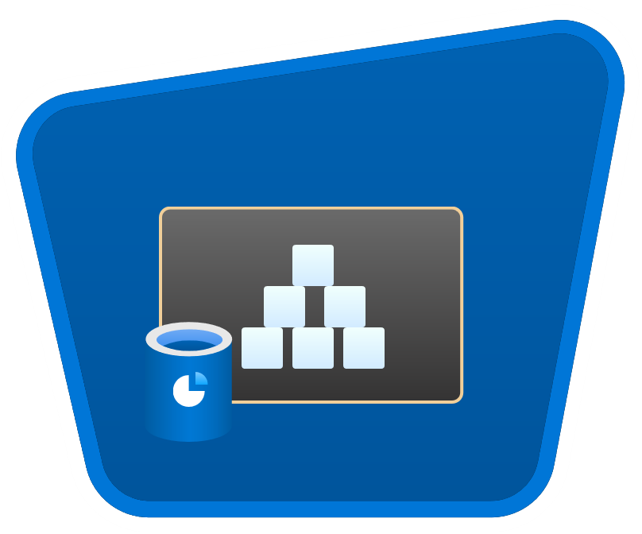




rakirahman.me
AUTOMATING
to Synapse
with Autoloader

Slide 8

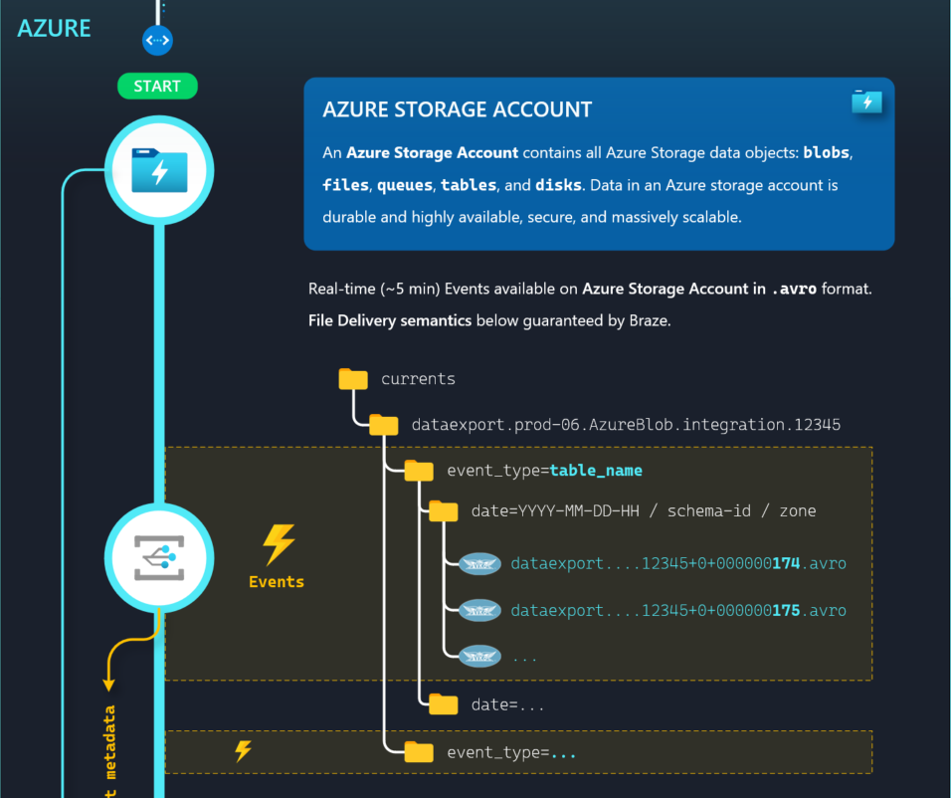
ILLUSTRATION
to Synapse
with Autoloader

Slide 9
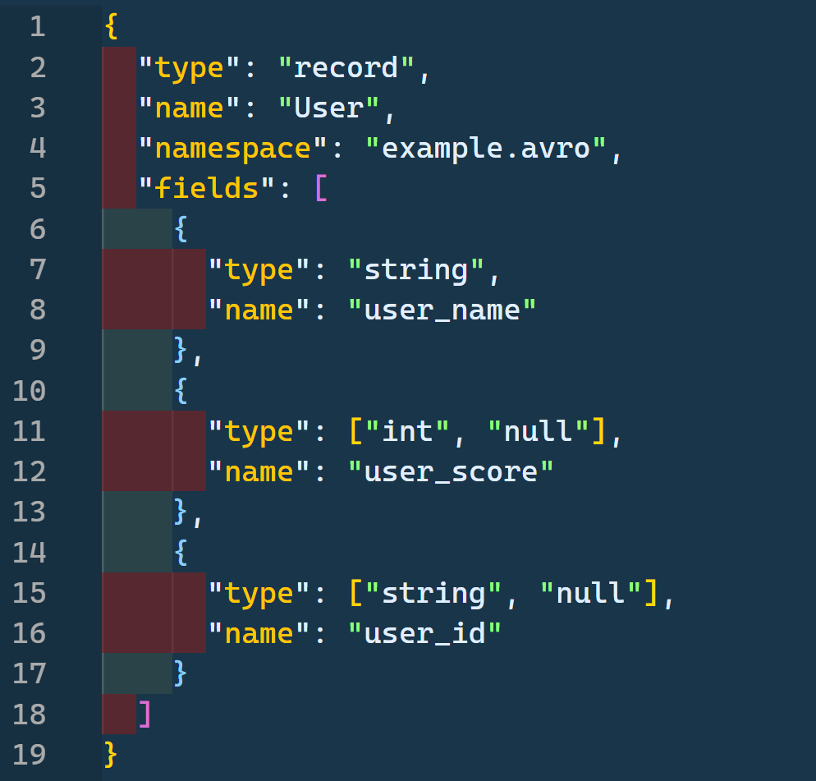

Exploring Azure Schema Registry with

Slide 10


rakirahman.me
PACKING
DENSITY
PREMIUM
MAXIMIZING
App Service Plan
AZURE FUNCTIONS

Slide 11
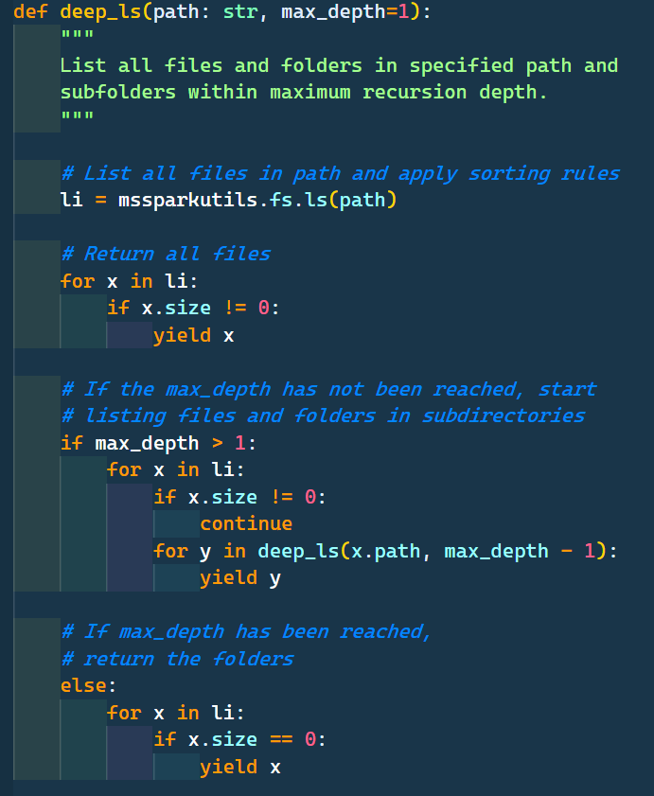
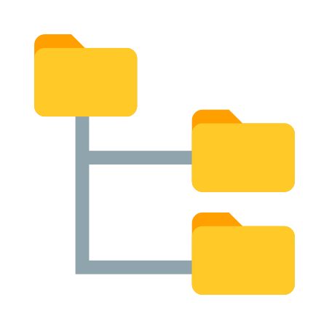

Slide 12
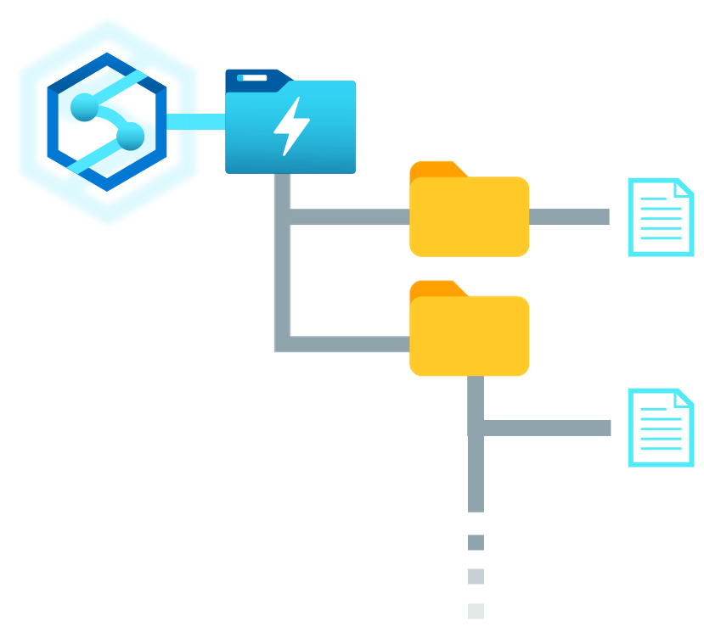
How to Recurse through Data Lake Folders with
Synapse Spark Pools

