Slide 1






Producers
Real-time Transformation (<1s)
Alerting
Actioning
Producers
Event Hubs Producer
Event Hubs
Consumer
Consumers
< 1 sec
Apache Spark Structured Streaming
RocksDB (Built-in State Store)
OneLake
Aribtrary Stateful Processing Spark guarantees:
Call-back f(x) executes within a microbatch of all events related to key (x)
A timeout callback for events not arriving within x time (heartbeat is offline)
Differentiators:
Massively scalable (million+ events/min)
Guaranteed latency
Pub/Sub with Event Hubs as source and sink
Use cases: ClickStream analytics, IoT heartbeat

Slide 2
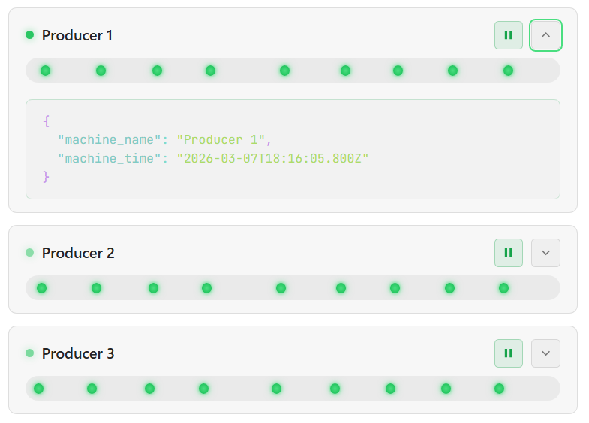
Ingestion into concurrent buffer: Event Hub
Producers
Real-time Transformation (<1s)
Alerting
Actioning
Producers
Event Hubs Producer
Event Hubs
Consumer
Consumers
< 1 sec
Apache Spark Structured Streaming
For very high volume, it’s best practice for clients to batch send events to avoid socket exhaustion and maximize throughput, at the slight cost of latency.
RocksDB (Built-in State Store)
OneLake
Events flow concurrently from each writer into Event Hub FQDN
Append only, concurrent buffer
Arbitrary Stateful Processing
Basically, Spark guarantees a callback f(x) will execute with a microbatch of all events related to a key (x). Spark also guarantees a event-time based timeout callback, if events don’t arrive for x (heartbeat offline).
Key differentiator: massively scalable because of Spark’s horizontal scalability (million+ events/min) with guaranteed latency. Use cases: ClickStream Analytics, IoT Heartbeat
No guarantee of equal distribution
Events are distributed based on:
Persistent key-based (hash and route)
Round-robin (random)
Named partition
Heartbeat payload

Slide 3
Ingestion into Stream Processor: Apache Spark
EventHubsConf(connectionString)
.setMaxEventsPerTrigger(50000)
.setPrefetchCount(30)
.setMaxRatePerPartition(5000)
.setThreadPoolSize(16)
.setConsumerGroup(“Spark-app-1”)
Producers
Real-time Transformation (<1s)
Alerting
Actioning
Max total events read per micro-batch across all partitions
Producers
Event Hubs Producer
Event Hubs
Consumer
Consumers
Events pre-fetched into local concurrent safe buffer
< 1 sec
Max events read per partition, per microbatch
Number of threadpools to use from the OS to connect
Apache Spark Structured Streaming
A unique Consumer Group PER DATAFRAME (not PER APP)
RocksDB (Built-in State Store)
OneLake
Consumer Group, some applications unique view into the Event Hub as a whole
Arbitrary Stateful Processing
Basically, Spark guarantees a callback f(x) will execute with a microbatch of all events related to a key (x). Spark also guarantees a event-time based timeout callback, if events don’t arrive for x (heartbeat offline).
Key differentiator: massively scalable because of Spark’s horizontal scalability (million+ events/min) with guaranteed latency. Use cases: ClickStream Analytics, IoT Heartbeat
Append only, concurrent buffer
Spark Executors Threadpools dequeing messages as fast as possible
Spark-app-1
0
1
2
Microbatch

Slide 4
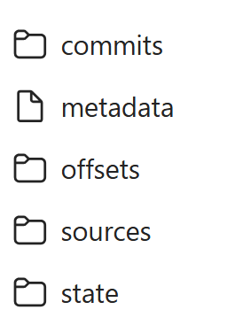
Stateful Stream Processor: Apache Spark + RocksDB
Producers
Real-time Transformation (<1s)
Alerting
Actioning
Spark Executors Performs tasks as fast as possible
Microbatch checkpoint Each Microbatch is checkpointed into OneLake to ensure resiliency on failures with exactly once guarantees
Producers
Event Hubs Producer
Event Hubs
Consumer
Consumers
< 1 sec
0
Batch completion marker
Query Unique ID
1
Source read positions
Apache Spark Structured Streaming
Initial metadata
RocksDB (Built-in State Store)
2
Rocks DB query state
OneLake
Shuffled by machine_name So all data for a given unique identifier ends up on the same computer in a microbatch
Arbitrary Stateful Processing
Basically, Spark guarantees a callback f(x) will execute with a microbatch of all events related to a key (x). Spark also guarantees a event-time based timeout callback, if events don’t arrive for x (heartbeat offline).
Key differentiator: massively scalable because of Spark’s horizontal scalability (million+ events/min) with guaranteed latency. Use cases: ClickStream Analytics, IoT Heartbeat
Lack of data per key Is also registered as an event. So if a given key is missing data for a given amount of time, we know when that time elapses
Concurrent flush to OneLake No chance of conflict as executo task durability guarantees for a given microbatch, 2 procs cannot write to the same path
RocksDB (Built-in State Store)
OneLake
Interesting events In <1 s for downstream subscribers
Perform whatever business logic GROUP BYs, WINDOWed JOINs, including flatMapGroupWithState or applyInPandasWithState etc.
< 1 sec

