Slide 1


rakirahman.me
Hi, I’m Raki.
I build Big Data & AI Solutions on Microsoft Azure.

Slide 2


rakirahman.me
Hey look,
IT’S A BLOG!

Slide 3




rakirahman.me
BLOGGING WITH
on Azure

Slide 4
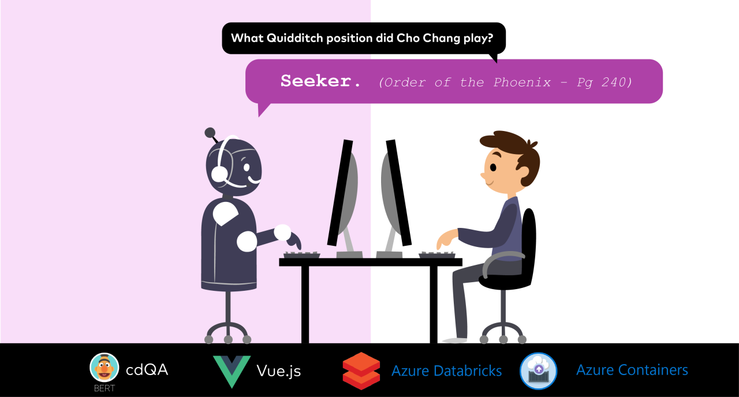
rakirahman.me

Slide 5
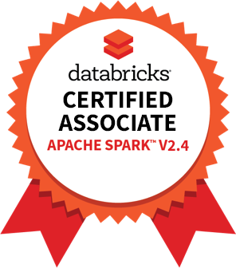

rakirahman.me
PART 1
COMPREHENSIVE
STUDY GUIDE

Slide 6
rakirahman.me
PART 2
COMPREHENSIVE
STUDY GUIDE

Slide 7



rakirahman.me
AUTOMATING
to Synapse
with Autoloader

Slide 8

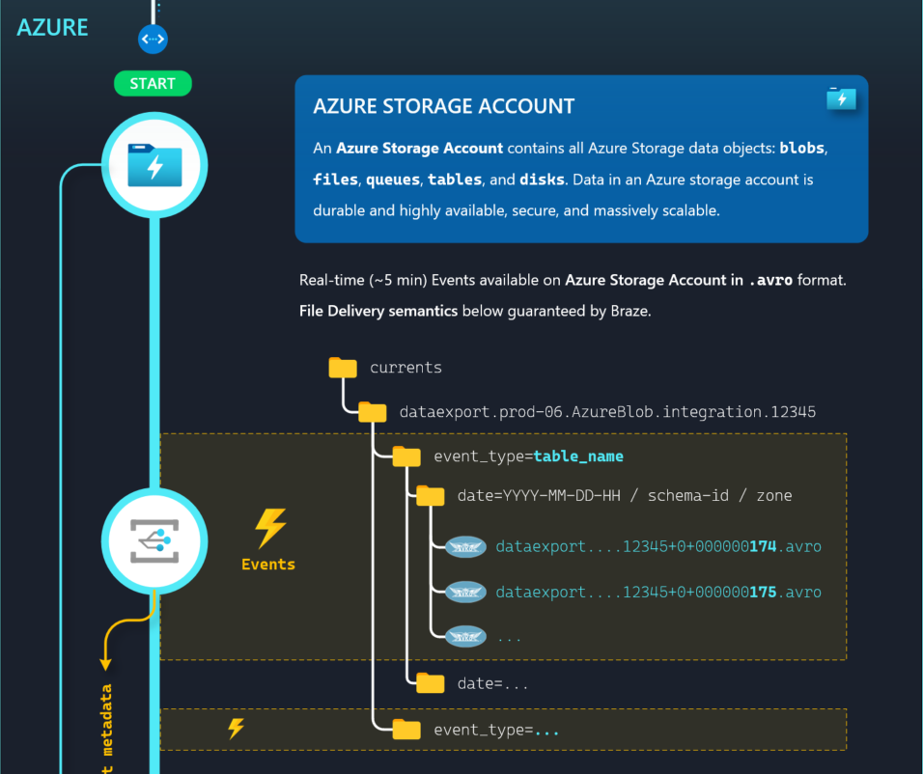
ILLUSTRATION
to Synapse
with Autoloader

Slide 9
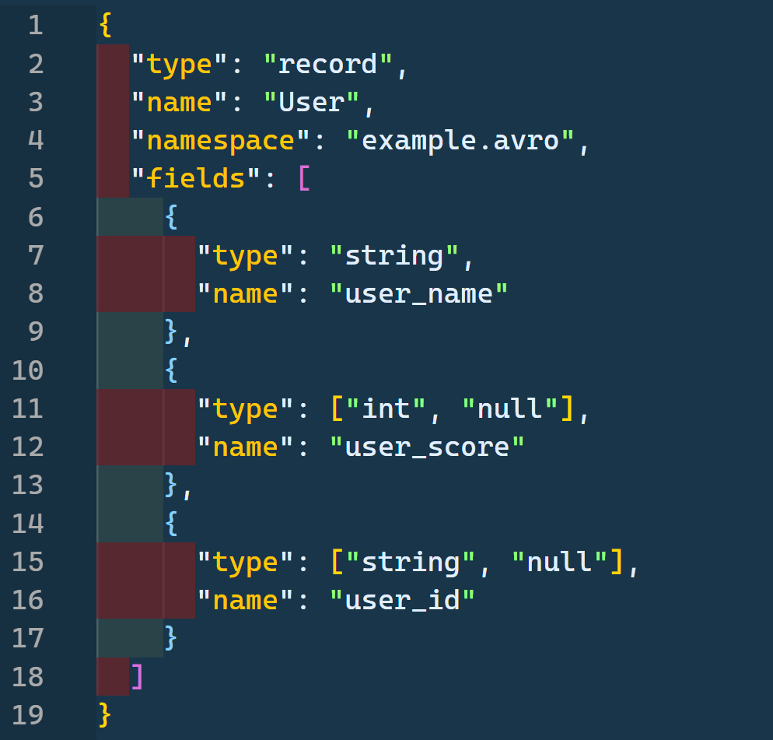

Exploring Azure Schema Registry with

Slide 10
rakirahman.me
PACKING
DENSITY
PREMIUM
MAXIMIZING
App Service Plan
AZURE FUNCTIONS

Slide 11
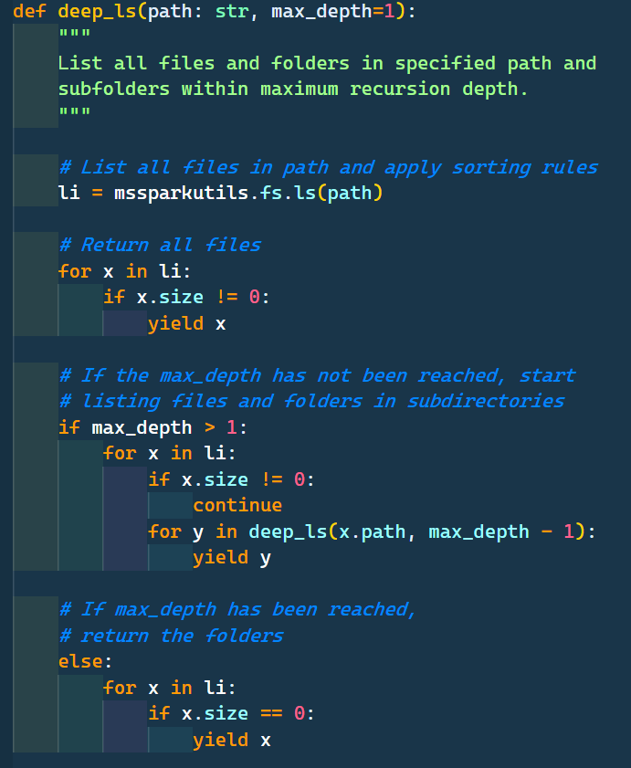


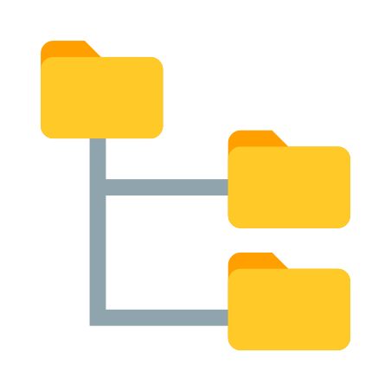



End-to-end Automation
CICD
Bash/pwsh
API
Purview API
pipeline
...proxy.purview.azure.com
Create new SHIR1
SHIR1
Get all SHIRs
Other SHIRs
1
2
Unregister VM1
Register VM2
3
4
VM1
VM2
old
new
SQL Server
Custom application
On-Prem
Azure
SQL Server
Replication mechanism
Azure
Database
...avro
SQL Server
...avro
Azure
On-Prem

Slide 12
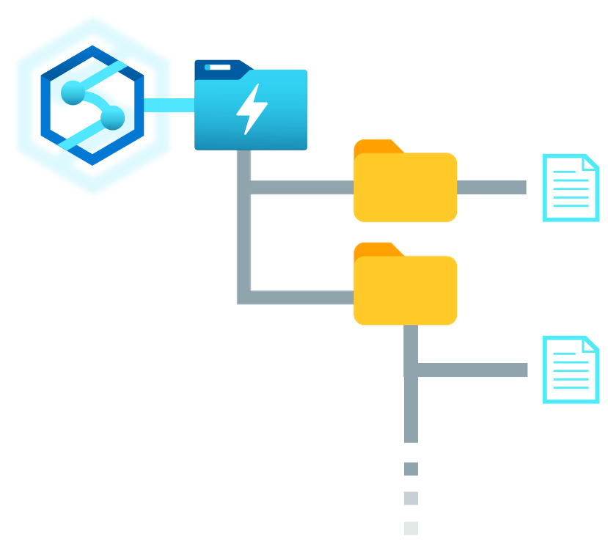
How to Recurse through Data Lake Folders with
Synapse Spark Pools

Slide 13
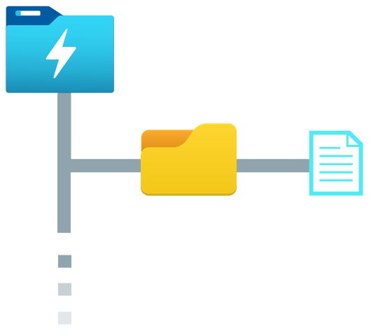

Purview
Synapse
Column name
Classifications
filename
asset
schema
email
Email Address
CashFlow_01.csv
CashFlow_{N}.csv
0: email, PERSONAL.EMAIL
1: creditcard, FINANCIAL.CREDIT_C...
2: creditcardtype, NULL
3: amount, NULL
creditcard
Credit Card Number
REST API
CashFlow_01.csv
creditcardtype
amount
Sales_02.parquet
Sales_{N}.parquet
[["ip_address","PERSONAL.IPADDRES...
CashFlow_{N}.csv
Profit_01.json
Profit_{N}.json
"[["id",null],["IBAN",“FINANCIAL...
Spark DataFrame
Exploring Purview’s API: accessing asset classifications in Synapse

Slide 14
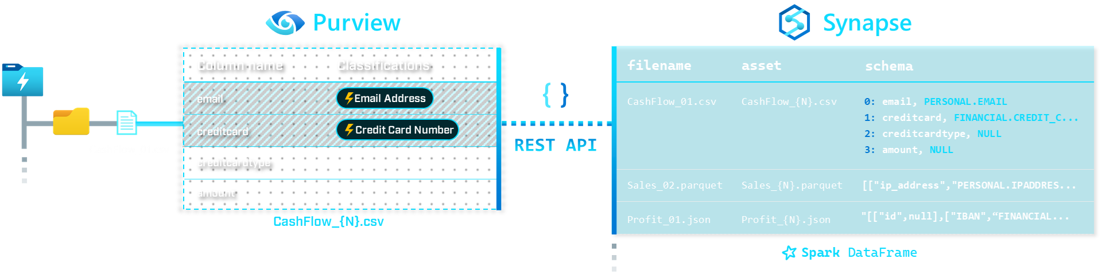
Exploring Purview’s REST API
with Synapse

Slide 15
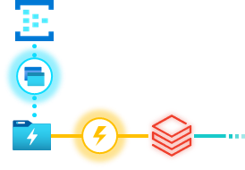
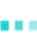
Stream Processing Event Hub Capture files
with Auto Loader

Slide 16
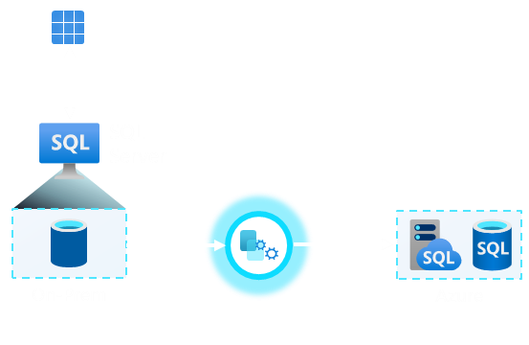
Replicating data from SQL Server to Azure SQL MI & DB

Slide 17
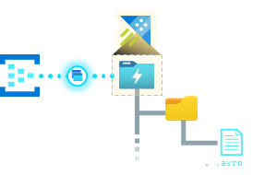
Querying Event Hub Capture files with Azure Data Explorer

Slide 18
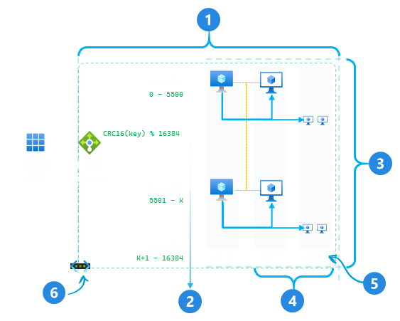
Demonstrating redis cluster management
(or lack thereof)
with Azure Cache for Redis

Slide 19
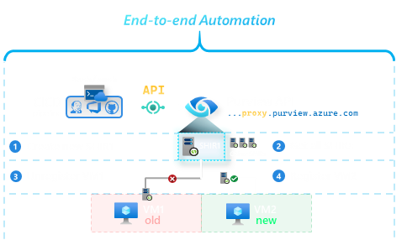
Automating Purview Integration Runtime
with the Proxy API

Slide 20

Reverse Engineering Dockerfiles for Azure Arc-Enabled Data Services
Arc-Enabled Data Services
mcr.microsoft.com
Data Controller
SQL MI
PostgreSQL Hyperscale
Reverse Engineering
Dockerfile(s)

Slide 21
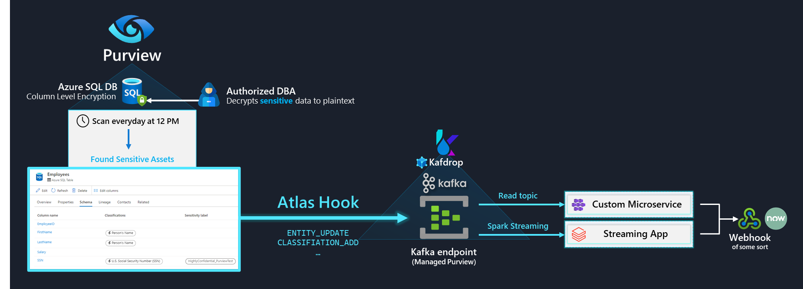
Detecting SQL Column Decryption using Purview, Kafka, Kafdrop and Spark

Slide 22
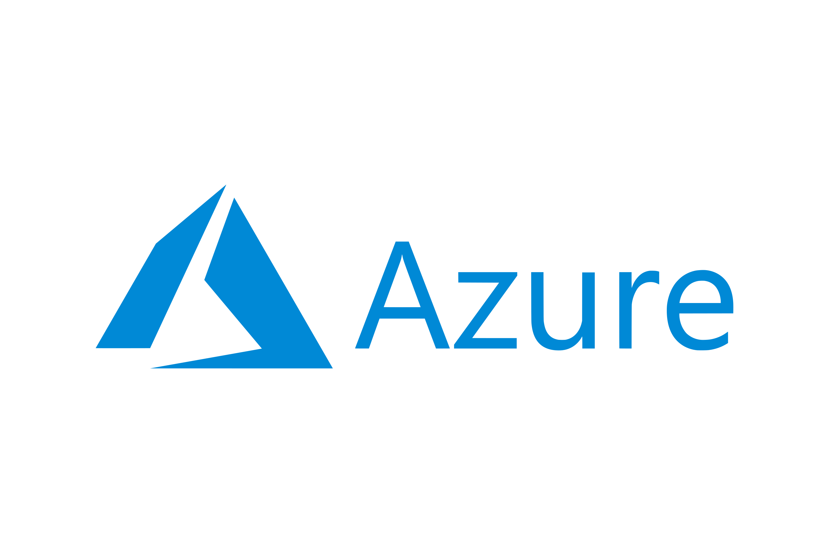


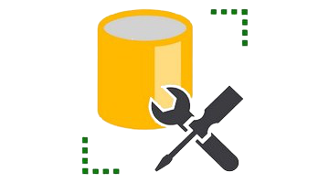

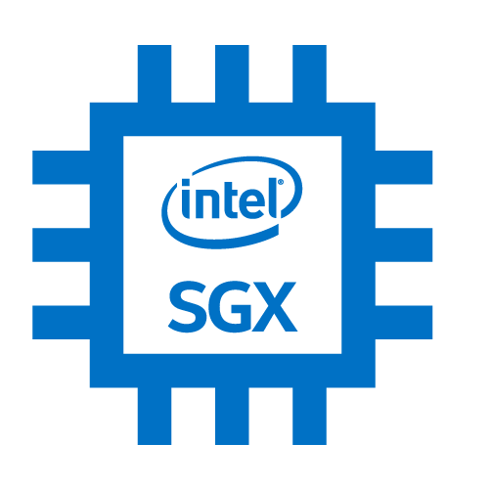
Key Vault: mHSM
Read
Column Master Key
End-to-end Sensitive Web App with Azure Confidential Computing
Azure Confidential VM
Azure Confidential Ledger
AMD EPYC 3 Sev-SNP
HR Admin
HR Web App
Authorized User
ASP.NET + Python
Sensitive logs
SQL Driver
ADO.NET
Azure SQL
Managed Identity
Ciphertext
SSMS
Malicious DBA
Plaintext
MSSQL
db_owner access
SGX Enclave
Azure Attestation
Token

Slide 23
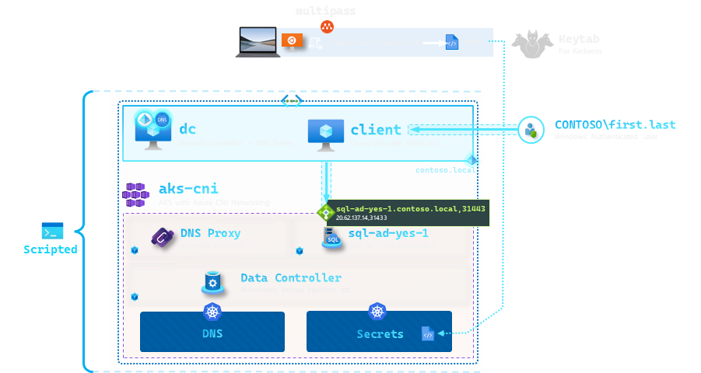
Arc SQL MI – Scripted Active Directory setup

Slide 24
Arc SQL MI – Increase Storage Size of PVC

Slide 25







BYOC
Secrets
Arc Data Controller Bring-your-own-Certs

Slide 26


CHAOS TESTING
Azure Arc-enabled SQL Managed Instance
Arc HA OPERATOR

Slide 27
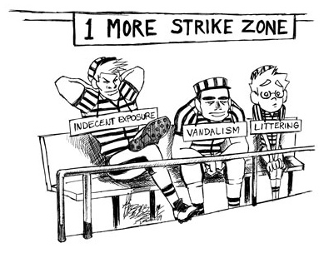


POD EVICTED ZONE
CONQUERING EVICTION MANAGER IN KUBERNETES
OOMKILLED
CRASHLOOP
STORAGE

Slide 28
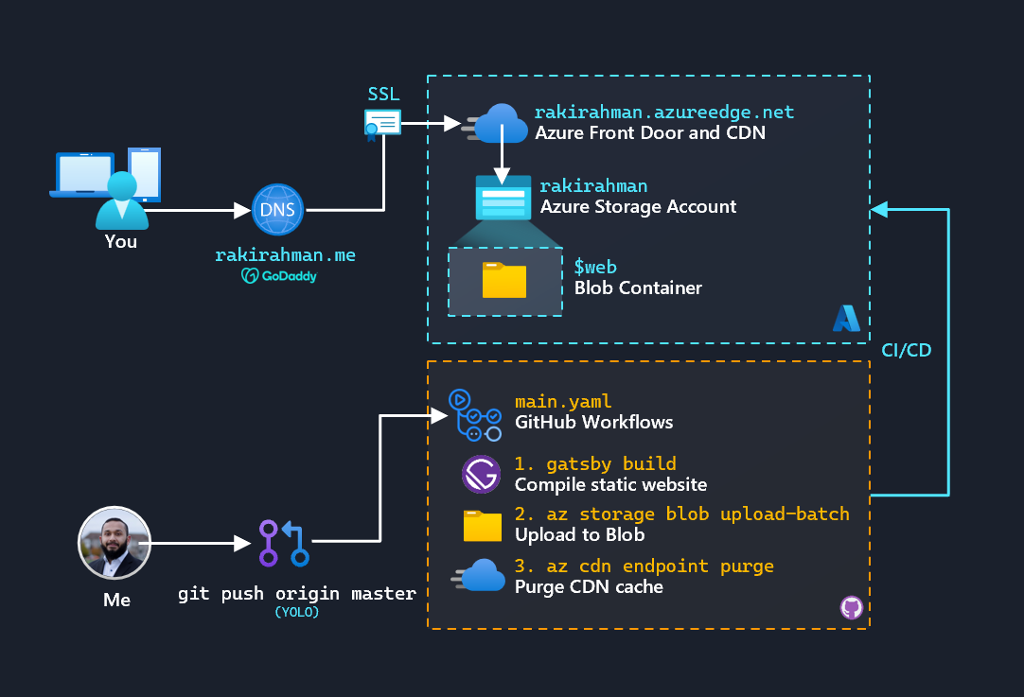


How I host a website on Azure for $1.50/month

Slide 29

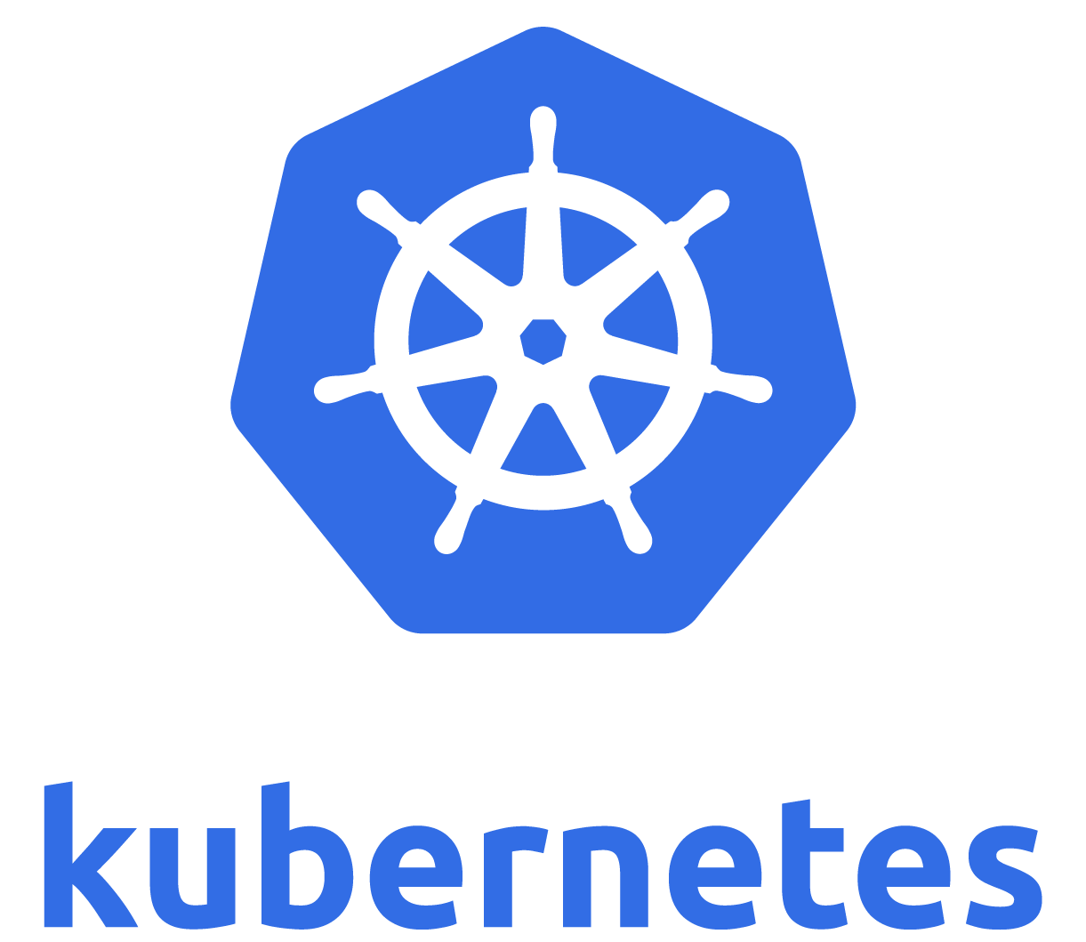







Flushing 27+GB/min from Event Hub to Delta Lake
with delta-dotnet
Bin PACKED hosting on
Bulk Delta Uploads
Sink: OneLake
Autoscaling with
Source: Event Hubs
Written in C#
Parallel Parquet Flushes
rakirahman.me

Slide 30
How to deeply instrument all nodes in a Spark Cluster with OpenTelemetry
(feat. Real-time Power BI report)

Slide 31





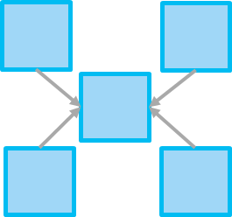


rakirahman.me
otel-json
One giant ...thing
otel-arrow
Easy to query STAR schema
to
with otel-arrow schema

Slide 32
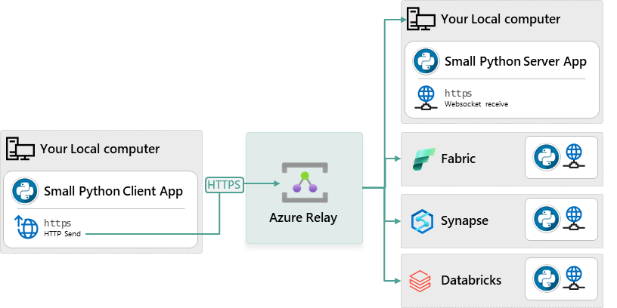
How to setup a secured tunnel from your local machine to Fabric, Databricks, Synapse or anywhere else

Slide 33
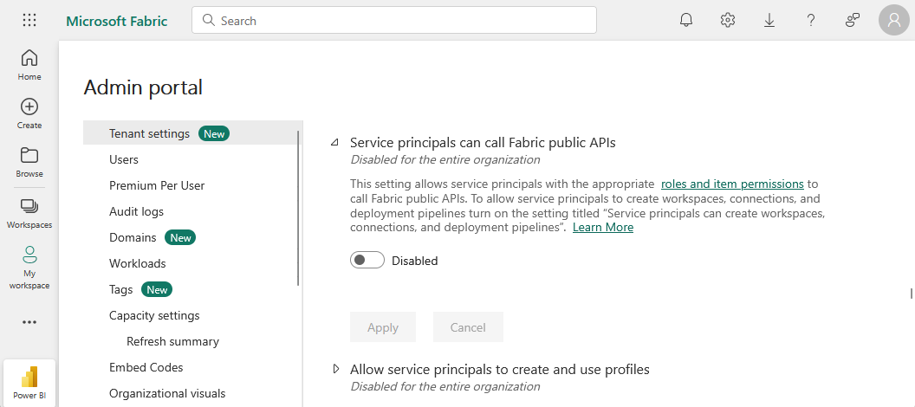





How to securedly setup CICD automation on Fabric when Service principal usage is disabled on the tenant

Slide 34

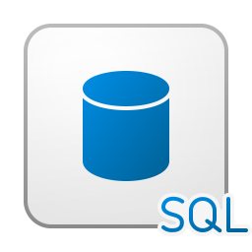
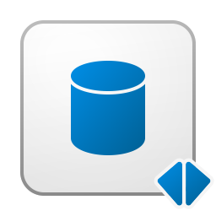






F2
v
Files / LandingZone / foo.schema / table
Tables / foo / table
🔥
Benchmarker App
_change_data
_FilesReadyToDelete
_delta_log
Multiple-threads
Duck DB Parquet
metadata.json
_index_bin
…parquet
deletion_vector.bin
part-000..parquet
COMPUTE
Courtesy of Fabric
STORAGE
Courtesy of OneLake (Up to FX Terabytes, then you pay)
Fabric Open Mirroring is really fast, and free (really!)

Slide 35


ItemJobEventLogs
Alert on thousands of Fabric Pipelines with Monitoring Eventhouse

Slide 36



Column level lineage in Fabric Spark with OpenLineage and stashing the lineage in Delta Lake

Slide 37
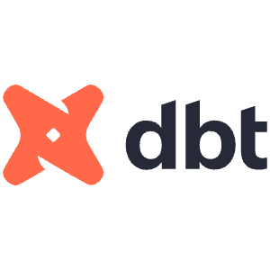

rakirahman.me
dbt with Fabric Spark in Production

Slide 38

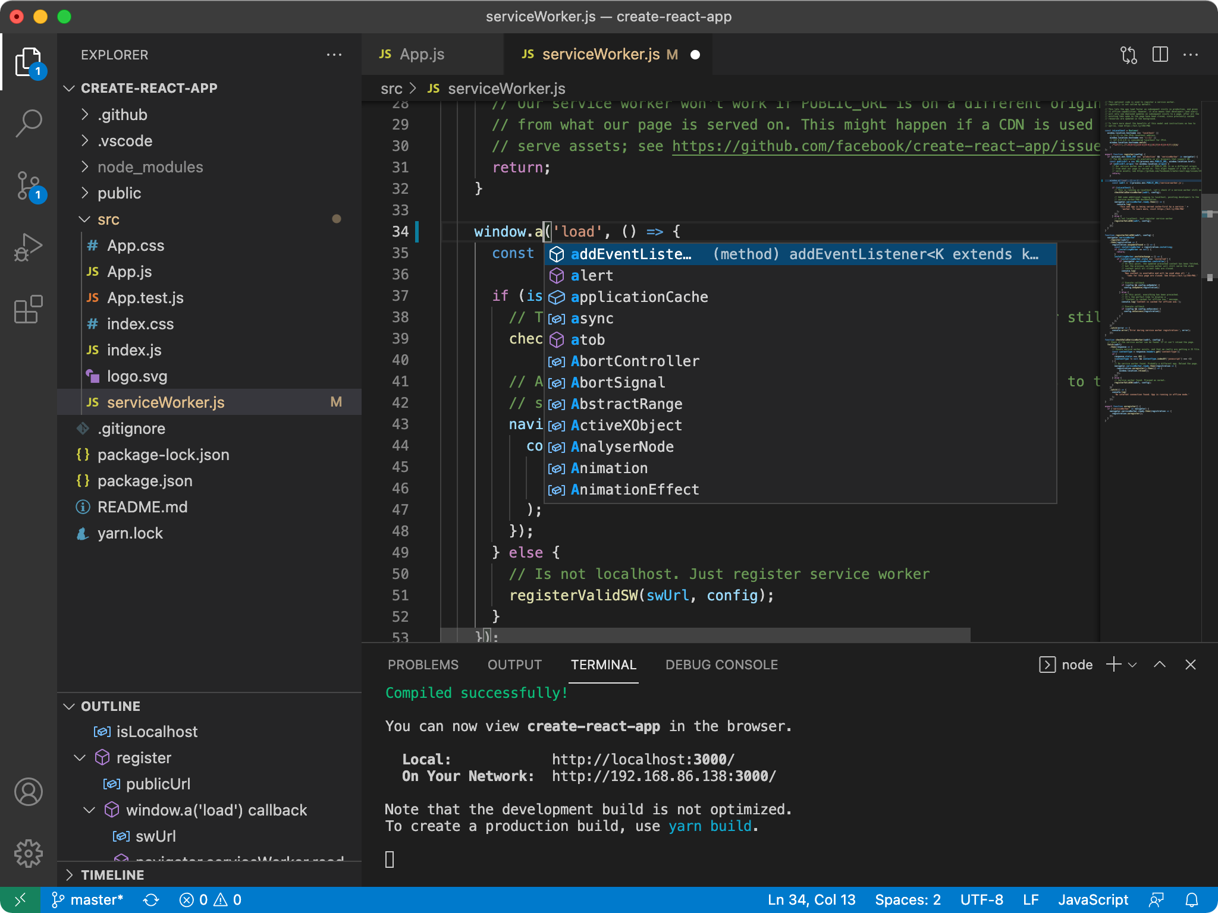









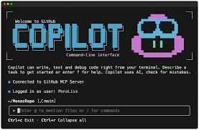
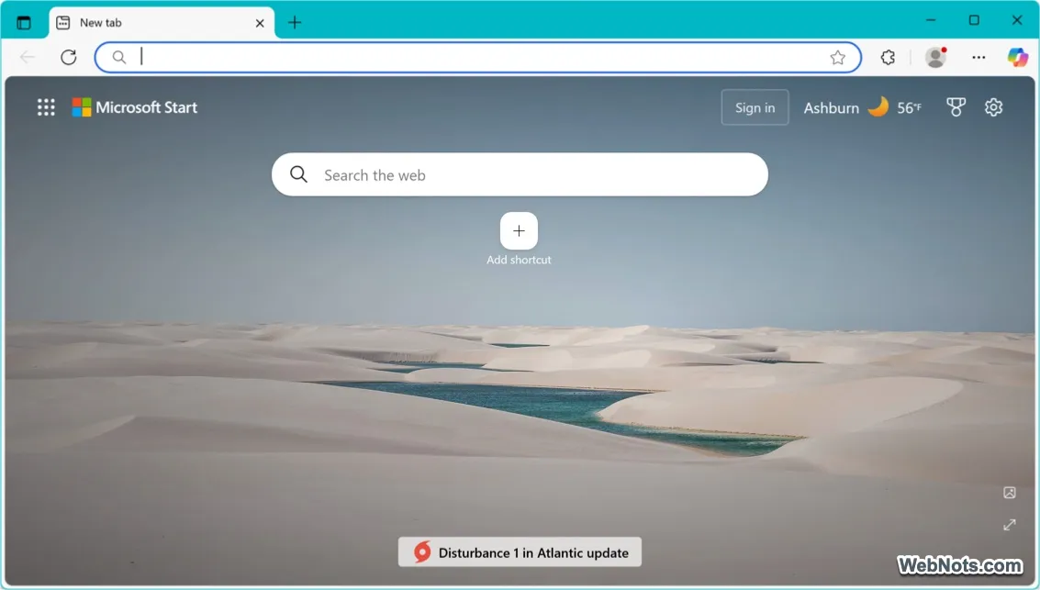


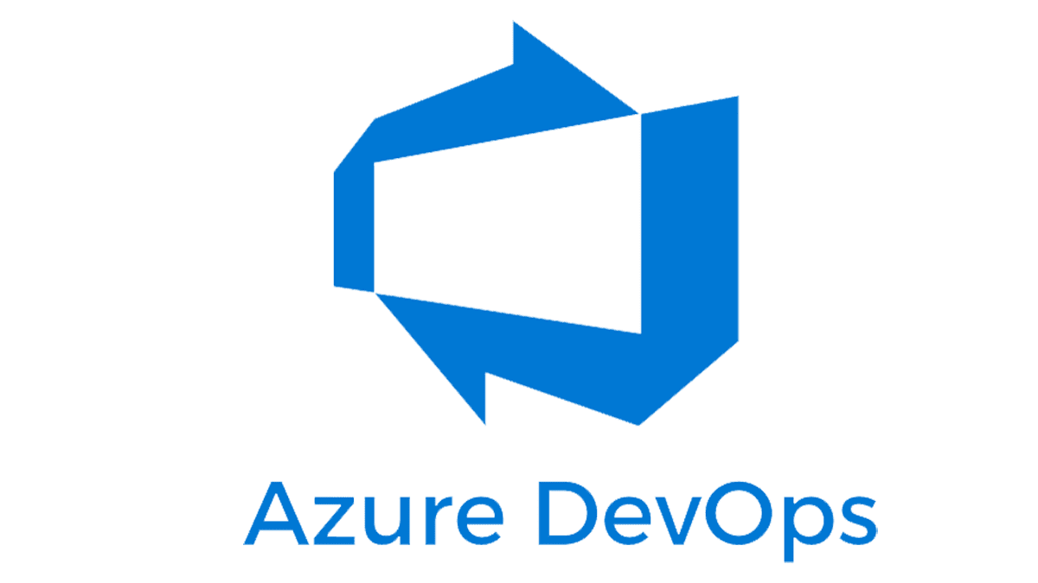






rakirahman.me
Local machine
Spark Streaming
Contains large git repositories and Windows Login context
copilot –acp –port 8080
Highly flexible rules engine
😩 Pain
11
12
2
10
TFIDF
Soundex
Agglomerative Clustering
Git blame
ODBC/Jupyter Kernel
Static RegEx rules
1
14
9
Lakehouse
SQL EP
Deterministic
Non-deterministic
Fabric
Flaky incident reassignment to original authors or their managers
with evidence of ownership
Deterministic, desired state, data driven, tested code that works with my JWT
Observed
impersonation
JWT
7
100s of incidents
😩 Pain
🤖
5
Synthetics
4
Best guess
3
Me
Sniff network trace to extract JWT
6
/plan
/research
/fleet
/autopilot
13
Livesite Incident Management System
Gigabytes of git history across several git repos
Many git repos
Playwright MCP to click around the UI to figure out all the undocumented API calls
8
Index, lemmatize, tokenize
Git provider
Inspired by OpenClaw, but significantly more deterministic and safer
Fabric and Github Copilot CLI for robust incident triaging

Slide 39

rakirahman.me
Migrating from Azure Front Door to Cloudflare Free Tier

