Slide 1


Bangladesh Army University of Engineering & Technology (BAUET)
|
Project on Restaurant Management System
Presented by
Md. Rashadul Alam Rimon
ID- 16104050
Dept. of CSE - B
Team - 7

Slide 2

Introduction
Restaurant Apps Panel
Criteria
Purpose
Module
Restaurant Apps Extension

Slide 3

Introduction
Restaurant Management system is a process of ordering food from a restaurant through a web page or app.
A customer will search for a favorite restaurant usually filtered
via type of cuisine & choose for available items for delivery or pick-up.

Slide 4
Restaurant Apps Panel
Admin Panel
Online User
Sub Admin
Guest on Board

Slide 5
Criteria
A digital computer based system which can handle the number
of guests pursuing order and can calculate the ordered food.
It intends to more user friendliness between guest and the restaurant environment.
Online ordering may help to get in touch with the food ASAP by FREE HOME DELIVERY service.

Slide 6
Purpose
One or more process allow customers to place order.
Reduces time consumption.
Allow guests to pay online or by hand to hand.
Guests are able to know the offer peak hour immediately.

Slide 7
Module
Customer Registration Module
Online Ordering & Reservation Module
Waiter Module
Menu Module
Feedback Module

Slide 8
Customer Reg. Module
Customer registration module contains customer's information.
All of this information recorded into database.
Customers are given with a facility to change his existing password.

Slide 9
Customer Online Ordering And Reservation Module
Customer online ordering and reservation module provides a form that needs to be fulfilling in term of ordering food and reservation table via online.

Slide 10
Waiter Module
Waiter module contains waiter information such as waiter personal information, task schedule and other information related to that waiter. Then, all of this information recorded into database.

Slide 11
Menu Module
Menu module is food that restaurant prepared for customer. This module, customer can view the menu and make decision for order.

Slide 12
Feedback Module
Based on food or everything about the restaurant, customer can comment to the restaurant with feedback form. From this form, side of restaurant will know their weaknesses and strengths.

Slide 13
Data Flow Main Frame
Main Frame

Slide 14
Data Flow Login
Login
Main Page
User ID
Password
Sub Page
No
Yes
Verified
Checking ID and password verification

Slide 15
Data Flow Offline Order
Cooked & served
customer order
if available
Customer – Cook Relation
Cook received

Slide 16
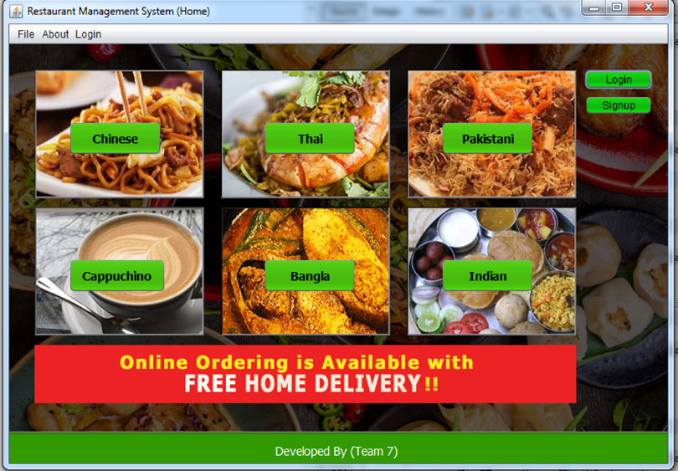
Restaurant Apps Revealed
Main Frame

Slide 17
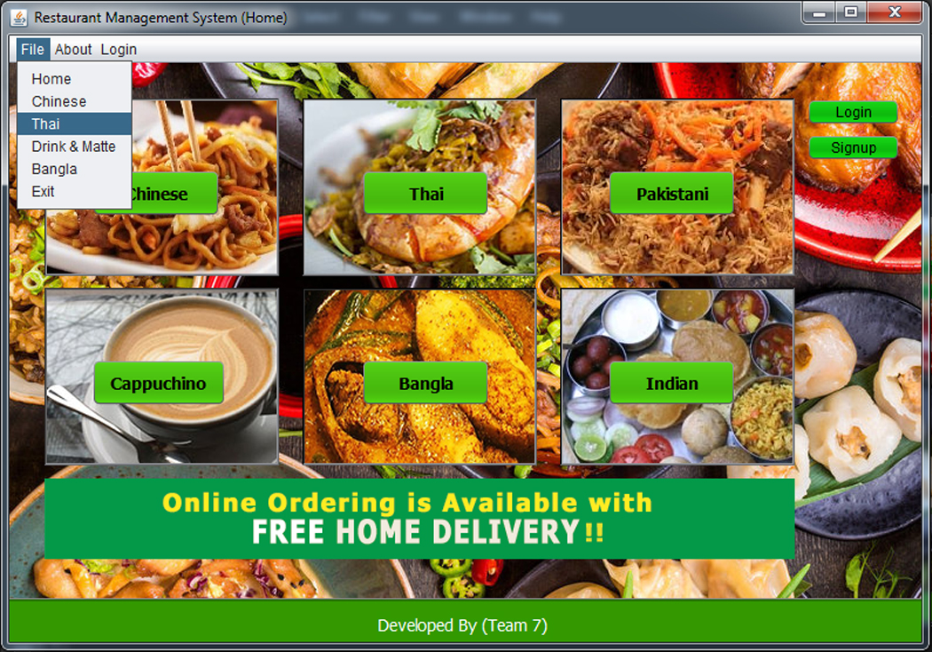
Restaurant Apps Revealed
Main Frame
With
Navbar

Slide 18
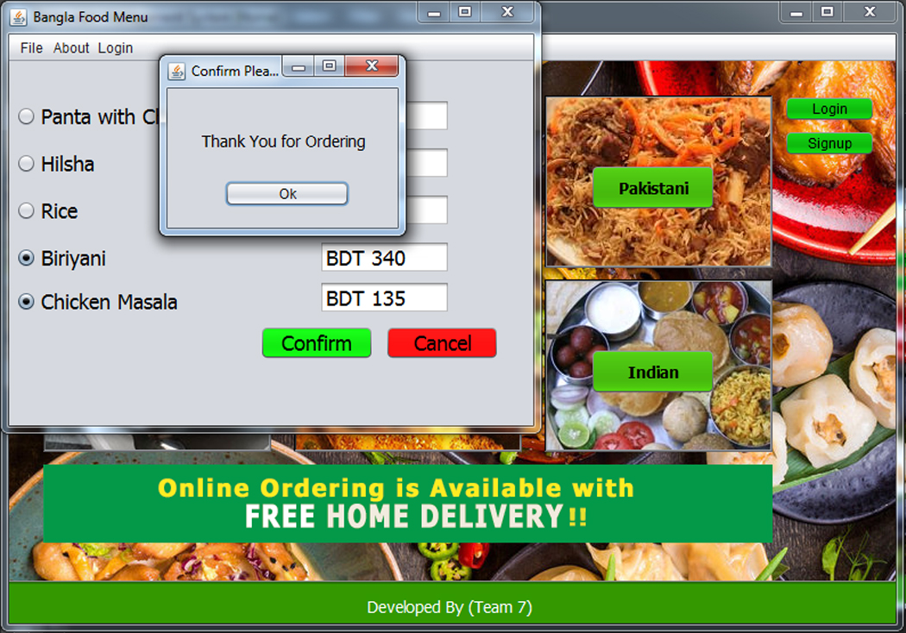
Restaurant Apps Revealed
Available
Food
Menu

Slide 19
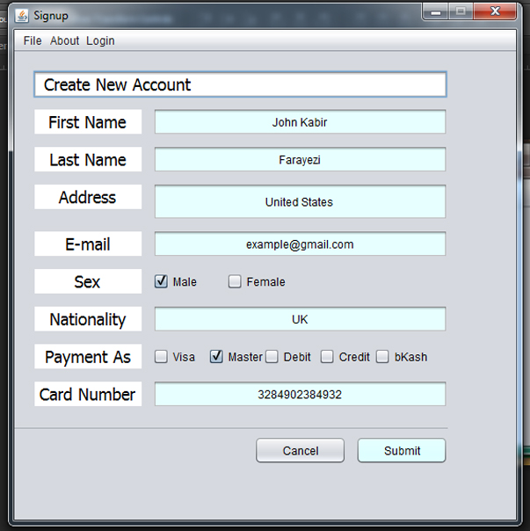
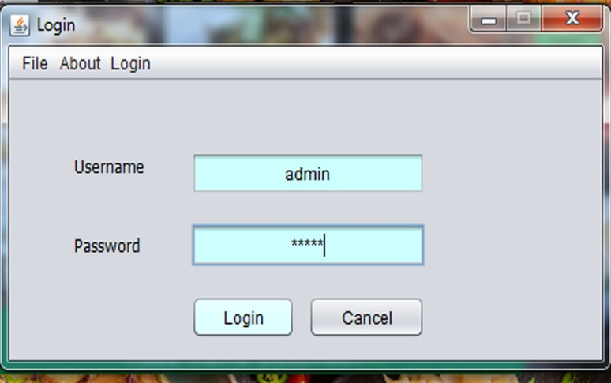
Restaurant Apps Revealed
Create
an
account
Login to your account

Slide 20
Question Please

