Slide 1
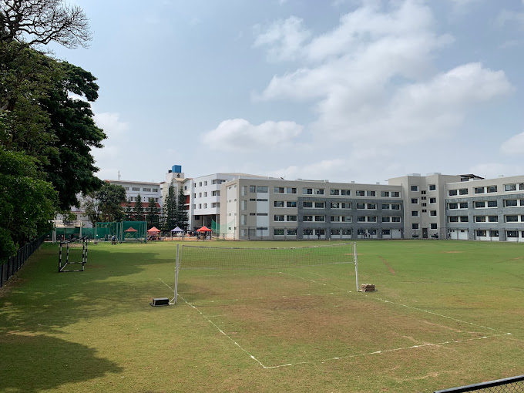
St. Joseph’s University
My Experience!

Slide 2
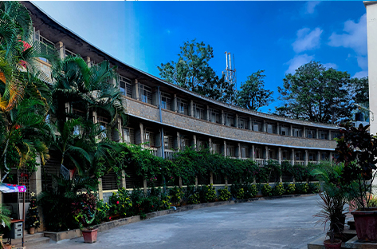
Division of events
1. 🎒 Attending Classes.
2. 📚 Visiting Library.
3. 🗣 Socializing.

Slide 3
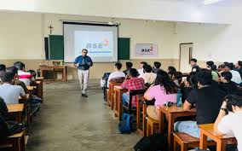
Event 1.
🗣 Socializing.
© C was enjoyable primarily because laptops were permitted, allowing me to browse other content after completing my coding tasks.
💻 FC was tedious due to my dislike for hardware-related topics.
➗ Math was engaging because I enjoy solving puzzles, and the material taught had a puzzling nature.
💻 Unix was uninteresting because it focused heavily on hardware concepts.

Slide 4
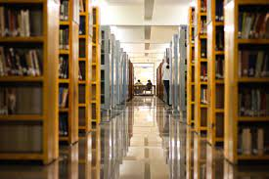
Event 2
📚 Visiting Library.
The library was enjoyable not because of the abundance of books📕 available for reading, but because I could use my laptop 💻 to solve puzzles.

Slide 5
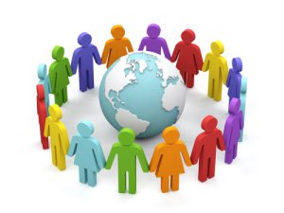
Event 3.
🗣 Socializing.
Meeting 👱 🙅 new people, and understanding what they were like was also an 👨‍interesting aspect.

Slide 6
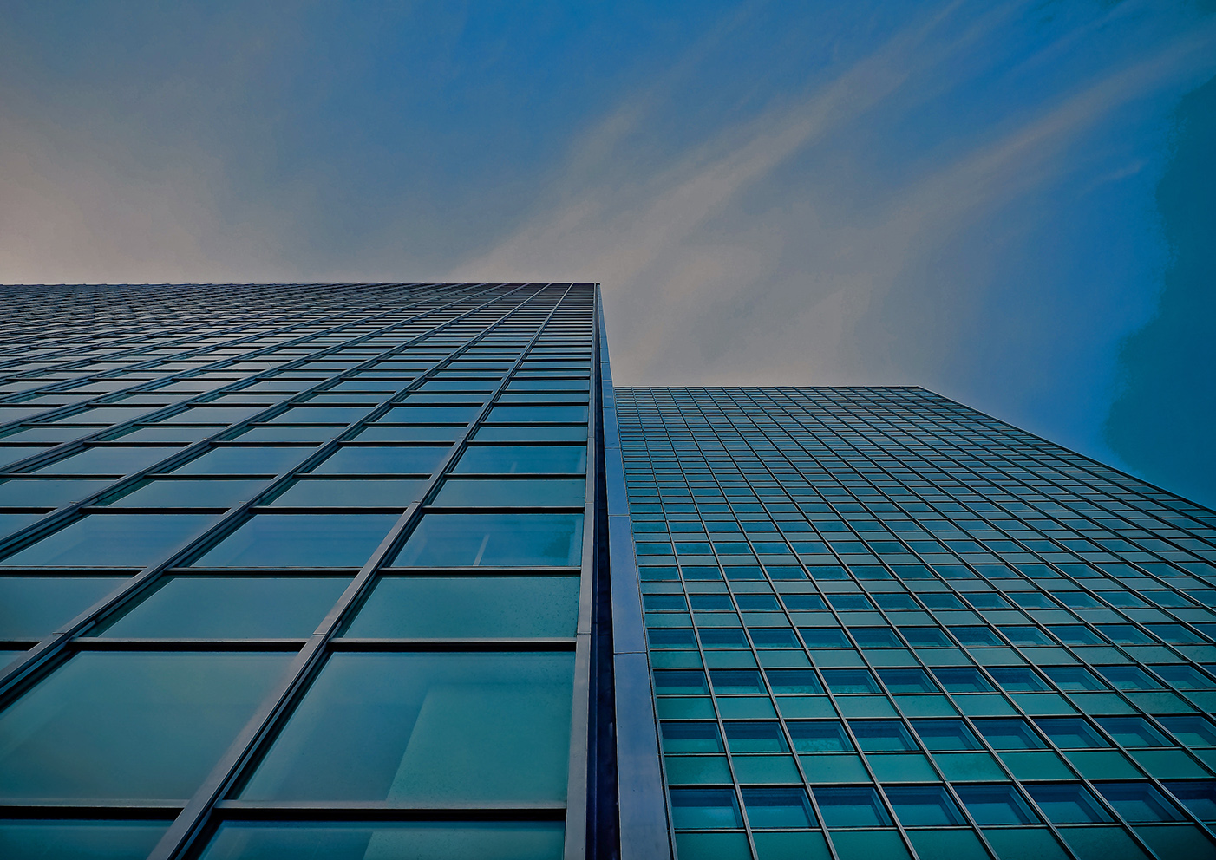
THANK YOU!
Rayaan Pasha

