Slide 1
Added value of BIM
How to profit from BIM as a pipe system manufacturer

Slide 2
Table of Contents
Some theory on BIM & Information Management
Strategic decisions for Manufacturers
Examples of successful BIM strategies
01
THEORY
OF BIM
02
STRATEGIC
PLAN
03
CREATE AND
IMPLEMENT

Slide 3

Get to know us
Started with BIM in 2004 as modeler
Author of the NLRS – Dutch Revit Standards since 2011
Chair of buildingSMART Benelux between 2015 – 2017
Author of several published articles about IFC and Revit
Speaker at RTC, BiLT, Autodesk University, Digital Construction Week on IFC and Revit.
Co-founder of Bimforce in 2015
Bimforce focusses on Information Management strategies
MARTIJN DE RIET
OWNER
Information Specialist, focussed on developing solutions

Slide 4
Most common strategies
For manufacturers that start with BIM

Slide 5
BIM Implementation strategies
Sales driven
Fabrication driven
Marketing
driven
Project / client
driven

Slide 6
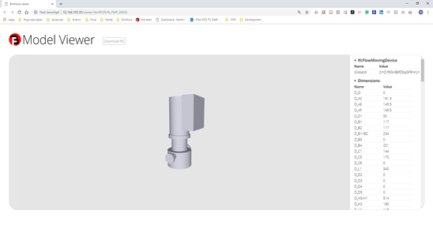
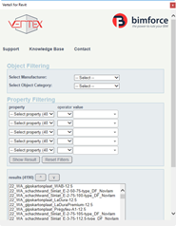





Marketing Strategy
01
DEFINE PRODUCT REACH
Search for products to “BIMify” that best suits your client wishes. Usually a small selection of products
02
DEFINE MARKET REACH
Search for content platforms with the biggest market reach, select multiple to advertise on
03
BE VISIBLE
Make as much noise as possible to promote your BIM readiness.

Slide 7
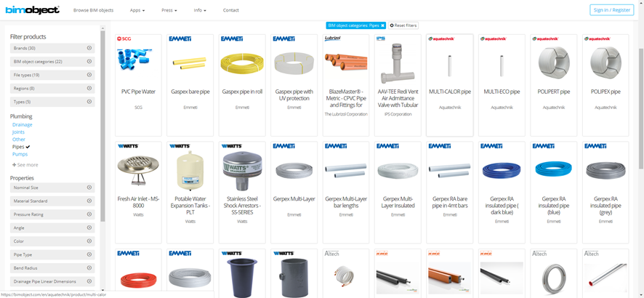
Marketing examples
Commercial Content providers
Pro’s
Visibility and product exposure are maximized
Availability leads to being used in projects
Content creator deals with sorting the data
Cons
Each content creator has its own standard
Visibility aimed at buyers, not users
International strategy costly & high maintenance

Slide 8
Sales strategy
Increase of BIM utilized
in building projects
Loss of revenue because of not
having BIM Content available

Slide 9
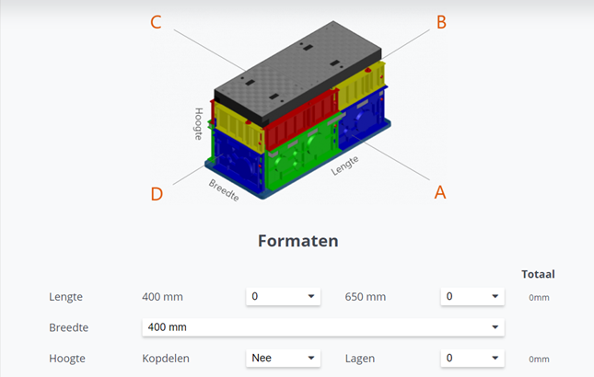
Sales examples
Pion, using a web configurator
Pro’s
Based on economic necessity. Clear decision process.
No “early-adopters” risks. Best-of-breed approach is possible.
Cons
Losing market position prior to stepping in creates a risk
Responsive approach. You’re not in the driving seat. Probably not even riding shotgun.

Slide 10
Fabrication Strategy
Manufacturer engineering services
Procurement & planning
Fabrication
Building design & engineering

Slide 11

Fabrication examples
OC Verhulst, AHU’s from engineering data
Pro’s
Deliver added value to both your clients and your own organisation
Better positioning in the AEC process, from manufacturer to knowledge partner
Cons
No easy transition or slow start
Requires substantial investments
Requires certain level of Information Management maturity

Slide 12
Project / Client Strategy
Product X
Product Z
Product Y
Product Z

Slide 13
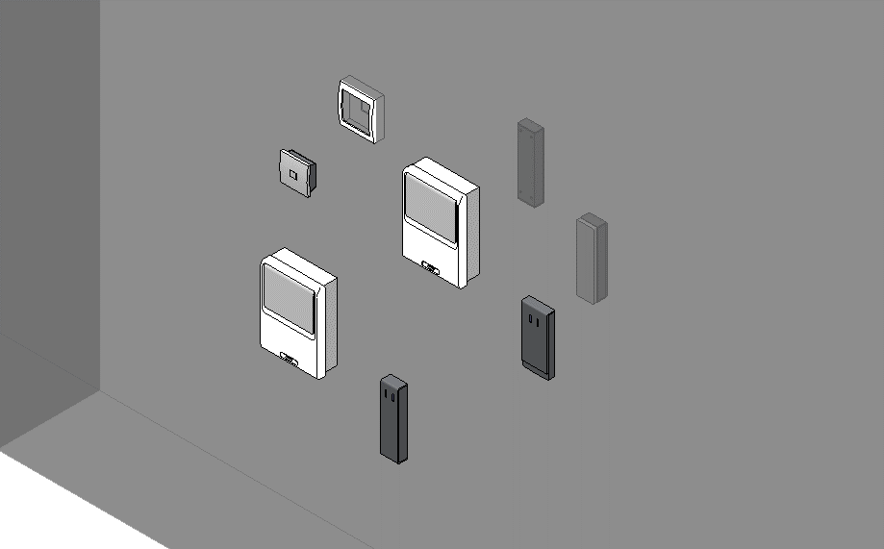
Client / project examples
Nedap, project based Revit libraries
Pro’s
Positive vibes with your clients
Gradual transition to BIM
You can take into account the lessons learnt
Cons
No strategic choices or plans
No ROI for your own organization
Different clients have different needs
Extremely difficult to keep your library up to date due to fragmented development

Slide 14
General challenges
Which you face no matter your strategy

Slide 15
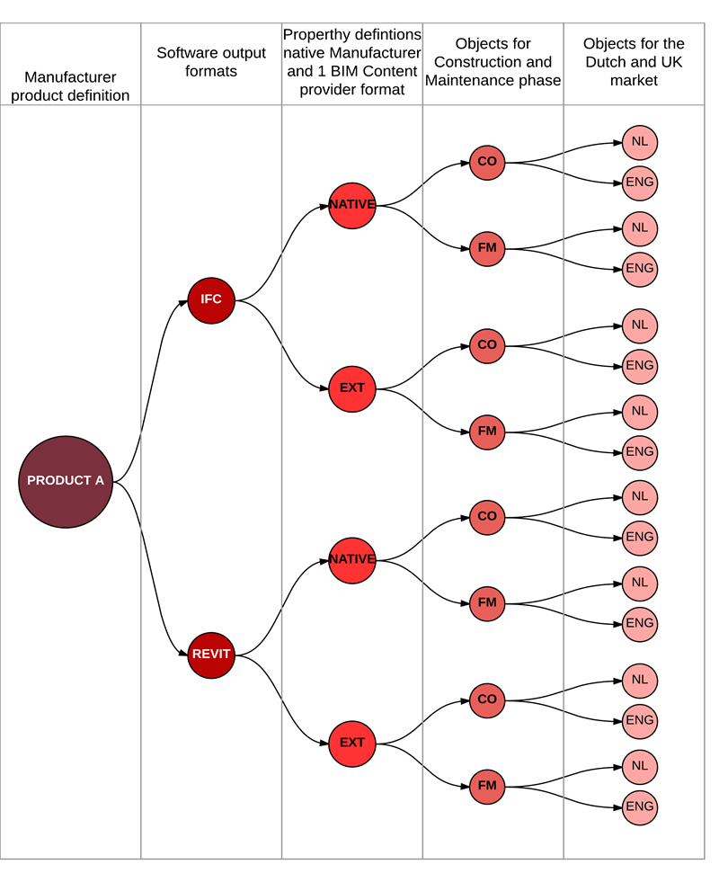
Variety in output specs
Software format
Output requirements
Project phase requirements
Language requirements

Slide 16
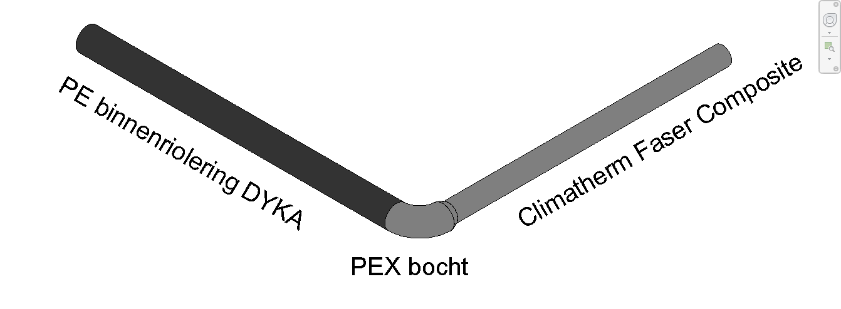
No “checks and balances” for BIM Content
“Unsupported” changes after placement in projects
Piping systems, manufacturers and products can be interchanged without error

Slide 17
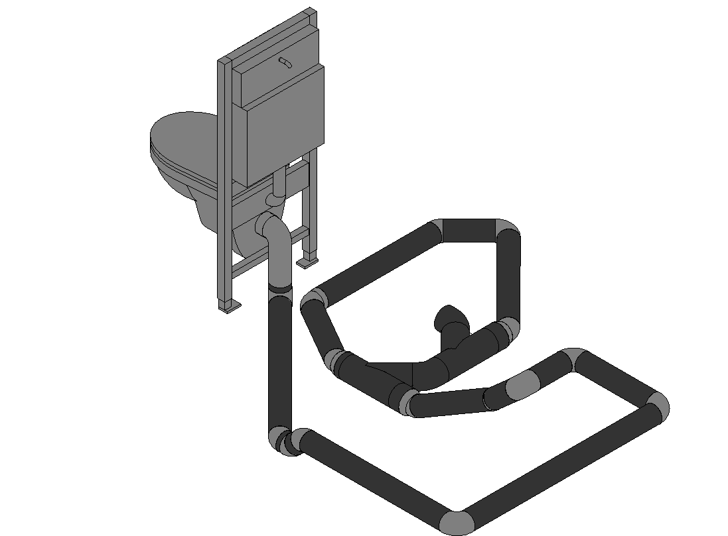
No “checks and balances” for BIM Content
Right products, installed wrong
Proper selection of products requires specific product knowledge / engineering skills

Slide 18
Examples
Of our integrated workflow

Slide 19
Verified Systems
Content information expandable to Systems
  Proper application of products in a System (Project) can be verified
  Engineering services can be automated

Slide 20
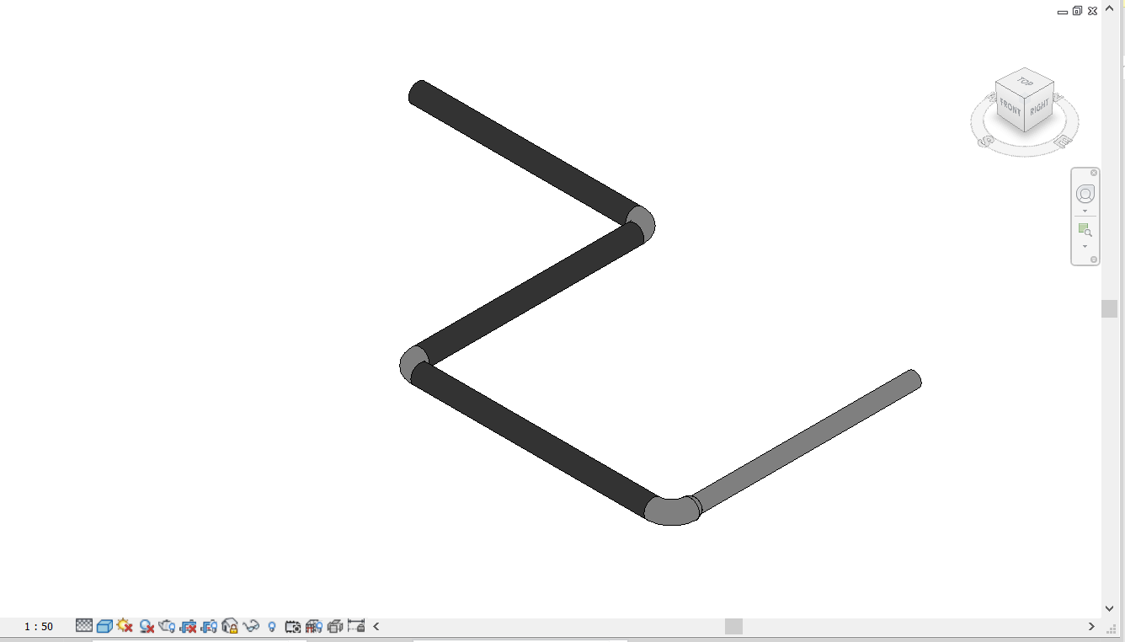
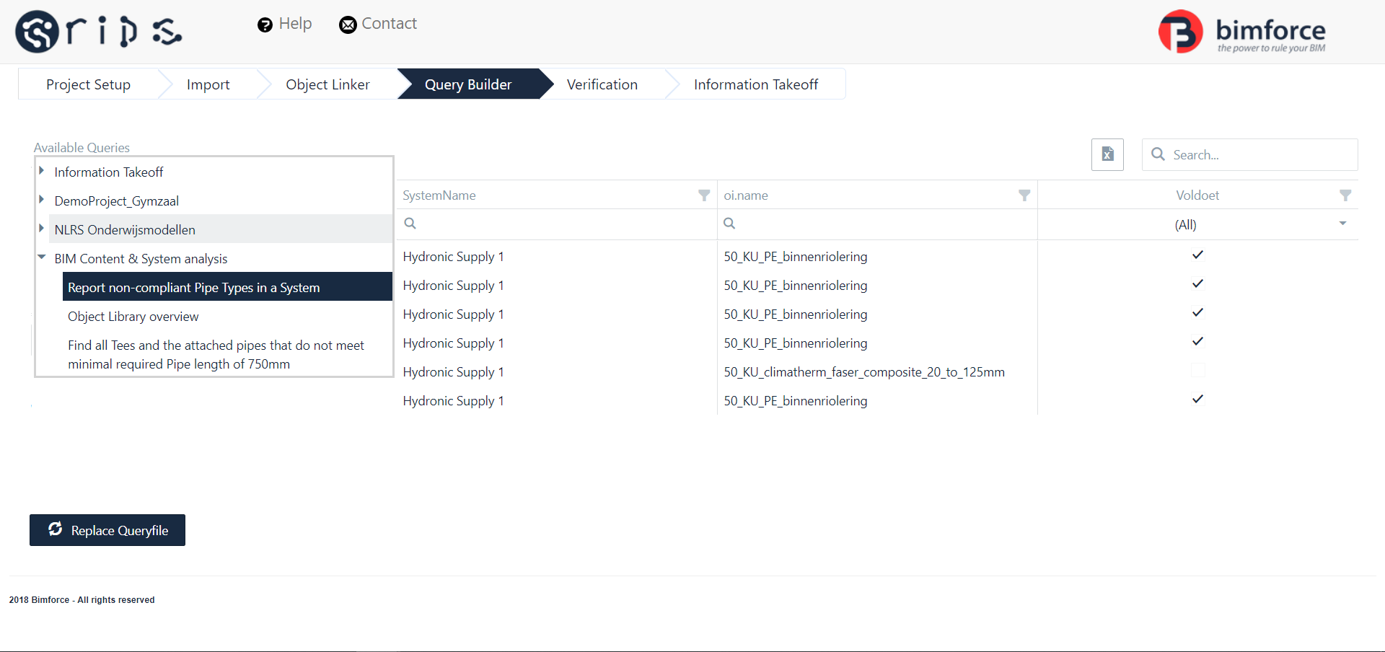
Verified Systems

Slide 21
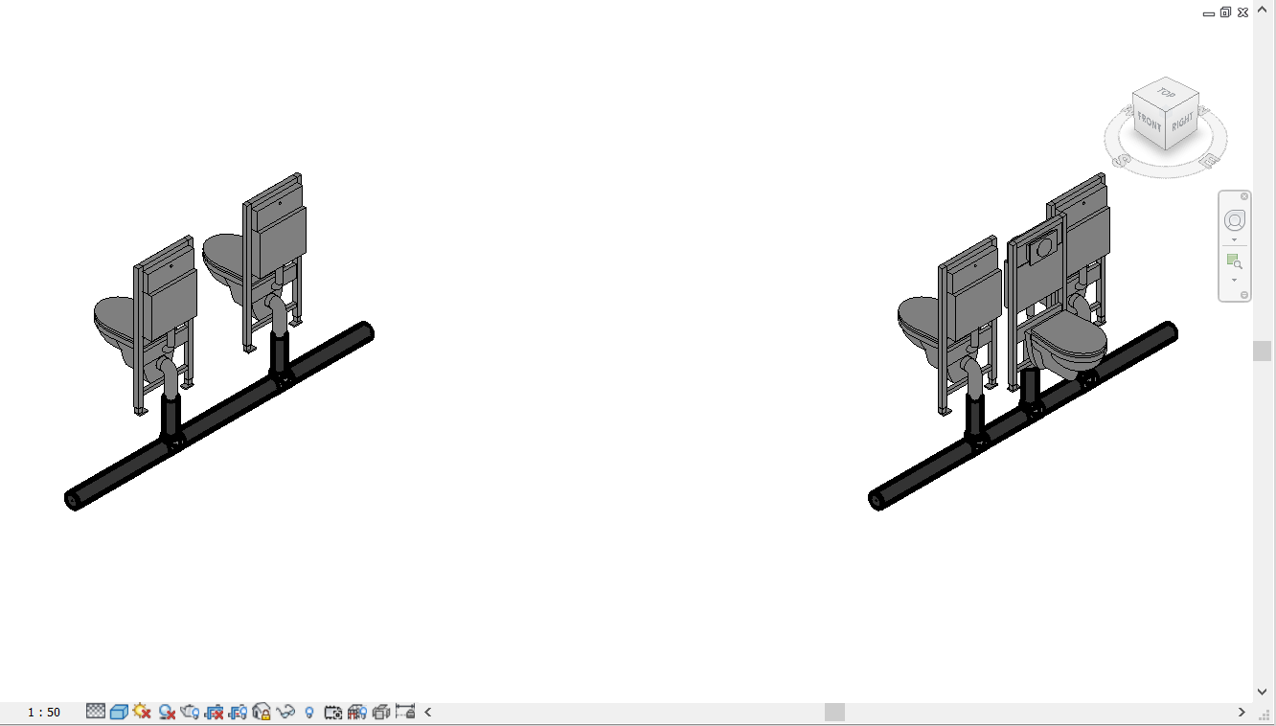
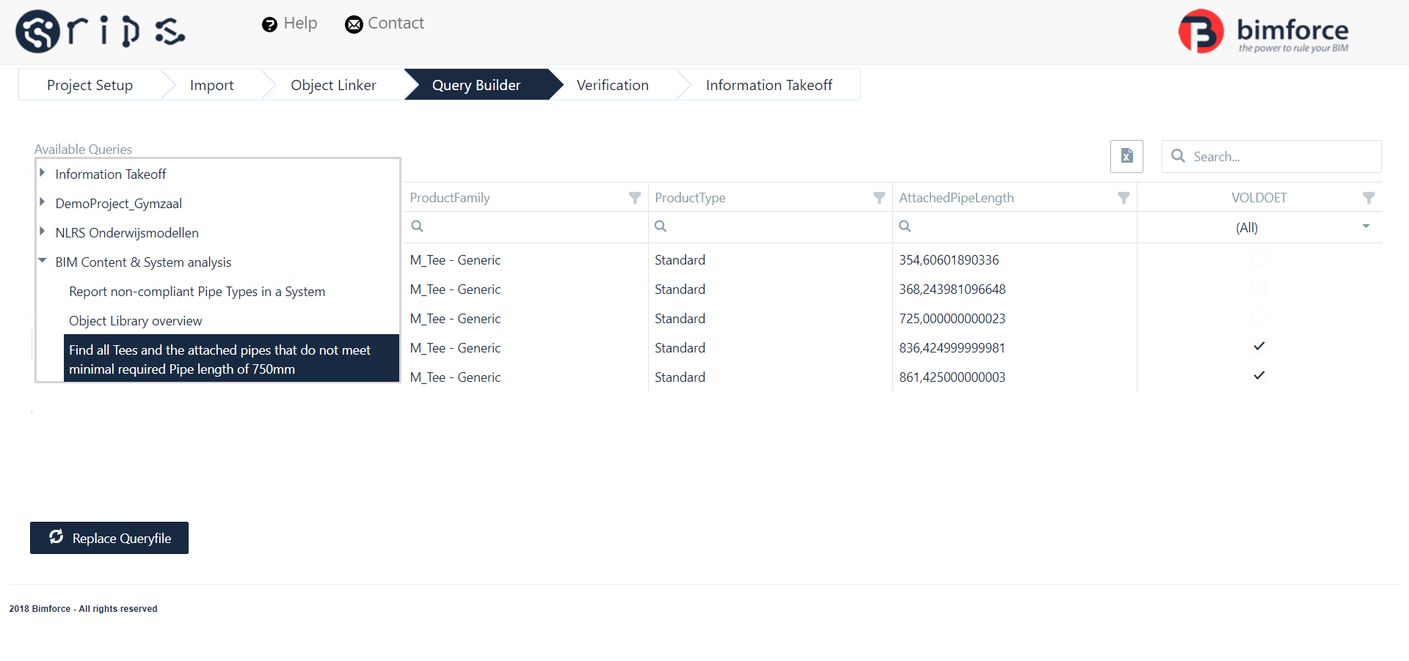
Verified Systems

Slide 22
Verified content
IFC based content:
  Can be viewed and generated without any modelling software
  Can be configured as desired upon generation
Data driven solution:
  Can be managed with simple datagrid interfaces
  Can be verified for changes

Slide 23
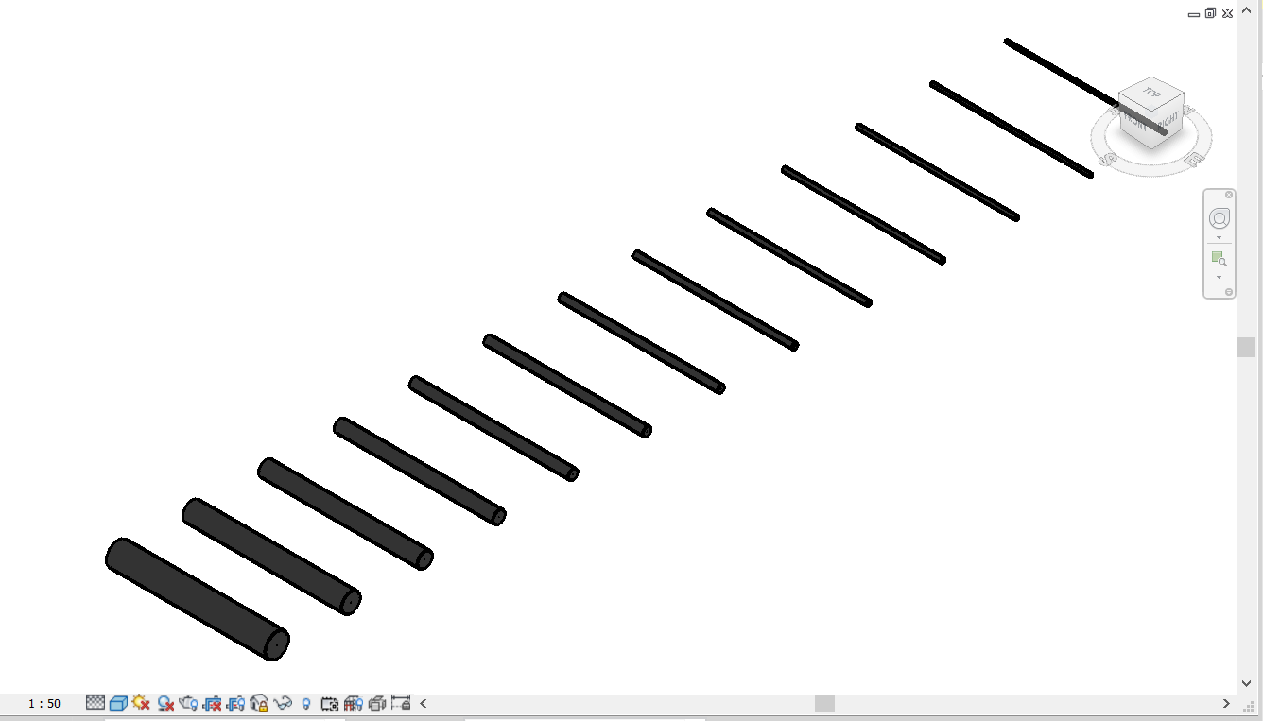
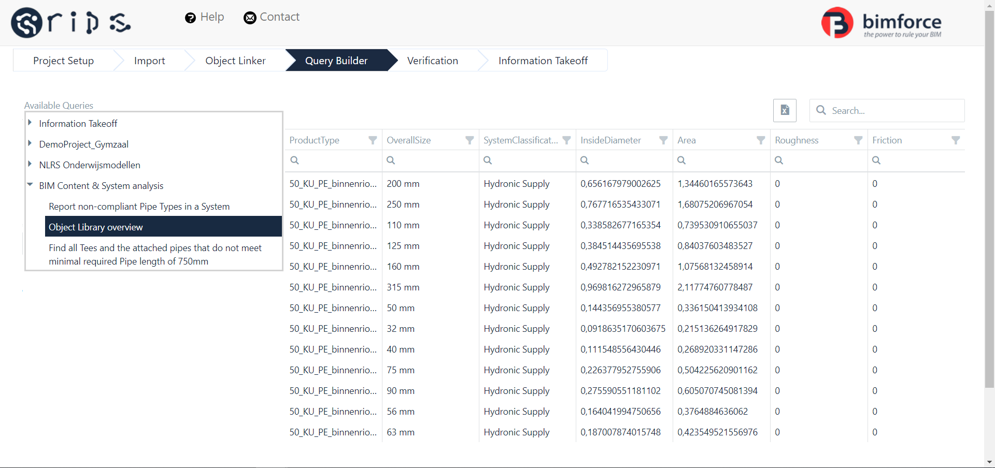
Verified Content

Slide 24
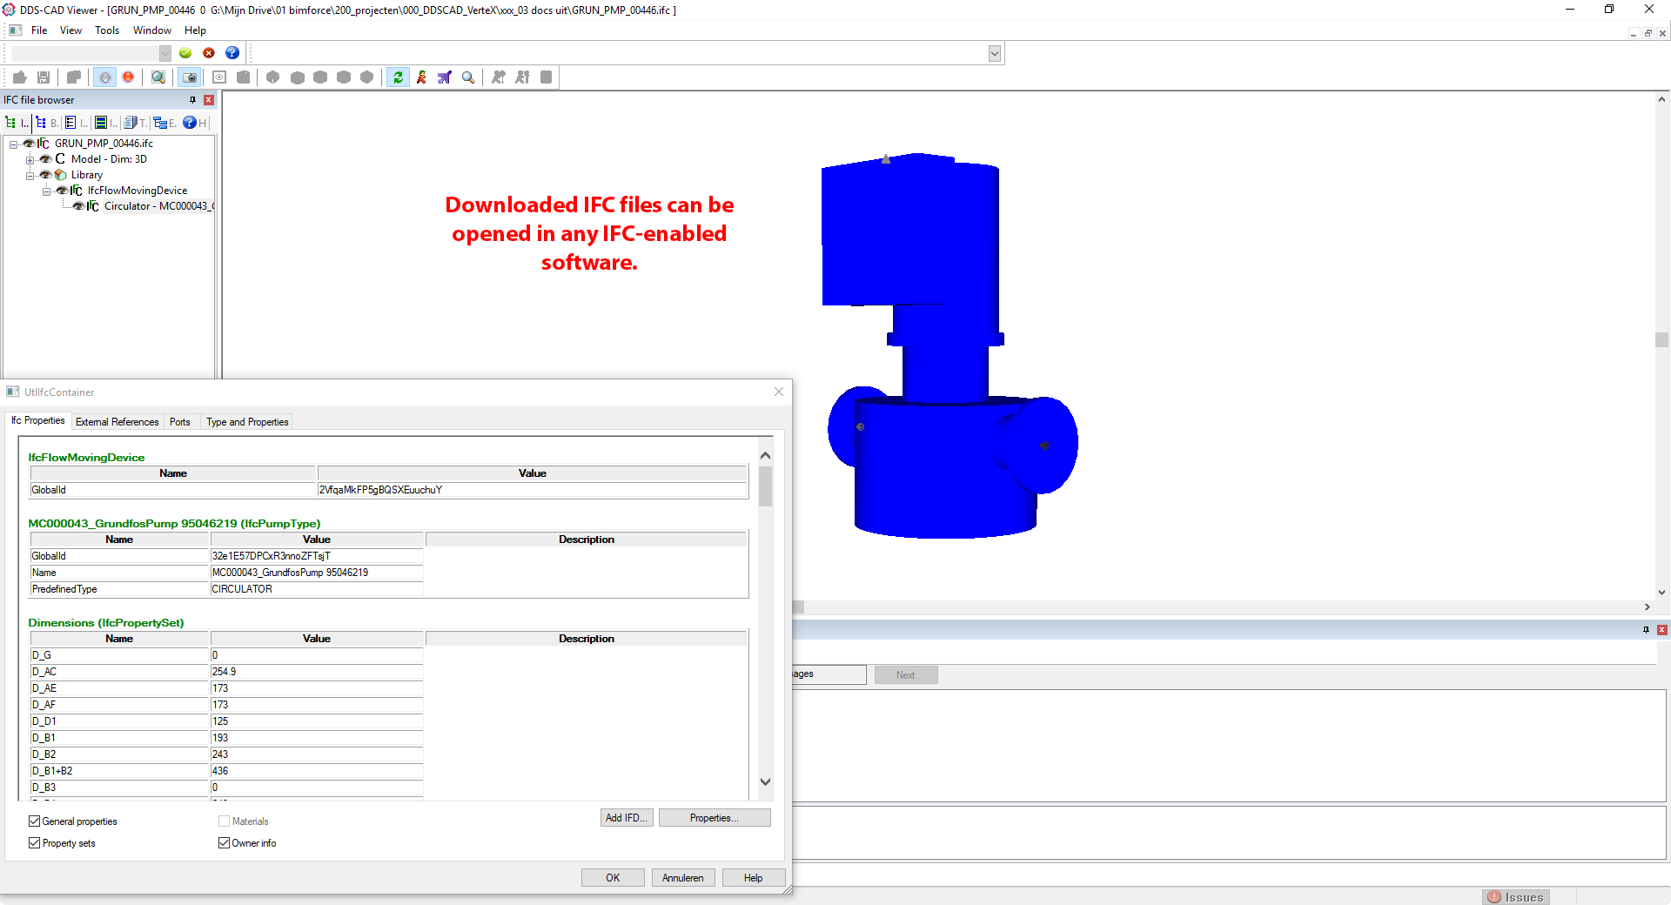
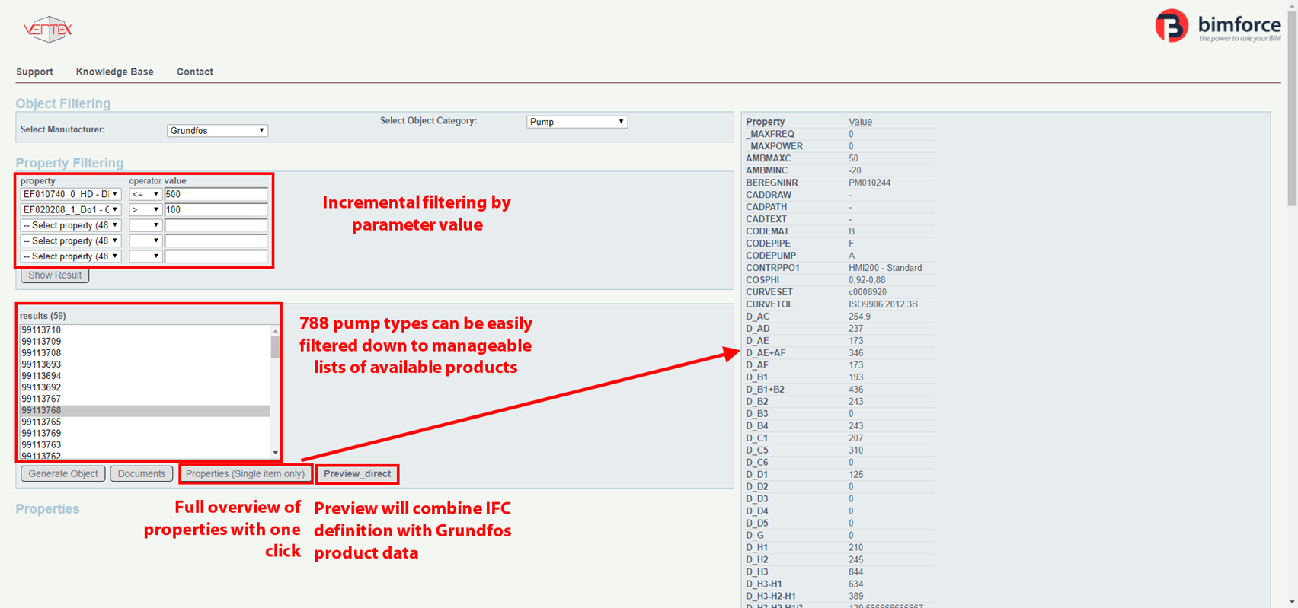
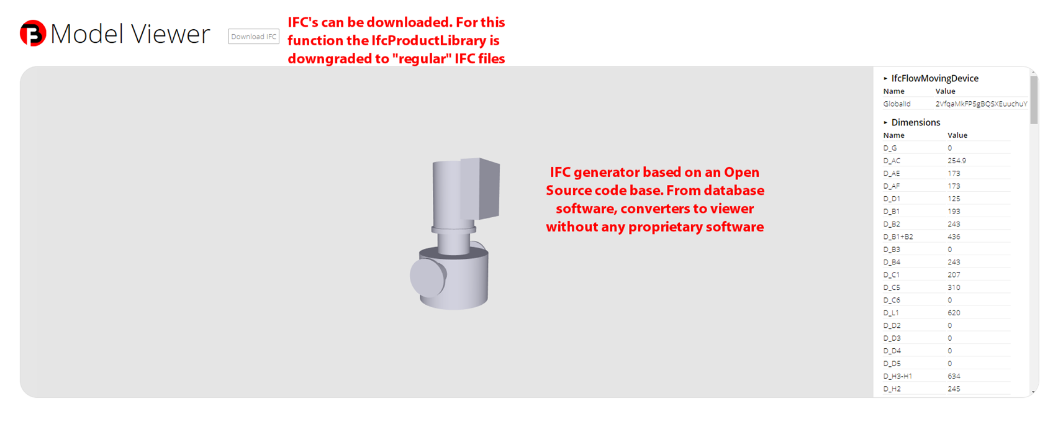
Verified Content

Slide 25
In conclusion
BIM can add value to all aspects of BIM:
  Marketing & Sales
  Project delivery & Manufacturing
BIM can implemented through an integrated approach allows the Manufacturer to increase the RoI by adding value to customer interaction and engineering processes
It also allows the Manufacturer to lower costs in maintaining the product library and making it available to customers

Slide 26
Questions?
W: www.bimforce.com
E: martijn@bimforce.com
T/L: @mdradvies / @bimforce

