Slide 1

Model Checking Tag Team
Owen Slootweg
Bimforce

Slide 2

Model Checking Tag Team
Revit vs Navisworks vs Solibri

Slide 3

Goal of this lecture
Introduce you to our three checkers
Learn the key differences between them
Learn to assess which checker is suitable for which
kind of task

Slide 4
About
3D modeling enthusiast, scripting, parametrics
Architect
Researcher
Teacher
BIM coordinator, BIM manager
Project leader
Software developer

Slide 5
Why Model Check?
Get ready for export to project partners or clients
Check if you modelled by company or external standards
Does the design pass legislation?
Did we make mistakes that can cost money?

Slide 6
What do we check?
Geometry
Data
Naming
Requirements

Slide 7
Geometry
Clashes and clearances
Duplicates checking
Presence/absence elements
Distances between elements

Slide 8
Data
Presence/absence of parameters
Values: empty or filled in?
Values correct?

Slide 9
Naming
Type-O’s: are spaces used when maybe forbidden, is text capitalized when everything needs to be de-capitalized, have forbidden symbols been used, and other general writing/textual issues..
Standards, like DRS and COBie, have fixed names or syntax that needs to be followed
Project standards: perhaps some specific parameters are required to be used by all modelling partners in the project
By doing naming checks you can identify objects that are supposed to be similar however are named somewhat differently. Take the example of a Revit Room being named: toilet, Toilet, WC, water closet, water-closet, or bathroom.

Slide 10
Requirements
Building Code/legislation
Design criteria
Standards and classifications

Slide 11
How do we check?
Filtering
Stacking filters
Combining rules/checks

Slide 12
Filtering
Element Category = Window
Element Assembly Code = 31
property
condition
value

Slide 13
Stacking options
And
Or/Include
Exclude
Ignore
Negate
operator

Slide 14
Stacking filters examples
Element Category = Window
AND
Element Assembly Code = 31
This means we are filtering for Elements of which both the Category is “Window” and the Assembly Code is “31”.
Element Category = Window
OR
Element Assembly Code = 31
This means we are filtering for Elements of which the Category is “Window” regardless of what their Assembly Code is, and Elements of which the Assembly Code is “31” regardless of what their Category is. Results will consequently also contain those elements of which both the Category is “Window” and the Assembly Code is “31”.

Slide 15
Combine rules
Element Category = Window
AND
Element Assembly Code = 31
AND
Element Width <= 500
Element Category = Window
AND
Element Assembly Code = 31
AND
Element Height <= 1200

Slide 16


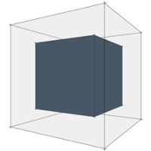
introductions
Project set up
Templates
Making your own rules
Managing and reporting check results
Examples

Slide 17

Revit Model Checker
Plug-in for Revit
+
RMC Configurator
introductions
Free download:
https://www.biminteroperabilitytools.com/modelchecker.php
https://www.biminteroperabilitytools.com/modelcheckerconfigurator.php

Slide 18
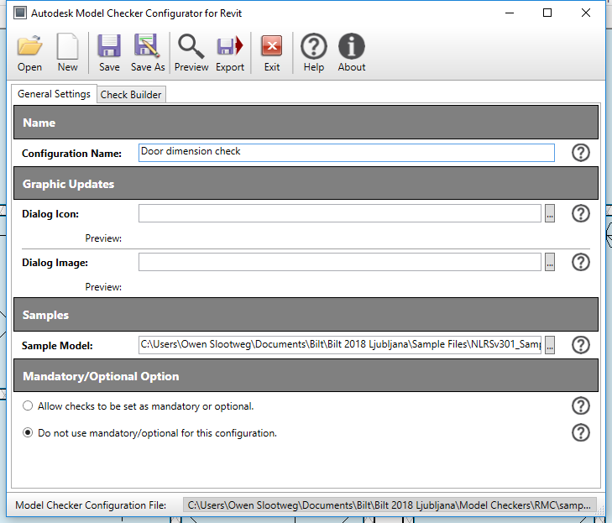
Revit Model Checker
RMC Configurator
Create your own checks
Runs separate from Revit
introductions

Slide 19
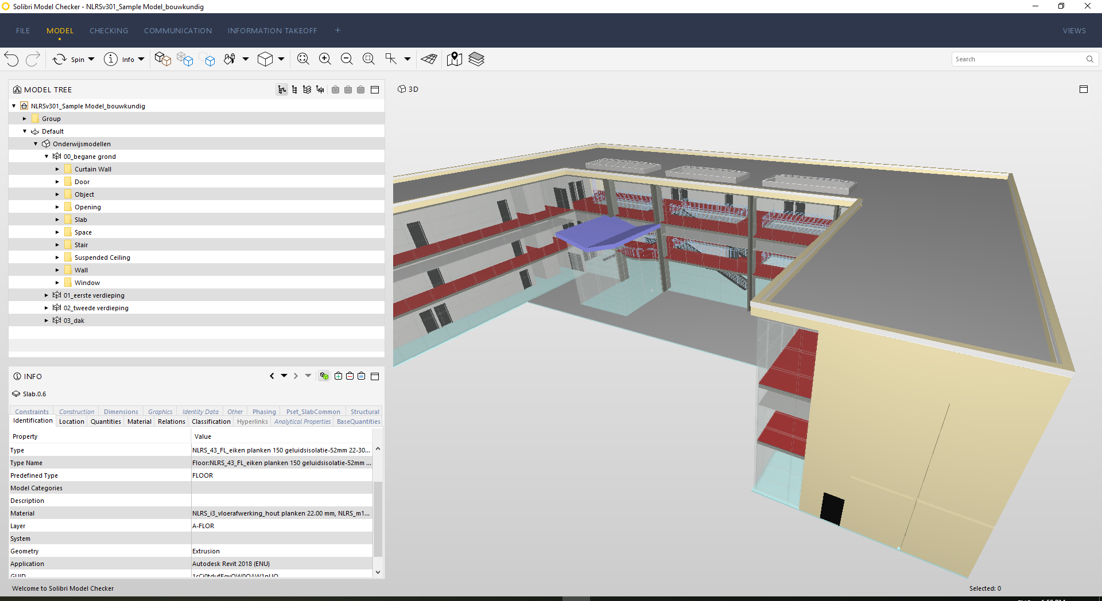
Solibri Model Checker
SMC Model menu
Model Tree hierarchies:
Containment
Component
Layer
introductions

Slide 20
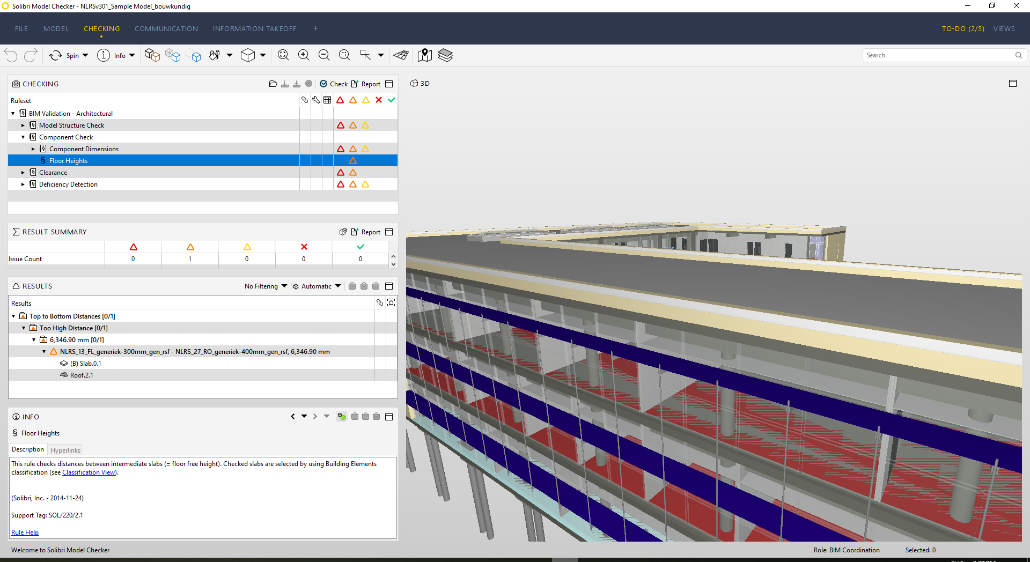
Solibri Model Checker
SMC Checking menu
Check rules
Check results
introductions

Slide 21
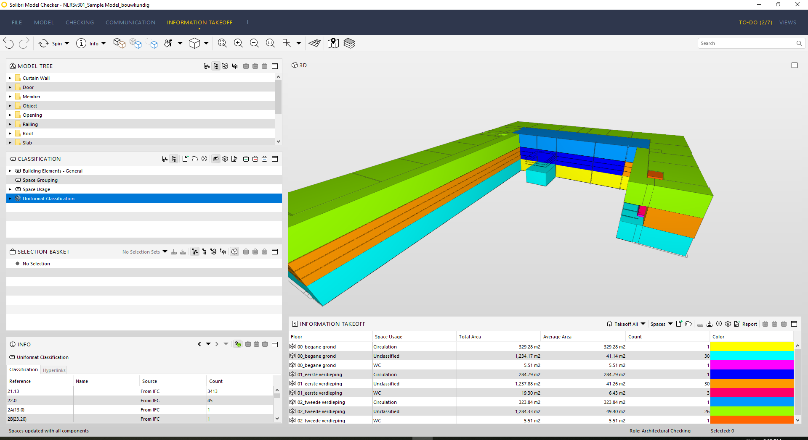
Solibri Model Checker
SMC Information
Takeoff menu
Classifications
introductions

Slide 22
Navisworks Manage
Model Review
Animations (walkthroughs)
Planning
Simulation
Quantity Take-offs
Cost calculations
Clash detection
introductions

Slide 23
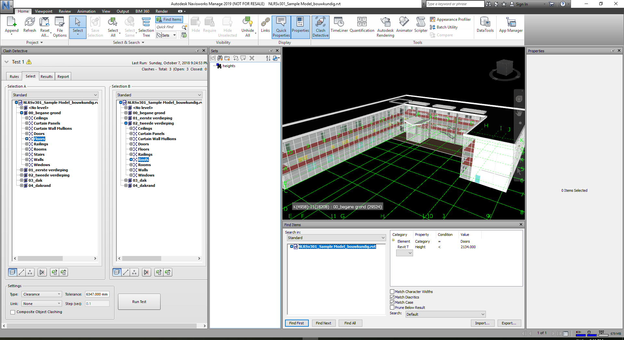
Navisworks Manage
NWM customizable
Interface with:
Clash Detective
Search & Selection Sets
Model View
Find Items menu
Properties
introductions

Slide 24
introductions
Project set up
Templates
Making your own rules
Managing and reporting check results
Examples

Slide 25




Project set up
Revit native, some IFC,
DWG
IFC, IFCzip,
DWG
IFC, RVT (as DWF, no data loss), 3DS, FBX, STEP, STL and many more

Slide 26
Revit Model Checker
Configure
Run
Done

Slide 27
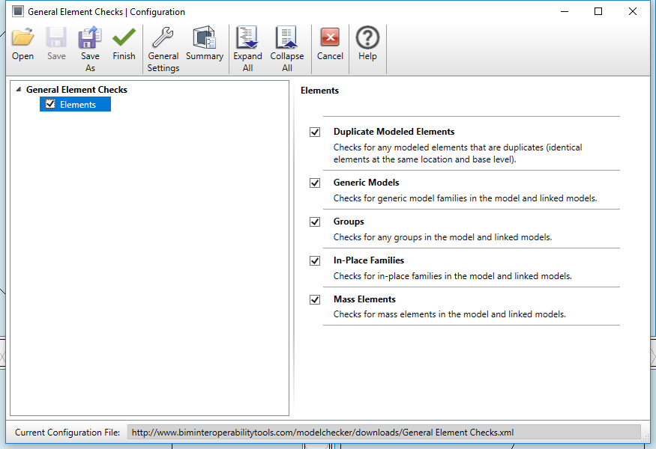
Revit Model Checker
RMC Configure menu
Open templates or your own
rules
Select individual checks
Project set up

Slide 28
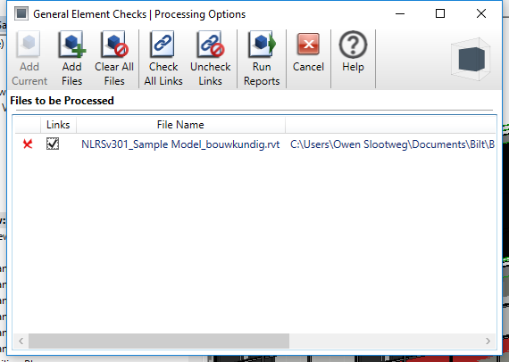
Revit Model Checker
RMC Run menu
Add external files
Select links
Project set up

Slide 29
Revit Model Checker
IFC: import with awareness
Room > IfcSpace > Generic Model
Project set up

Slide 30
Revit Model Checker
Open and aggregate models
Assign a discipline to each model
Choose a Role
Add Classifications
Open Rulesets
Run Checks

Slide 31
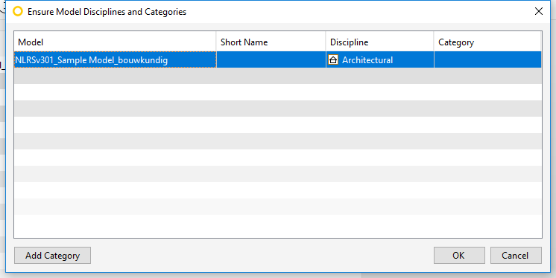
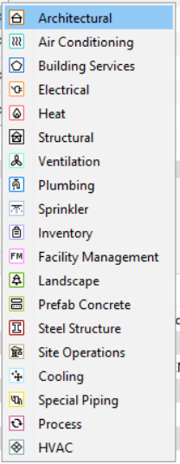
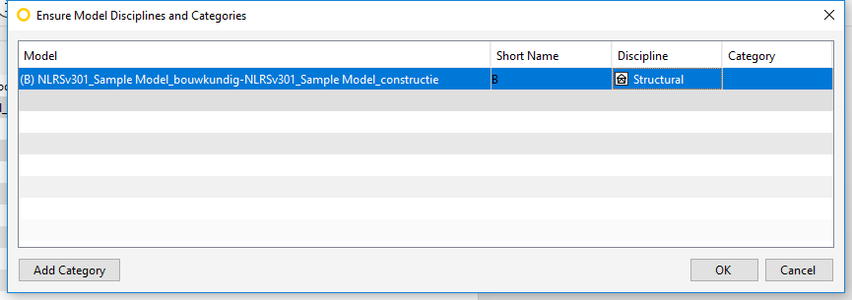
Solibri Model Checker
Assign a discipline to each model
Project set up

Slide 32
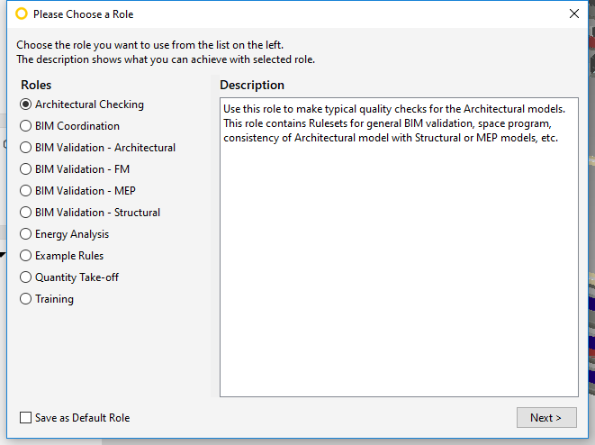
Solibri Model Checker
Choose a Role
Project set up

Slide 33
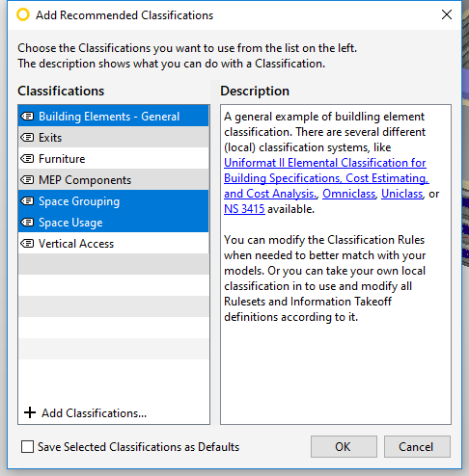
Solibri Model Checker
Add Classifications
Project set up

Slide 34
Solibri Model Checker
Open Rulesets and run your checks
Project set up

Slide 35
Revit Model Checker
Import and aggregate models
Check out the property sets with their properties
Find Items based on rules
Save you search and selection sets
If needed: Clash

Slide 36
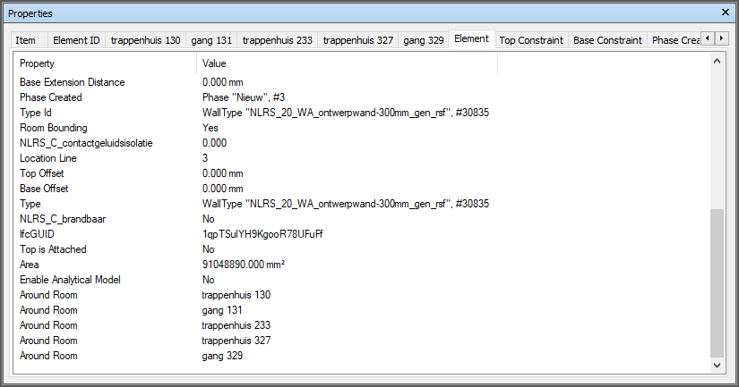
Navisworks Manage
Properties menu:
Find the properties
that you need in order to create your filters
Different for each imported file format!
Project set up
Example properties of an imported Revit file

Slide 37
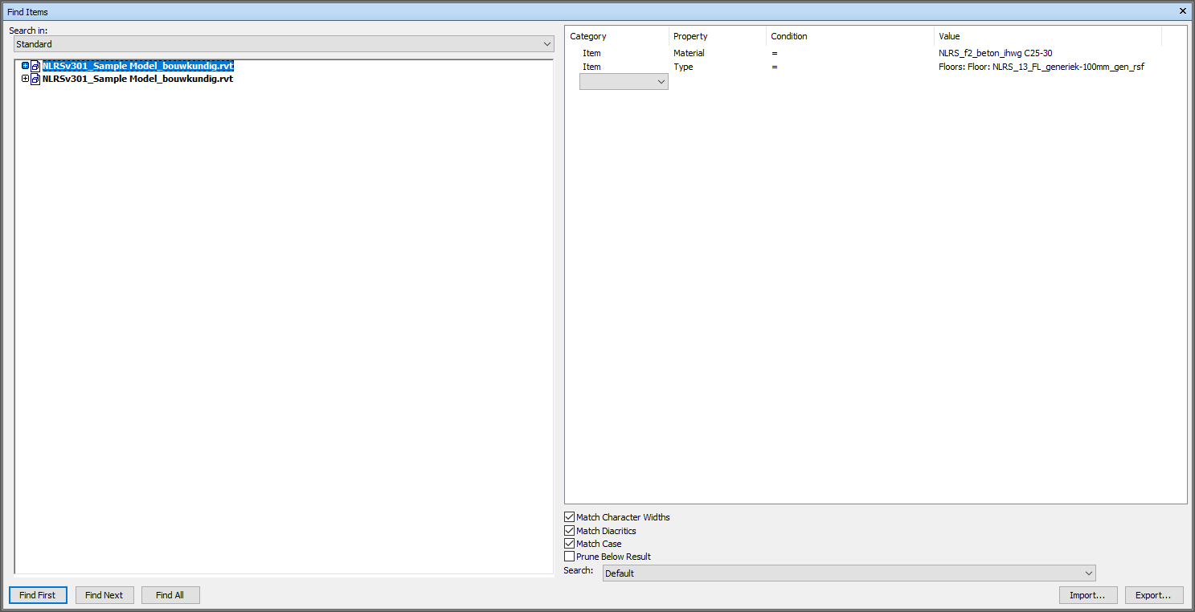
Navisworks Manage
Find Items menu:
Create search sets
based on your own rules, no templates available!
Project set up

Slide 38
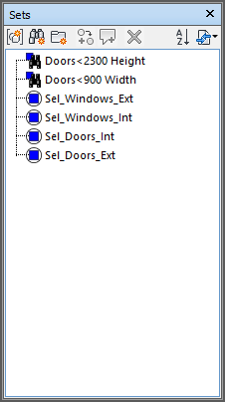


Navisworks Manage
Sets menu:
Selection Sets
Search Sets
Project set up

Slide 39
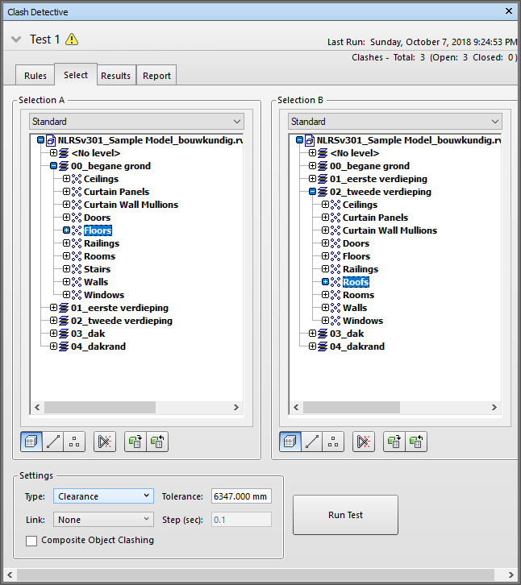
Navisworks Manage
Clash Detective menu
Clash new selections or clash your saved search sets
Create and save different clash tests
Project set up

Slide 40
introductions
Project set up
Templates
Making your own rules
Managing and reporting check results
Examples

Slide 41
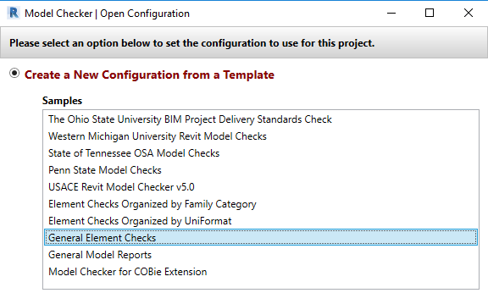
Revit Model Checker
University templates
USACE
Elements checks
Model Reporting
COBie
templates

Slide 42
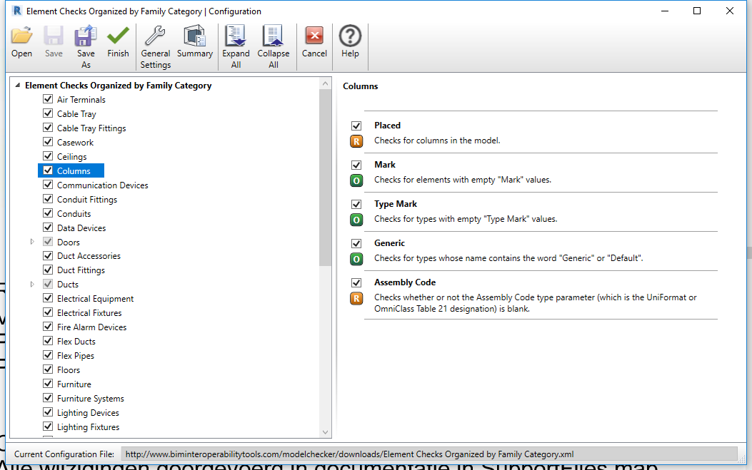
Revit Model Checker
templates

Slide 43
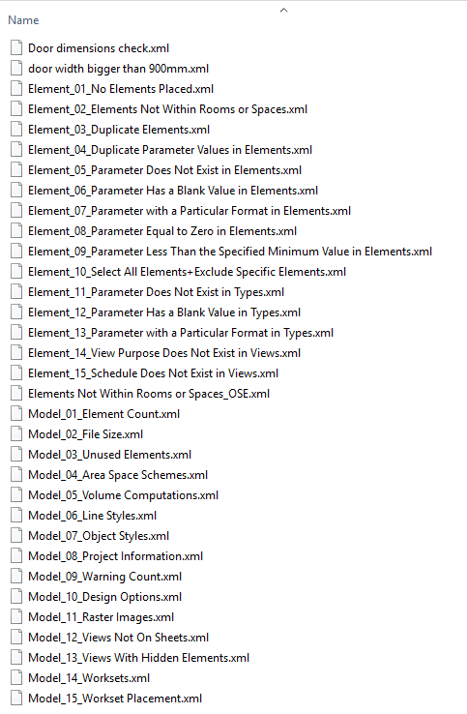
Revit Model Checker
Sample rules
templates

Slide 44
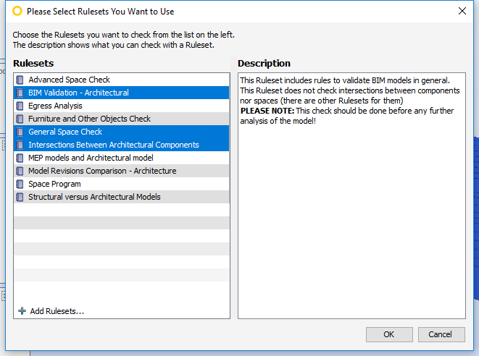
Solibri Model Checker
Templates based on
Role decision
Add custom Rulesets
(.cset)
templates

Slide 45
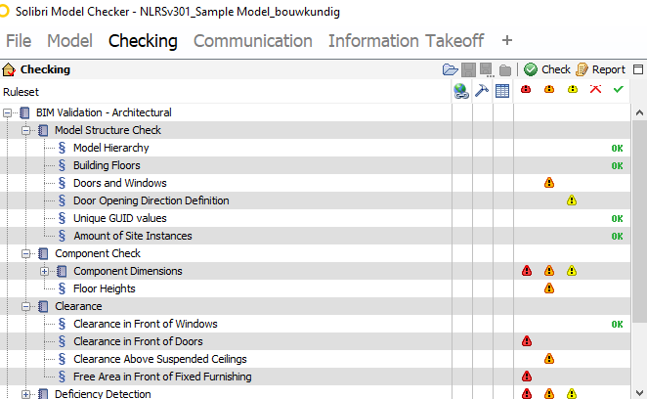
Solibri Model Checker
templates

Slide 46
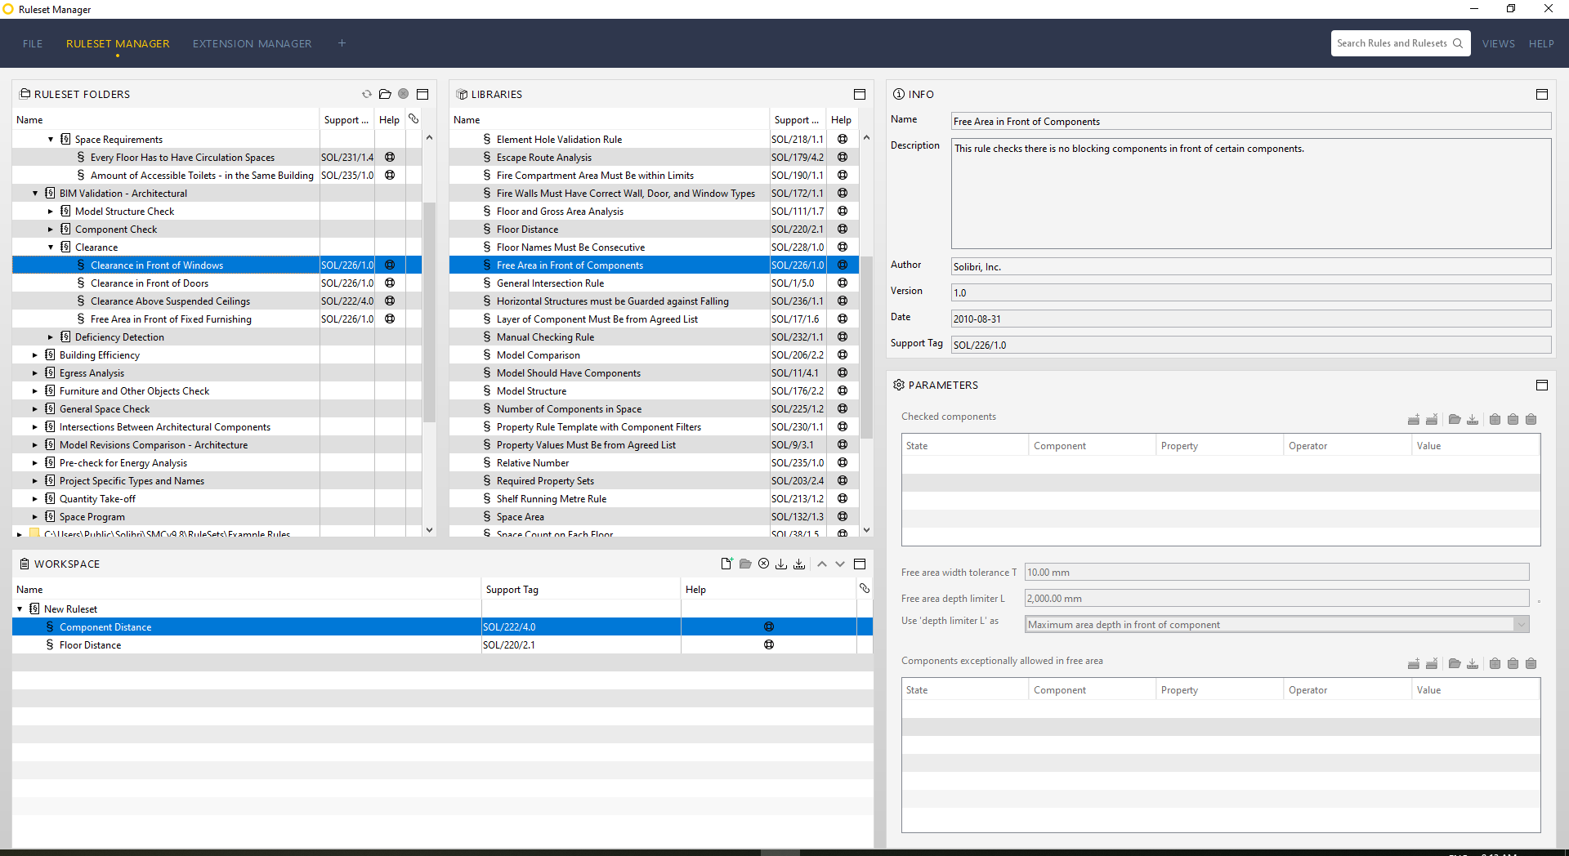
Solibri Model Checker
templates

Slide 47

Navisworks Manage
templates

Slide 48
introductions
Project set up
Templates
Making your own rules
Managing and reporting check results
Examples

Slide 49
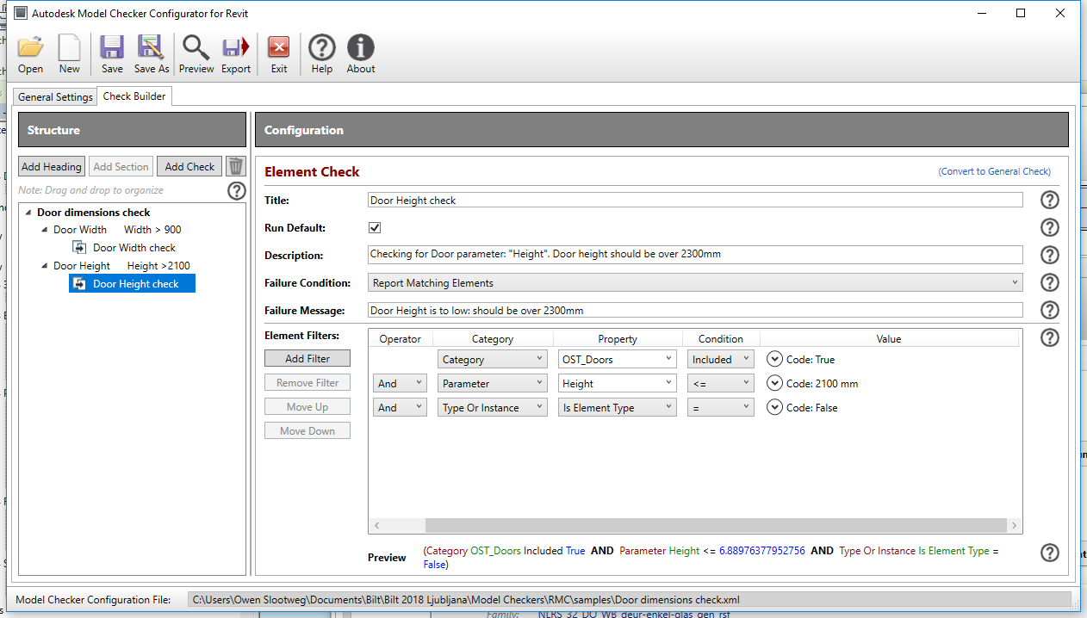
Revit Model Checker
RMC
Configurator
Check Builder
Making your own rules

Slide 50
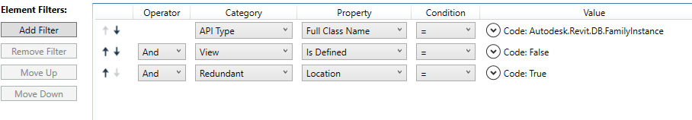
Revit Model Checker
RMC Configurator doubles check
Making your own rules

Slide 51
Revit Model Checker
Making your own rules

Slide 52
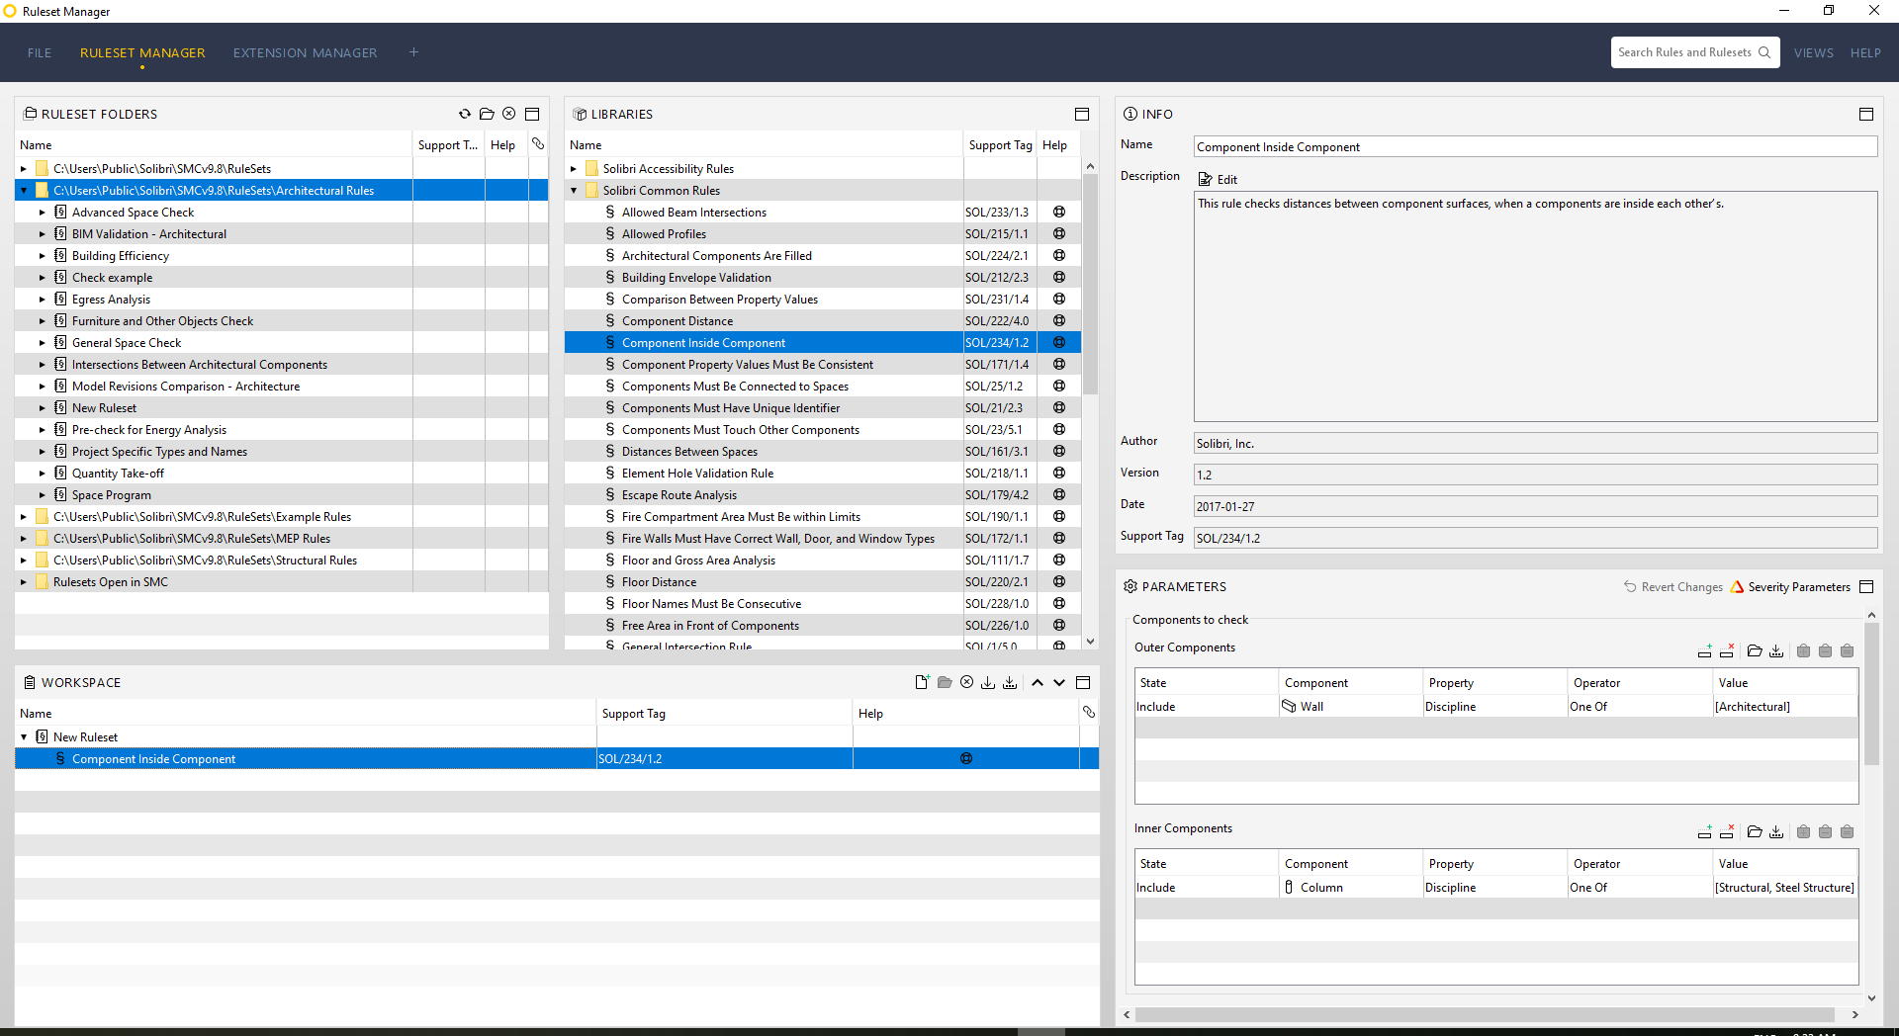
Solibri Model Checker
Ruleset Manager
Making your own rules

Slide 53
Ruleset Manager
Making your own rules

Slide 54
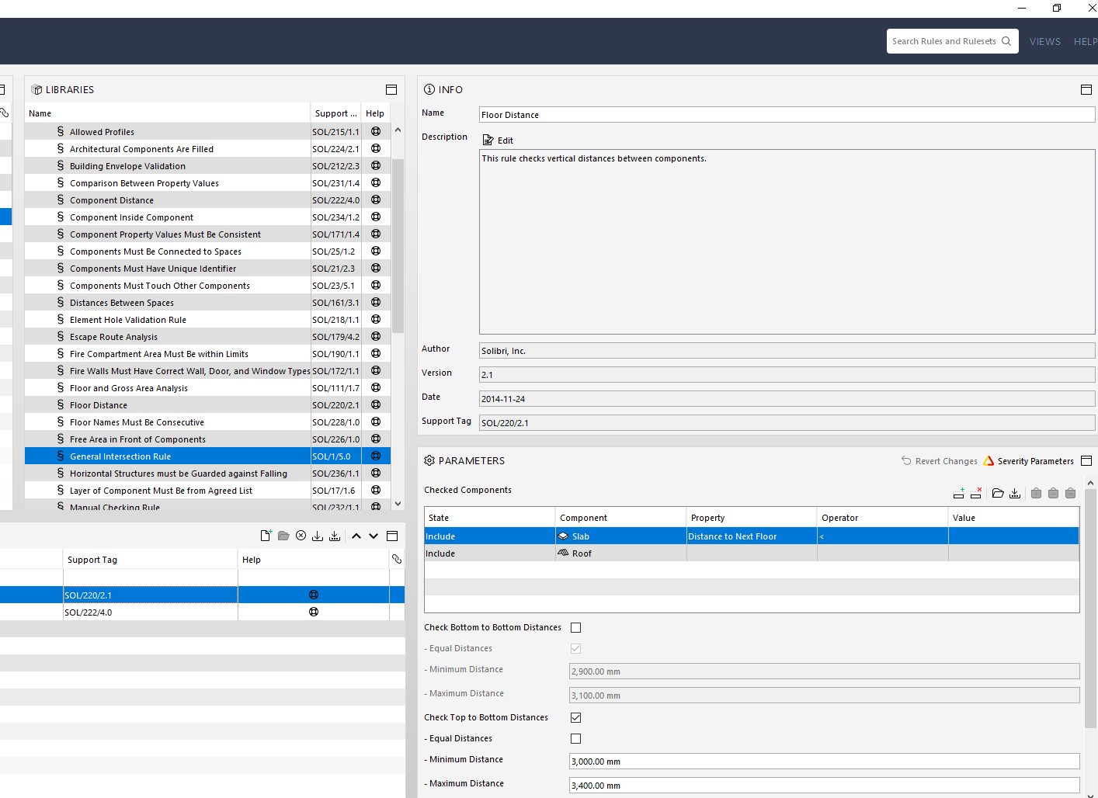
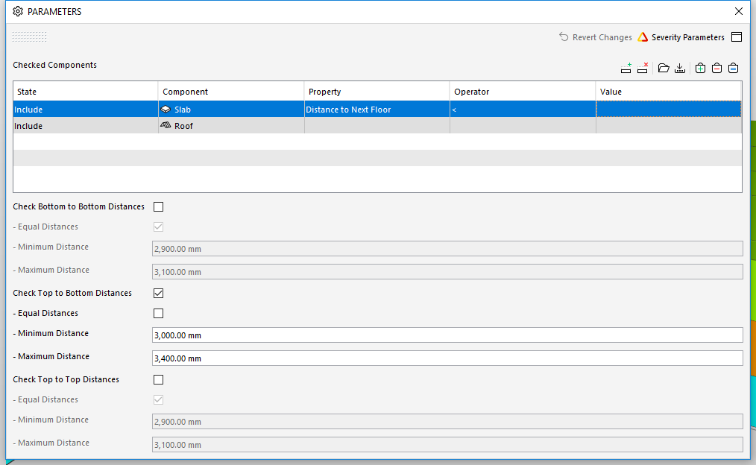
Solibri Model Checker
Ruleset Manager
Making your own rules
Checking Environment>
RMB on the rule>
Rule Parameters

Slide 55
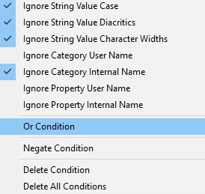
Navisworks Manage
Find Items menu
RMB>Or/Negate
Making your own rules

Slide 56
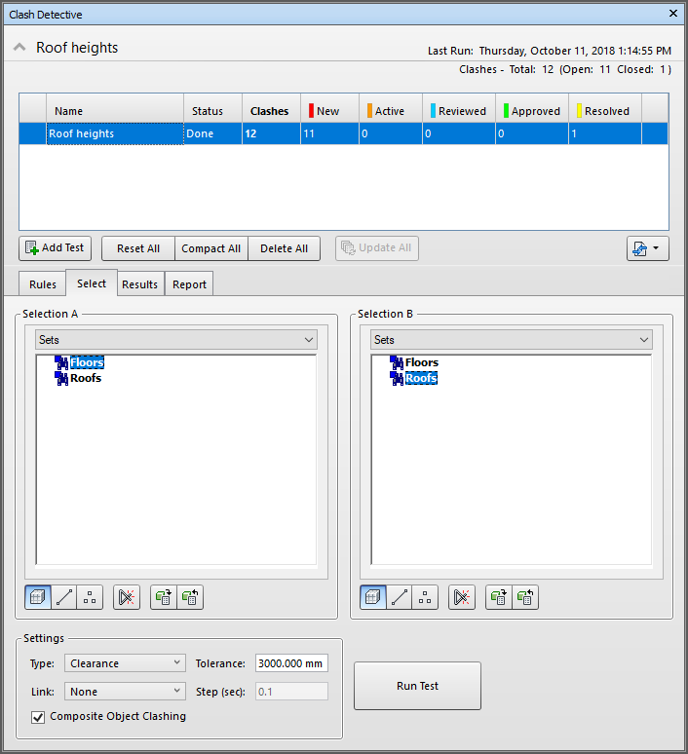
Navisworks Manage
Clash Detective
Select your Found Items via saved Search Sets
Making your own rules

Slide 57
introductions
Project set up
Templates
Making your own rules
Managing and reporting check results
Examples

Slide 58
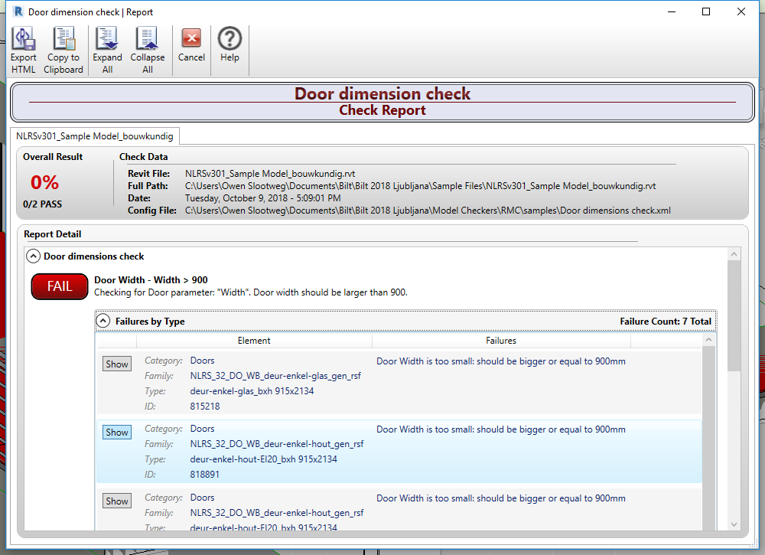
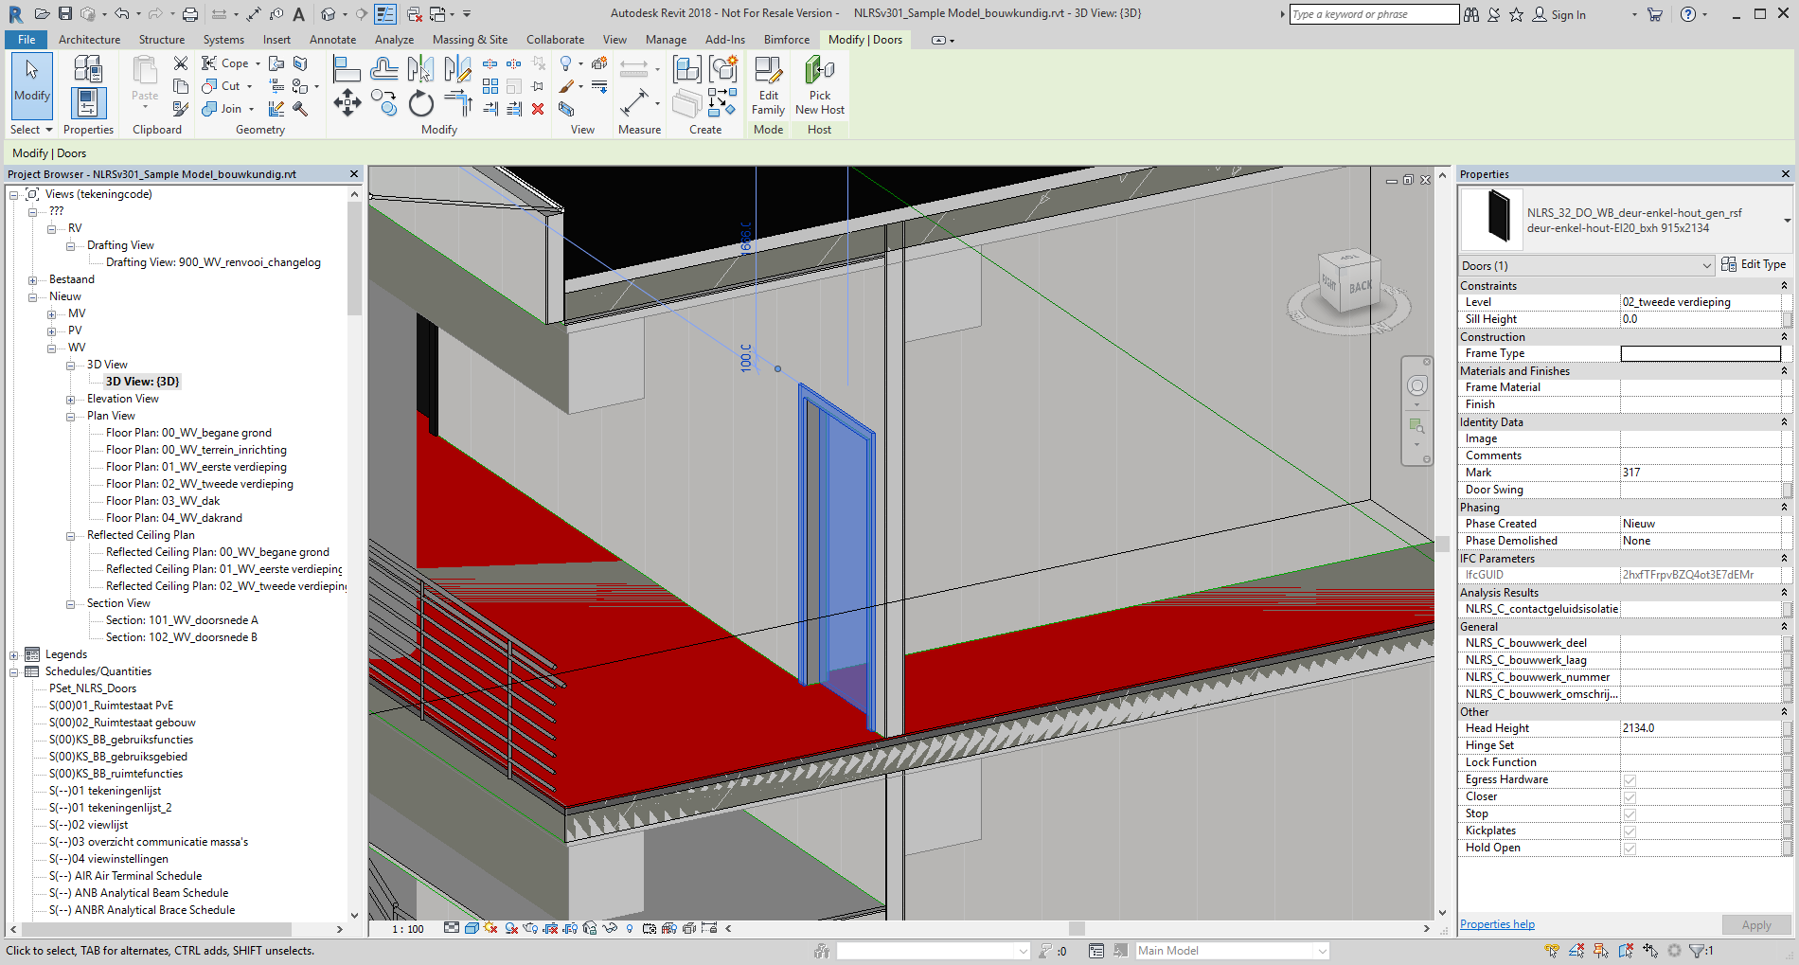
Managing and reporting check results

Slide 59
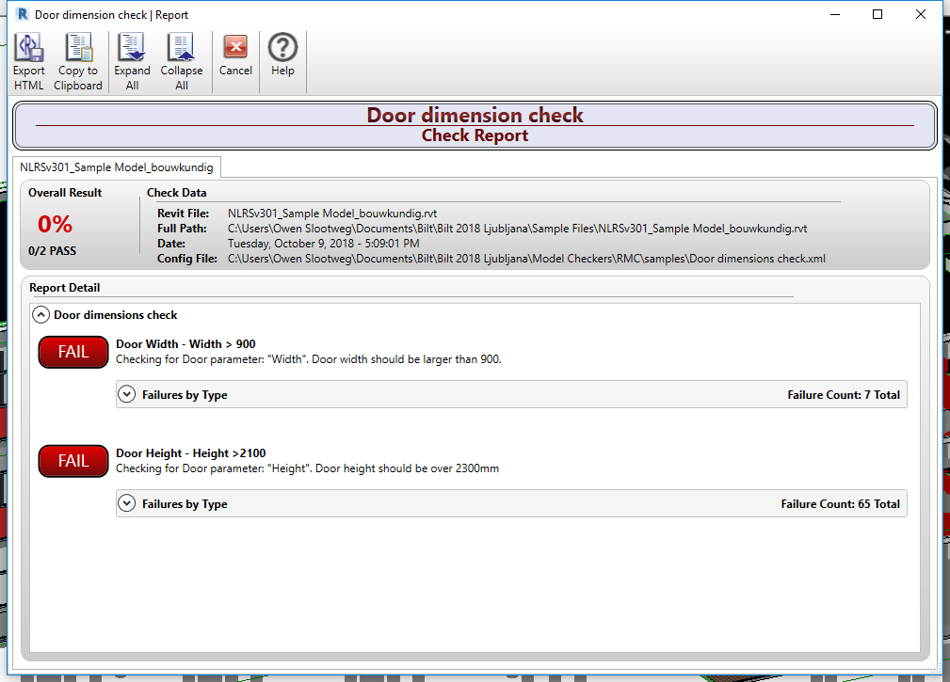
Revit Model Checker
Exports to:
HTML
XLS
Failure notification per check
Managing and reporting check results

Slide 60
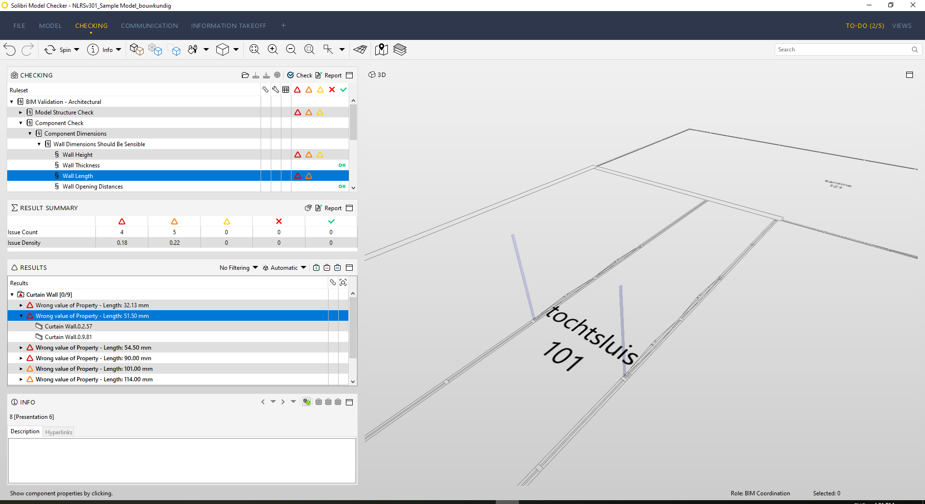
Solibri Model Checker
Exports to:
XLS
PDF
RTF
BCF
Failure notification per check, including severity warning
Show results button per involved element
Managing and reporting check results

Slide 61
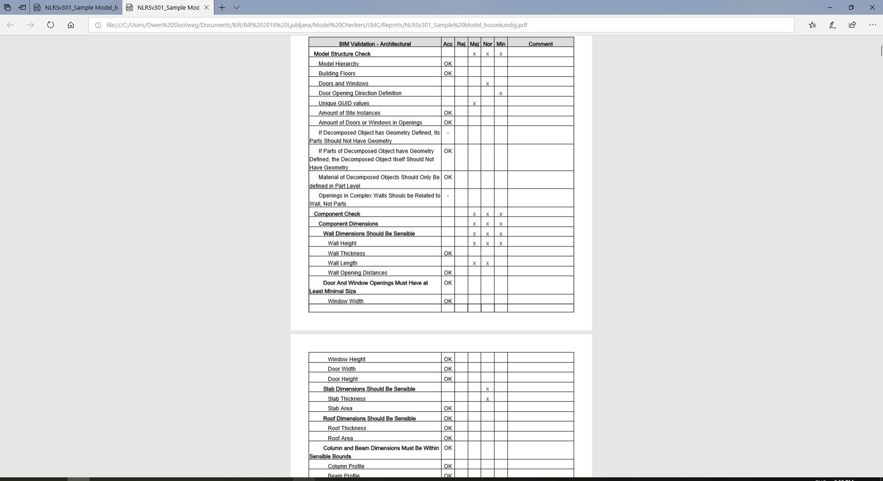
Managing and reporting check results

Slide 62
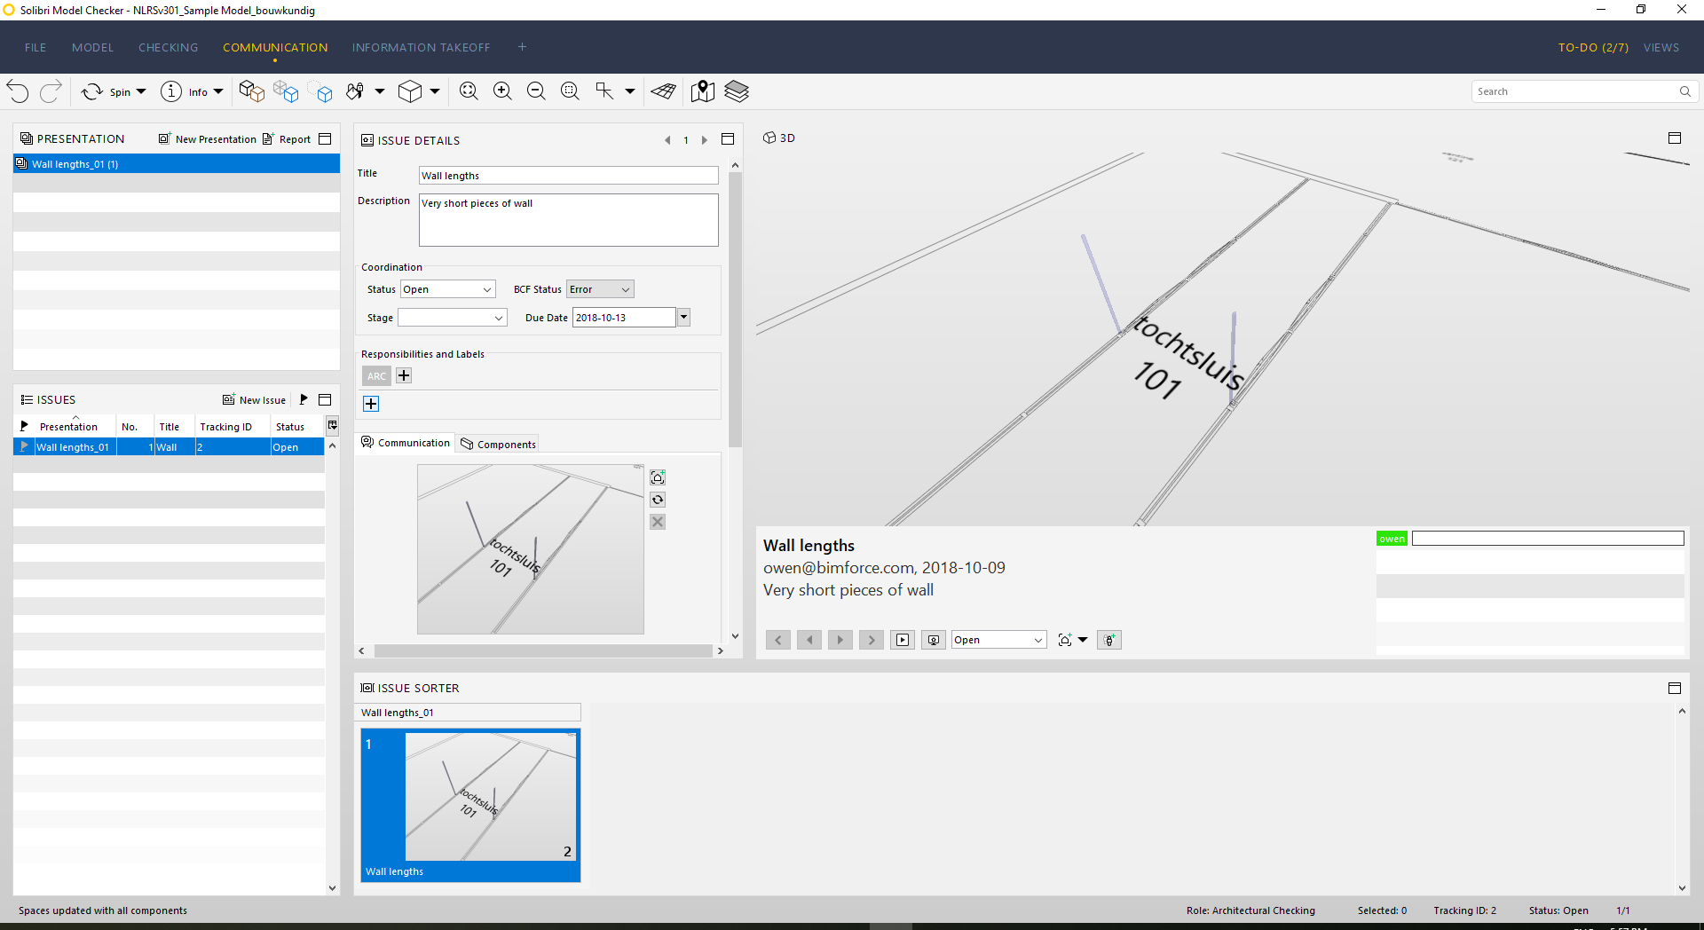
Solibri Model Checker
Creating a BCF report
Managing and reporting check results

Slide 63


Navisworks Manage
Selection Inspector
Clash Detective
(Quantity TakeOff)
Managing and reporting check results

Slide 64
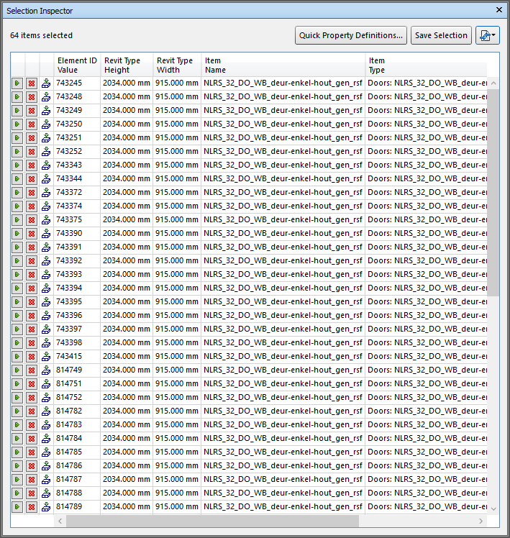
Navisworks Manage
Selection Inspector
Exports to:
CSV
Show results button per element
No failure notification: name your search sets right!
Managing and reporting check results

Slide 65
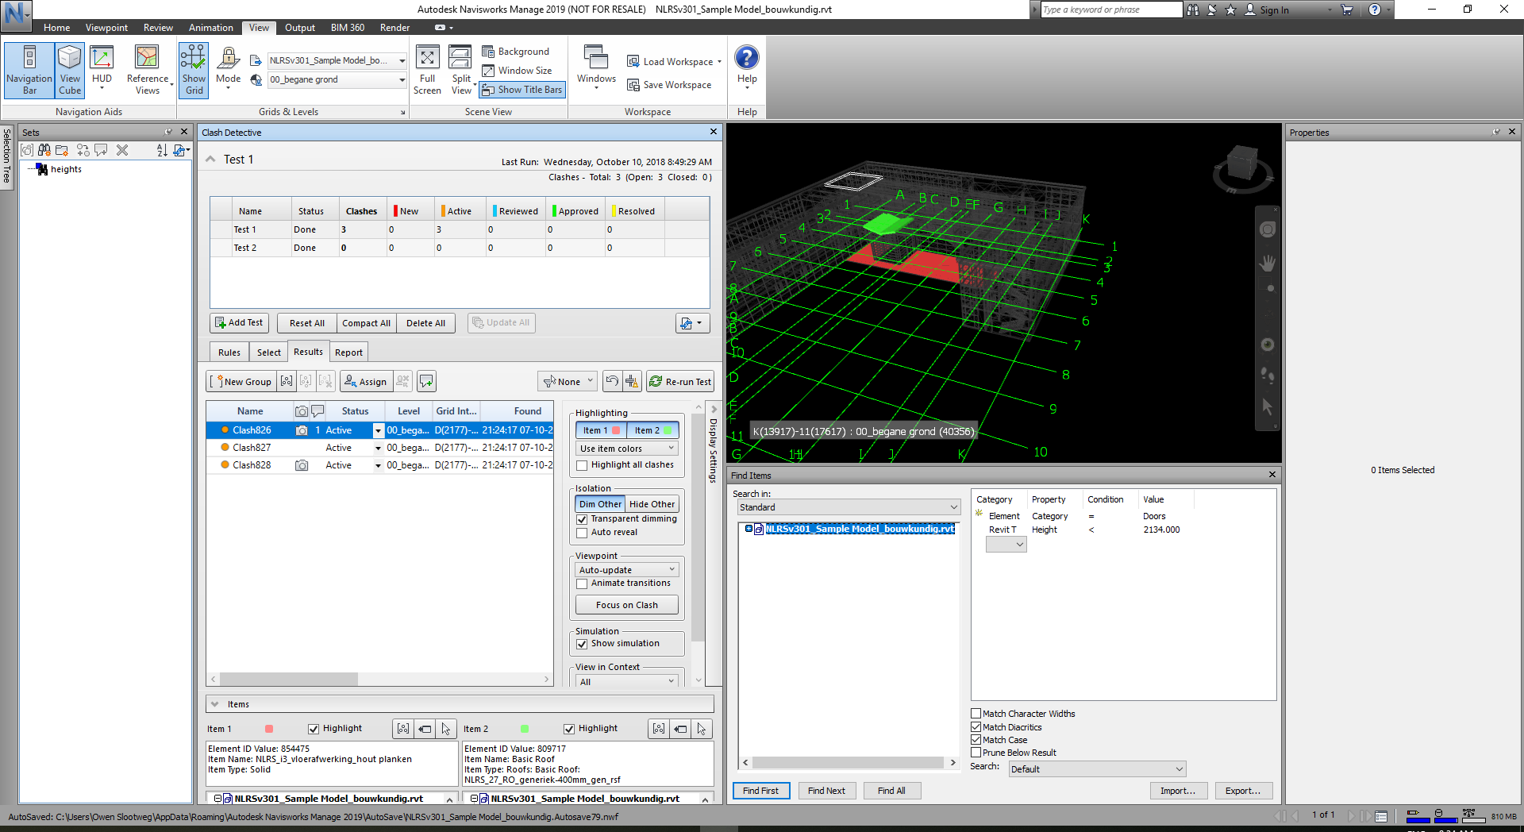
Navisworks Manage
Clash Detective
Exports to:
HTML
XML
Text
Show results button per involved element
No failure notification: name your tests right!
Managing and reporting check results

Slide 66
introductions
Project set up
Templates
Making your own rules
Managing and reporting check results
Examples

Slide 67
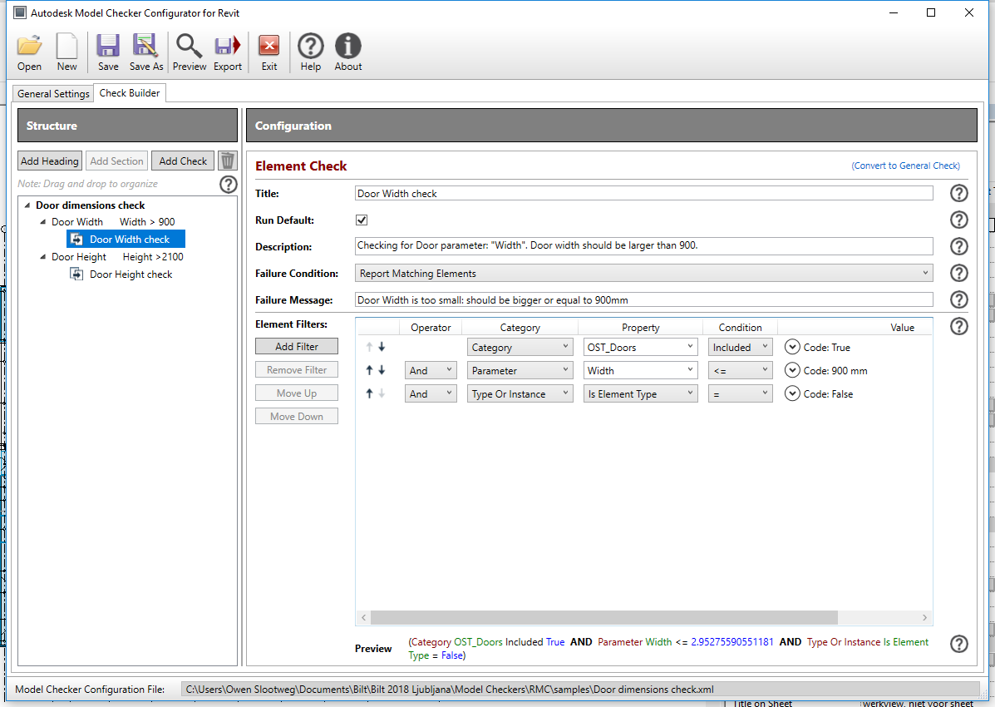
Revit Model Checker
Door dimensions check
OST_Doors?
Type/Instance
Constraints?
Examples

Slide 68
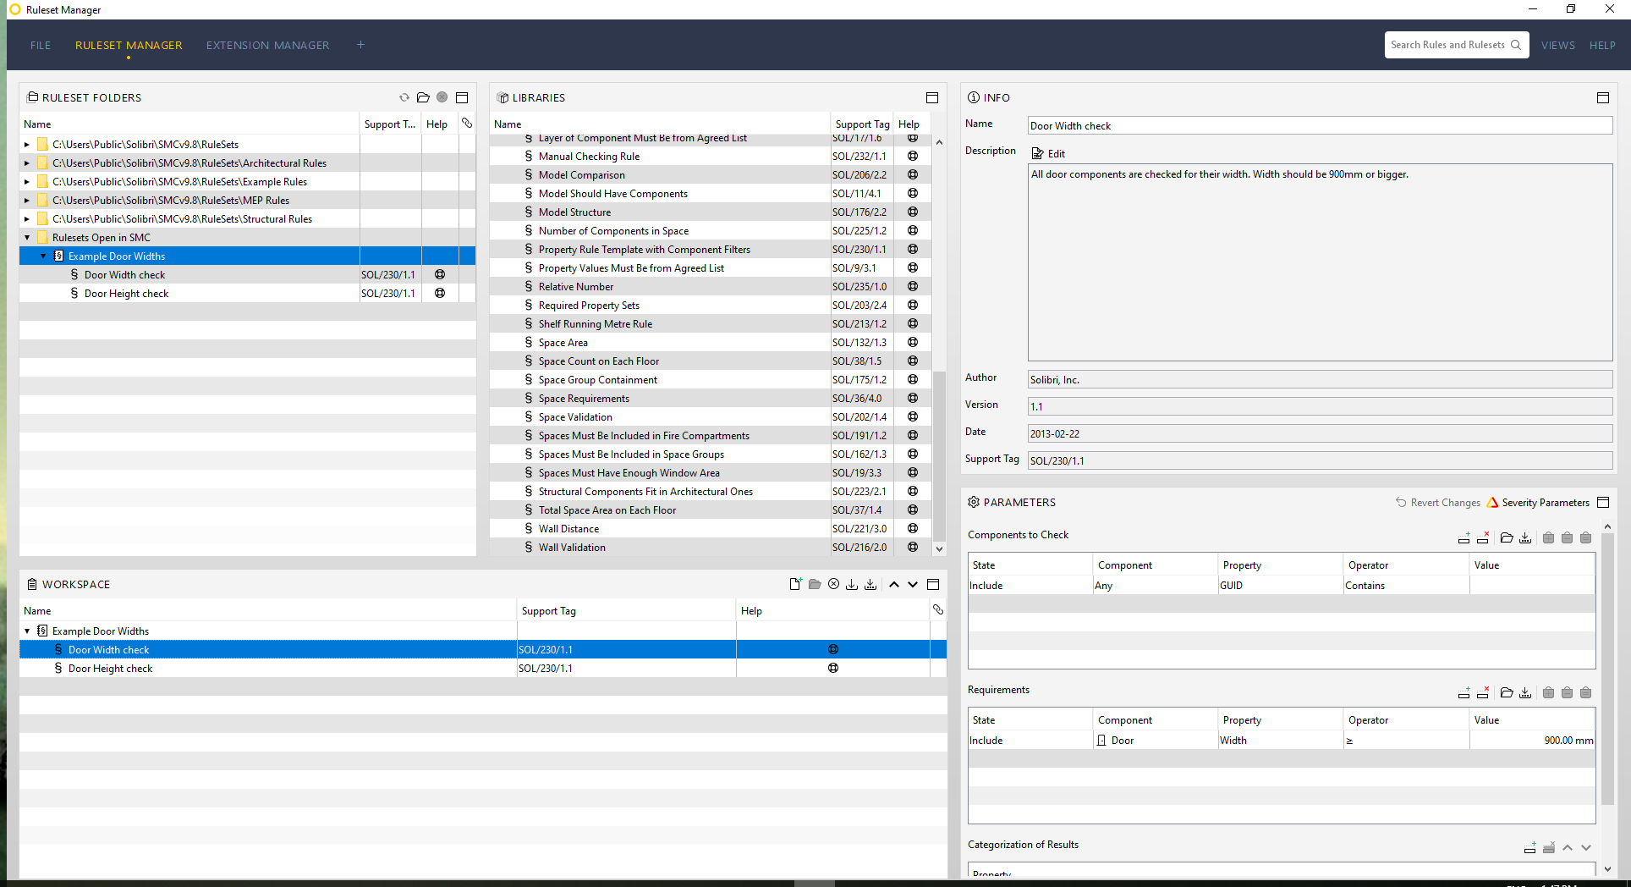
Solibri Model Checker
Door dimensions check
“Property Rule Template with Component Filters”
No Type/Instance
Operator switches from < to >
Examples

Slide 69
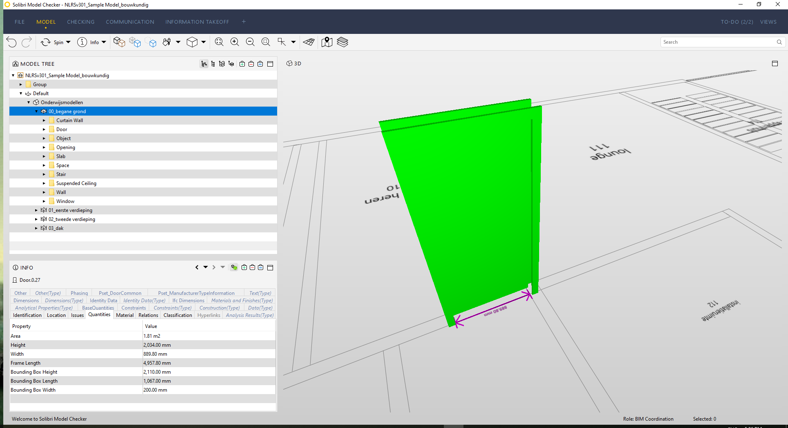
Solibri Model Checker
Door dimensions check
Examples
Solibri smart door check: takes into account the (wrongful)
placement of the door inside the adjacent wall

Slide 70
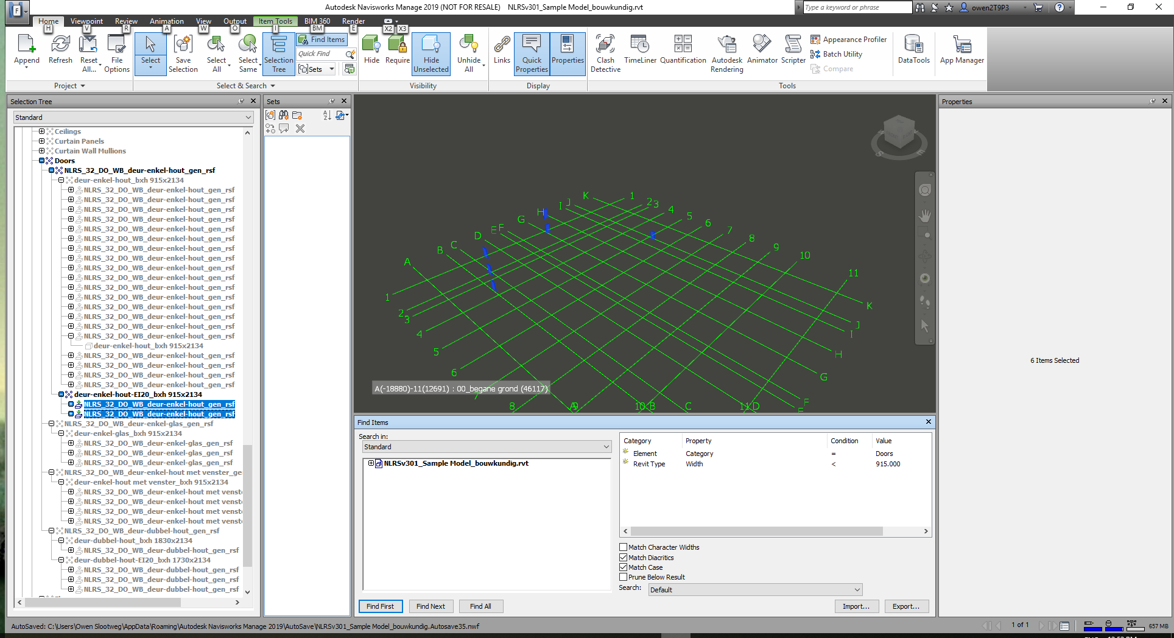
Navisworks Manage
Door dimensions check
Check property sets to find the Width property under “Revit Type”
Condition (operator) set to <
Save to search set and repeat for Height
Examples

Slide 71

Revit Model Checker
Sloped roof height check
Not possible in RMC
Examples

Slide 72
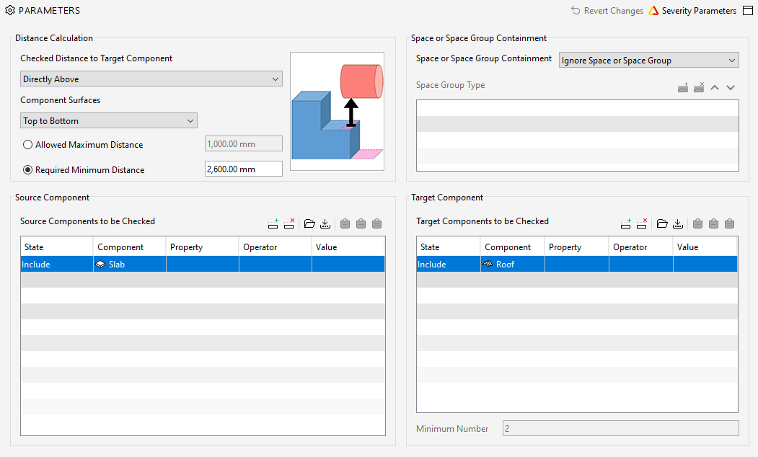
Solibri Model Checker
Sloped roof height check
Component distance rule
Examples

Slide 73
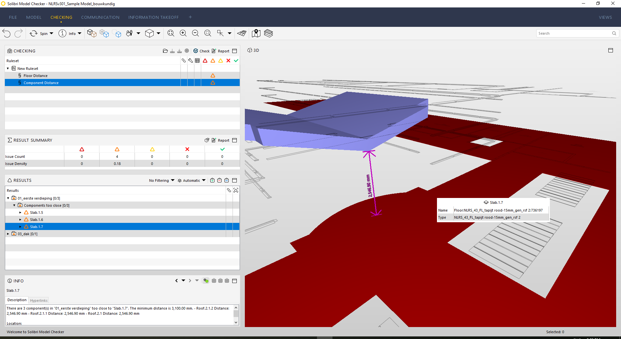
Solibri Model Checker
Sloped roof height check
Another option for this check is the Floor distance rule
Examples

Slide 74
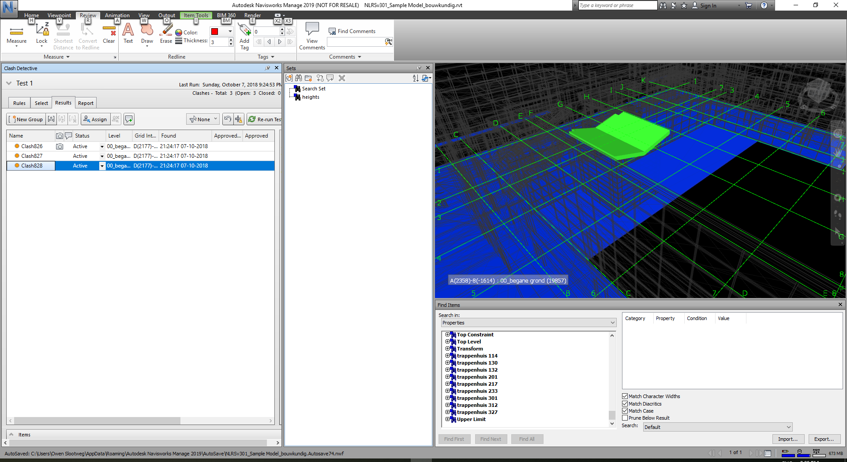
Navisworks Manage
Sloped roof height check
Clash set A: Floors
Slash set B: Roofs
Clash for clearances and set your preferred height
>results
Specify further
Examples

Slide 75
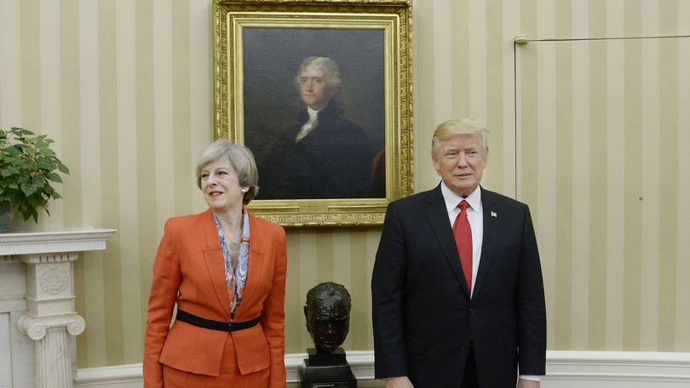

?
find the
secret door
https://bimforce.com/bedrijf/publicaties/
Image: Rex Features

Slide 76
REMINDER:
Speaker Feedback is appreciated
Fill in the Survey on the Mobile App
..and don’t forget to check out my handout

Slide 77
2.3 Model Checking Tag Team:
Revit vs Navisworks vs Solibri
Owen Slootweg
Bimforce
owen@bimforce.com

