Slide 1


MOVIETWEET
Enterprise Web Development Assignment

Slide 2
Agenda
Introduction
Architecture and Software Used
Main New Features
Issues Encountered
Implementation Overview
Demo
Q & A
MOVIETWEET
Enterprise Web Development Assignment
9th January 2013

Slide 3
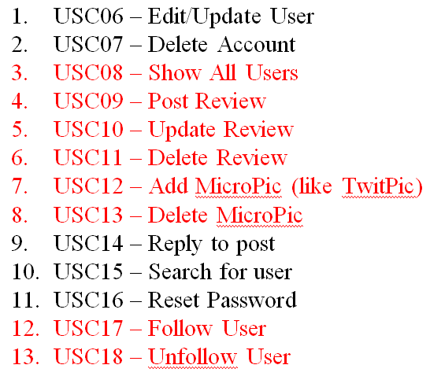
Introduction
Updates to proposal
  CSS used
  Features updated
    USC06 - Edit/Update User -> Lets Rate
    USC07 - Delete Account -> Movie Pics
    USC14 / 15 / 16
      Access to content when not signed in
      Styling
MOVIETWEET
Enterprise Web Development Assignment
9th January 2013

Slide 4
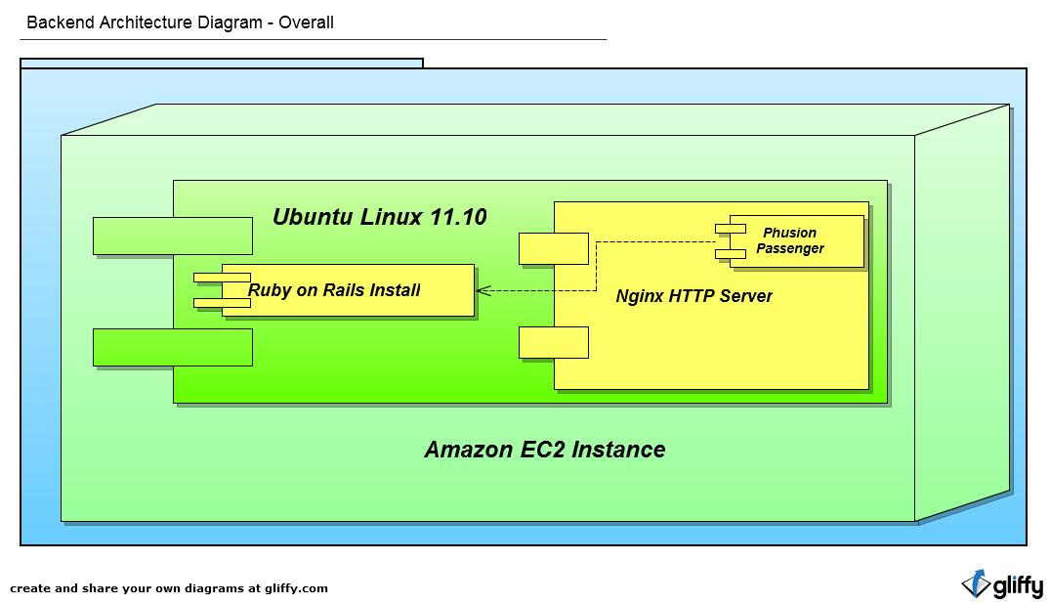
Architecture and Software Used
MOVIETWEET
Enterprise Web Development Assignment
9th January 2013

Slide 5
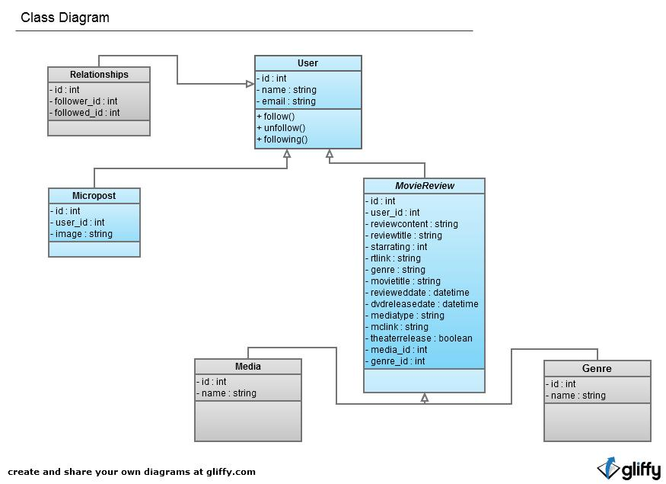
Architecture and Software Used
MOVIETWEET
Enterprise Web Development Assignment
9th January 2013

Slide 6
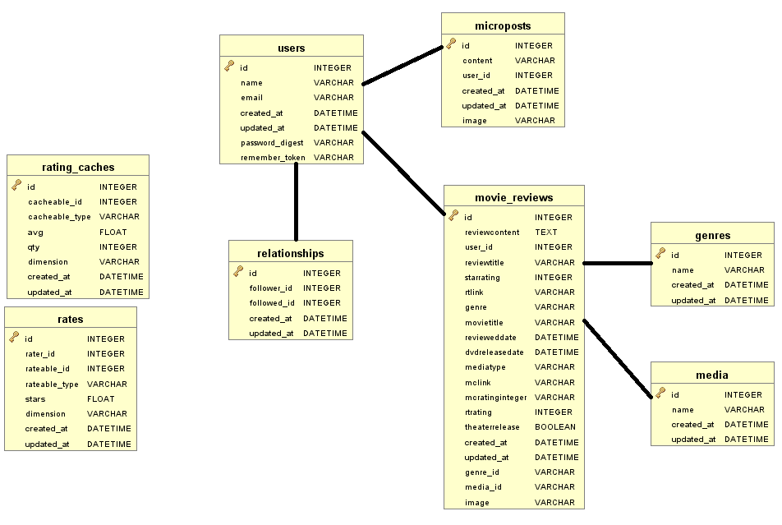
Architecture and Software Used
Data Model
MOVIETWEET
Enterprise Web Development Assignment
9th January 2013

Slide 7
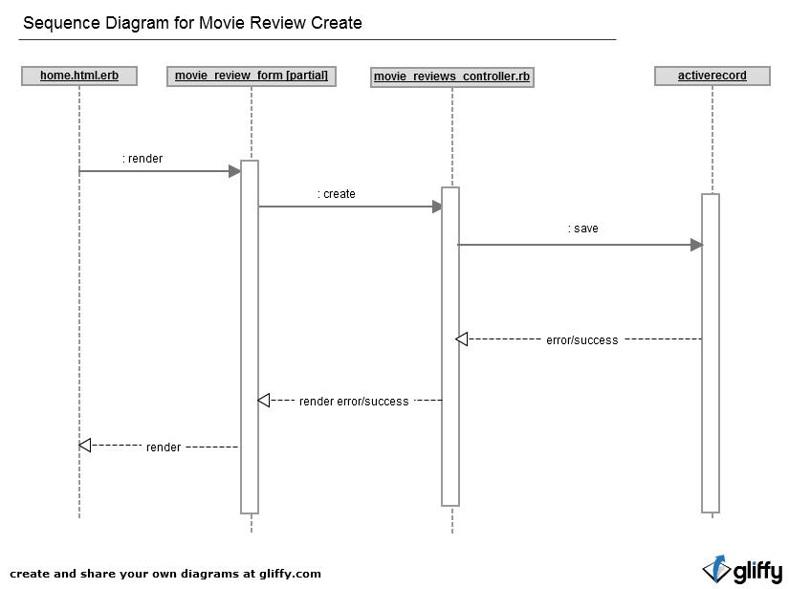
Architecture and Software Used
MOVIETWEET
Enterprise Web Development Assignment
9th January 2013

Slide 8
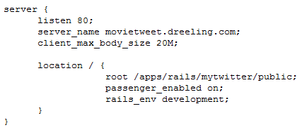
Architecture and Software Used
EC2 us-east (Virginia) on AWS
  Micro Instance Free 1 Year with Nginx already installed (from Node.JS module)
Rails 3.2.3
  carrierwave gem
  bootstrap-datepicker-rails gem
  letsrate gem
Phusion Passenger
  Nginx Module and Gem version 3.0.12
  rvmsudo passenger-install-nginx-module
Ruby 1.9.3p194
  Installed using Ruby Version Manger (curl -L get.rvm.io | bash -s stable)
  http://blog.sudobits.com/2011/10/27/how-to-install-ruby-on-rails-in-ubuntu-11-10/
  https://www.digitalocean.com/community/articles/how-to-install-rails-and-nginx-with-passenger-on-ubuntu
MOVIETWEET
Enterprise Web Development Assignment
9th January 2013

Slide 9
Main New Features
Movie Reviews
  Public and Private
  Add Image (carrierwave)
  Ratings by other users (letsrate)
  Genre and Mediatypes Added to model
  Modeled for Rotten Tomatoes/Metacritic Links
    Did not implement
Twitter.com CSS integration
  Converted application to their CSS and Javascript
  5 CSS files – must be switched in/out depending on location
  Chopped the site up into partials and integrated with Rails
MOVIETWEET
Enterprise Web Development Assignment
9th January 2013

Slide 10
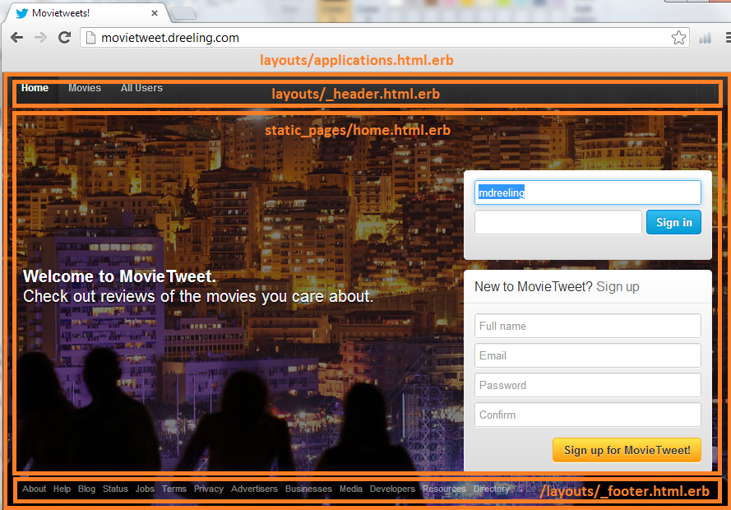
Implementation Overview 1
Signed Out

Slide 11
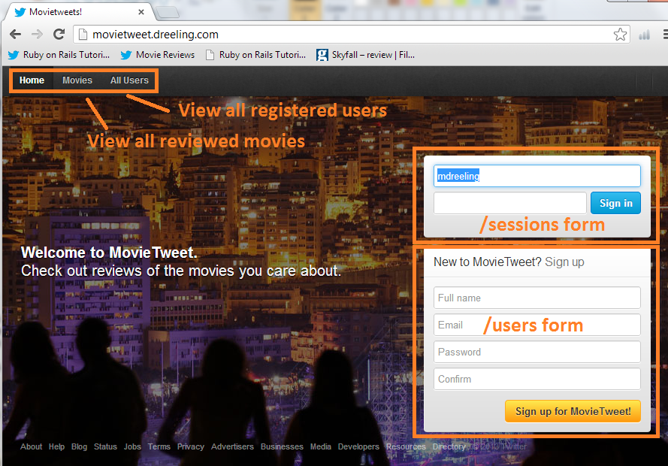
Implementation Overview 2
Signed Out
Home Page
  home.html.erb
  What you see if not logged in
  Twitter ‘page-container’ css class
  Uses t1_core_logged_out.css
  Signin / Signout moved here
Movies
  Shows all movie reviews
  /movie_reviews
Users
  Shows all users
  /users
On sign-in
  Brings you to /users/:id
MOVIETWEET
Enterprise Web Development Assignment
9th January 2013

Slide 12
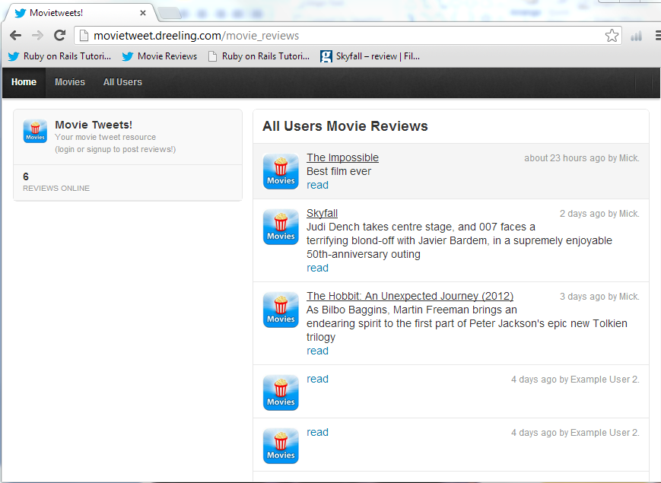
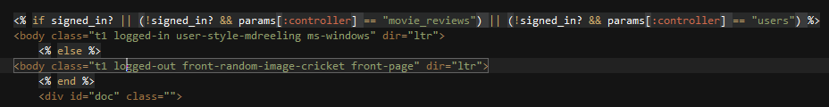
Implementation Overview 3
Signed Out
Movies Page
  movie_reviews/index.html.erb
  What you see if not logged in
  Twitter ‘page-container’ css class
  Uses t1_core.bundle.css
Logic
  Code in application.html.erb
  switches CSS for this page
  dependent on whether signed
  in/out and current page location
  Shows a different view on the left
  and number of reviews if not
  logged in – otherwise
  renders differently
MOVIETWEET
Enterprise Web Development Assignment
9th January 2013

Slide 13
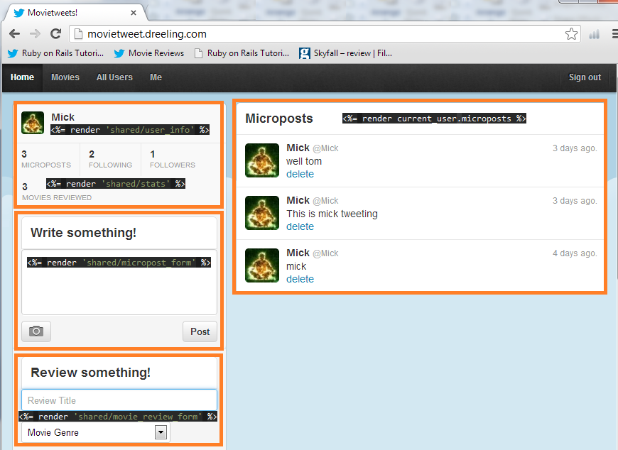
Implementation Overview 4
Signed In
Home Profile
  home.html.erb
  What you see when logged in
  Twitter ‘page-container’ css class
  Uses t1_core.bundle.css
Logic
  Code in application.html.erb
  switches CSS for this page
  dependent on whether signed
  in/out and current page location
  Renders separate movie_review
  and micropost forms
MOVIETWEET
Enterprise Web Development Assignment
9th January 2013

Slide 14
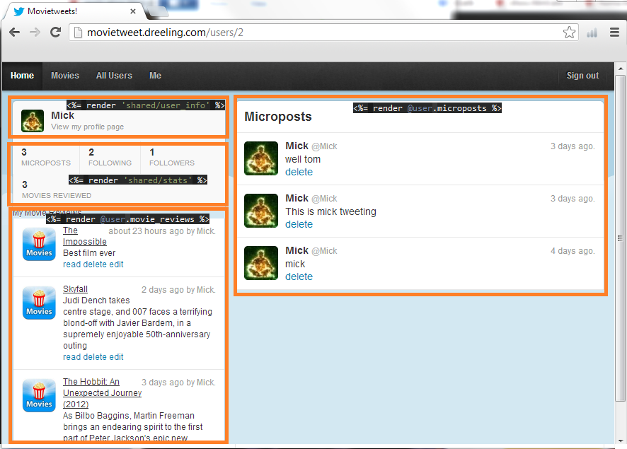
Implementation Overview 5
Signed In
Movies
  users/show.html.erb
  What you see when logged in
  Twitter ‘page-container’ css class
  Uses t1_core.bundle.css
Logic
  Code in application.html.erb
  switches CSS for this page
  dependent on whether signed
  in/out and current page location
  Renders your reviews underneath
  stats if you are logged or if you
  are viewing others profiles
  Shows microposts always on right
  Owner can edit/delete reviews
MOVIETWEET
Enterprise Web Development Assignment
9th January 2013

Slide 15
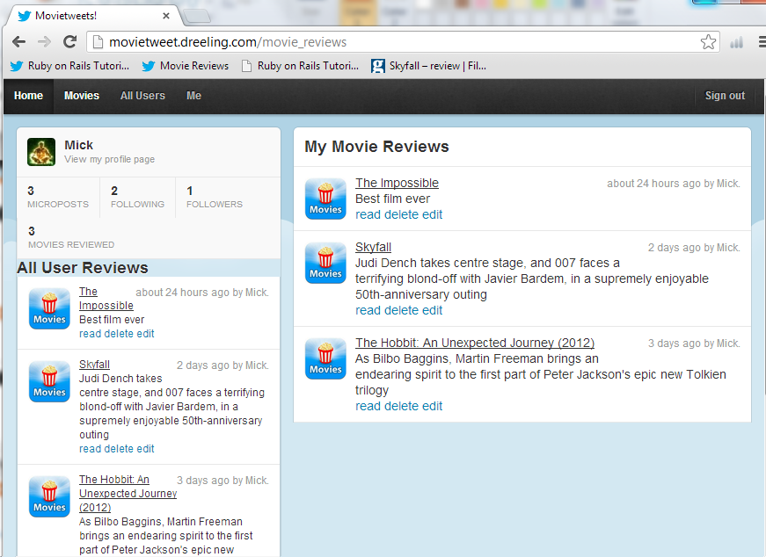
Implementation Overview 6
Signed In
Movie Reviews
  movie_reviews/index.html.erb
  What you see when logged in
  Twitter ‘page-container’ css class
  Uses t1_core.bundle.css
Logic
  Renders the user and stats panels
  Switches the location of
  “All Users” to be under the user
  and renders “your” reviews to be
  on the right
MOVIETWEET
Enterprise Web Development Assignment
9th January 2013

Slide 16
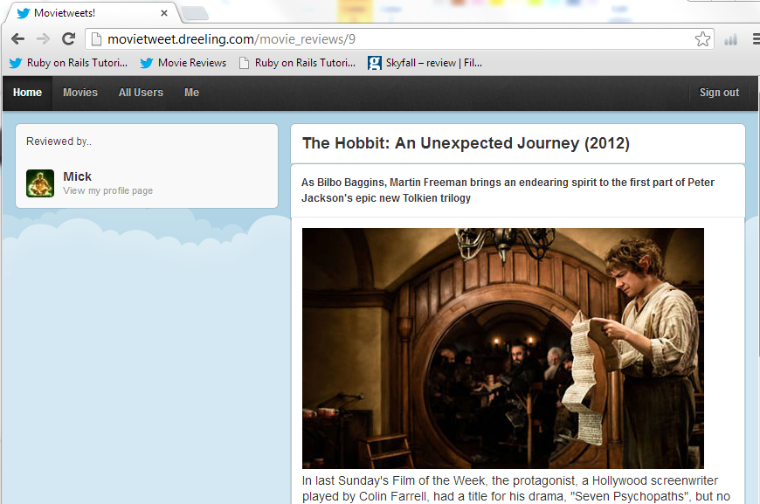
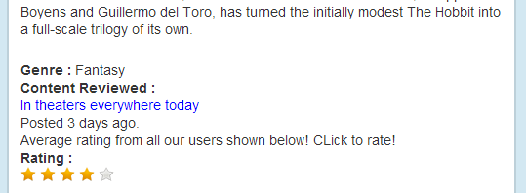
Implementation Overview 7
Signed In
Movie Detail
  _movie_review_detail.html.erb
  What you see when logged in
  Twitter ‘page-container’ css class
  Uses t1_core.bundle.css
Logic
  Renders images
  Shows ‘reviewed by’
  Renders Genre and Media type
  Renders ‘In theaters’ if true
Ratings
  Uses ‘letsrate’ to calc and average
  rating
  Logged in users can only rate
MOVIETWEET
Enterprise Web Development Assignment
9th January 2013

Slide 17
Issues Encountered
CSS Styling
  CSS from Twitter was very complicated – when stripping out pieces – frequently broke causing to have to debug.
Error Rendering
  Even though the ‘errors’ of the Movie Review post is populated with the validation error – it does not feed back to the main form ( it is nil) and so errors on Movie Review posts are not rendered.
  Works fine in edit mode
  In original before breaking it out to style like twitter – this was working.
MOVIETWEET
Enterprise Web Development Assignment
9th January 2013

