Slide 1
Project: Lance
Tom Abraham, Miles Dreisbach, Corey Dues,
Matthew Lempa, Connor Loftus, Kyle McHenry

Slide 2
Game Overview
Continuous third-person platformer
Developed inside Unreal Engine 4 (Game Engine)
Used a combination of C++ and Blueprint Script
Semester focus was underlying functionality

Slide 3
Core Game Components
Single-player and multiplayer functionality
Multiple playable characters
User Display (HUD)
Dynamically-generated levels
Gradually-increasing difficulty
Menu system with data storage for settings

Slide 4
Turning Single-Player into Multiplayer
PlayerStart object tells Unreal where to spawn player
Map has an array of PlayerStart objects
Global variable stores the selected number of players
GameMode is a collection of default settings for game, functions to run
GameMode gets global variable, runs a while loop to call Create Player to spawn player pawn on random PlayerSpawn in array
Custom function called SpawnCharacter, destroys placeholder character with selected character

Slide 5
Unique Characters
Fan Girl
Upwards draft, directional wind tunnel
Ninja
Dash forward, throw knives, grapple hook, double jump
Eloise
Throwable lance, teleport to lance
Animal Companion
Stamina bar, use monkey as platform, throw monkey at player, flutter jump

Slide 6
Dynamic Level System

Slide 7
Priority Level Loading Algorithm
Coded in C++
Runs upfront before the game is loaded for efficiency
Uses a LevelInfo object that has two variables for LevelID and Priority
Outputs an array of integers
Levels are loaded from the array of integers corresponding to LevelID
Used UPROPERTY in Unreal to prevent array from being garbage-collected

Slide 8
Dynamic Loading
Level is split into level segments that are loaded as needed
Level segments are loaded based on the character in first place
Segments are removed based on position of moving Death Wall
Only the levels needed are loaded
Priority algorithm runs at the start
Generate a unique combination of level segments each time

Slide 9
Dynamic Loading cont.
Utilizes an Attach Point and trigger volumes on each map 'tile’
A 'tile' consists of a section of level to be loaded
All tiles are loaded into an array
When a player moves through a tile's trigger volume, a new tile spawns at the current end of the track, on the Attach Point
When the kill cloud moves through a tile's trigger volume, the tile will despawn

Slide 10
Increasing Difficulty
Death Wall trigger slowly increases speed
Constant variable multiplied by variable dependent on distance between the first player and the wall
Difficult level segments only added later into loading algorithm

Slide 11
Menu system & data storage
Game includes menus for
Main Menu
Game Mode Selection
Character Select
HUD (In-Game)
Pause Menu
End-of-Game Screen
Settings Menu
Screen Resolution
Saving of data

Slide 12
Technical Decisions

Slide 13
Game Engine Choice
Unreal Engine 4 vs. Unity
Picked Unreal
Presented a learning curve for the team
Benefits outweighed the curve

Slide 14
Benefits of Unreal Engine 4
Higher quality graphics
Engine has emphasis on object-oriented design
Motivated team to learn C++ (game industry standard)
Many prebuilt functions via Blueprint Scripting
Triple-A games have been made in Unreal
Gears of War, Bioshock, Borderlands, Dead Island 2

Slide 15
C++ vs. Blueprint Visual Scripting
Blueprint pros:
Many prebuilt functions
Quick to add new functionality
Easy to learn with a programming background
Blueprint cons:
Simple tasks can turn complex
Often refactoring needed to prevent unreadable messes
Extra overhead
Team used a mix of Blueprint and C++

Slide 16
Refactoring to C++
Refactored complex Blueprint Pieces to C++
Learned Blueprint Scripts can directly call created C++ classes and functions

Slide 17
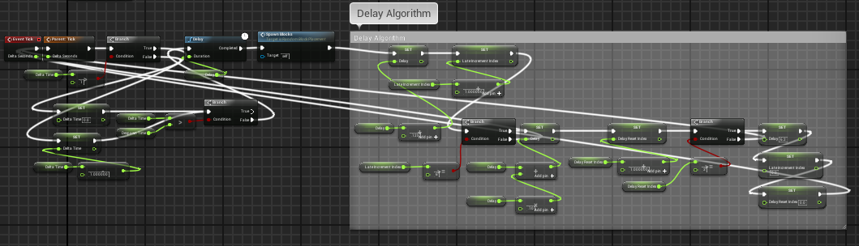
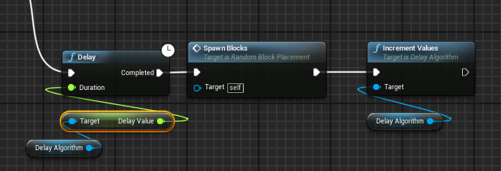
Before Refactor
After Refactor

Slide 18
Efficiency Decisions
Choose to run priority algorithm before game start
Only held integer array in memory
Only loaded level segments as needed
Refactored repetitive Blueprint Script to C++
Ex: Delay Algorithm
Used OO design whenever possible
Ex: Kill floor implemented on a level segment “super class”

