Slide 1
MACHINE LEARNING | FINANCIAL RISK ANALYTICS
Fraud Detection
System
AI
DETECT • EXPLAIN
SUPPORT REVIEW
An explainable machine-learning workflow for identifying
potentially fraudulent financial transactions.
CAPSTONE PROJECT
Prepared by Md Rejwanoor Rahaman
Boston Institute of Analytics LLC

Slide 2
01 | PROJECT OVERVIEW
Executive summary
BUSINESS CHALLENGE
MODELLING APPROACH
REPORTED RESULT
Fraud is a minority outcome, but missed cases can carry significant financial cost.
Compared XGBoost, LightGBM and CatBoost; tuning used RandomizedSearchCV.
CatBoost recorded the highest reported ROC-AUC: 0.9998.
PROJECT OBJECTIVE
Detect fraudulent activity with high recall while managing false-positive alerts.
Results are transcribed from the supplied project deck. Confirm evaluation split, threshold and reproducibility before presenting these as production performance.
CAPSTONE PROJECT | MD REJWANOOR RAHAMAN
02

Slide 3
01 | PROJECT OVERVIEW
Presentation roadmap
01
Business problem & data
02
Data quality & EDA
03
Feature engineering
04
Model development & tuning
05
Evaluation & explainability
06
Application & next steps
CAPSTONE PROJECT | MD REJWANOOR RAHAMAN
03

Slide 4
02 | BUSINESS CONTEXT
Business problem & modelling objective
THE CHALLENGE
THE OBJECTIVE
Fraudulent transactions are relatively rare. Predicting every transaction as legitimate can look accurate while failing to detect fraud.
Identify as many fraudulent transactions as possible, emphasizing fewer false negatives while monitoring false alarms.
DECISION PRINCIPLE
Prioritize recall, then select an operating threshold based on investigation capacity and false-alert cost.
CAPSTONE PROJECT | MD REJWANOOR RAHAMAN
04

Slide 5
03 | DATA UNDERSTANDING
Dataset overview
TARGET VARIABLE
TRANSACTION
ORIGIN ACCOUNT
isFraud
type • amount • step
oldbalanceOrg • newbalanceOrig
Transaction-level financial activity
DESTINATION
TIME
oldbalanceDest • newbalanceDest
step represents one-hour time units
Types: CASH-IN, CASH-OUT, DEBIT, PAYMENT and TRANSFER. Destination balance fields are not available for merchant accounts beginning with M.
CAPSTONE PROJECT | MD REJWANOOR RAHAMAN
05

Slide 6
03 | DATA UNDERSTANDING
Data quality & preprocessing
MISSING VALUES
DUPLICATES
OUTCOME
No missing values were reported in the supplied analysis.
No duplicate records were reported.
Dataset described as clean and structured for training.
RECOMMENDED REPRODUCIBILITY CHECKS
Record row counts, feature types and target prevalence.
Document the split strategy and check for leakage.
Fit encoders and transformations on training data only.
CAPSTONE PROJECT | MD REJWANOOR RAHAMAN
06

Slide 7
04 | DATA EXPLORATION
Exploratory data analysis
Reviewed target-class distribution.
EDA INTERPRETATION
Compared fraud and non-fraud counts across transaction types.
Transaction type and balance movement appear useful for distinguishing suspicious activity. These are associations, not evidence of causation.
Examined transaction amounts and account-balance movements.
Supplied analysis reports fraud concentration in TRANSFER and CASH_OUT.
Original deck describes class distribution as highly imbalanced (~10%). The plotted sample on page 7 shows 1,142 fraud and 10,000 non-fraud records; confirm the dataset subset represented.
CAPSTONE PROJECT | MD REJWANOOR RAHAMAN
07

Slide 8
04 | DATA EXPLORATION
Target-class distribution
OBSERVED SAMPLE
10,000 non-fraud records
1,142 fraud records
Fraud share ≈ 10.2% in this plotted sample.
Source: target distribution chart in the supplied presentation, page 7.
CAPSTONE PROJECT | MD REJWANOOR RAHAMAN
08

Slide 9
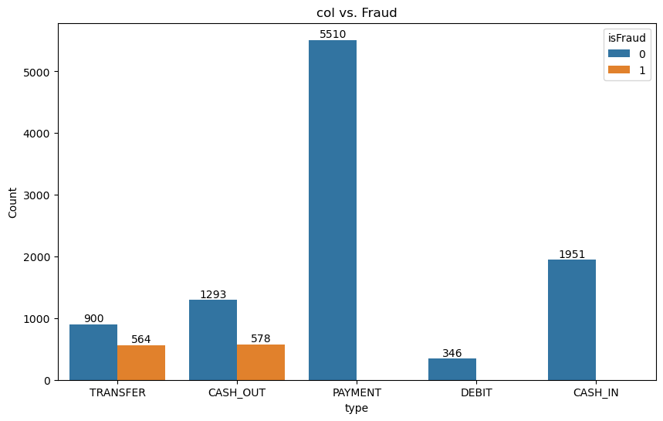
04 | DATA EXPLORATION
Fraud patterns by transaction type
OBSERVED PATTERN
Fraud counts are concentrated in TRANSFER and CASH_OUT in the supplied chart. PAYMENT and CASH_IN show no fraud bars in this sample.
Raw counts are sample-specific; do not interpret them as transaction-type fraud rates without denominators.
CAPSTONE PROJECT | MD REJWANOOR RAHAMAN
09

Slide 10
05 | MODEL DEVELOPMENT
Feature engineering
ORIGIN BALANCE MOVEMENT
DESTINATION BALANCE MOVEMENT
balance_diff_orig = oldbalanceOrg − newbalanceOrig
balance_diff_dest = newbalanceDest − oldbalanceDest
HOUR OF DAY
PURPOSE
hour = step % 24
Represent account movement and an intraday time signal.
Confirm feature definitions, sign conventions and prediction-time availability in the final pipeline.
CAPSTONE PROJECT | MD REJWANOOR RAHAMAN
10

Slide 11
05 | MODEL DEVELOPMENT
Model development
XGBOOST
LIGHTGBM
CATBOOST
Gradient-boosted decision trees for tabular classification.
Efficient gradient boosting for structured data.
Boosting approach with categorical-feature support.
Three tree-based boosting algorithms were compared to capture non-linear patterns in transaction data.
CAPSTONE PROJECT | MD REJWANOOR RAHAMAN
11

Slide 12
05 | MODEL DEVELOPMENT
Hyperparameter optimization
SEARCH METHOD
SCORING OBJECTIVE
PARAMETERS
RandomizedSearchCV
ROC-AUC
n_estimators • max_depth
learning_rate • num_leaves
For a technical handoff, include search space, cross-validation strategy, best parameters and independent holdout results.
CAPSTONE PROJECT | MD REJWANOOR RAHAMAN
12

Slide 13
06 | MODEL EVALUATION
Evaluation framework
PRECISION
RECALL
F1-SCORE
ROC-AUC
Of transactions flagged, how many were fraud?
Of actual fraud cases, how many were detected?
Harmonic balance of precision and recall.
Ranking separation across thresholds.
Accuracy alone is insufficient for imbalanced classification. Report confusion matrix, precision-recall curve, ROC curve and threshold-specific results.
CAPSTONE PROJECT | MD REJWANOOR RAHAMAN
13

Slide 14
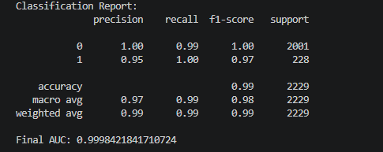
06 | MODEL EVALUATION
Classification results — supplied report
FRAUD CLASS (1)
Precision: 0.95
Recall: 1.00
F1-score: 0.97
Support: 228
Supplied report: 2,229 evaluated records (2,001 non-fraud; 228 fraud), accuracy 0.99 and final AUC ≈ 0.99984.
Tie these results to the exact model, decision threshold and test split when presenting.
CAPSTONE PROJECT | MD REJWANOOR RAHAMAN
14

Slide 15
06 | MODEL EVALUATION
Model comparison — reported ROC-AUC
XGBoost
0.9997
LightGBM
0.9986
CatBoost
0.9998
Best reported ROC-AUC: CatBoost (0.9998)
Transcribed from supplied comparison screenshot. Verify these scores were computed on a consistent independent holdout set.
CAPSTONE PROJECT | MD REJWANOOR RAHAMAN
15

Slide 16
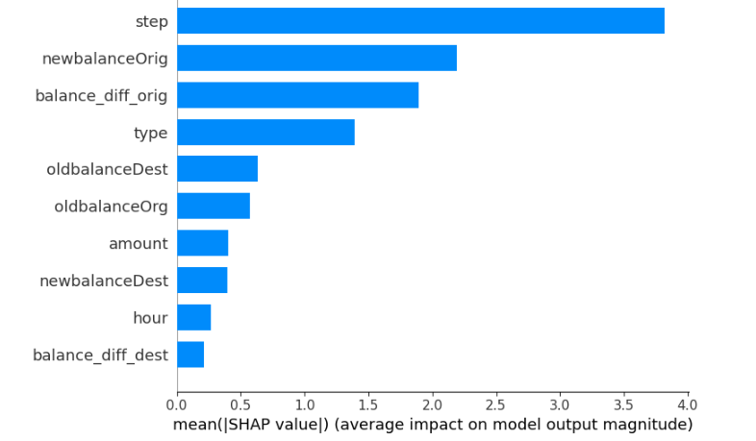
07 | INTERPRETABILITY
Model explainability — SHAP
LEADING FEATURES SHOWN
step
newbalanceOrig
balance_diff_orig
type
oldbalanceDest
SHAP feature importance summarizes feature contributions to model output; it does not establish causation.
CAPSTONE PROJECT | MD REJWANOOR RAHAMAN
16

Slide 17
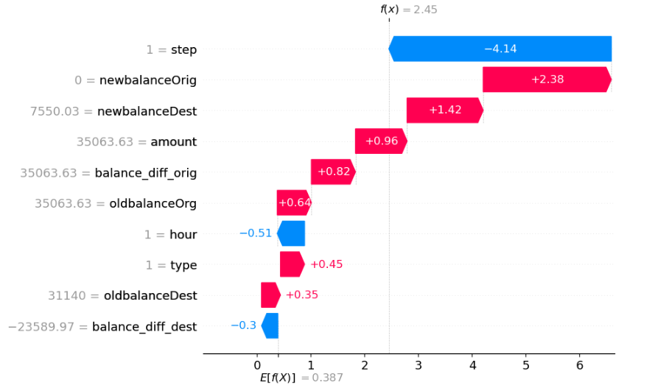
07 | INTERPRETABILITY
Transaction-level explanation
WATERFALL INTERPRETATION
Red contributions push the prediction toward fraud; blue contributions push toward the non-fraud side.
Use the explanation alongside transaction context and the model decision threshold; it should support, not replace, investigation.
CAPSTONE PROJECT | MD REJWANOOR RAHAMAN
17

Slide 18
07 | INTERPRETABILITY
Illustrative suspicious transaction
TRANSACTION SIGNAL
CONTEXT
MODEL OUTPUT
High transaction amount and a substantial origin-balance reduction.
Transaction type identified in the project analysis as associated with fraud.
The supplied case study describes the example as predicted FRAUD.
Illustrative case from the original deck; a full transaction record and calibrated risk probability were not provided.
CAPSTONE PROJECT | MD REJWANOOR RAHAMAN
18

Slide 19
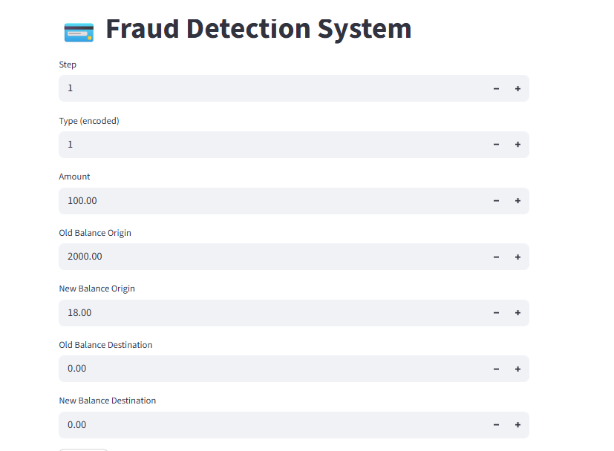
08 | DELIVERY
Application prototype — Streamlit
User enters transaction attributes.
Application passes inputs to the trained model.
Interface displays a fraud prediction.
Production considerations: input validation, preprocessing parity, model versioning, access controls, logging, latency and drift monitoring.
CAPSTONE PROJECT | MD REJWANOOR RAHAMAN
19

Slide 20
08 | DELIVERY
Business implications & controls
EARLY FLAGGING
ANALYST WORKFLOW
RISK GOVERNANCE
Prioritize suspicious transactions for review.
Provide alerts with explanations and supporting context.
Track false positives, missed fraud and model drift.
The supplied deck does not quantify realized savings or live decisioning outcomes. Measure business impact through a controlled pilot.
CAPSTONE PROJECT | MD REJWANOOR RAHAMAN
20

Slide 21
09 | NEXT STEPS
Production-readiness roadmap
Document dataset source, scope, time period and target prevalence.
Confirm leakage-safe validation and independent holdout performance.
Select decision threshold using business costs and review capacity.
Add PR-AUC, confusion matrix and threshold-level reporting.
Pilot with human review; monitor drift, alert volume and outcomes.
Takeaway: a complete modelling and explainability prototype is presented; independent validation and operational controls are next.
CAPSTONE PROJECT | MD REJWANOOR RAHAMAN
21

Slide 22
DISCUSSION
Questions
& Answers
Thank you
Md Rejwanoor Rahaman

