Slide 1
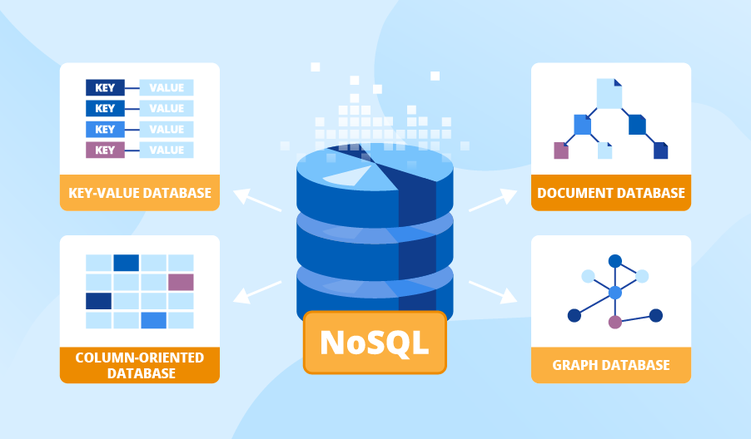

Slide 2
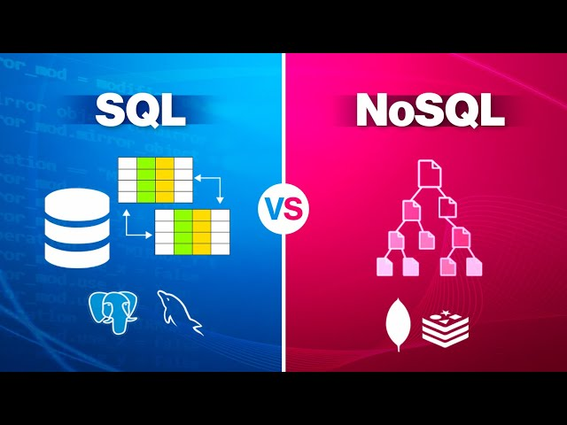

Slide 3
SQL
PersonId | name
1 | a
2 | b
3 | c
4 | d
5 | e
JPID | PersonId | cpid
1 | 1 | 101
2 | 3 | 102
3 | 5 | 103
job_inbox
cpid | C_name
101 | A
102 | B
103 | C
Personal
Company
abc database

Slide 4
Nosql
bdj
personal
Job_inbox
company
jpid
cpid
pid
pid
C_name
name
cpid

Slide 5
Nosql
bdj
personal
pid
personal
pid
cpid
name
jpid
company
C_name
cpid

Slide 6
No SQL Type
Mongo DB (MQL)
Adobe,eBay,Uber,The New York Times,T-Mobile,CERN,MetLife
Cassandra (CQL)
Netflix,Apple,Facebook,Instagram,Twitter,Spotify,Reddit
Couch DB
IBM,Adobe,Mozilla,Cisco,Nokia,The Guardian

Slide 7
MongoDB
Cassandra
Couch DB
db.company.find({ cpid: 'your_cpid_here' });
SELECT * FROM mykeyspace.company
WHERE cpid = 'your_cpid_here';
{
"selector": {
"cpid": "your_cpid_here"
},
"fields": ["_id", "_rev", "c_name", "cpid"]
}

