Slide 1
Git and GitLab
HCJB Senior Design Team
April 10, 2013

Slide 2
Development Tool
When working with a team, the need for a central repository is essential
Need a system to allow versioning, and a way to acquire the latest edition of the code
A system to track and manage bugs was also needed

Slide 3
Development Tool
Many tools exist which accomplish the task, or at least an element of the overarching problem
SVN
Bazaar
Mercurial
To address our problems, we have chosen to use a development environment consisting of the use of both Git and GitLab

Slide 4
Goal
Explain and educate on the tools Git and GitLab
Advantages of Git over SVN
How these tools are used in combination
Method for implementing this toolset into your projects

Slide 5
What is Git
Git is a version control system
Developed as a repository system for both local and remote changes
Allows teammates to work simultaneously on a project
Tracks each commit, allowing for a detailed documentation of the project along every step
Allows for advanced merging and branching operations

Slide 6
What is Git
Developed by Linus Torvalds as a replacement for SVN and to manage the development of the Linux kernel
“Subversion has been the most pointless project ever started…Subversion used to say CVS done right: with that slogan there is nowhere you can go. There is no way to do CVS right…If you like using CVS, you should be in some kind of mental institution or somewhere else.”
-Linus Torvalds

Slide 7
Git in Industry
Companies and projects currently using Git
Google
Android
Facebook
Microsoft
Netflix
Linux
Ruby on Rails
Gnome
KDE
Eclipse
X.org

Slide 8
Why Git is Better
Git tracks the content rather than the files
Branches are lightweight, and merging is a simple process
Allows for a more streamlined offline development process
Repositories are smaller in size and are stored in a single .git directory
Allows for advanced staging operations, and the use of stashing when working through troublesome sections

Slide 9
Git vs SVN
Git is much faster than SVN
Coded in C, which allows for a great amount of optimization
Accomplishes much of the logic client side, thereby reducing time needed for communication
Developed to work on the Linux kernel, so that large project manipulation is at the forefront of the benchmarks

Slide 10
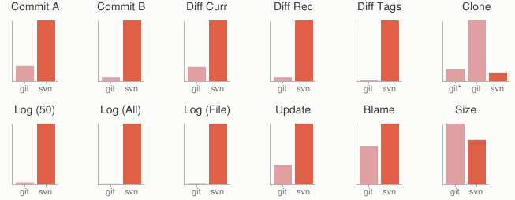
Git vs SVN
Speed benchmarks
Benchmarks performed by http://git-scm.com/about/small-and-fast

Slide 11
Git vs SVN
Git is significantly smaller than SVN
All files are contained in a small decentralized .git file
In the case of Mozilla’s projects, a Git repository was 30 times smaller than an identical SVN repository
Entire Linux kernel with 5 years of versioning contained in a single 1 GB .git file
SVN carries two complete copies of each file, while Git maintains a simple and separate 100 bytes of data per file, noting changes and supporting operations

Slide 12
Git vs SVN
Git is more secure than SVN
All commits are uniquely hashed for both security and indexing purposes
Commits can be authenticated through numerous means
In the case of SSH commits, a key may be provided by both the client and server to guarantee authenticity and prevent against unauthorized access

Slide 13
Git vs SVN
Git is decentralized
Each user contains an individual repository and can check commits against itself, allowing for detailed local revisioning
Being decentralized allows for easy replication and deployment
In this case, SVN relies on a single centralized repository and is unusable without

Slide 14
Git vs SVN
Git is flexible
Due to it’s decentralized nature, Git commits can be stored locally, or committed through HTTP, SSH, FTP, or even by Email
No need for a centralized repository
Developed as a command line utility, which allows a large amount of features to be built and customized on top of it

Slide 15
Git vs SVN
Data Assurance
A checksum is performed on both upload and download to ensure sure that the file hasn’t been corrupted.
Commit IDs are generated upon each commit
Linked list style of commits
Each commit is linked to the next, so that if something in the history was changed, each following commit will be rebranded to indicate the modification

Slide 16
Git vs SVN
Branching
Git allows the usage of advanced branching mechanisms and procedures
Individual divisions of the code can be separated and developed separately within separate branches of the code
Branches can allow for the separation of work between developers, or even for disposable experimentation
Branching is a precursor and a component of the merging process

Slide 17
Git vs SVN
Merging
The process of merging is directly related to the process of branching
Individual branches may be merged together, solving code conflicts, back into the default or master branch of the project
Merges are usually done automatically, unless a conflict is presented, in which case the user is presented with several options with which to handle the conflict

Slide 18
Git vs SVN
Merging
Content of the files is tracked rather than the file itself
This allows for a greater element of tracking and a smarter and more automated process of merging
SVN is unable to accomplish this, and will throw a conflict if a file name is changed and differs from the name in the central repository
Git is able to solve this problem with its use of managing a local repository and tracking individual changes to the code

Slide 19
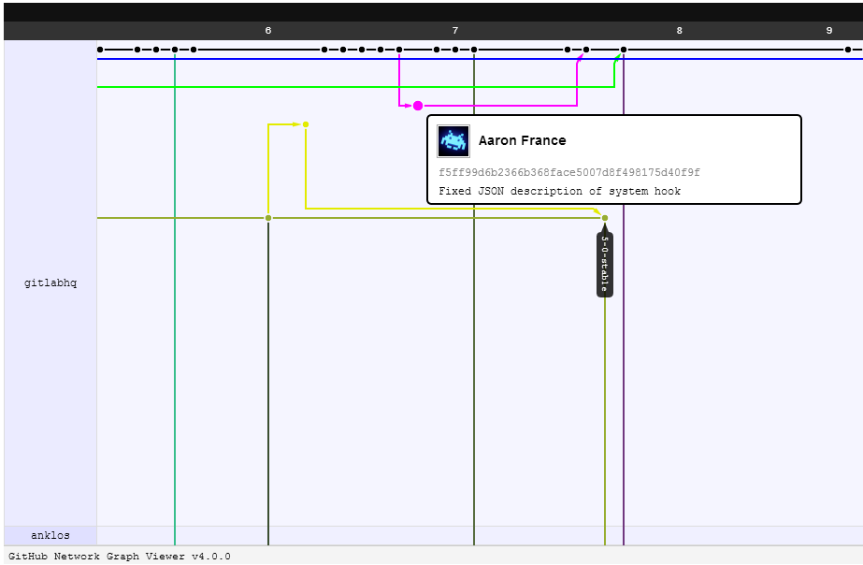
Git vs SVN
Merging example

Slide 20
Interface with SVN
It is possible to import and export from SVN
Exporting from SVN to Git can be done through a series of manual bash scripts
Use of a program such as svn2git allows for a more seamless integration of Git from a SVN repository
https://github.com/nirvdrum/svn2git

Slide 21
What is GitLab
A web interface for Git
Provides additional features on top of a Git repository
Developed as a Github clone for self-hosting
Allows for access to the repository from a web browser
Issue and milestone tracking implemented
Support for attachments and code snippets
Integration of a wiki and wall for project documentation

Slide 22
What is GitLab
Runs on a Ruby on Rails platform
Developed for Debian or Ubuntu systems, however community support exists for other distributions such as Arch, CentOS, Fedora, or Gentoo
Requires a specified version of Ruby and several Gem components to operate
Based to run on top of Git, and utilizes a special Git user account to separate the repository
Utilizes Nginx as the web server, as opposed to Apache

Slide 23
What is GitLab
Each user is able to submit a generated SSH key to uniquely identify the submitter and machine
Option to input a passphrase along with the key is possible
Commits are done through an SSH shell, using the generated public key for authentication
Cloning of the repository can be done through either HTTP or SSH

Slide 24
What is GitLab
Supports the deployment of hooks, both service and web
Service hooks can be used to launch specific services or compilations based on a particular event, such as a commit or merge
Continuous integration servers, such as GitLab CI, provide additional features within this set of options
Web hooks can be used to deploy the project remotely to a separate development server
RSS feed provided to allow the latest project news and developments to be sent to your personal reader

Slide 25
Use of GitLab
We use the combination of Git and GitLab to maintain our code
By submitting each work session’s code, we ensure that a record is kept of our development along each step of the process
The merging process makes it easy to compile everyone’s work together
In the case of a mistake being made in the code, we are able to revert to any edition committed previously into the repository

Slide 26
Use of GitLab
Issue Tracking
We can assign small parts of the project to team members through GitLab
This allows the group to know exactly what needs worked on
Bugs can also be submitted as an issue, and assigned to a particular developer to address
Issues can be closed in a ticketing like system to show which parts of the project have been completed
Milestones can be created with issues assigned to them, and a chosen due date applied

Slide 27
Use of GitLab
Backup
“A file does not exist unless it is present in multiple geographical locations”
With a local repository on each of our machines, development server, and our GitLab server, we have a great amount of data redundancy in the event of a failure, either software or hardware
Our repository is stored on the Amazon cloud in addition to our server on campus
Allows us to pull old versions of the project as well

Slide 28
Advantages of GitLab
Allows for self-maintained version control for a closed source project
Integrates seamlessly with Git
Allows for a detailed viewing and documentation of the project
Common alternative is Github, which does not provide free hosting for closed source projects

Slide 29
Our Development Environment
Each machine used for development has a Git shell installed, and key generated to deploy to the central repository
WinSCP used for the Windows machines to synchronize the code with the development server
Development server running CentOS 6.4
Apache web server used to host the content, with individualized public html folders in each home directory

Slide 30
Our Development Environment
GitLab is running on a specialized server in the Amazon EC2 Virginia cloud
Running remotely to allow access both on and off campus
Deployed on an Amazon micro virtual server
Server running TurnKey Linux
Stripped down version of Debian, with the sole purpose of hosting a GitLab instance

Slide 31
Demo
Repository demo
http://54.242.34.43/

Slide 32
How to Use
Git can be downloaded for Windows, Linux or Mac
http://git-scm.com/
GUI clients are available for Git
http://git-scm.com/downloads/guis

Slide 33
How to Use
Once Git shell is installed, it is best to generate a security key
ssh-keygen -t rsa -C "yourEmail@cedarville.edu"
Copy the generated key to the server for authentication
clip < ~/.ssh/id_rsa.pub
Clone the git repository to your local machine
git clone git@kashyyyk.cedarville.edu:hcjb_web_gui.git

Slide 34
How to Use
Git commands for everyday usage are relatively simple
git pull
Get the latest changes to the code
git add .
Add any newly created files to the repository for tracking
git add –u
Remove any deleted files from tracking and the repository
git commit –m ‘Changes’
Make a version of changes you have made
git push
Deploy the latest changes to the central repository

Slide 35
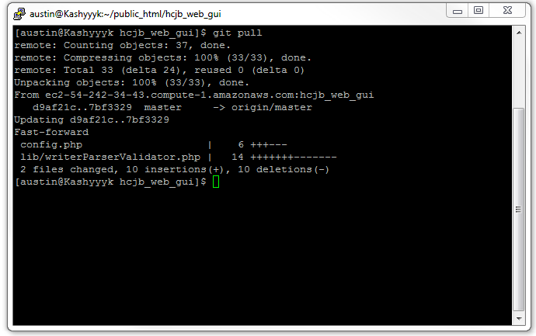
How to Use
Git pull example

Slide 36
How to Use
While Git is installed client side and server side, GitLab is installed on the server used for the central repository
http://gitlab.org/
An installation guide is provided with the recommended use of a Debian or Ubuntu server
https://github.com/gitlabhq/gitlabhq#installation
TurnKey prebuilt GitLab versions also available
http://www.turnkeylinux.org/gitlab

Slide 37
Summary
Over the course of our project, we have found both Git and GitLab to be powerful tools which have greatly aided our development process
While Git has provided the majority of the behind the scenes features, GitLab has allowed us to seamlessly integrate these tools within our development environment
How would your project management be different if Git was used instead of SVN?

Slide 38
References and Resources
Git
http://git-scm.com/
GitLab
http://gitlab.org/
Git and SVN Comparison
https://git.wiki.kernel.org/index.php/GitSvnComparison
Switch from SVN to Git
http://blog.teamtreehouse.com/why-you-should-switch-from-subversion-to-git
https://github.com/nirvdrum/svn2git

