Slide 1
The Ultimate Blackjack App
Project 3

Slide 2
Introduction
By Gino Petrosian, Ryan Stowers, Adrian Manlangit, Michael Drinkard

Slide 3
Introduction
Our project aims to create a cutting-edge gaming platform for online gambling, starting with a Blackjack game.
We will use blockchain technology to offer transparency, security, and fairness, addressing key concerns in the gambling industry.
Our goal is to provide a seamless and secure online gambling experience, utilizing Ethereum (ETH) as game chips for betting.

Slide 4
What does our app do?
Real-time Game Play:
Our blackjack app offers a virtual version of the classic card game, providing an immersive and secure gambling experience.
Play against a virtual dealer in real-time, simulating the excitement of a physical casino.
Receive game outcomes instantly, ensuring a seamless and fast-paced gaming experience.
Ethereum Betting
Real-time gameplay, Ethereum (ETH) betting, blockchain integration, and fair play ensured by smart contracts.
Use Ethereum (ETH) as game chips for betting, providing a secure and decentralized betting experience.

Slide 5
Benefits
Blockchain Integration:
All game data is recorded on the blockchain, ensuring transparency and fairness.
Blockchain technology provides a secure platform for transactions and game outcomes, reducing the risk of fraud.
Fair Play with Smart Contracts:
Python code ensure that game rules are followed automatically, eliminating the need for trust in a centralized authority.
Game outcomes are verifiable on the blockchain, ensuring that every game is fair and transparent.

Slide 6
Game Overview

Slide 7
Game Overview
Blackjack Game Mechanics
How the Game Works: Blackjack, also known as 21, is a card game where players aim to beat the dealer by having a hand value closest to 21 without exceeding it.
Rules and Objectives: Players place bets, receive two cards, and can choose to "hit" (receive another card) or "stand" (keep their current hand). The objective is to beat the dealer's hand without going over 21.
Winning: A player wins if their hand is closer to 21 than the dealer's without exceeding it, or if the dealer busts (exceeds 21).

Slide 8
What we did

Slide 9
Game Logic in Python Library
Creating Python Dataclasses
Card Class
This Dataclass assigns the Card Value with the suit, and links it with an image file in the resources folder
Deck Class
This Dataclass takes the card object and creates a deck based on each suit/value of each card. In this case it will create 52 card deck
Dealer Class
This Dataclass defines the actions a dealer will take like the hit or stand functions of gameplay
Wallet Class
This Dataclass defines the balance and wallet the player is betting with

Slide 10
Cont
Dataclasses Continued
Player(dealer) Class
This Dataclass determines player actions a player can take during gameplay
Gameplay Class
This Dataclass creates the commentary for the game and initiates the gameloop

Slide 11
Solidity Backend
Contract EtherWallet
Creates a contract that allows a selection of accounts that you can select to deposit money into the smart contract.
Functions
Deposit
Allows you to select an account and deposit money into the contract
Withdraw
Allows you to select an account and withdraw money from the contract
Get Balance
Checks balance of the contract

Slide 12
Current State of the APP
Successes
The Blackjack Logic of the game works
The player balance correctly increases and decreases as he wins or loses the game
The solidity backend correctly deposits money into the contract and displays on the app
Problems
The Solidity Contract balance and the Balance variable on the app have yet to be connected.
Cashout feature
Gas Estimates
Bugs in the app
Pressing the place bet button after the hand has been played will cause the dealer to draw again winning the money again.

Slide 13
Future Plans

Slide 14
Future Development:
Fix Current Bugs
Connect Solidity Balance with the Gameplay Balance variable
Fix input bugs
Enhanced Features:
Multiplayer
Cash out function
Continuous updates and improvements based on user feedback.
Combat Gas Fees by exploring other block chains
Solana would be an interesting choice of chain because of their transaction execution speeds and low gas fee’s

Slide 15
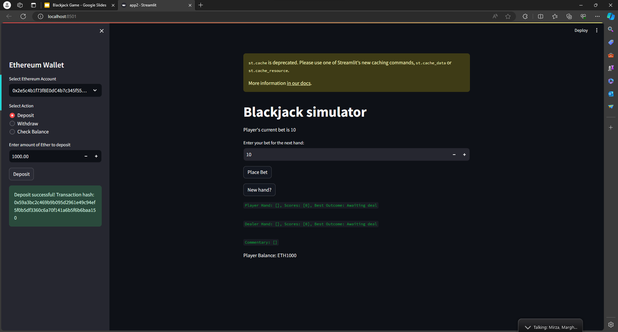
Live Demo of app

Slide 16
References
Creating And Hosting Blackjack Simulator Using Python and Streamlit | by Michael Camden-Smith | Python in Plain English

Slide 17
Questions?

