Slide 1
CYBER SECURITY PROJECT
KEYLOGGER
Presented By:
1. Mohamed Riyaz A N | VV College Of Engineering | CSE

Slide 2
OUTLINE
Problem Statement
Proposed System/Solution
System Development Approach
Algorithm & Deployment
Result (Output Image)
Conclusion
Future Scope
References

Slide 3
Problem Statement
In today's digital age, where cybersecurity threats loom large, one of the significant concerns is the proliferation of keyloggers, stealthy software tools designed to monitor and record keystrokes on a user's computer without their knowledge. Keyloggers pose a severe threat to individuals and organizations as they can capture sensitive information such as passwords, credit card details, and other personal data, leading to Identity theft, financial loss, and privacy breaches.

Slide 4
Proposed Solution
The proposed keylogger system aims to provide a comprehensive solution for monitoring and logging keystrokes on target systems. Beyond the basic functionality of capturing keystrokes, the keylogger offers several advanced features and considerations to enhance its utility and effectiveness.
Key Features:
Real-time Analysis: In addition to logging keystrokes, the keylogger can perform real-time analysis of user input, enabling immediate detection of suspicious or anomalous behavior. By incorporating algorithms for pattern recognition and anomaly detection, the keylogger can identify potentially malicious activities and alert users to take appropriate action.
Remote Monitoring: The keylogger supports remote monitoring capabilities, allowing users to access and view logged keystrokes from a remote location. This feature is particularly useful for administrators and security professionals who need to monitor multiple systems or devices simultaneously, providing centralized control and oversight of user activities.
Encryption and Secure Transmission: To ensure the confidentiality and integrity of logged data, the keylogger employs encryption techniques to encrypt the captured keystrokes before storing or transmitting them. Additionally, secure transmission protocols such as SSL/TLS can be used to securely transmit logged data to a remote server or cloud storage, mitigating the risk of data interception or tampering.
Benefits:
Proactive Threat Detection: By combining real-time analysis with remote monitoring capabilities, the keylogger enables proactive detection and response to potential security threats. Administrators can identify suspicious activities in real-time and take immediate corrective actions to mitigate risks and protect sensitive information.
Compliance and Auditing: The keylogger facilitates compliance with regulatory requirements and industry standards by providing detailed logs of user activities. Organizations can use these logs for auditing purposes, demonstrating adherence to security policies and regulatory mandates, and facilitating incident response and forensic investigations.
Enhanced User Awareness: Through user-friendly interfaces and informative alerts, the keylogger raises user awareness about security risks and best practices for safe computing. By educating users about the importance of cybersecurity and privacy, the keylogger helps promote a culture of security within organizations and communities.
Considerations:
Resource Consumption: The keylogger may consume system resources, such as CPU and memory, especially when performing real-time analysis or remote monitoring. Users should carefully consider the impact on system performance and scalability when deploying the keylogger in production environments or on resource-constrained devices.

Slide 5
System Approach
The "System Approach" section outlines the overall strategy and methodology for developing and implementing the keylogger system. Below is a suggested structure for this section:
System Requirements:
The keylogger system has the following requirements to ensure its proper functioning:
Operating System: The keylogger is compatible with major operating systems, including Windows, macOS, and Linux distributions.
Python Version: The system requires Python 3.x to be installed on the target system.
Dependencies:
The keylogger relies on the following Python libraries:
Tkinter: for creating the graphical user interface (GUI).
Pynput: for monitoring keyboard events and capturing keystrokes.

Slide 6
Algorithm & Deployment
Initialization: The keylogger initializes by creating a GUI using Tkinter.
Keylogging Process: User triggers keylogging by clicking "Start." Keylogger captures key events using Pynput.
Event Handling: Event handlers process key events, logging them into text and JSON files.
Logging: Key events are written into key_log.txt for plain text and key_log.json for structured logging.
Termination: User stops keylogging by clicking "Stop." Monitoring ceases, and logging finalizes.
Deployment Guidelines
System Preparation: Ensure compatible OS and Python version. Install required Python libraries (Tkinter, Pynput) via pip.
Application Deployment: Transfer/install keylogger source code from a trusted source. Execute script to launch application and start keylogging.
User Interaction: Interact via GUI for keylogging control. GUI provides clear status feedback.
Monitoring and Analysis: Monitor keystrokes in real-time or review later. Logged data serves security and forensic purposes.

Slide 7
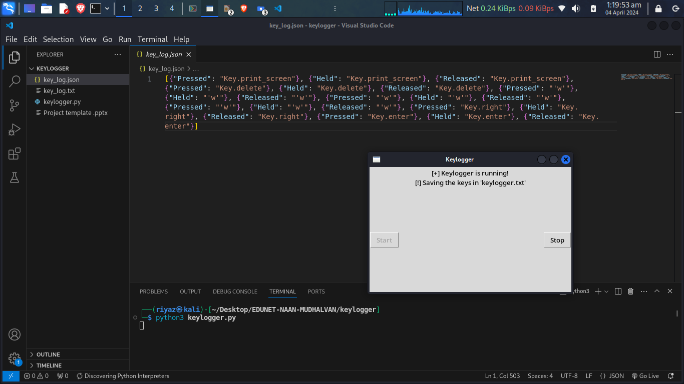
Result

Slide 8
Conclusion
The keylogger system provides a straightforward and effective solution for monitoring and logging keystrokes on a target system. By leveraging Python libraries such as Tkinter and Pynput, the system offers a user-friendly graphical interface for initiating and controlling the keylogging process.
Through real-time event handling and logging mechanisms, the system captures and records key events into both plain text and structured JSON formats, ensuring data integrity and facilitating subsequent analysis. The system's termination feature allows users to stop keylogging at any time, providing flexibility and control over the monitoring process.
Deployment guidelines ensure seamless installation and execution of the keylogger on target systems, while user interaction via the GUI interface offers clear feedback and intuitive control options.
Overall, the keylogger system serves as a valuable tool for security monitoring, forensic analysis, and behavioral research, empowering users to gain insights into user activities and enhance system security. With its robust functionality and user-friendly design, the keylogger system meets the needs of various applications and environments, contributing to a safer and more secure digital landscape.

Slide 9
Future scope
The keylogger system presents numerous opportunities for future growth, aiming toenhance its functionality, usability, and security aspects. These avenues include incorporating advanced logging capabilities such as mouse events and clipboard activity tracking, implementing robust encryption and authentication measures tosafeguard logged data, enabling remote monitoring for administrators, integrating machine learning for behavioral analysis and anomaly detection, ensuring cross-platform compatibility, refining the user interface for intuitive customization, integrating with existing security ecosystems, and establishing a framework for continuous updates to stay current with evolving security landscapes and technological advancements. Through these developments, the keylogger system seeks to fortify its capabilities and adaptability, addressing emerging challenges and meeting evolving user needs effectively.

Slide 10
References
Python Tkinter Documentation: https://docs.python.org/3/library/tkinter.html
Pynput Documentation: https://pynput.readthedocs.io/en/latest/

Slide 11
THANK YOU

