Slide 1
Fake News Analysis
Team Id : 30
College – GB Pant Govt Eng College
Team Leader – Keshav Raturi
Members – Keshav, Ankit Pal, Mohd Rizwan

Slide 2
AGENDA
Objective 1 - Develop a machine learning model
Objective 2 - Evaluate and Validate the model
Objective 3 - Provide a Practical Solution

Slide 3
PROBLEM STATEMENT
The rise of social media and online platforms has made it increasingly challenging to distinguish between accurate and false information. The spread of fake news poses a significant threat to public opinion, democratic processes, and societal well-being. Therefore, there is a need to develop effective methods for fake news analysis and detection.
The objective of this project is to develop a robust system that can analyze and classify news articles or posts as either real or fake. The system should utilize machine learning and natural language processing techniques to identify patterns, linguistic cues, and contextual information that can help differentiate between reliable and deceptive content.

Slide 4
PROJECT OVERVIEW
Data Collection
Data Preprocessing
Feature Extraction
Model Development
Model Training and Evaluation
Model Optimization

Slide 5
WHO ARE THE END USERS?
General Public
Journalists and News Organizations
Social Media Platforms
Fact-Checking Organizations
Researchers and Academics

Slide 6
THE WOW FACTOR IN OUR SOLUTION
Efficiency: The system can process a large volume of news articles in a short period, enabling quick verification and identification of fake news.
Accuracy: Machine learning algorithms are trained on extensive datasets, allowing them to learn patterns and indicators of fake news with high precision.
Scalability: The solution can be scaled to handle a wide range of news sources and adapt to evolving forms of misinformation.
Accessibility: The tool can be accessed online, making it widely available to users who want to verify the authenticity of news articles.
Continuous Learning: As the system encounters new instances of fake news, it can continuously update its models to improve detection accuracy over time.

Slide 7
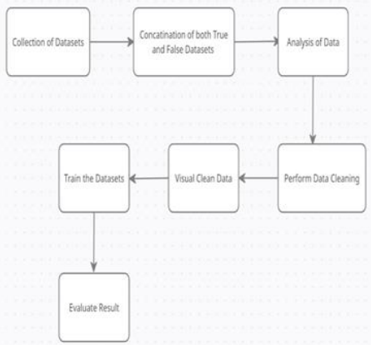
Data Flow Diagram

Slide 8
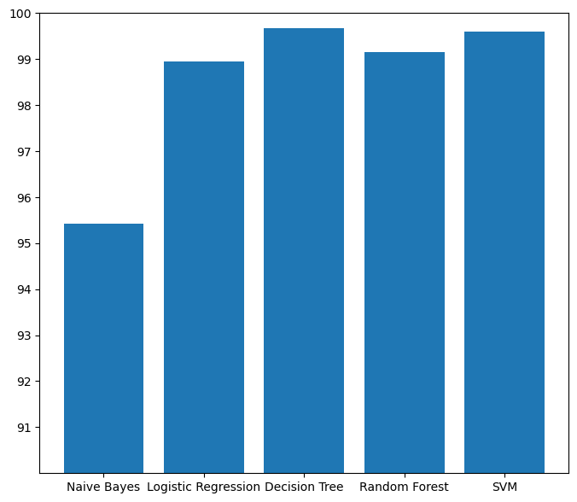
RESULTS
Demo/Github Link : https://github.com/mdrizwan1018/fakenews/blob/main/FakeNewsDetection.ipynb

Slide 9
CONCLUSION
Based on the reported accuracy scores, it can be observed that the Decision Tree model achieved the highest accuracy of 99.67%, followed by Logistic Regression with an accuracy of 98.94%. The Naive Bayes, Random Forest, and SVM models achieved accuracies of 95.43%, 99.15%, and 94.94% respectively.
By comparing the accuracy scores of different models, it can be concluded that the Decision Tree model performed the best on the given fake news classification task.

Slide 10



MEET OUR TEAM
Keshav Raturi
Mohd. Rizwan
Ankit Pa;

