Slide 1
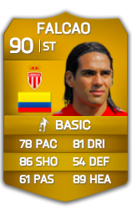
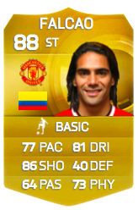
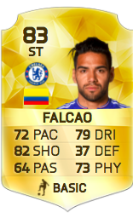
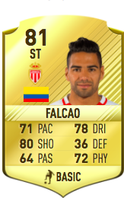
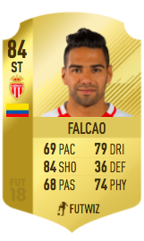
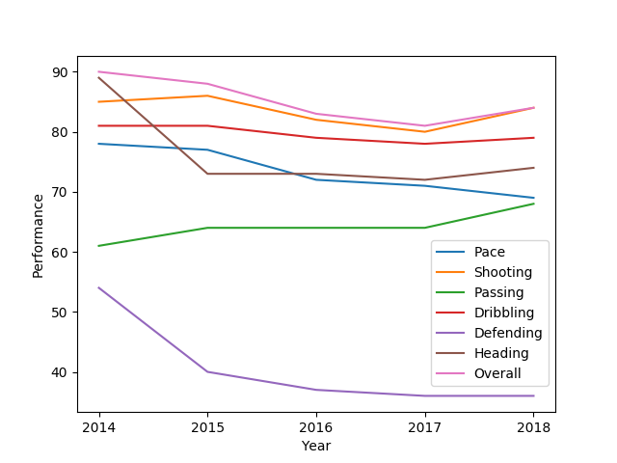
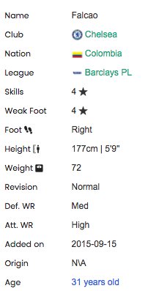
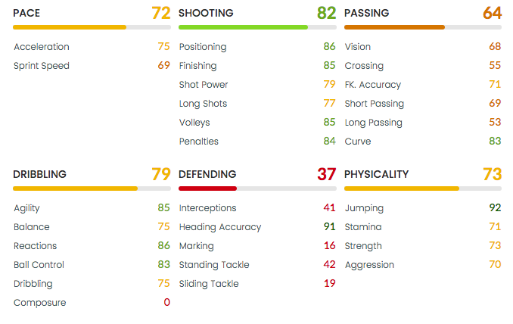
Prediction of Soccer Player Rating
Turash Mosharraf, Maria Babaeva, Muhammad Muhaimin, Vladimir Kozyr, Oliver Schulte
Simon Fraser University
PROBLEMS
– Step 1:
Predict Key Attributes from historical data
– Step 2:
Predict Rating from Key Attributes + Other attributes
Contribution: A novel approach to estimate player rating from a mixture of known and unknown features.
Motivation
Methodology
– Step 1:
– Step 2:
X₁¹⁸
X₂¹⁸
X_{m}¹⁸
PAC
X₁¹⁷
SHO
2016 Data
2017 Data
2012-13
2013-14
2014-15
2015-16
2016-17
X₂¹⁷
PAS
EPL
NN
Rating
2018 Other Attribute
NN
DRI
2018 Key Attribute
X_{n}¹⁷
DEF
2018 Rating
PHY
.
Experimental Result
Theory
Dataset
References

