Slide 1


Introduction to NumPy
Mason Ruby
April 8, 2025
Union University

Slide 2
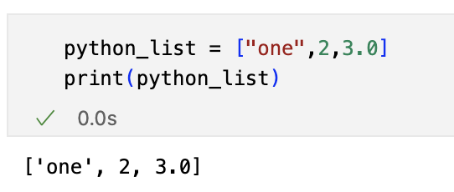
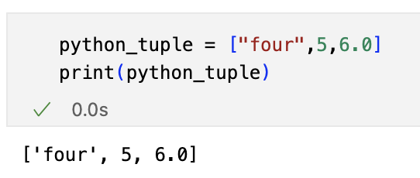
Data Storage in Python
Base python provides lists and tuples as the primary built-in sequence data types.
Lists: created with [] and are mutable
Tuples: created with () and are immutable
Each element can be any type of data

Slide 3
Data Storage in Python
Base python provides lists and tuples as the primary built-in sequence data types.
Lists: created with [] and are mutable
Tuples: created with () and are immutable
Each element can be any type of data

Slide 4

Data Storage in Python
Base python provides lists and tuples as the primary built-in sequence data types.
Lists: created with [] and are mutable
Tuples: created with () and are immutable
Each element can be any type of data

Slide 5
Data Storage in Python
Base python provides lists and tuples as the primary built-in sequence data types.
Lists: created with [] and are mutable
Tuples: created with () and are immutable
Each element can be any type of data

Slide 6

What is NumPy?
NumPy (Numerical Python) is a python library that provides support for large multidimensional arrays
Linear algebra (very important for ML)
Statistical analysis
Efficient sorting/selection
Random number generation
And more!
NumPy forms the core of many data science libraries such as Pandas, Matplotlib, and Scikit-Learn

Slide 7

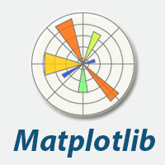

What is NumPy?
NumPy (Numerical Python) is a python library that provides support for large multidimensional arrays
Linear algebra (very important for ML)
Statistical analysis
Efficient sorting/selection
Random number generation
And more!
NumPy forms the core of many data science libraries such as Pandas, Matplotlib, and Scikit-Learn

Slide 8
NumPy vs Base Python
Arrays have fixed size at creation
Elements must all be of the same data type
Exception: the data type can be "python object" allowing elements of different sizes (less efficient)
Capable of advanced mathematical operations
Lists and tuples can grow dynamically
Elements can be of different types
Limited to simple operations such as append, delete, etc.

Slide 9
NumPy vs Base Python
Arrays have fixed size at creation
Elements must all be of the same data type
Exception: the data type can be "python object" allowing elements of different sizes (less efficient)
Capable of advanced mathematical operations
Lists and tuples can grow dynamically
Elements can be of different types
Limited to simple operations such as append, delete, etc.

Slide 10
NumPy vs Base Python
Arrays have fixed size at creation
Elements must all be of the same data type
Exception: the data type can be "python object" allowing elements of different sizes (less efficient)
Capable of advanced mathematical operations
Lists and tuples can grow dynamically
Elements can be of different types
Limited to simple operations such as append, delete, etc.

Slide 11
NumPy vs Base Python
Arrays have fixed size at creation
Elements must all be of the same data type
Exception: the data type can be "python object" allowing elements of different sizes (less efficient)
Capable of advanced mathematical operations
Lists and tuples can grow dynamically
Elements can be of different types
Limited to simple operations such as append, delete, etc.

Slide 12

Performance
Python is an interpreted language
Code is executed line-by-line by an interpreter
This is slow!
NumPy operations are vectorized, meaning they are executed as optimized, pre-compiled C code and can take advantage of "Single Instruction, Multiple Data" (SIMD) processes on the CPU
Much faster!

Slide 13
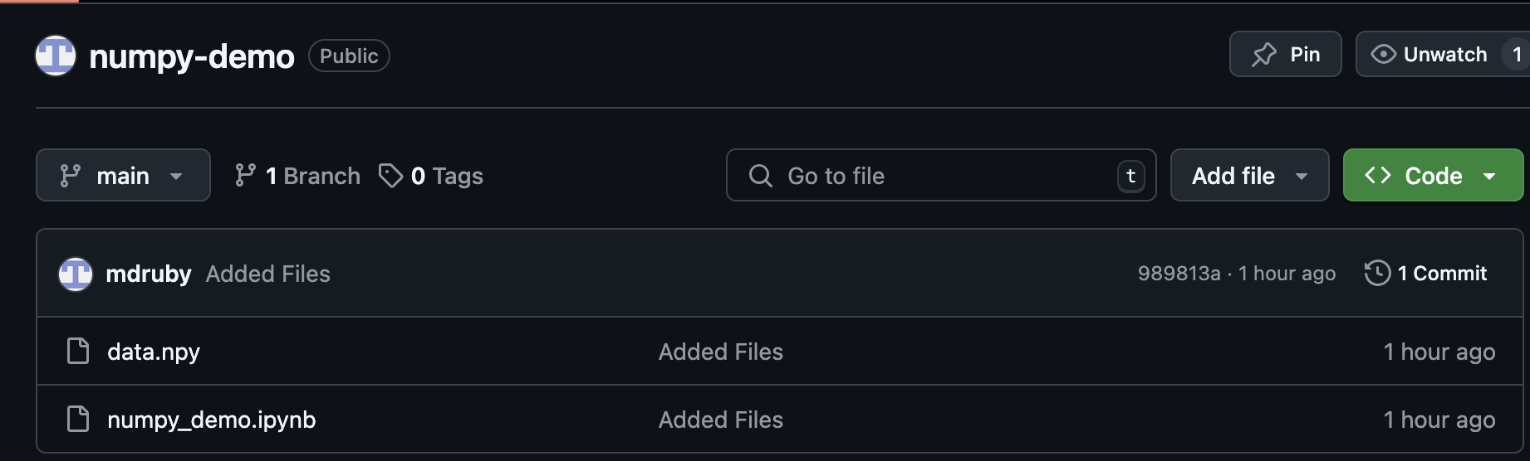
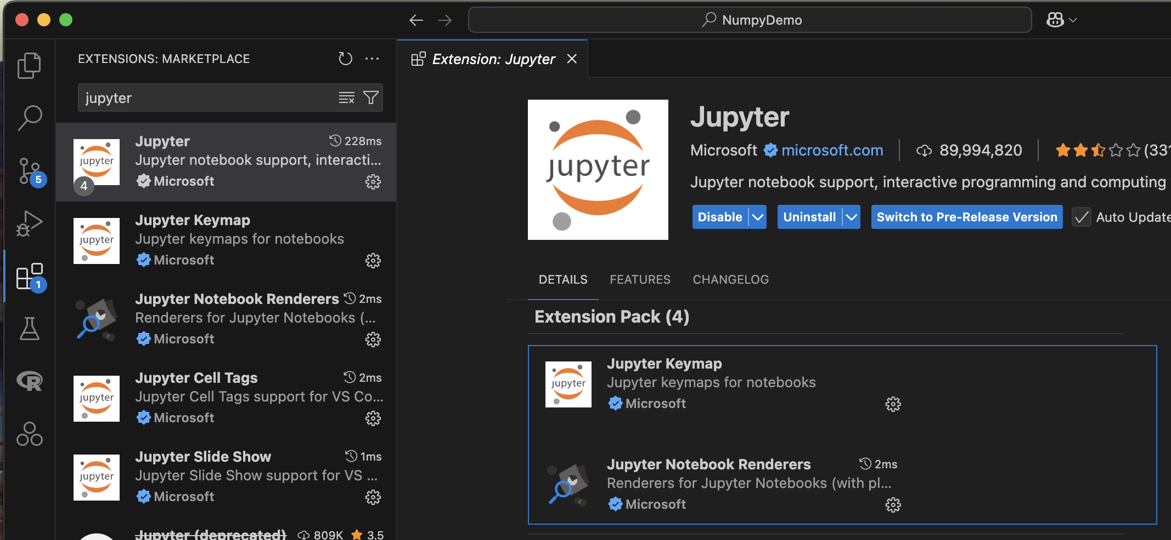
Lab
Make sure python is installed
Open VS Code terminal and run:
pip install numpy matplotlib jupyter
Install jupyter notebook extension on VS Code
Go to https://github.com/mdruby/numpy-demo and download the raw file data.npy

