Slide 1
ClearQuest XML Server with ClearCase Integration
Northwest Rational User’s Group
February 22, 2007
Frank Scholz
frank_scholz@mentor.com
Casey Stewart
casey_stewart@mentor.com
© 2007 Mentor Graphics Corporation
All Rights Reserved

Slide 2
Agenda
Mentor Graphics Environment
Requirements
High-Level Overview
Samples
Architecture
Details
Findings
ClearCase Client
Demonstration

Slide 3
Mentor Graphics Environment
Product development effort is widely distributed.
  3000+ developers
  30+ development sites worldwide
ClearQuest deployment is 100% web-based.
ClearQuest sits behind the corporate firewall.
No ClearQuest groups.
Implementation by the numbers:
120,000+ 350,000+ 1,350,000+ 3,500,000+ 1 | stateless records defects records notes records history records database

Slide 4
Requirements
No client installs.
No remote servers.
Perform well over the WAN.
Scalable.
Utilize a generic interface.
Enforce permission restrictions.
Password encryption.
Notification on errors.

Slide 5
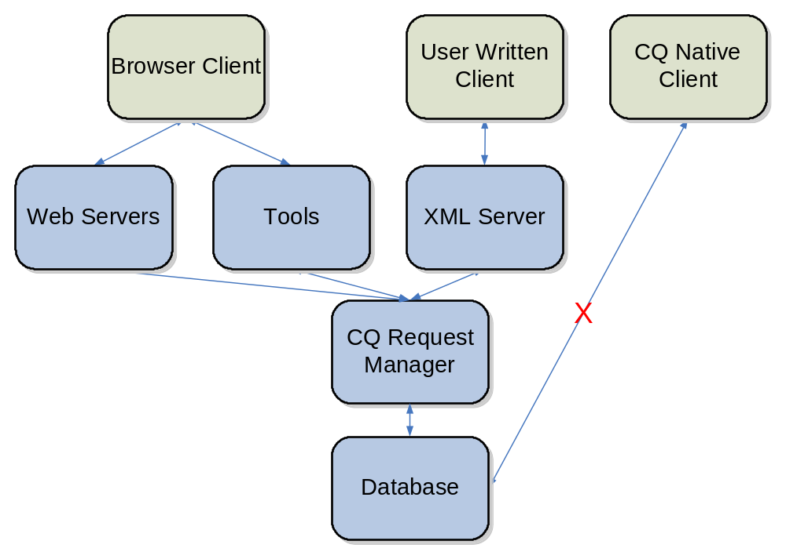
High-Level Overview

Slide 6
High-Level Overview
The ClearQuest XML Interface (CQ/XML) uses industry standard communication methods and formats to communicate to the ClearQuest Request Manager.
  Immediate updates to ClearQuest data.
  ClearQuest business rules are enforced.
  Development activity can have direct relationships to defect data.
“Industry standard communication…”
  method: platform-independent TCP sockets
  format: XML

Slide 7
High-Level Overview: Features
All CQ/XML communication is done via XML.
  input, output, errors, logs and configuration
  W3C standard
Read, write and create ClearQuest defect records.
Performs well over the WAN.
Supports RC4 password encryption.
Permissions can be limited to a single user, multiple systems or anywhere in between.
Allows interactive or batch response.

Slide 8
High-Level Overview: Features
Users can run existing ClearQuest queries, including prompted queries.
Special functionality has been added to support user-specific interactivity.
ClearQuest defect histories record XML updates.
Logs are reviewable in all of the current browsers.
CQ/XML server can email users ClearQuest errors.

Slide 9
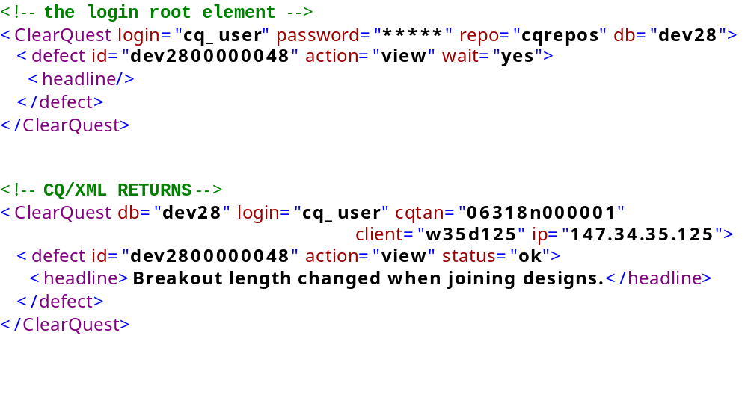
Sample: view a defect’s headline

Slide 10
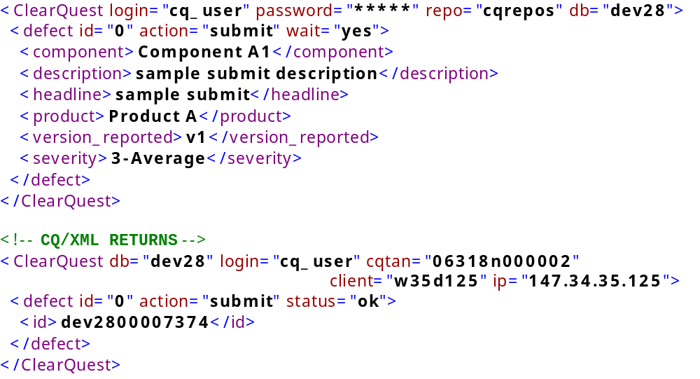
Sample: submit a defect

Slide 11
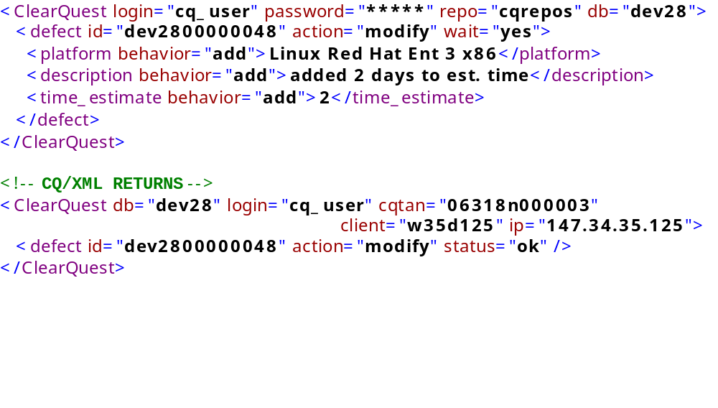
Sample: “adding” to defect fields

Slide 12
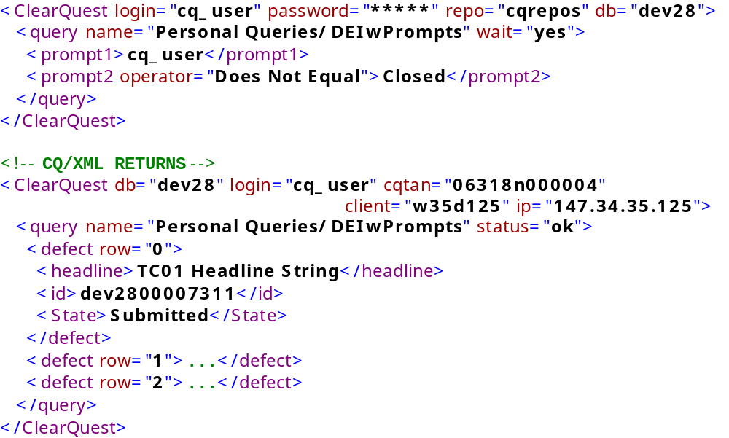
Sample: prompted query

Slide 13
Architecture
Client
Live Server
Queue Manager
socket
Queue
XML
XML
CQ API
XML
CQ API
XML
XML
ClearQuest Request Manager
user site
Wilsonville
system visible
user visible
Logs
Logs
ClearQuest Web

Slide 14
Architecture
Client
Live Server
Queue Manager
socket
Queue
XML
XML
CQ API
XML
CQ API
accept socket
assign conn. id
fork
read socket
XML
XML
ClearQuest Request Manager
user site
Wilsonville
system visible
user visible
Logs
Logs
ClearQuest Web

Slide 15
Architecture
Client
Live Server
Queue Manager
socket
Queue
XML
XML
CQ API
XML
CQ API
pre-parse XML
write queue file
XML
XML
ClearQuest Request Manager
user site
Wilsonville
system visible
user visible
Logs
Logs
ClearQuest Web

Slide 16
Architecture
Client
Live Server
Queue Manager
socket
Queue
XML
XML
CQ API
XML
CQ API
parse XML
restructure XML obj
XML
XML
ClearQuest Request Manager
user site
Wilsonville
system visible
user visible
Logs
Logs
ClearQuest Web

Slide 17
Architecture
Client
Live Server
Queue Manager
socket
Queue
XML
XML
CQ API
XML
CQ API
login to CQ
run CQ commands
logout of CQ
XML
XML
ClearQuest Request Manager
user site
Wilsonville
system visible
user visible
Logs
Logs
ClearQuest Web

Slide 18
Architecture
Client
Live Server
Queue Manager
socket
Queue
XML
XML
CQ API
XML
CQ API
send status
close socket
XML
XML
ClearQuest Request Manager
user site
Wilsonville
system visible
user visible
Logs
Logs
ClearQuest Web

Slide 19
Details: Live vs. Queued
Allows faster response for jobs that don’t require a return message.
Can run on a second machine to lighten the load on the live server.
Every successfully parsed job is written to disk.
Queue manager is a scheduled process that runs every 5 minutes to process queued jobs and clean the disk.

Slide 20
Details: XML Parser
Since you can’t compile modules for cqperl/ratlperl, the only stand-alone parser available is XML::Mini.
  XML::Mini can get in some recursive loops so we pre-parse and reformat the XML before calling the parser.
  XML::Mini doesn’t differentiate between attributes and elements so we made all attribute names unique from element names.
  Resulting data structure is complex and differs based on the input.
  Results may not be in the same order as the input.
Our users aren’t well-versed on XML so we ignored DTDs, external entities, parameter entities, XML Schema, etc.

Slide 21
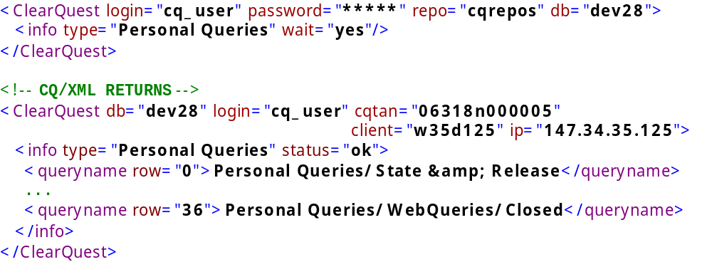
Details: <info…> Elements
“Special functionality has been added to support user-specific interactivity.”
Can return a list of personal, public or all queries.
Can return login or database information.

Slide 22
Details: Miscellaneous
Encryption implemented via Crypt::RC4.
  Stand-alone Perl package.
  Very simple and fast.
Appending to XML logs requires overwriting the root element end.
Prompting dates was error prone and dropped from the implementation.
Wrap every ClearQuest call with an eval{} so a failure in ClearQuest doesn’t kill the entire server.

Slide 23
Findings
Stable
  No application-level failures encountered through seven months of testing and three months of production deployment.
Scales extremely well
  Under Grid testing, the CQ/XML server was still handling requests with over 350 near-simultaneous connections.
Response time meets user requirements
  defect update jobs < 3 seconds
  defect view jobs < 1 second
  query jobs < 1 second

Slide 24
ClearCase Client
Why not use IBM ClearCase/ClearQuest integration?
  Requires Native Clients
    CCRC currently only supports CQ UCM integration
  Does not work over WAN and MultiSite does not work for us
  ClearCase and ClearQuest user must have same version of client installed
  Not configurable
    Most of the CC information captured in CQ is unusable
    Need to Configure differently on a per VOB basis (different processes and requirements per group)

Slide 25
ClearCase Client: Implementation Details
Uses CC Triggers to send data to CQ via XML
  Triggers use ratlperl/ccperl
Allows users to Associate Defect(s) to file during checkout/checkin
  Uses either Command Line prompts or GUI
  CC Data: File Path, Version, User, Date, Checkin Comment
Removes Defect Associations during uncheckout
CC Uses CrmRequest hyperlink to link to Defects

Slide 26
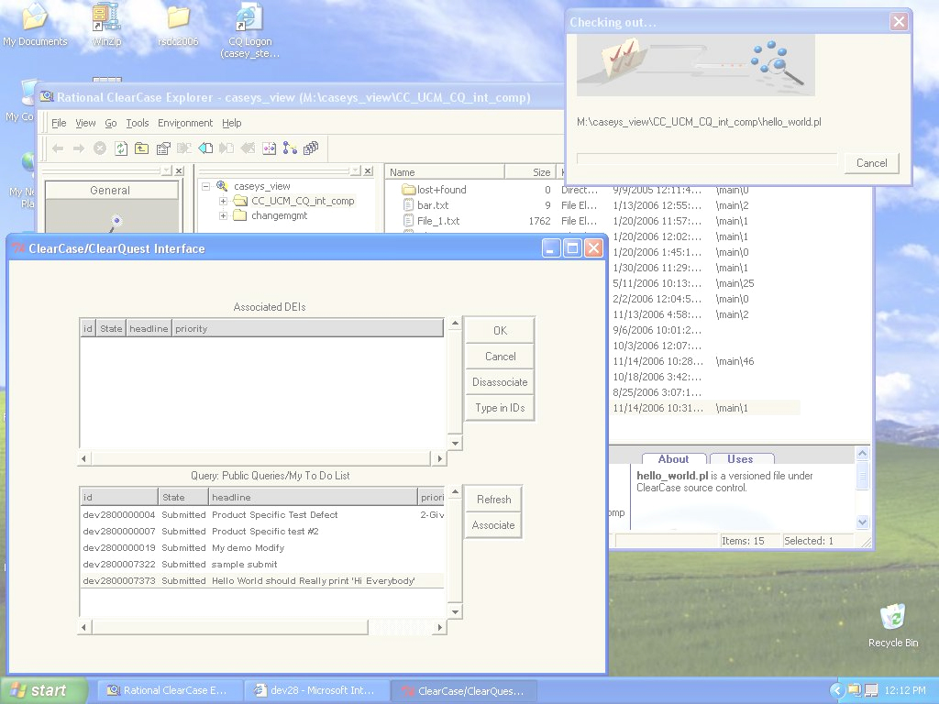
Demonstration
ClearQuest / ClearCase Integration via CQ/XML
Demo

Slide 27


