Slide 1
Md. Ruhit Been Siddik
Id: 2137620106
Course Code: CSE2242
Course Title: Technical Writing and Presentation
Notes:
Here to present to all of my respected teacher and classmates assalamu alaikum to all of you. Now I'm going to start the presentation.

Slide 2

Cryptocurrency
Understanding the Future of Digital Currency
Notes:
Toda I will discus about cryptocurrency. Let’s start to understand the digital currency.

Slide 3

Understanding Cryptocurrency
Definition:
Cryptocurrency is a digital or virtual form of currency that uses cryptography for security.
Examples: Bitcoin, Ethereum, Litecoin.
Decentralize System
Notes:
If we talk about cryptocurrency, then first of all, comes to our mind Bitcoin, but in addition to this Bitcoin, there are many other cryptocurrencies such as dose coin ,Ethereum, Litecoin. Basically cryptocurrency is a digital from of currency. We know Normal Currency is Centralize that controls a country or agency, but crypto is decentralize. If we want to know about decentralize system then we have to know about block chain. We will be informed in the next slide about the blockchain and the decentralize system.

Slide 4

History of Cryptocurrency
True Identity has not been verified or revealed.
Authored the Bitcoin on Whitepaper (in 2009).
Designed first blockchain database.
Satoshi Nakamoto
Born: Unknown
Net Worth : $78 billion
Notes:
Satoshi Nakamoto True Identity has not been revealed but he is the first who designed blockchain database. And discuss about bitcoin in 2009, on a online forum which name is whitepaper.

Slide 5
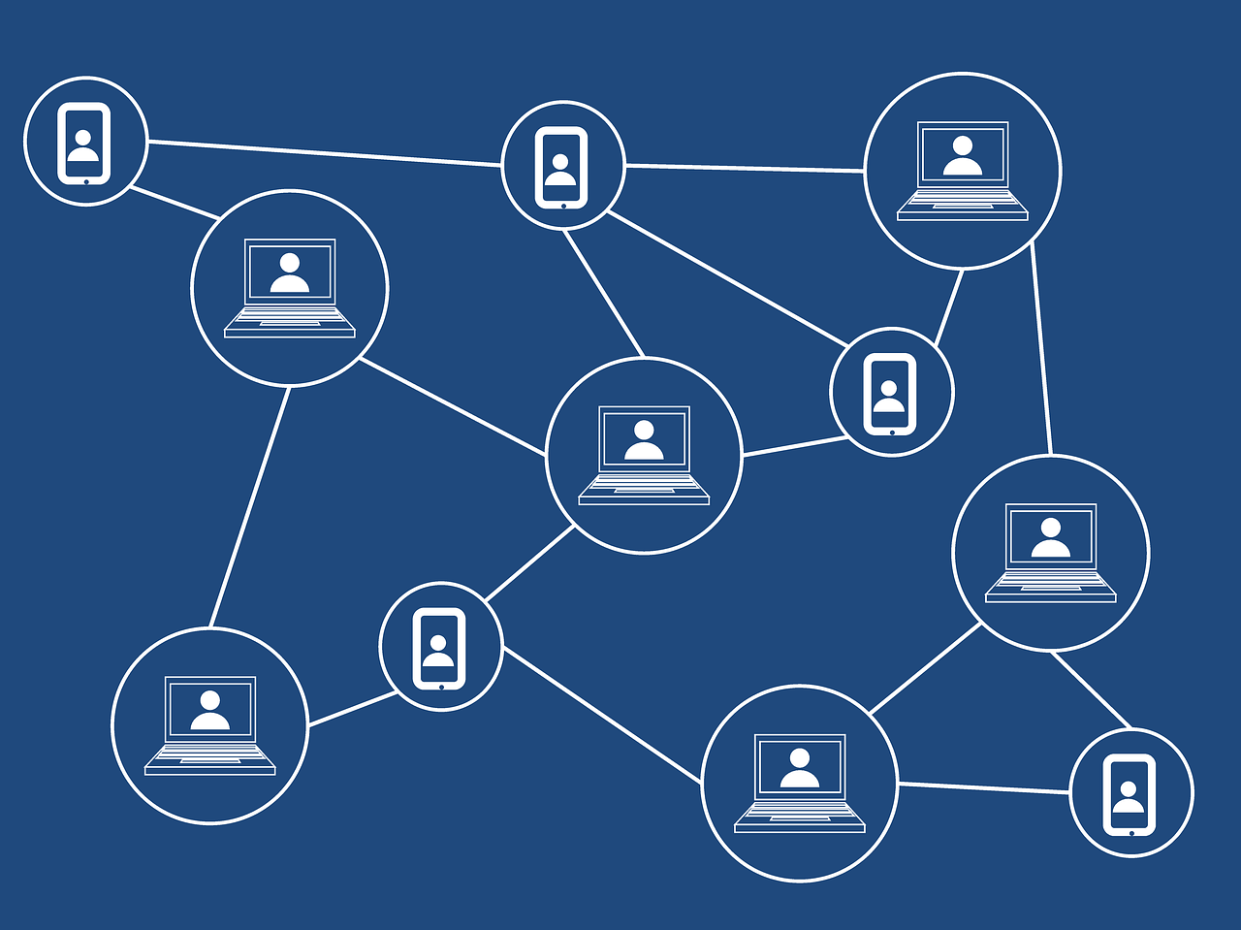
How Cryptocurrency Works
Blockchain:
Blockchain is a decentralized digital technology that records transactions across multiple computers in a way that makes them secure, transparent.
Notes:
Ok, first of all , In this slide we can see a picture of blockchain technology. It operates on decentralized networks, meaning they are not controlled by any single authority like a government or bank. This decentralization can make transactions more transparent and easier.

Slide 6

Benefits of Cryptocurrency
Advantage:
→ Decentralization
→ Security
→ Lower Transaction Fees
→ Fast Transactions
→ Global Reach
Notes:
Decentralization: We have already talked about it. Security: We already know all transaction records are transparent and risk-free.

Slide 7


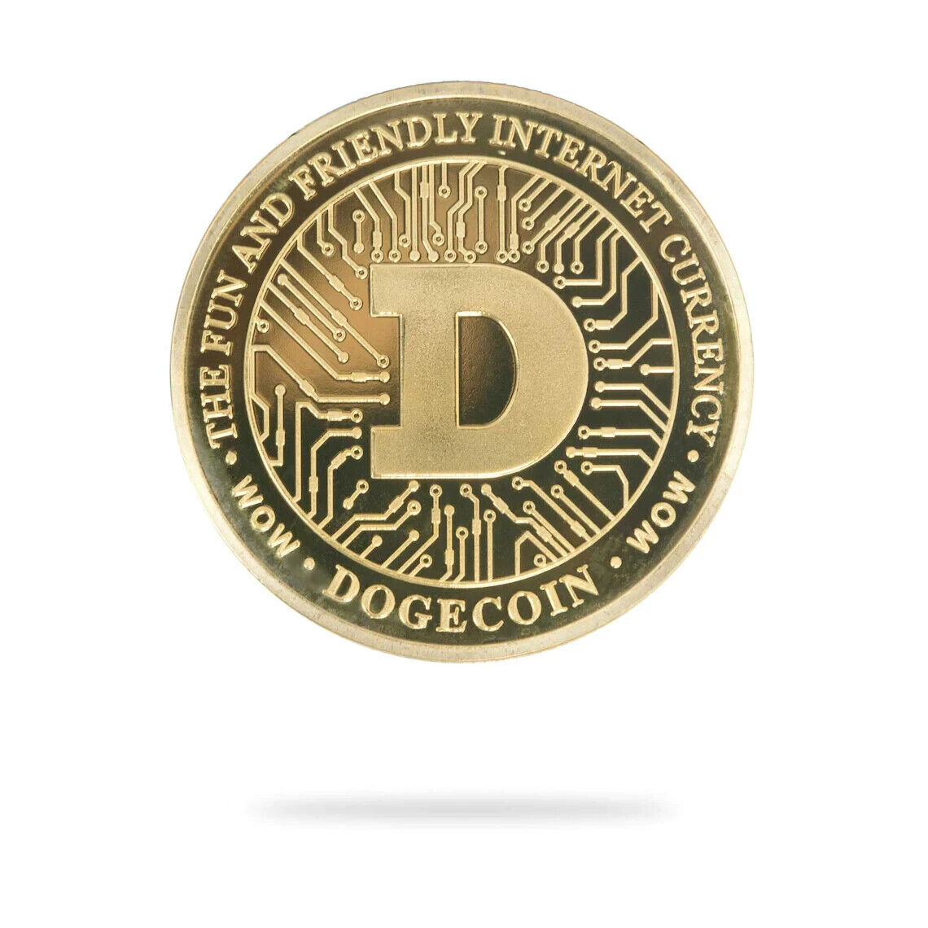

Types of Cryptocurrency
1. Bitcoin
2. Litecoin
3. Ethereum
4. Dogecoin
Notes:
Bitcoin: It’s a first and most well known coin . It’ also called the digital gold!!
Litecoin: It’s a silver coin. Litecoin is a peer-to-peer cryptocurrency that enables fast and low-cost transactions.
Ethereum:A decentralized platform that enables smart decentralized applications
Dogecoin: Initially created as a joke. But it has gained popularity as a peer-to-peer digital currency with a strong community

Slide 8
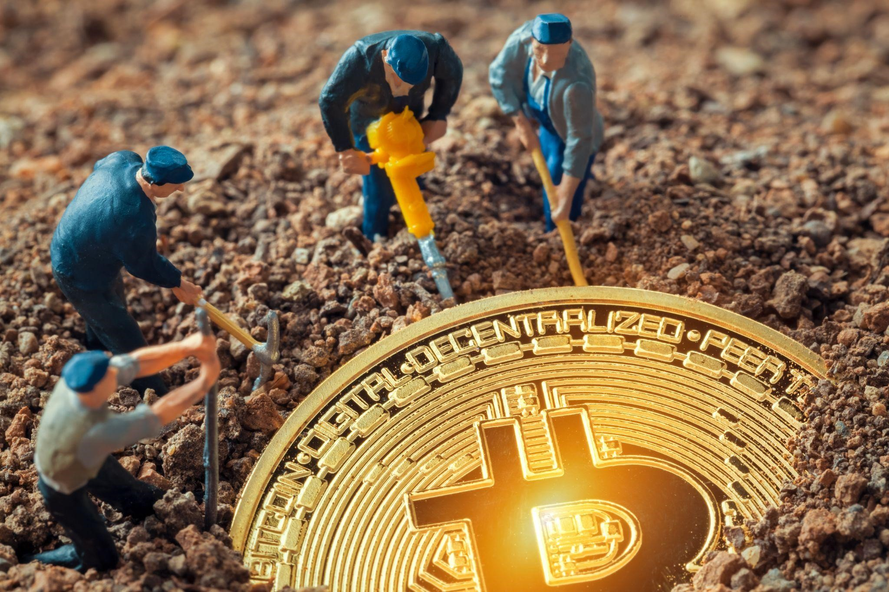
Crypto Mining
Transaction Validation
Creating a Block
Adding the Block to the Blockchain
Reward
Notes:
Miners collect and verify transactions from users on the network. These transactions are then grouped into blocks.
Miners compete to solve a cryptographic puzzle by using their computing power to hash the data in the block. The first miner to find the correct solution broadcasts it to the network.
Once a solution is found and verified by other nodes on the network, the new block is added to the blockchain, and the transactions it contains are considered confirmed.
In return for their efforts, miners are rewarded with newly created cryptocurrency coins .

Slide 9
Future Trends Of Cryptocurrency
Top 3 future trends of Crypto Currency:
1. Decentralized Finance Evolution
2. Non-Fungible Token
3. Web 3.0

Slide 10
Conclusion
So, as we finish up, just remember to stay curious and be careful. Whether you're thinking about investing or just interested in how things might change, there's still a lot to learn and explore in the world of cryptocurrency.
Thank You
Notes:
cryptocurrency is like a revolution in money and technology. We've covered a lot today.

