Slide 1
Rejoyana Kabir Roshni
Department of CSE
Rangpur Engineering College, Rangpur
ID NO: 2137620129
Course: Technical Writing and Presentation(CSE2242)
Slide: 01

Slide 2
Internet of Things
Connecting the dots, Creating the future
Slide: 02

Slide 3
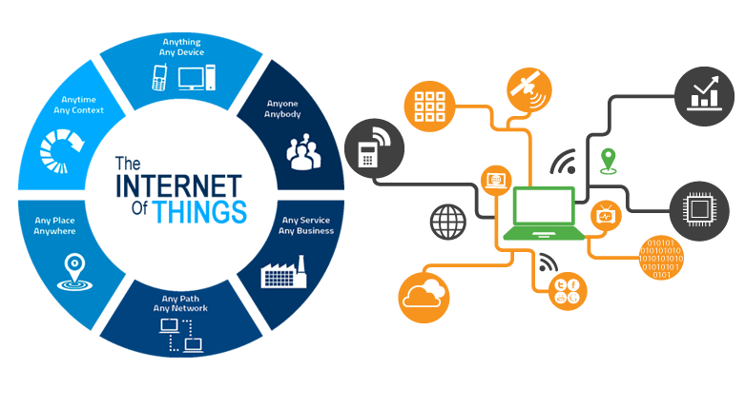
What is IoT?
Connecting devices to the internet for data exchange.
Slide: 03

Slide 4
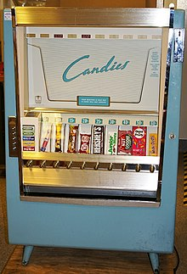

History of IoT
Vending Machine
Peter T. Lewis
In 1982, the concept of networking smart devices began, highlighted by a modified Coca-Cola vending machine at Carnegie Mellon University. It was the first ARPANET-connected appliance, able to report inventory and chill the status of drinks.
The term “Internet Of Things, first appeared in a speech by Peter T. Lewis in September 1985.
Slide: 04

Slide 5
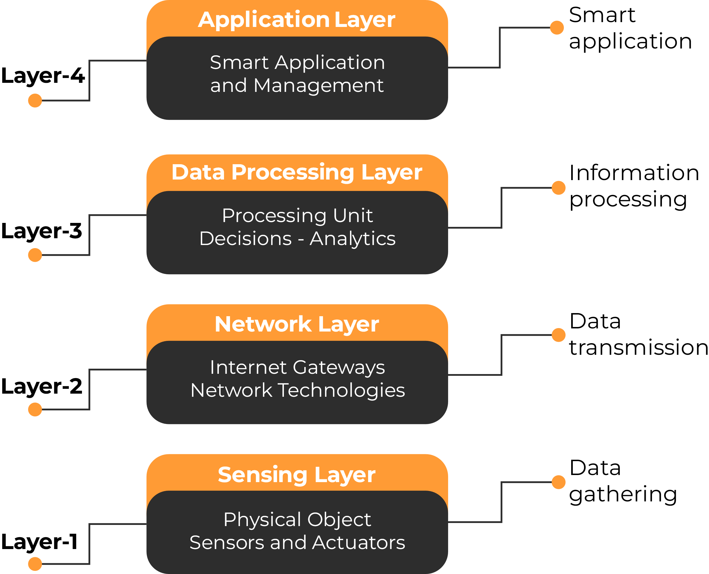
Types of layers of IoT architecture
The most common layers of Internet of Things architecture are 4, however, it doesn’t mean that every IoT device has the same amount.
Slide: 05

Slide 6
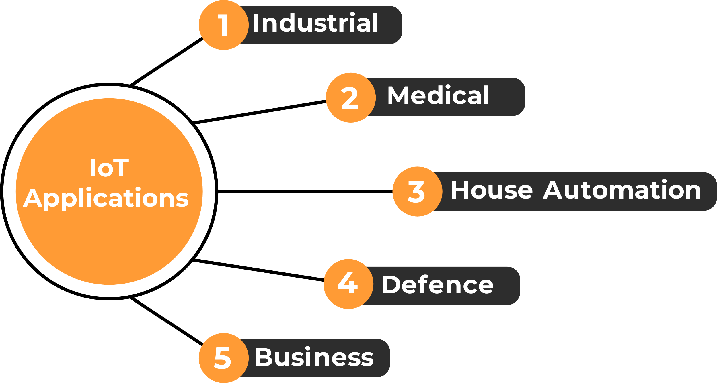
Top 5 IoT Application
Slide: 06

Slide 7
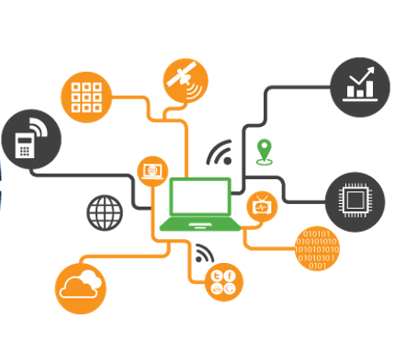
Benefits of IoT
Minimize human effort.
Save time.
Enhanced data collection.
Improved security.
Efficient resource utilization.
Slide: 07

Slide 8
Challenges of IoT
Security challenges.
Lack of encryption.
Lack of sufficient testing and updating.
Weak login details.
Design challenges.
Battery sizes.
Security risk.
Deployment challenges.
High cost.
Connectivity.
Maintenance.
Data processing.
Slide: 08

Slide 9
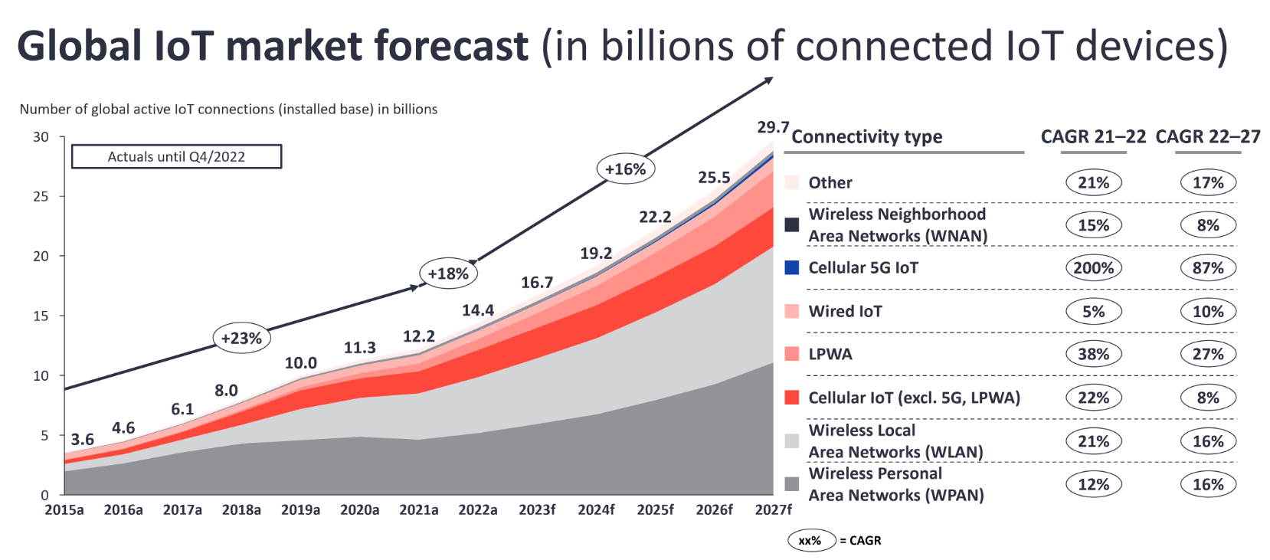
Present State of IoT
State of IoT 2023: Number of connected IoT devices growing 16% to 16.7 billion globally.
Slide: 09

Slide 10

Future Trends of IoT
→ Top 4 future trends of IoT
1. Edge Computing.
2. 5G Connectivity.
3. AI and Machine Learning Integration.
4. Blockchain for IoT Security.
Slide: 10

Slide 11
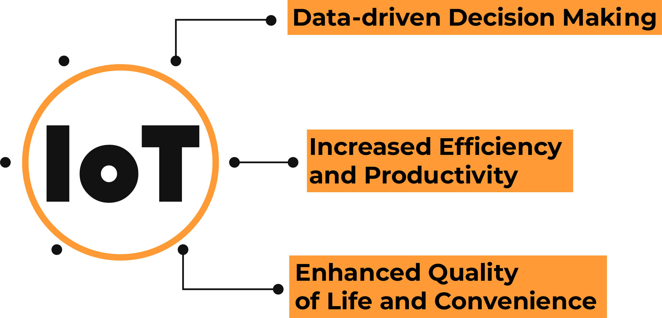
Conclusion
Slide: 11

Slide 12
THANK YOU
Slide: 12

