Slide 1
Name: Sayada Halima ID: 2137620108 Department of CSE
Course Code: CSE2242 Course Title: Technical Writing and Presentation

Slide 2
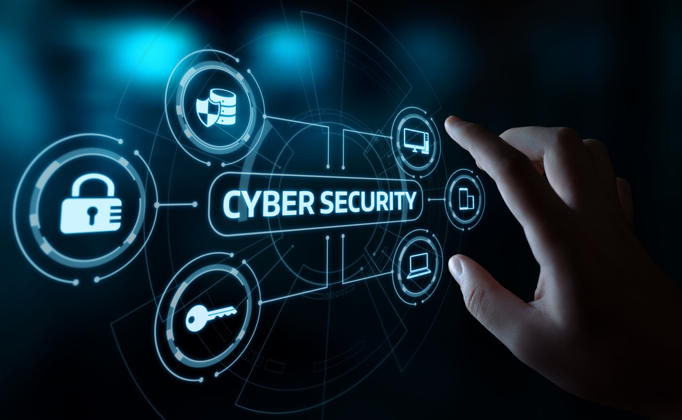
Cyber Security
Safeguarding Digital Assets

Slide 3

Introduction to Cyber Security
Definition
Cybersecurity is protecting digital systems from unauthorized access and threats to ensure data security and operational continuity.
Importance
Safeguarding sensitive data.
Preventing cyber attacks.
Ensuring business continuity.
Preserving trust.
Complying with regulations.

Slide 4
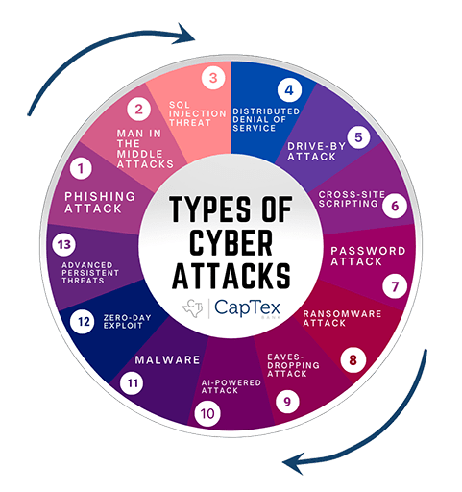
Common Cyber Attacks

Slide 5
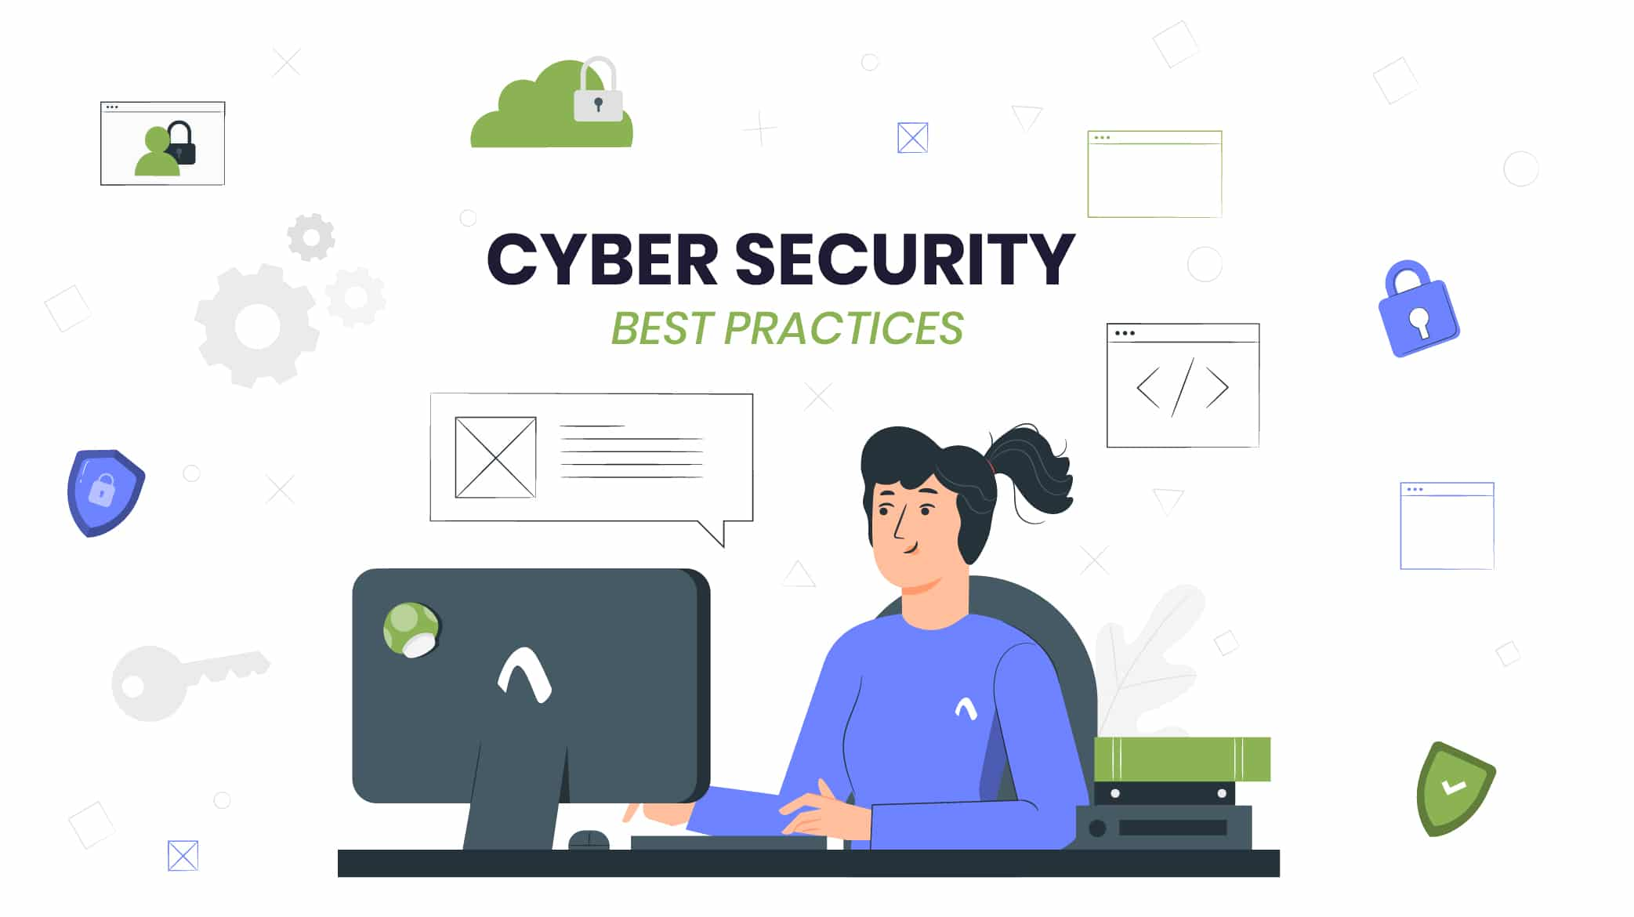
Cyber Security Best Practices
For Individuals:
→ Be Vigilant
→ Backup Data
→ Secure Wi-Fi
→ Educate Yourself

Slide 6
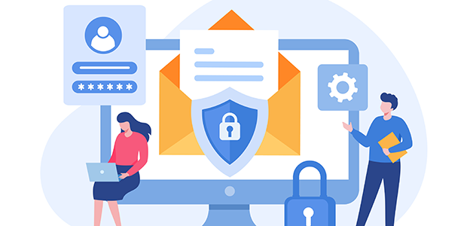
Cyber Security Best Practices
For Organizations:
→ Develop a Cyber Security Policy
→ Conduct Regular Training
→ Implement Access Controls
→ Incident Response Plan

Slide 7
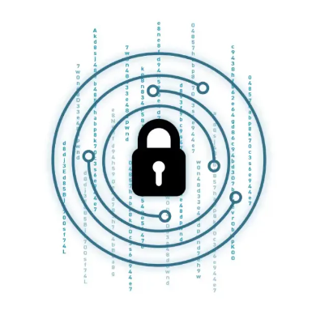
Role of Encryption
Confidentiality: Ensures only authorized parties can access data.
Data Protection: Safeguards sensitive information from theft.
Secure Communication: Encrypts data in transit, preventing interception.
Data Integrity: Verifies data authenticity and trustworthiness.
Compliance Requirements: Meets regulatory standards for data protection.
Protection Against Insider Threats: Limits access to authorized users.
Cloud and Mobile Security: Secures data in cloud storage and on mobile devices.

Slide 8
Top 5 Cyber Security Tools
1. Firewalls
3. Intrusion Detection Systems (IDS)
2. Antivirus Software
4. Encryption Tools
5. Vulnerability Scanners

Slide 9

Emerging Trends in Cyber Security
4 Main Field:
Artificial Intelligence: Both a tool for attackers and defenders, AI is being increasingly used in cyber security applications.
Internet of Things (IoT): The proliferation of IoT devices presents new challenges for security.
Cloud Security: As more data moves to the cloud, ensuring its security becomes paramount.
Quantum Computing: While still in development, quantum computing could potentially render current encryption methods obsolete.

Slide 10
Conclusion
Cyber security is a constant battle against evolving threats.
By implementing best practices and staying informed about emerging trends, individuals and organizations can better protect themselves in the digital landscape.
Thank You

