Slide 1
Using Cointegration to develop Mean Reversion Strategies

Slide 2
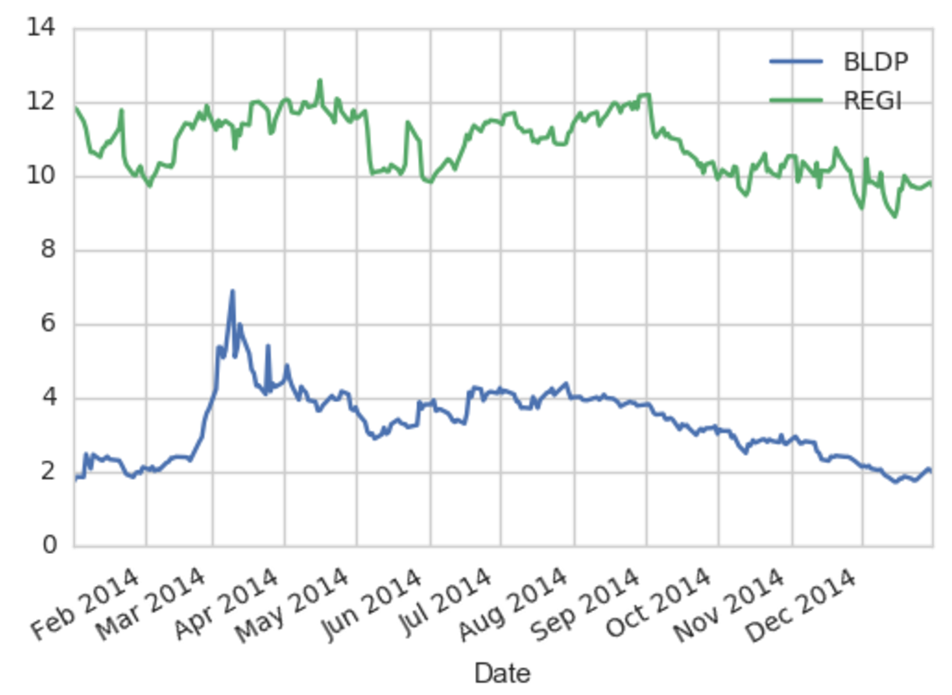
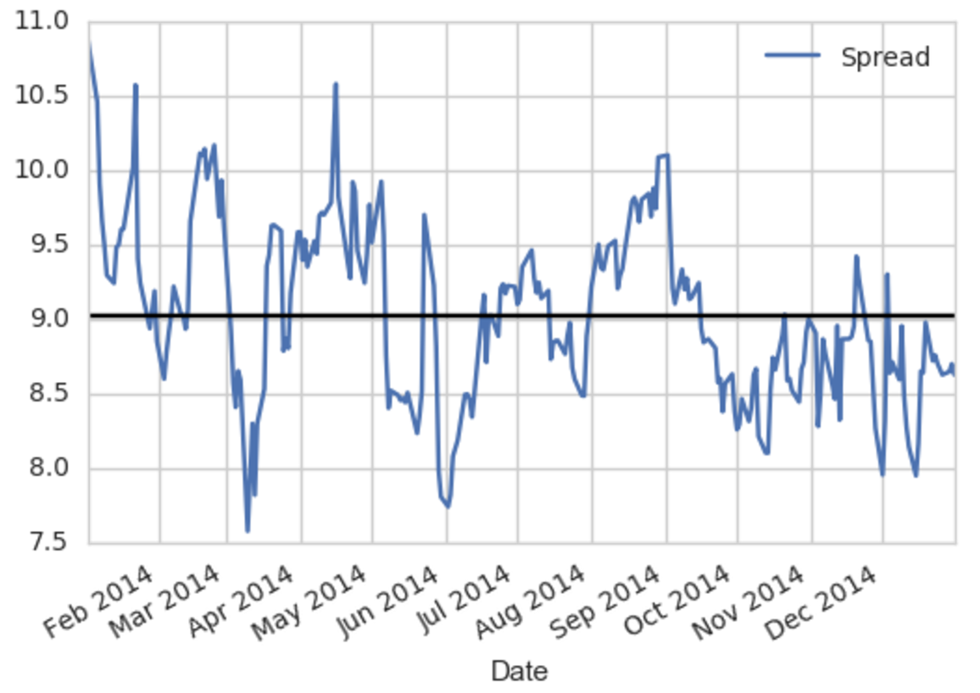
Medium Term Mean Reversion
(Pairs Trading)
Idea: Trade mean reverting spreads between two assets

Slide 3
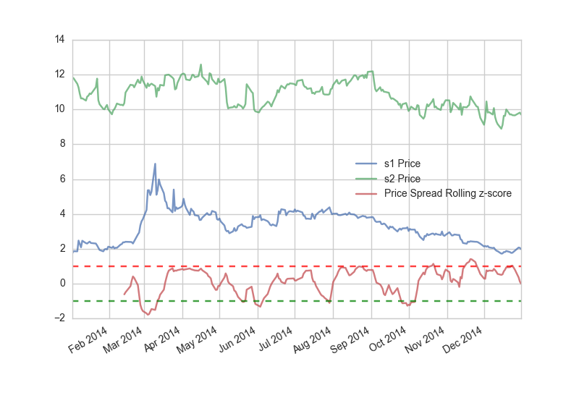
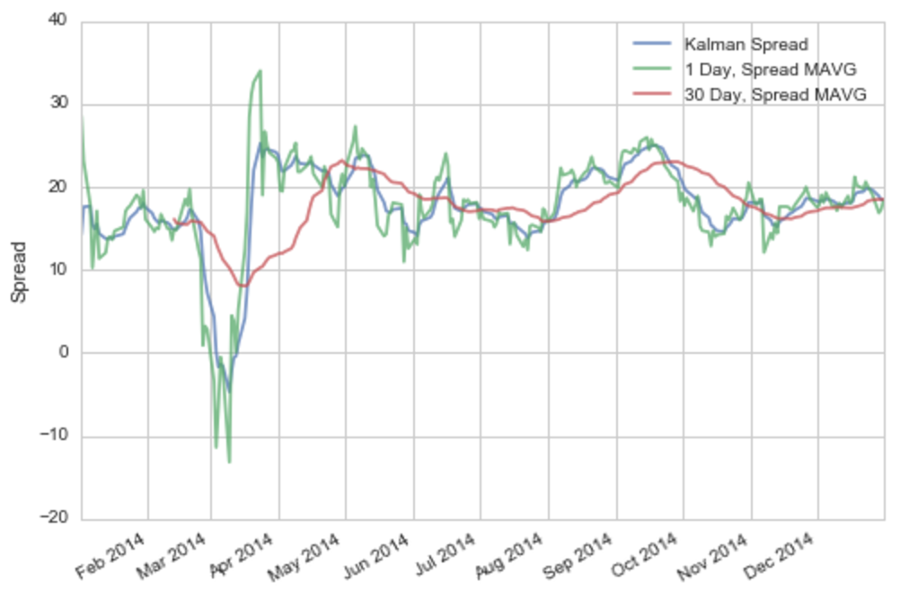
Medium Term Mean Reversion
(Pairs Trading)
We filter spread with a kalman filter to reduce noise, then calculate a z-score for the spread.
The z-score will be our alpha factor. (predictive signal)
A high z-score signals a spread selling opportunity.
A low z-score signals a spread buying opportunity.

Slide 4
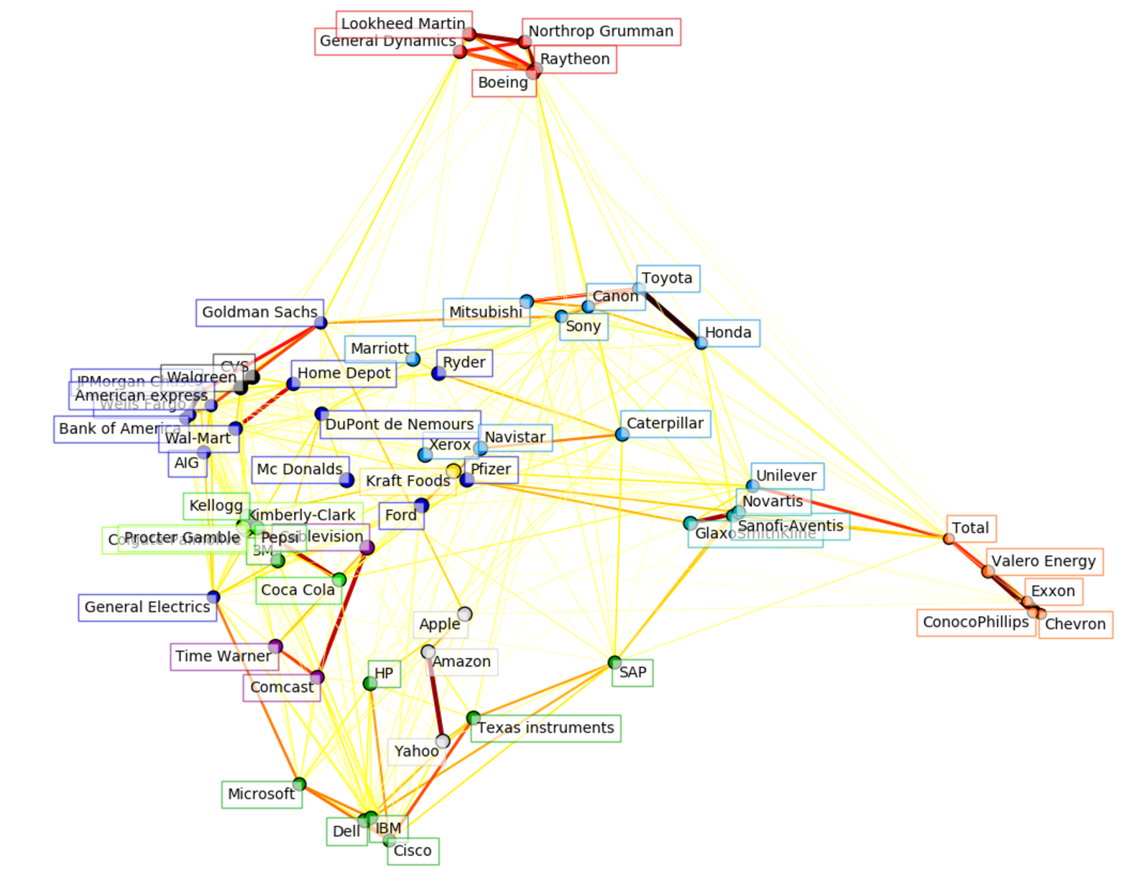
Medium Term Mean Reversion
(Pairs Trading)
We have our trading signal, but now we need the cointegrated stock pairs to trade using the signal.
Task: Find a dynamic method for finding reliable stock pairs to trade.
Solution 1 (unsupervised): Stock price covariance clustering using affinity propagation
Solution 2 (supervised): Train a logistic regression and Random Forest models using cointegrated pairs and non-cointegrated pairs.

Slide 5
Medium Term Mean Reversion
(Pairs Trading)
Pair Selection Via Clustering:
Checking for cointegration between pairs within the same cluster.
Generated 56 cointegrated pairs from a universe of 500 US stocks
Calculate rolling spreads and z-scores for cointegrated pairs
Rank pairs based on z-score factor
Build a factor weighted portfolio
Position sizes proportional to z-score factor

Slide 6
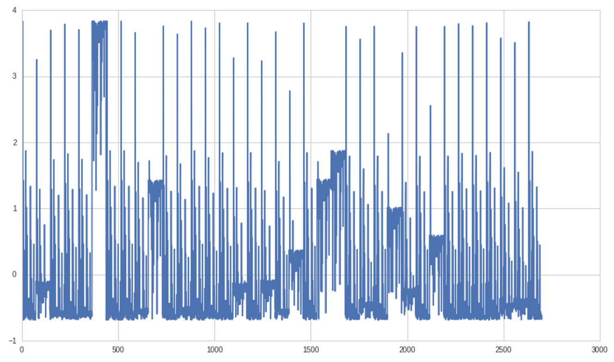
Medium Term Mean Reversion
(Pairs Trading)
Pair Selection Logistic regression and RF Classification:
Normalized Market Capitalization
Labels: cointegrated, non-cointegrated
Data points: stock pairs
Economic fundamental features
K-fold cross validation
Most predictive fundamental features:
Cash return
Current Ration
Market capitalization
Net debt
94% test accuracy
precision recall f1-score support 0 0.94 1.00 0.97 277 1 1.00 0.63 0.77 51 avg / total 0.95 0.94 0.94 328

Slide 7
Results of Cointegration Tests (All of the Cointegrating Pairs that fit our Requirements)
HSC + DEL HSC + TREX HSC + POL HSC + IKNX HSC + CMP HSC + BCC MAS + BCPC MTX + PX MTX + TREX NUE + TREX NUE + POL NUE + TS NUE + TX NUE + FMSA PATK + ECL
BCPC + MAS BCPC + WDFC BCPC + IOSP MTRN + SHLM MTRN + CMP MTRN + SXCP CMC + STLD DD_PRA + STLD DD_PRB + CMP DD_PRB + GPRE UFS + POL UFS + TX ECL + PATK ECL + NP AXLL + RGLD AXLL + HCLP HSC + MTRN

Slide 8
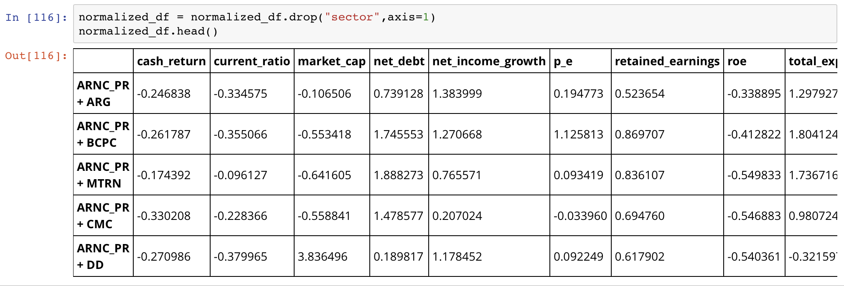
BCPC + WDFC MTRN + SHLM DD + DD_PRA DD + DD_PRB DD_PRA + WY_PRA UFS + RGLD AXLL + RGLD MTX + PX MTX + SHW

Slide 9
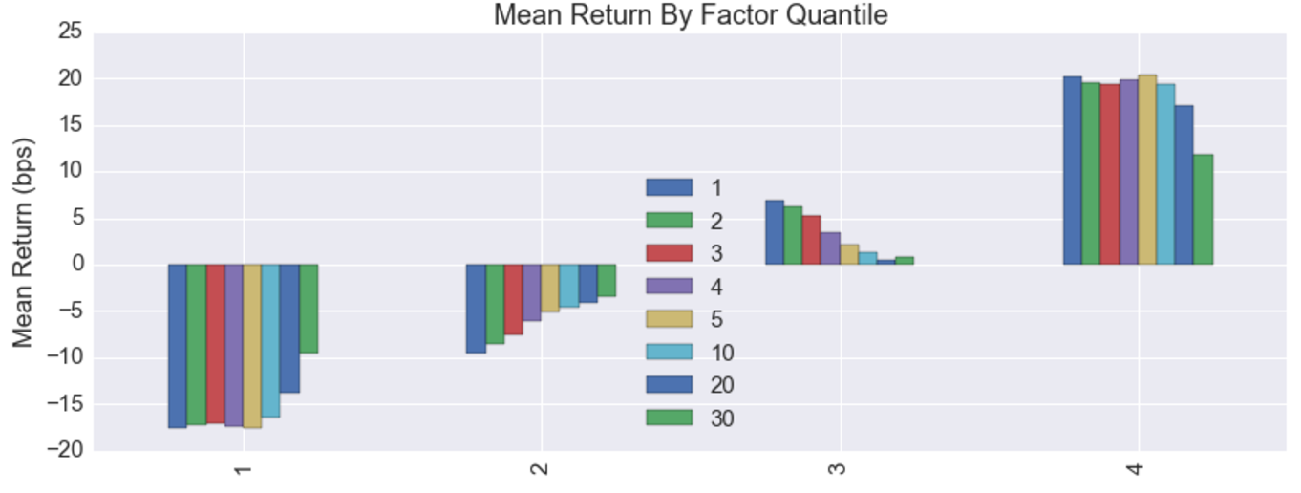
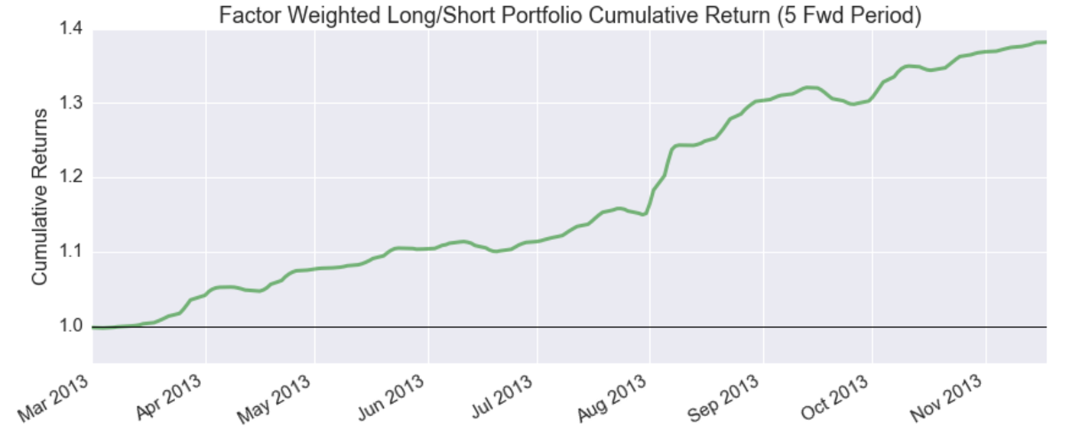
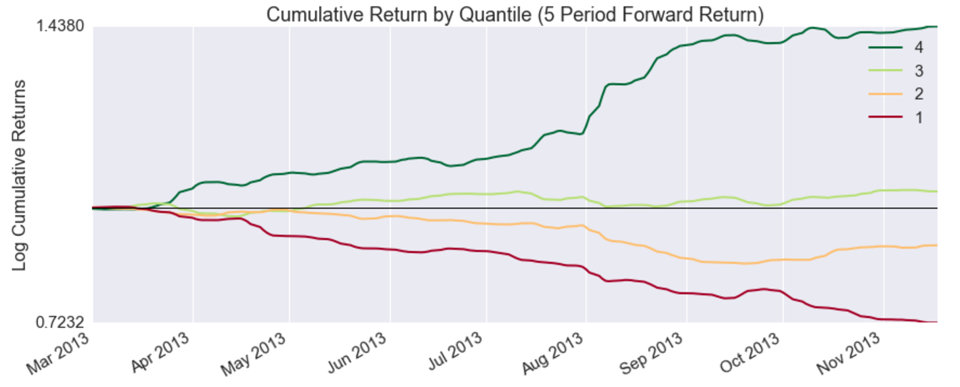
Medium Term Mean Reversion
(Pairs Trading)
Pair Clustering
In Sample Portfolio Performance
5-day holding period 10 month returns: 38%
Mean information coefficient: 0.175
Annualized alpha: 0.377
Annualized market beta: 1.245
very high, closer to 0 prefered

Slide 10
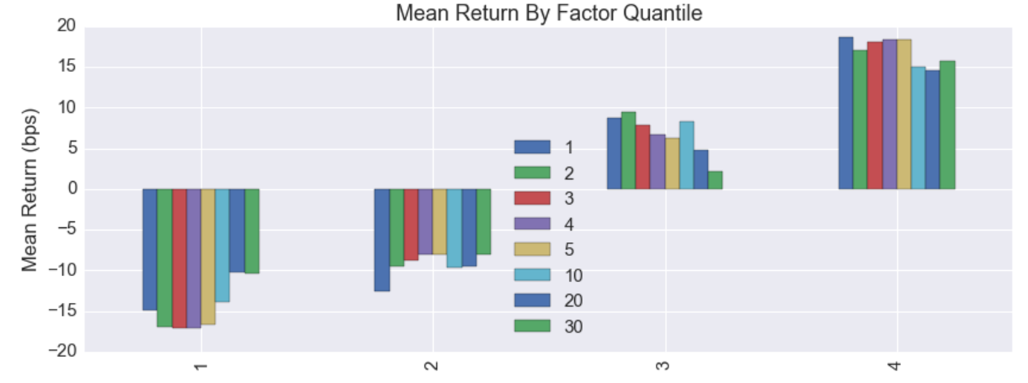
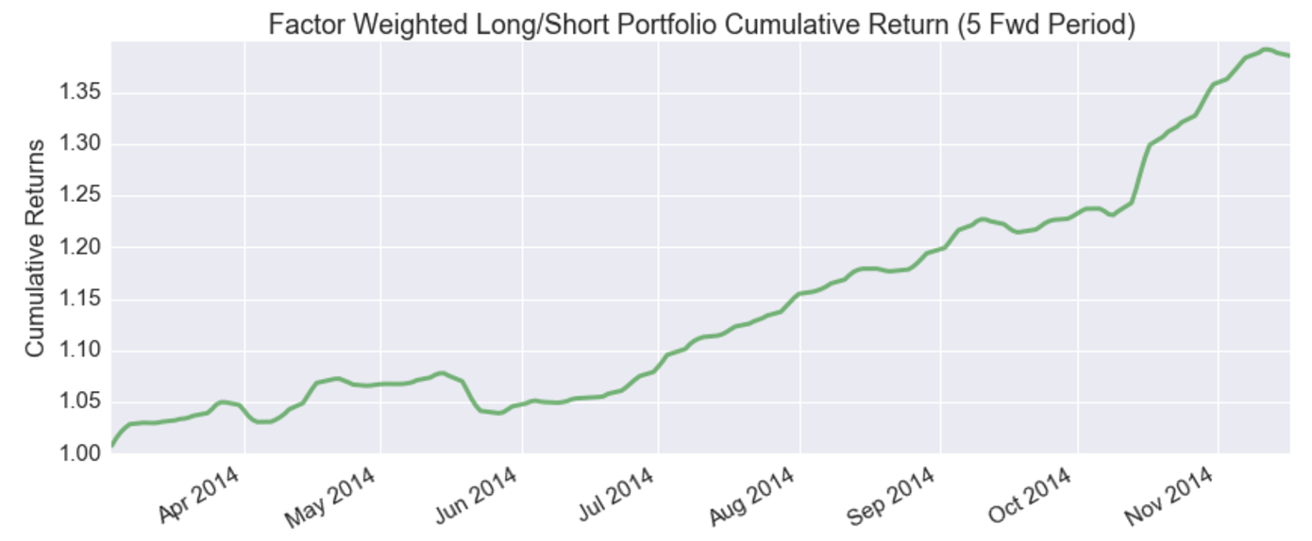
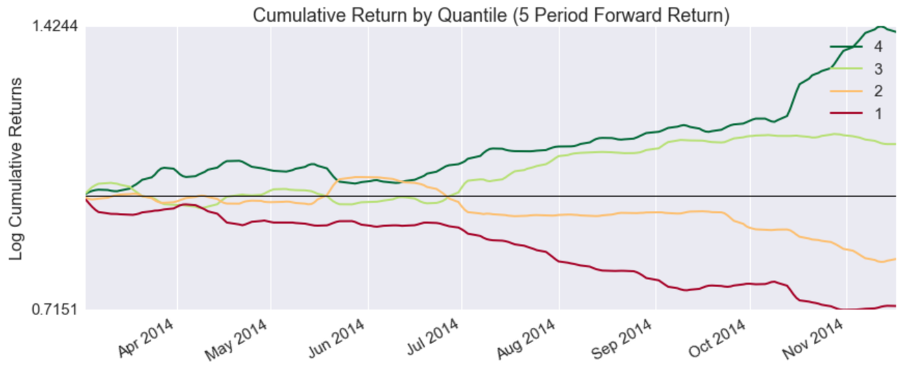
Medium Term Mean Reversion
(Pairs Trading)
Pair Clustering Portfolio
Out of Sample Performance
5-day holding period 10 month returns: 35%
Mean information coefficient: 0.104
Annualized alpha: 0.375
Annualized market beta: 0.413
Fairly good, close to 0 prefered

