Slide 1
Auto Course Advising
Presented to:
Md. Abu Rumman Refat
Lecturer Dept. of CSE
Green University of Bangladesh
Presented by:
Md. Sabbir Hossain
Id: 221902126

Slide 2
1
Content
Introduction
Problem Domain
Objectives
Project Diagram
Tools & Technologies
Project Show

Slide 3
2
Introduction
My project name is " Auto course advising system".
An Automated Course Advising System has been devised to guide students in selecting appropriate courses suitable to online registration.

Slide 4
3
Problem Domain
I think this problem has not solve before.
It is an Exceptional problem.
And this problem will be very effective for new student.

Slide 5
3
Objectives
Students can’t face any problem to take their next courses.
New students will know their student portal facility.
Students will also know the easy system of student portal.
Admin panel will be very beneficial.

Slide 6
3
Tools & Technologies
IntelliJ IDE
macOS system
Java Programming Language
Xampp server For Database
Computer

Slide 7
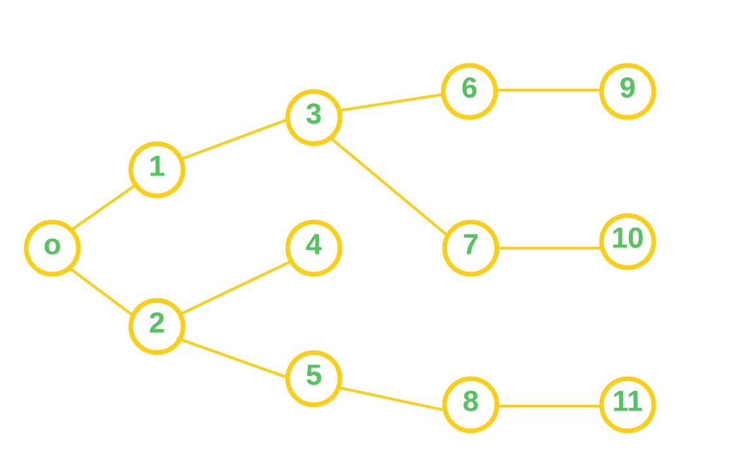
4
Project Diagram

Slide 8
4
References
• Anisul Islam YouTube https://www.youtube.com/@anisul-islam • GeeksforGeeks https://www.geeksforgeeks.org • Javapoint https://www.javatpoint.com/java-swing

Slide 9
Project show

Slide 10
Project show

Slide 11
Thank You

