Slide 1





Better Learning Everyday

Slide 2






CLOUD COMPUTING & AMAZON WEB SERVICES
Contents
Pg No.
Section
01
Introduction
08
Features
11
Why Companies are Deploying Cloud Computing
13
The Current Landscape
21
Types of Cloud Computing
27
Architecture of Cloud Computing
31
Security and Safety Threats
34
Amazon Web Services(AWS)
as a Cloud Service
45
Steps for Deploying AWS in Cloud
51
Some Cloud Alternative in the Market
62
Conclusion

Slide 3
CLOUD COMPUTING & AMAZON WEB SERVICES
Introduction
Today’s generation is plagued by the constant rise in need of services and
resources that are required in order to establish a solid entity. A website needs
a platform which can be live and continuously running, to generate maximum
hits and grow its community. This is where cloud computing comes into the
picture. It provides a platform which enables the website to grow online and be
visible to everyone. It can be accessed anywhere and changes by the admin can
be done to it anytime at their own comfort.
Cloud computing has been known to optimize IT-infrastructure costs. Many
companies are known to deploy it in their systems to decrease costs and
concentrate more on their business goals. This promotes professionalism and
helps the company to be more focused on attaining its business goals. There
are many features and advantages of cloud computing that we are going to
cover in this guidebook. This guidebook has been specifically crafted to
nurture the different deployment models and services that cloud computing
has up its sleeve. The online markets have realized the lackluster performance
of their personally owned servers which is incapable of handling so much
traffic at once. Cloud computing has facilitated many organizations to look
past their local servers and rely on high-performance remote servers that can
be futile for their business.
History
During the 2000s, cloud computing gained momentum. Before this period, it
was used to represent a batch of computers that were connected with each
other to save data. After the advent of Virtual Private Networks, companies
gradually implemented VPN in their networks for better security. This enabled
the companies to use the overall network bandwidth more efficiently. Later, a
cloud-like logo was used to denote for the advent of cloud computing. As more
and more servers were included and the infrastructure was growing steadily,
the storage computing had a paradigm shift. Scientists and computer
Page 01

Slide 4
CLOUD COMPUTING & AMAZON WEB SERVICES
engineers learned more ways to extend this storage by implementing large-
scale computing to include more real-time servers to process and save
data.More and more algorithms were tested to optimize the services that use
the cloud computing platform as their way of communication with the real
world.
Definition
Cloud computing is a collective system which uses remote servers on the
internet to collect, maintain and process data rather than a local server or
personal computer. If a person wants to host his website online, he can buy a
bunch of servers at a subsidized cost to keep his website up and running.
Excessive data traffic is common at peak hours and makes us realize the true
potential of cloud computing. The reason why more companies are relying on
this technology is to make sure that their services are rendered to the
customers without any hiccups and the flow is maintained without the
slightest interruption.
Deployment models
Choosing the right cloud model to host business in real-time is the first step
which a company comprehends before entering the market. Sometimes, a
cloud-hosting service may fail even though it has been undertaken and
managed online with all the accurate steps. This situation usually occurs when
the companies select the wrong cloud-model to demonstrate their business.
To get this initial step right, let's explore four different models in cloud
computing which can get the job done.
Private Cloud
Public Cloud
Hybrid Cloud
Community Cloud
Page 02

Slide 5

CLOUD COMPUTING & AMAZON WEB SERVICES
Private Cloud :
Companies opt for cloud services that are accessible only in their premises and
not outside. This can be labeled as a private cloud. A company which comprises
of different departments, domains, clients, employees are given access to the
cloud. These entities are allowed to access and make certain limited changes
which can be beneficial for the company. They are given access to limited
bandwidth network, security disclosures, and legitimate requirements which
might be necessary. Private cloud is also known to be an internal cloud due to
restricted access. This makes it less susceptible to security threats due to its
inbuilt firewall and a ton of services which maintain the confidentiality of the
entities, for example, banks where safeguarding customer data is the first
priority. Plus, a private cloud is known for its customizable services as per the
demands of a business. It accommodates and facilitates the organization's
requirements in the cloud so that it can have more control over its business.
Page 03
Pvt
Ltd

Slide 6
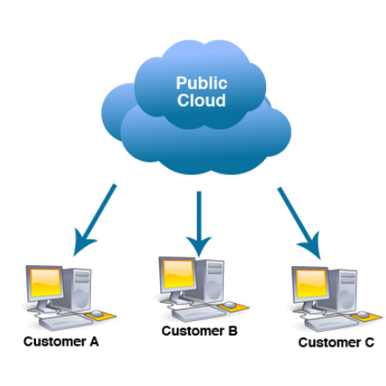
CLOUD COMPUTING & AMAZON WEB SERVICES
Public Cloud :
The public cloud model is established with a goal to supply limitless memory
storage and expanded data transmission through the Internet to all
organizations and their loyal customers. It takes care of all the prerequisites
for small, medium and big-sized enterprises. This model works on the per-
minute billing system. Companies only pay for the services they utilize and can
avail other services to ease down their workload and concentrate on
important entities. For instance, the Amazon cloud service AWS provides its
consumers the option to avail certain features which may suit their needs
according to some specific guidelines led by the company. Sometimes, the
company will share some basic information with their customers but the
private data is not disclosed to the customers. The customers can take full
advantage of this cloud by availing their favorite services and can also share
this information with others. Public cloud is accessible from any part of the
world to the user who wants to access it on the go. This enables them to reach
out to the global audience and enable better and wider service.
Page 04

Slide 7
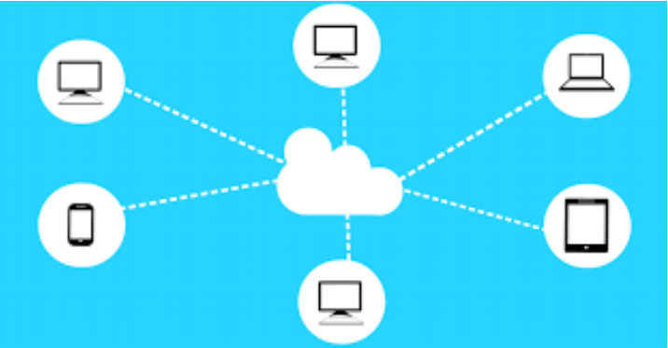
CLOUD COMPUTING & AMAZON WEB SERVICES
Hybrid Cloud :
A hybrid cloud combines the services provided by a private and public cloud. It
enables the consumers to have access to the information and these services are
safeguarded in order to avoid any hacking or information leak. At times, a cloud
service provider must ensure that the uptime of their service is maximum. Hence,
if a company has opted for a hybrid cloud, it can get enough uptime for the
resources it has opted for. Majority of cloud providers have a Service Level
Agreement(SLA) which guarantees maximum uptime and minuscule downtime to
ensure consistency. A hybrid cloud can be owned by a few organizations
collectively in order to minimize costs and avail services whenever they need.
They can even share information with each other provided they are bound by an
agreement in doing so.
Page 05

Slide 8

CLOUD COMPUTING & AMAZON WEB SERVICES
Community Cloud :
The community cloud architecture is initially supervised, then managed by a
different number of corporations that plan for the same core foundation,
business, or projects.Core domains like software and hardware are taken into
consideration in order to reduce the running costs of the IT department.
Academic clouds are a perfect example of a community cloud service.
Page 06

Slide 9
CLOUD COMPUTING & AMAZON WEB SERVICES
Questions that can be expected in interviews
Q) Difference between private and public clouds.
A) Private cloud is owned by a single company and access is giving to some
employees of the company. Whereas, the public cloud can be shared among
many external entities and changes can be made by anyone who has access to
the public cloud.
Q) What are hybrid clouds?
A) Hybrid cloud is a combination of both private and public cloud, with some
features of public and some features of private cloud under the hood.
Page 07

