Slide 1





CLOUD COMPUTING & AMAZON WEB SERVICES
Types of Cloud Computing
SaaS- Software as a Service
Software as a service is provided by the Cloud Service Provider to the client.
The CSP leases applications or software to the client as and when needed on a
per-service pay basis. For example, Salesforce provides the Customer Relation
Manager(CRM) to companies who are willing to check its relation with the
customers. The infrastructure is owned by Salesforce and the services
provided to the client are managed from its end.
Most companies utilize SaaS for meeting their business obligations. It provides
tons of features which are owned by a third-party vendor. A majority of SaaS
applications are able to operate directly through the web browser, therefore
they do not require any download or installations at the client side for
operation. Cloud vendors try to maintain all the inherent technical issues such
as data, servers, and storage, while businesses can simply concentrate on
maintenance and support.
SaaS is often recommended to small startups and businesses that have e-
commerce as their target market. This can reduce a lot of stress and time for
companies to launch their products quickly. Companies can utilize SaaS for
both web and mobile access. To collaborate on small projects, SaaS is a great
option for businesses. As SaaS is known to provide on-demand software and
applications for easy implementation at the client’s end, it is also vital for the
third-party to ensure that enough bandwidth is used to make businesses shine
and continue without any hiccups.
Examples of SaaS are Salesforce, GoToMeeting, Dropbox, and Cisco WebEx.
The organizations have to rent these applications from their parent companies
in order to utilize the potential features in their businesses.
Page 21

Slide 2
CLOUD COMPUTING & AMAZON WEB SERVICES
PaaS- Platform as a Service
In PaaS, the CSP gives the heritage of deploying customer-created applications
to the customers using various programming tools which are provided by the
CSP. The customer has no control over the underlying architecture including
operating systems, storage, and servers.
PaaS supplies a variety of frameworks for developers in order to build and
deploy customized applications. All servers, storage, and networking can be
handled by a third-party provider while the developers can work on their
applications.
The working of PaaS is similar to SaaS, except for one thing, instead of
delivering the software over the internet, PaaS provides a platform for
software formulation. This platform is presented over the web which gives
software developers a sense of liberty to concentrate in building the software
based on the guidelines laid by the company and not having a second thought
on establishing a perfect base for the company.
The best part of PaaS is virtualization, which allows the resources to be scaled
up and down depending on the requirements laid by the enterprise. It also
provides a bunch of different services to help with the developing, testing, and
deployment of applications in the cloud. It is quite user-friendly for coders and
developers and enables easy migration to another cloud. Most importantly,
the web services and databases are integrated for smoother execution of
applications in the cloud.
Examples of PaaS are Google App Engine, Apache Stratos, OpenShift, AWS
Elastic BeanStalk, and Heroku.
Page 22

Slide 3
CLOUD COMPUTING & AMAZON WEB SERVICES
IaaS- Infrastructure as a Service
IaaS is exemplary for organizations that require satisfying support for a full-
fledged cloud computing infrastructure, but can’t afford the hardware
components that they need. It delivers virtualized computing resources over
the internet without any extra fuss. The client can relax and trust in the
underlying physical machine that is being harnessed to coordinate services
and resources to the company. It basically abstracts the user from the physical
machine.
IaaS basically liberates cloud computing platform to organizations, including
elements such as servers, network, operating systems, and storage, through
virtualization technology. These cloud servers are handed over to the client
through an API. IaaS clients have absolute control over the entire cloud
infrastructure. It provides the same technologies and capabilities as a
traditional data center without having to physically maintain or manage all of
it. The IaaS model has an upper hand in presenting cloud computing
infrastructure as an on-demand service. As clients have the freedom to access
servers, data storage centers, and network equipment, they can work and take
advantage of this service as much as they want.
The IaaS is just as beneficial in some situations as Saas and PaaS. It can vary
from small startups to giant companies who can invest in this model and save
time and money in both hardware and software. It is beneficial for big
organizations in order to gain complete control of their applications and
infrastructures. It is recommended for companies who like to challenge their
boundaries and keep growing despite having lack of resources to expand their
business to meet their goals.
Due to its flexibility and tangibility, it becomes very easy for enterprises to
scale their resources up or down depending on the requirements. Examples of
IaaS are RackSpace, Amazon Web Services(AWS), Microsoft Azure and
DigitalOcean.
Page 23

Slide 4
CLOUD COMPUTING & AMAZON WEB SERVICES
DaaS- Desktop as a Service
DaaS provides a platform to the clients and arranges a virtual desktop with the
cloud provider enabling all the back-end services to the client. Adopting DaaS
has its own share of advantages like migrating to another cloud is quite easy.
The structure and architecture of this platform compared to other models is
quite simple and easy to understand. Another good thing about DaaS is that it
can be easily customized as per the client's expectations.
The most ideal application of DaaS would be in small organizations who have
access to only limited resources. They need the cloud services to run and
manage some of their services for the client and customers. However, large
multi-national corporations should stay away from this as they might require a
more linear and sophisticated approach towards managing their services on
the cloud for the big offshore clients. They should prefer IaaS to maintain the
confidentiality of their business and focus more on achieving bigger business
goals which will help in maintaining their credibility in the market.
Examples for Daas are VMWare Horizon Cloud, Amazon Workspaces and
Citrus XenDesktop. These services are vital for small businesses who are
looking to deploy cloud services to maintain the coherence of their products.
Page 24

Slide 5


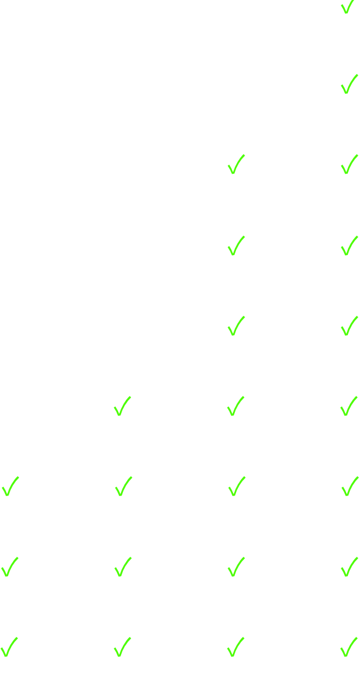
CLOUD COMPUTING & AMAZON WEB SERVICES
To sum it up all, we can have a look at the table below.
X means the user manages that service
Service
DaaS
IaaS
PaaS
SaaS
Applications
X
X
X
Data
X
X
X
Runtime
X
X
Middleware
X
X
OS
X
X
Virtualization
X
Servers
Storage
Networking
Page 25

Slide 6
CLOUD COMPUTING & AMAZON WEB SERVICES
Questions that can be expected in interviews
Q) What is Saas, IaaS, PaaS, DaaS?
A) SaaS is used to lease a particular software available in the market through
the means of a cloud. Companies like SalesForce provide their CRM(Customer
Relation Manager) to enterprises who are keen to interact with their customer
base.
CSPs provides PaaS to deploy applications or websites on a platform that is
well-optimized for these tasks. Anyone willing to launch their product can
utilize PaaS.
IaaS delivers virtualized computing resources packaged in an environment
required by small companies to deploy their services.
A setup similar to a desktop computer is provided by DaaS. It gives enough
resources and computing power with access to back-end services of the client.
Q) What are the models used to deploy cloud computing?
A) Cloud computing uses four models- SaaS, Iaas, Paas, and DaaS to
implement and utilize its services with the means of an internet connection.
Q) What is the most preferred model?
A) Businesses prefer Infrastructure as a Service(IaaS) compared to SaaS or
PaaS as it provides more resources in form of a virtualized computing
environment. This achieves better computing power to handle heavy
applications and the maximum number of services.
Page 26

