Slide 1




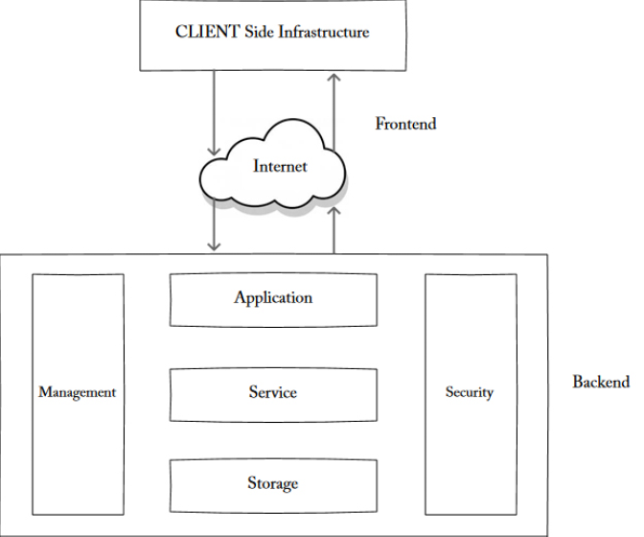

CLOUD COMPUTING & AMAZON WEB SERVICES
The architecture of cloud computing
To understand the working and architecture of a cloud, we need to take a deep
look into its components and establish significance for each one of them. The
cloud components are loosely coupled. In other words, they are independent
of each other. Let us see what cloud is made of.
Front End
The front end of a cloud belongs to the client side. This part of cloud computing
is managed by the client. This comprises interfaces and applications that are
required to access the cloud. For example, we generally use a web browser like
Google Chrome or Mozilla Firefox to access the services that are available in
the cloud through the internet.
Page 27

Slide 2
CLOUD COMPUTING & AMAZON WEB SERVICES
Front-end components include the user interface, along with the client’s
computer system that is utilized for harnessing the cloud system. There is a
provision where all cloud computing services have different interfaces for
users to learn and manage—for instance, the Google Docs user interface is
distinctive than that of Salesforce cloud interface.
Back End
The back end of a cloud belongs to the vendor who is managing the entire
cloud. It comprises of all the necessary components that are needed to run a
cloud. It has data storage, virtual machine, security mechanism, services,
deployment modes, and servers. CSPs are responsible for the functioning of all
these components.
Internet
The most mandatory component required to pull off this setup is, of course,
the bandwidth. It connects both the client and the vendor and enables a
smoother flow of data. To sum it up, cloud computing services can be found
everywhere these days. If a user is utilizing services like Google Drive or Office
365 at home or work, then he is a dedicated cloud computing user.
Let us discuss some important types of architectures which can vary
depending on the business requirements.
Single Server
Single server cloud templates embody the use of one server, physical or
virtual, that includes a web server, an application, and a database. Single server
architectures are not widely used, as they have potential security risks which
can compromise the whole system. These architectures are usually deployed
for development purposes, enabling developers to strengthen functionality
without having to deal with connectivity and communication issues between
different servers.
Page 28

Slide 3
CLOUD COMPUTING & AMAZON WEB SERVICES
Single Site
Single-site platforms utilize the single server architecture and divide the layers
in different systems thus modeling a three-tier architecture. As the system is
administered in the same location, single-site architecture is maintained as up
and running.
Redundant three-tier architectures
Redundant three-tier architectures have the capability of appending another
set of the same components to look after redundancy. These pairs of
components increase the complexity of the system but are required to tackle
failover and manage recovery protection. Constructing redundant
infrastructures requires a well-executed plan for the components within each
layer for horizontal scaling, along with a plan for how the traffic will circulate
from one layer to another meant for vertical scaling.
Auto-scaling architecture
The main takeaway of cloud computing is the ability to utilize a particular
service or resource when it is needed. This autoscaling feature enables the
cloud to scale horizontally which is to shrink or grow the number of running
server instances in a largely coupled system with changes in demand of
application over time.
Different sorts of architectures are supplied to the clients. It is the
responsibility of the client to make sure that the model he prefers for his
business must suit his business needs and requirements in the long run. At
times, it is necessary to gain information regarding cloud from the vendor to
ensure smoother execution of applications and work-flow balance.
Page 29

Slide 4
CLOUD COMPUTING & AMAZON WEB SERVICES
Questions that can be expected in interviews
Q) Explain the architecture of cloud computing.
A) Cloud computing architecture is made of the following three components
Front End
Back End
Internet
*Explain each of these components in brief, where are they situated, what they do
and what are their main features.*
Q) Name the types of architectures used in cloud computing.
A) Single site
Single server
Redundant three-tier architecture
Auto-scaling architecture
Page 30

