Slide 1




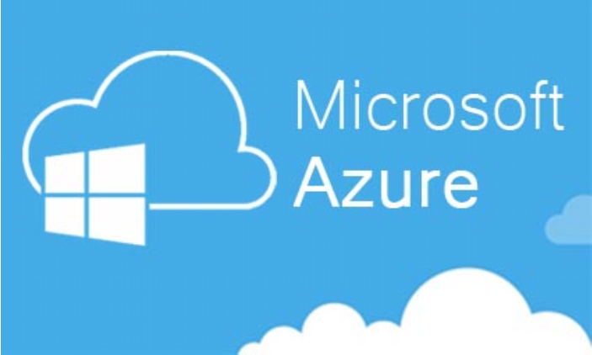

CLOUD COMPUTING & AMAZON WEB SERVICES
Some Cloud Alternative in the Market
Microsoft Azure
Microsoft’s answer to Amazon’s AWS is its cloud service Azure which was
established in 2010. It is a cloud computing service capable of building, testing
and deploying cloud-related services and applications on globally connected
servers through a network. Azure’s infrastructure is composed of SaaS, Iaas,
PaaS just like AWS. It has included many diverse programming languages and
frameworks which Microsoft has designed specifically for its cloud
infrastructure.
Microsoft's marketing concept for Azure is “Turn your ideas into solutions
faster using a trusted cloud which is designed for you. Azure. Cloud for all”.
Azure has support for languages such as PHP, ASP.NET, Node.js, and Python. It
delivers mobile engagement experience which collects real-time analytics that
highlight users’ behaviors.
Page 51

Slide 2
CLOUD COMPUTING & AMAZON WEB SERVICES
Storage services like REST and SDK APIs are used for storing and retrieving
data in the cloud. Azure has a data management system which offers options
for altering and managing data. For example, Cosmos DB is embedded in the
system to communicate with a NoSQL database which implements a subset of
the SELECT statement on JSON documents.
SQL Database has been assigned to build, balance and support applications in
the cloud using Microsoft SQL Server technology. It also integrates with Active
Directory and Big Data’s Hadoop. Microsoft has also implemented a Machine
Learning service in Azure which enables predictive analytics and synergy with
data using natural language processing (NLP) with the likes of Cortana. This is
also a part of Cortana Intelligence Suite which translates human speech to
computer language with the help of NLP.
Some of the advantages of assigning Azure your cloud computing
responsibilities.
Productive
Microsoft Azure comprises more than 100 services with great end-to-end
tools to make any small idea or a big business prosperous.
Hybrid
It gives you the power of developing and deploying applications where you
want, with the only steady hybrid cloud available in the market.
Scalable
Azure’s services can be extended with the help of on-board Azure Stack.
Intelligent
Gives you the provision of building intelligent apps using compelling data and
Artificial Intelligence
Page 52

Slide 3
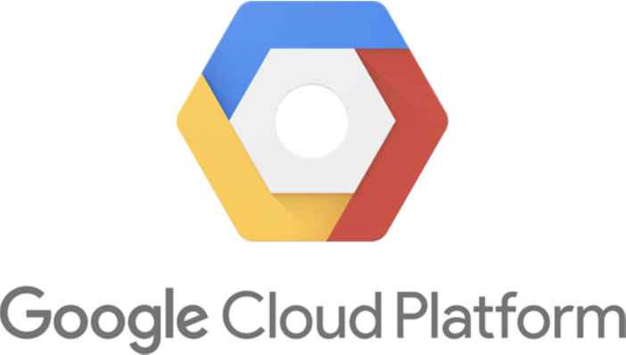
CLOUD COMPUTING & AMAZON WEB SERVICES
Trusted
95% of the top 500 Fortune companies are running on this platform. Many
startups and governments bodies are using this service.
Similar to other public cloud providers in the market, Azure follows a pay-as-
you-go pricing model that charges the user based on his usage. If a business
has opted for a single application but is using multiple services then each
service might be charged according to the multiple pricing tiers laid down in
the guidelines. Microsoft also has the provision of delivering some extended
services at a discounted rate.
Google Cloud Platform
Page 53

Slide 4
CLOUD COMPUTING & AMAZON WEB SERVICES
“One Cloud, endless possibilities”. Google has administered its own cloud
services under GCP. It has ample computing power to take care of big business
requirements and responsibilities. G Suite was created to accelerate the
prospectus of healthy business performance and derive meaningful business
from the clients using a host of its services. Data Analytics is just the icing on
the cake. It provides smart insights of the data to help understand the topology
of data. Artificial Intelligence and machine learning have been embedded to
extract meaningful patterns from the data collected daily by means of various
sources. Google provides its premier service Google Maps Platform to
formulate immersive geographical experiences. This data is garnered from
real-time servers and satellites by Google tracks and administers every region
on this earth and gives us accurate directions to our destination. All of these
are backed up by an infrastructure which includes tons of servers which are
online 24 hours and are scattered all over the globe. They work in unison to
provide the on-the-go storage for businesses and users who want to run their
business on the cloud.
Google Cloud Platform delivers Infrastructure as a service, Platform as a
service, and serverless processing environments for the cloud computing
platform. It has some smart solutions under its belt which include services
related to infrastructure and big data. CLoud migration can be trusted to move
your cloud from one platform to another. It has Hybrid Cloud which utilizes
open, container-based services for companies to work seamlessly. API
management takes care of deploying our own APIs with enhanced security,
stability and visibility. Big Data services include IoT devices which can be
connected to each other anywhere globally.
Google Search and YouTube are in the front seat of the Google Cloud
Platform. They are accessed by billions of people every day. Google has
become an integral part of our lives as it takes care of our queries- both
personal and business-related.
Page 54

Slide 5
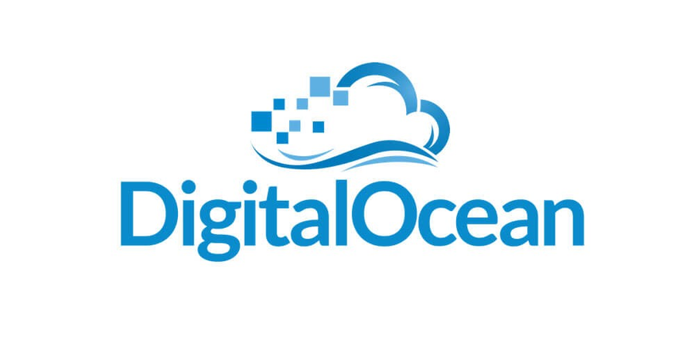
CLOUD COMPUTING & AMAZON WEB SERVICES
Youtube is a video-streaming service which connects us to diverse and mature
creators across the globe. It has creators ranging from vloggers to technology
experts who are using this platform to deliver fresh content to us from time to
time.
Google seems to have taken care of the future prospects for ML. Cloud
AutoML was created to train and deploy custom machine learning models.
Cloud TPU is an accelerator engine used by Google to train machine learning
models. It has Job Discovery services which have been trained and built on
machine learning models for recruiting purposes. Cloud Natural Language
provides text analysis services based on deep learning models. For computer
vision and image analysis, it has Vision API. And lastly, it has a Video
Intelligence service which takes care of video analysis based on some
predefined machine learning management tools.
Digital Ocean
Page 55

Slide 6
CLOUD COMPUTING & AMAZON WEB SERVICES
DigitalOcean is an American cloud infrastructure provider which has its data
centers worldwide. It was created with a notion of providing developers cloud
services that facilitate the deployment and scaling of applications that can run
simultaneously on multiple computers. In 2018, DigitalOcean was the third-
largest hosting company in the world in terms of providing cloud services.
Earlier, in 2003, it was founded as ServerStack, which integrated the services
like web hosting and virtual servers for tidy businesses. They targeted the
markets belonging to entrepreneurial developers that were untapped during
that period for a long time. Slowly and steadily, ServerStack gained its space in
the cloud market and got rebranded to Digital Ocean for bigger businesses and
better opportunities.
DO offers virtual servers known as VPS or droplets in DO terms. It uses KVM
as hypervisor and has the option to be created in either standard or optimized
forms. It includes out-of-the-box services like GNU/Linux distributions and a
bunch of one-click applications which enable faster business and better
growth. Later, DO added load balancers in their bucket of services. Services
like DevOps were added to deliver applications and products of a company at
a faster rate.
DO was hand-stitched for developers to give them a platform where they can
manage their own infrastructure and APIs for creating their own customized
applications in less time to tailor their business needs. DigitalOcean is
currently offering a community resource, which enables to users all over the
world to connect and share their ideas and resources for better
implementation. in 2014, this community received 2 million visitors per month
and now has more than 1,000 self-made tutorials.
Page 56

Slide 7

CLOUD COMPUTING & AMAZON WEB SERVICES
RackSpace
Rackspace is a cloud hosting service which allows users to launch their website
online with the help of resources and tools available. It protects the user’s
sensitive data by delivering environments designed for PCI-DSS, HIPAA, SOX
and FISMA compliance. Speed and availability are required in a customized
cloud environment to avoid downtime and get maximum hits. RackSpace has a
holistic approach towards security as any potential thread can hit the servers
anytime from anywhere.
It all started in 1996 when an internet service provider started his own office
in his garage in Texas. It offered application development work along with
Internet access and web hosting. Later, when the company started working on
building internet applications, it was renamed as Cymitar Technology. The
founder of the company had the opinion that it would be better to host an
array of cloud services as the primary business goals of the company and later
in 1998, Rackspace launched its cloud hosting services in the market.
It can replace the aging physical infrastructure with powerful modern
hardware for enhanced efficiency and scalability. This guarantees maximum
uptime and on-par performance. It follows the guidelines laid by government
compliance which makes it easy and cheap for small businesses to migrate to
RackSpace using minimum resources.
Page 57

Slide 8
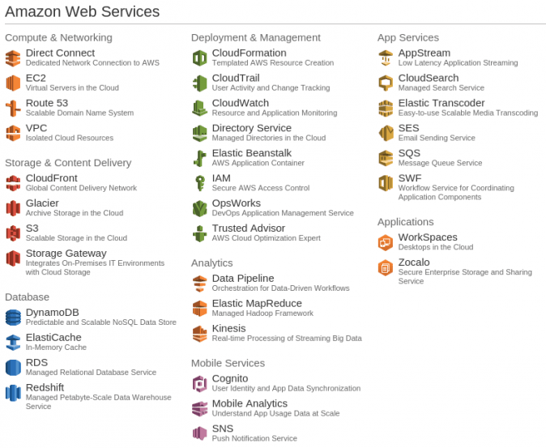
CLOUD COMPUTING & AMAZON WEB SERVICES
Why AWS is considered superior to its alternatives
While people may argue that there are better cloud services available in the
market compared to AWS, the truth is enterprises trust AWS for its long
history and consistent customer support. Let's shed some light on some points
on how AWS can outshine its competition.
The array of services it provides
Amazon has been updating its cloud services from time to time to
accommodate new and demanding services that businesses require for their
website or applications. A long list of services like EC2, Route S3 in
computation and networking, Glacier and CloudFront for storage, RDS and
DynamoDb for manipulating relational databases, Kinesis for real-time
analytics and many more are embedded in AWS to ensure that the clients
never have to consider an alternative.
Page 58

Slide 9
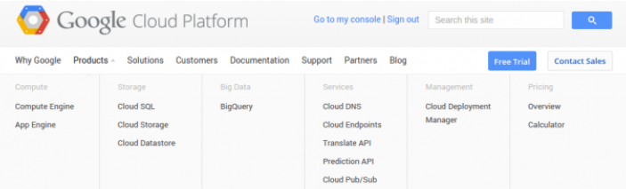
CLOUD COMPUTING & AMAZON WEB SERVICES
On the contrary, Google Cloud Platform delivers only a handful of features
related to IaaS and SaaS. These services can be deployed in the cloud to fulfill
some of the business requests and prospects which is beneficial for companies
that don’t require many premium services and have limited use of cloud in
their business.
Market dominance
AWS is a clear winner in terms of market share. It has cornered nearly half of
the market share for Infrastructure as a Service (IaaS). Taking into
consideration the fact that AWS was hovering in the game cloud for the past 5
years, it gives Amazon an advantage over others in terms of market share and
dominance.
Data Centers in every nook and corner
AWS again outshines its competition in terms of global outreach and
marketing. Enterprises are already aware of the advantages and perks that
AWS will provide in the long run due to its wide accessibility. There are AWS
data farms present in each continent and country around the globe which are
always online for businesses and enterprises. These servers are scattered
everywhere to cater to all businesses and enable speedy recovery of data in
case of any data breach.
Page 59

Slide 10
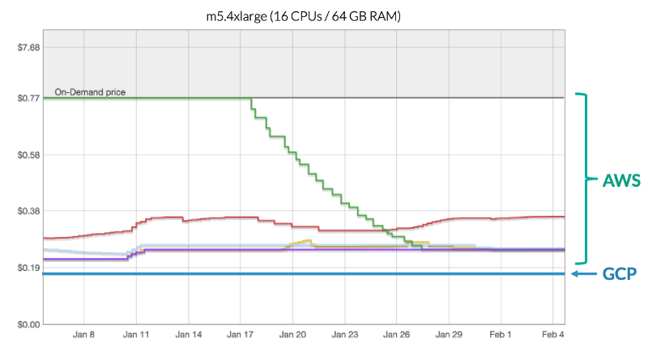
CLOUD COMPUTING & AMAZON WEB SERVICES
Pricing model
The pricing models for all cloud services are different from each other. Google
Cloud Platform has limited services and hence, its services are cheaper than
AWS. Small businesses and medium-sized enterprises may prefer GCP over
AWS due to its fair pricing model and delivery. On the other hand, AWS,
though not cheap as others, provides discounts on some servers and provides
free services from time to time to make sure users are able to access and build
their business empire without any interruptions in the long run. The above
graph depicts the rise in investment in AWS while pricing for GCP is constant
throughout.
Free-Tier Account
Many cloud services deliver at least 1 year of free subscription to their
services. Same goes for AWS and GCP and many other services present in the
market. In the end, it all boils down to the host of services that AWS provides
to its users. Why will anyone consider using any other subscription for free if
Amazon is flooded with tons of features in its platform?
Page 60

Slide 11
CLOUD COMPUTING & AMAZON WEB SERVICES
Improved Security
AWS renders numerous security capabilities and services to increase privacy
and control of the network. Network firewalls that are built into Amazon VPC
make it secure from external threats. Amazon has embedded firewall
capabilities for web applications in AWS WAF. This lets the users create
private networks and gain access to cloud instances and applications. Many
services in AWS are fabricated with a security firewall that keeps it protected
from external breaches.
Machine Learning and Big Data
The closest that anyone can come to AWS in term of ML and big data services
is GCP. As Google has to deal with 2 billion searches daily, it has a repository of
“data mines” which it can utilize with the help of Bigquery. AWS has diverse
options to deal with Big Data. It delivers market-oriented solutions like Docker
and Kubernates in DevOps along with a permanent solution for serverless
computing. It also has AWS Lambda for real-time Big Data analytics.
Page 61

