Slide 1




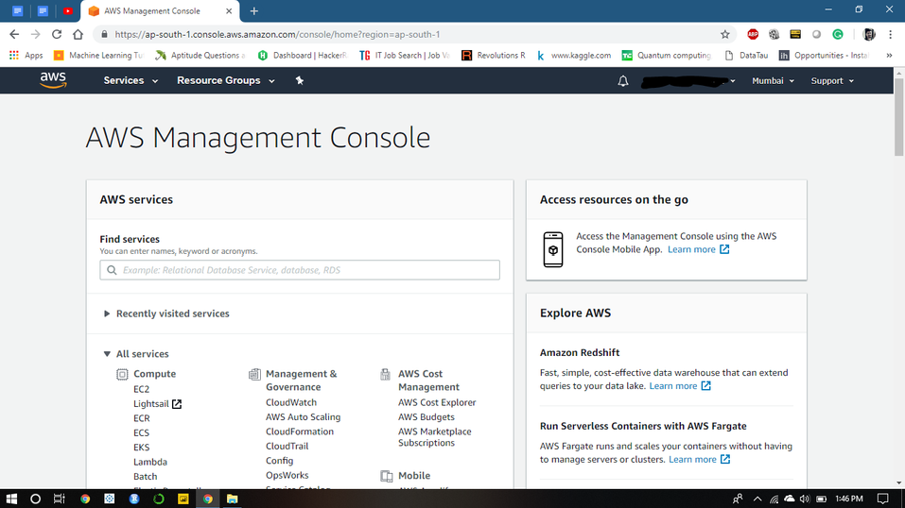

CLOUD COMPUTING & AMAZON WEB SERVICES
Steps for deploying AWS in cloud
Amazon Web Services has a host of services under its belt enabling faster
storage and retrieval of data from the cloud. Let us shed some light on the
steps needed to deploy a server in the cloud.
STEP 1
Amazon provides a Free-Tier account for which you have to enter your credit
card credentials and register. A minimum fee of ₹2 will be charged. As soon as
you create an account, you will be greeted with the AWS Dashboard which
displays services and tools that will be beneficial to launch your website or
application.
Page 45

Slide 2
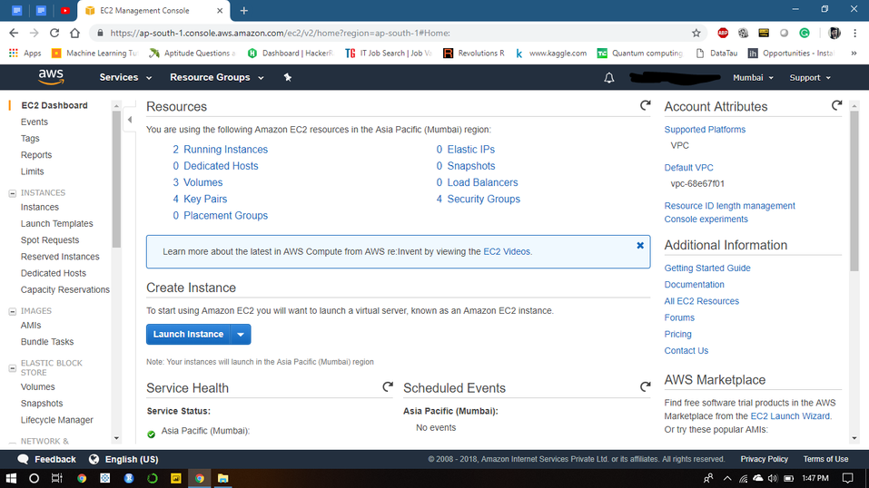
CLOUD COMPUTING & AMAZON WEB SERVICES
STEP 2
In our case, we will be selecting the EC2 service for our review. After selecting
EC2, you can see a screen which displays various options available to exploit it
like Dedicated Hosts, Volumes, Key Pairs etc. These options can be utilized by
the user to further explore EC2. Click on Launch Instance to advance to the
next screen.
STEP 3
This screen shows the operating server or the environment the user desires to
work on for his implementation. It provides various options like Ubuntu, Linux,
MS Windows Server, Deep Learning AMI and many iterations of the
mentioned operating systems. We will be working in the Ubuntu environment
so we will select the Ubuntu server.
Page 46

Slide 3
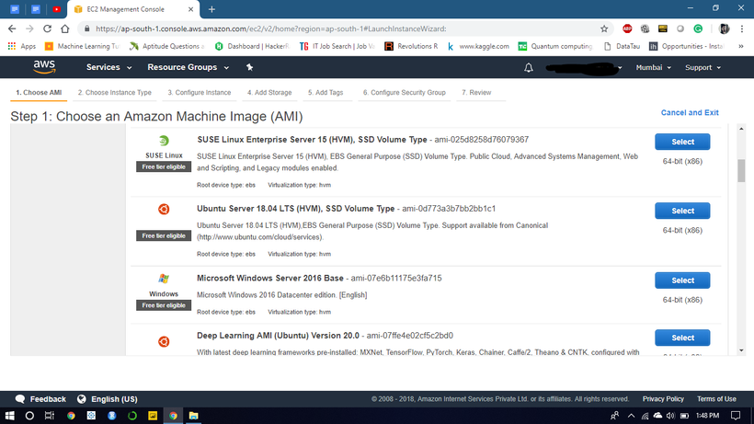
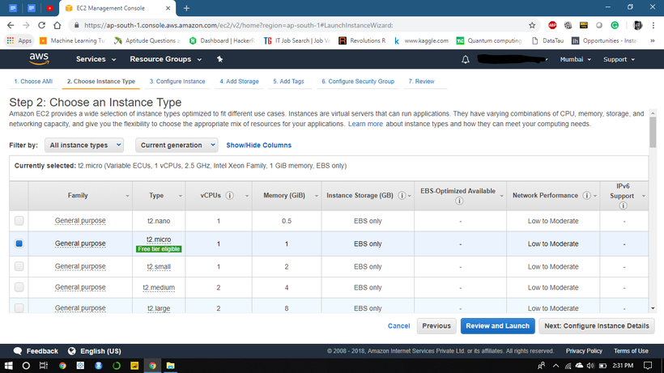
CLOUD COMPUTING & AMAZON WEB SERVICES
STEP 4
After selecting Ubuntu, the free-tier users have the option of selecting only
one type of server, that is the t2.micro. This is usually free and gets the job
done. Select the t2.micro server and then select Preview and Launch.
Page 47

Slide 4
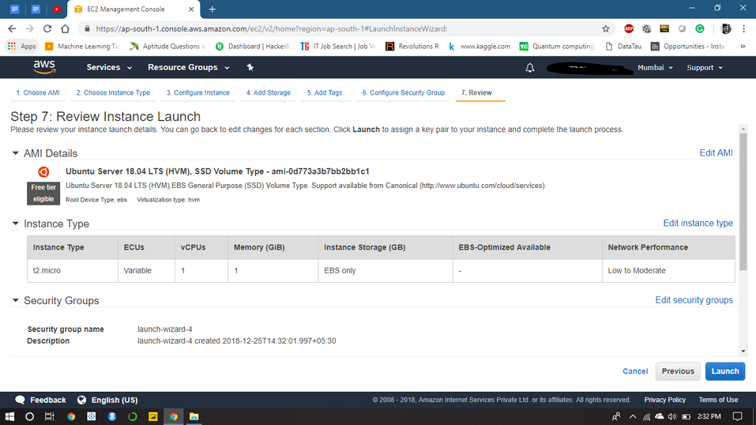
CLOUD COMPUTING & AMAZON WEB SERVICES
STEP 5
Next, it will show the configuration and the network performance of this
server. Select Launch to launch the server in the cloud.
Next window will show you the message that the server is launched in the
Cloud. AWS calls them instances. Let’s check the status of our server.
STEP 6
Page 48

Slide 5
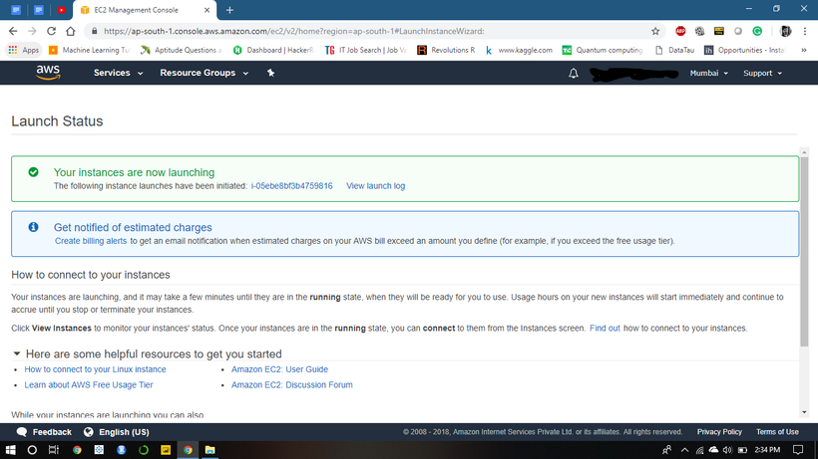
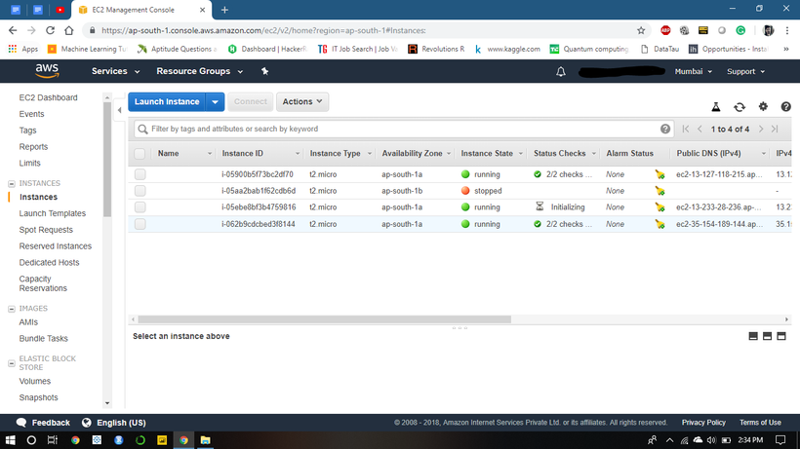
CLOUD COMPUTING & AMAZON WEB SERVICES
STEP 7
After stepping into the EC2 dashboard, You can see the green dot and
"running" status under the running tab. This means that our server has been
launched in the cloud and now we can launch our website or applications in the
cloud to take full advantage of this server.
Page 49

Slide 6
CLOUD COMPUTING & AMAZON WEB SERVICES
Amazon also provides users with the services to deploy their applications in
the cloud. After deploying the server, the user needs to generate a private key
pair. For that, a key pair in .ppk format will be downloaded. Later, by using the
PuTTY generator, the key pair has to be converted into a .pmm file as Amazon
supports only .pmm formats. After converting the key pair, a Public IP address
is assigned to the launched server which has to be used to launch the user’s
applications or services in the cloud.
Deploying a server whether free or paid is quite easy and painless in AWS. For
years, Amazon has worked hard and tried to reduce the complexities linked to
deploying a server in the cloud to enable users and businesses to work in
unison and access their services at any point of time.
Page 50

