Slide 1

Movie Recommendation System using Deep Learning
Presentation by Mohammad Nurnabi
NEUB | CSE | 7th Semester | ID: 0562210005101011

Slide 2
Project Overview
🔹 Goal: Predict user preferences and recommend movies.
🔹 Dataset: MovieLens 100k (943 users, 1682 movies, 100k ratings)
🔹 Tools: Python, TensorFlow, Keras, Pandas, Matplotlib
🔹 Technique: Deep Neural Network with Embedding Layers

Slide 3
Dataset Details
✔️ MovieLens 100k Dataset
- u.data: user_id, item_id, rating, timestamp
- u.item: movie_id, title, genre
✔️ Preprocessing:
- Merge ratings with movie titles
- Average ratings per user-movie pair
- Label Encoding on users & movies

Slide 4
Model Architecture
📌 Inputs: Encoded user ID and movie ID
📌 Layers:
- Embedding (users, movies)
- Concatenate → Dense(32) → Dense(16)
- Output: Dense(9, activation='softmax')
📌 Loss: SparseCategoricalCrossentropy
📌 Optimizer: Adam

Slide 5
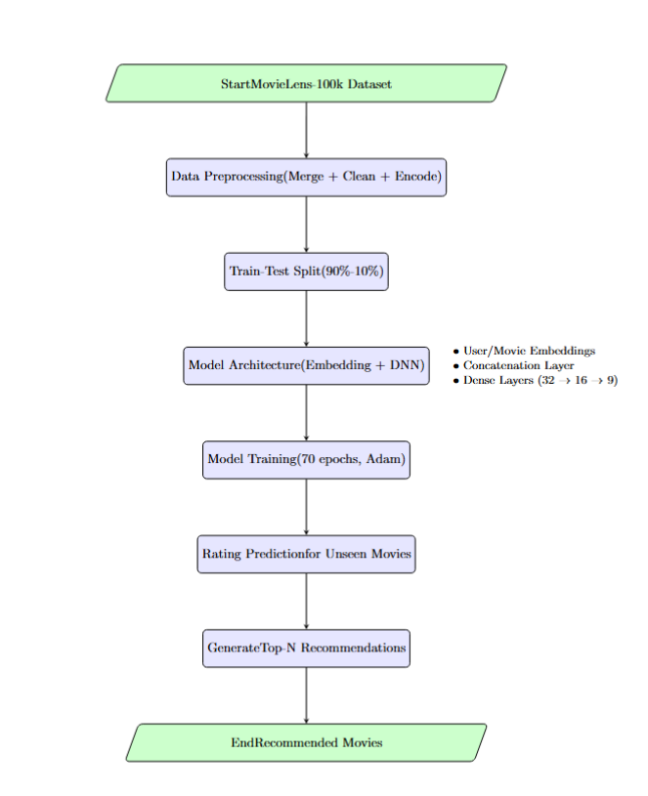
Project Workflow

Slide 6
Results & Demo
🎯 Model trained for 70 epochs
🎯 Evaluation metric: validation loss decreases steadily
🎯 Example: User 777 receives top 10 personalized movie suggestions
✔️ Function: recommender_system(user_id, model, n_movies)

Slide 7
Future Improvements
🔮 Add genre/context-aware attention mechanisms
🔮 Use larger, real-world implicit feedback datasets
🔮 Deploy as web API with interactive UI
🔮 Add timestamp-based temporal recommendations

Slide 8
Thank You
Questions?
Contact: Mohammad Nurnabi
Email: nurnobi123a@gmail.com

