Slide 1
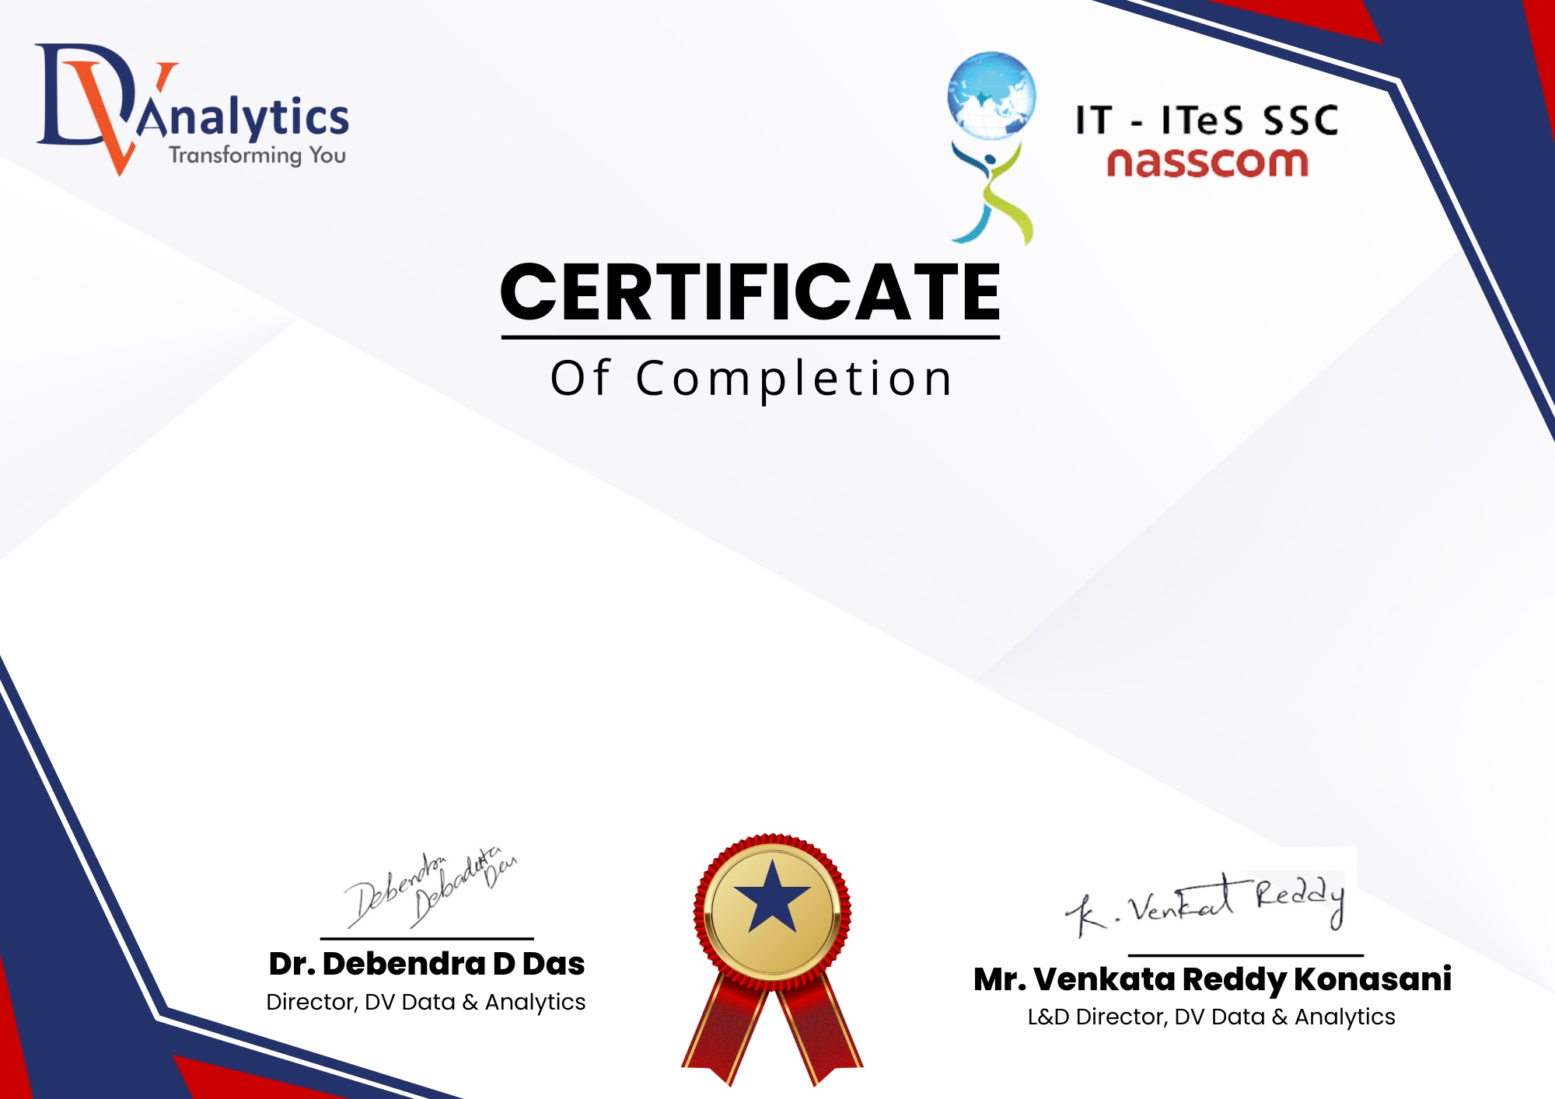
This is to certify that [ ] has successfully completed 6 months Advanced Program in Industrial Data Science (APIDS) . This course covered fundamental and advanced topics in Data Science, including DBMS Programming, Data Analysis & Visualization, and Data Mining providing hands-on experience in data-driven solutions. Applications: Excel, SQL, Python, SAS, Tableau, Power BI Projects: Banking, Telecom, Retail, eCommerce, Healthcare
Certificate Registration Number: [ 202505DVA2057 ] Date of Completion: [ 08-04-2026 ]

