Slide 1
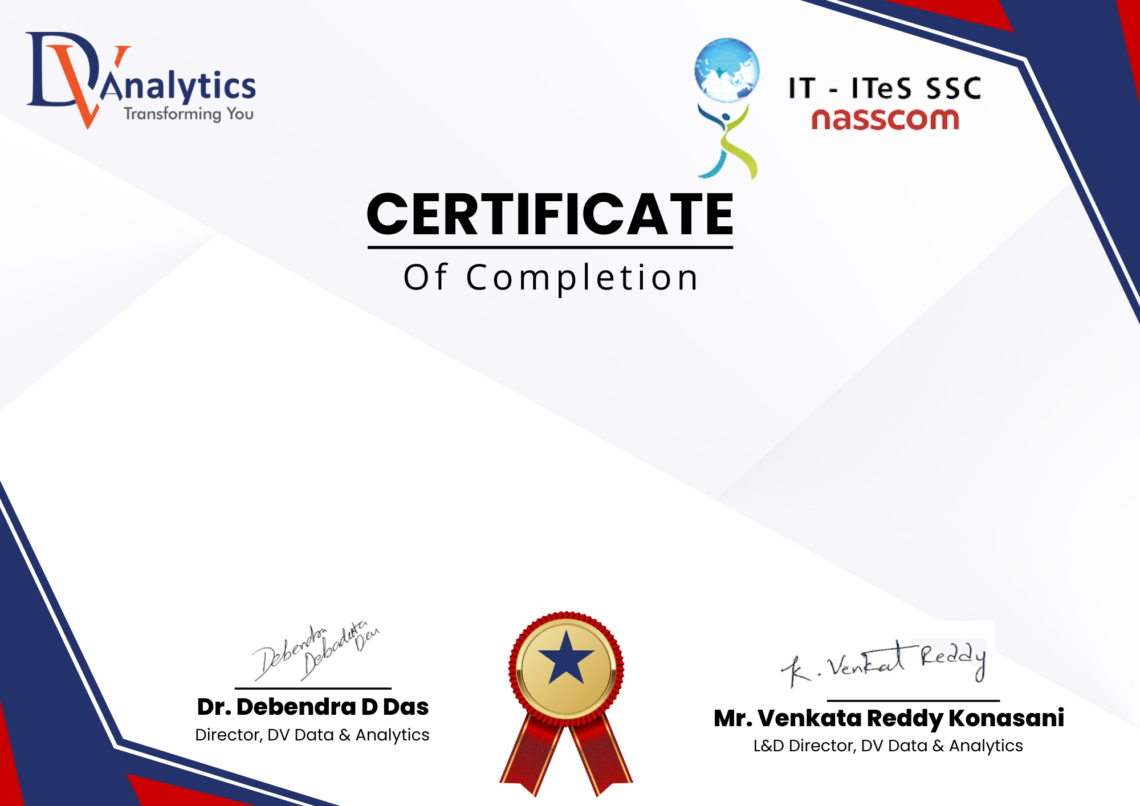
This is to certify that [ ] has successfully completed 6 months Advanced Program in Industrial Data Science (APIDS) . This course covered fundamental and advanced topics in Data Science, including DBMS Programming, Data Analysis & Visualization, and Data Mining (Predictive Modeling, Machine Learning, Deep Learning, and Generative AI) providing hands-on experience in data-driven solutions. Applications: Excel, SQL, Python, SAS, Tableau, Power BI, Python ML & Gen AI, Azure MLOPS Projects: Banking, Telecom, Retail, eCommerce, Healthcare
Certificate Registration Number: [202505DVA2073 ] Date of Completion: [ 07-09-2026 ]

