Slide 1

GOVT. POLYTECHNIC MASABTANK WEBSITE

Slide 2
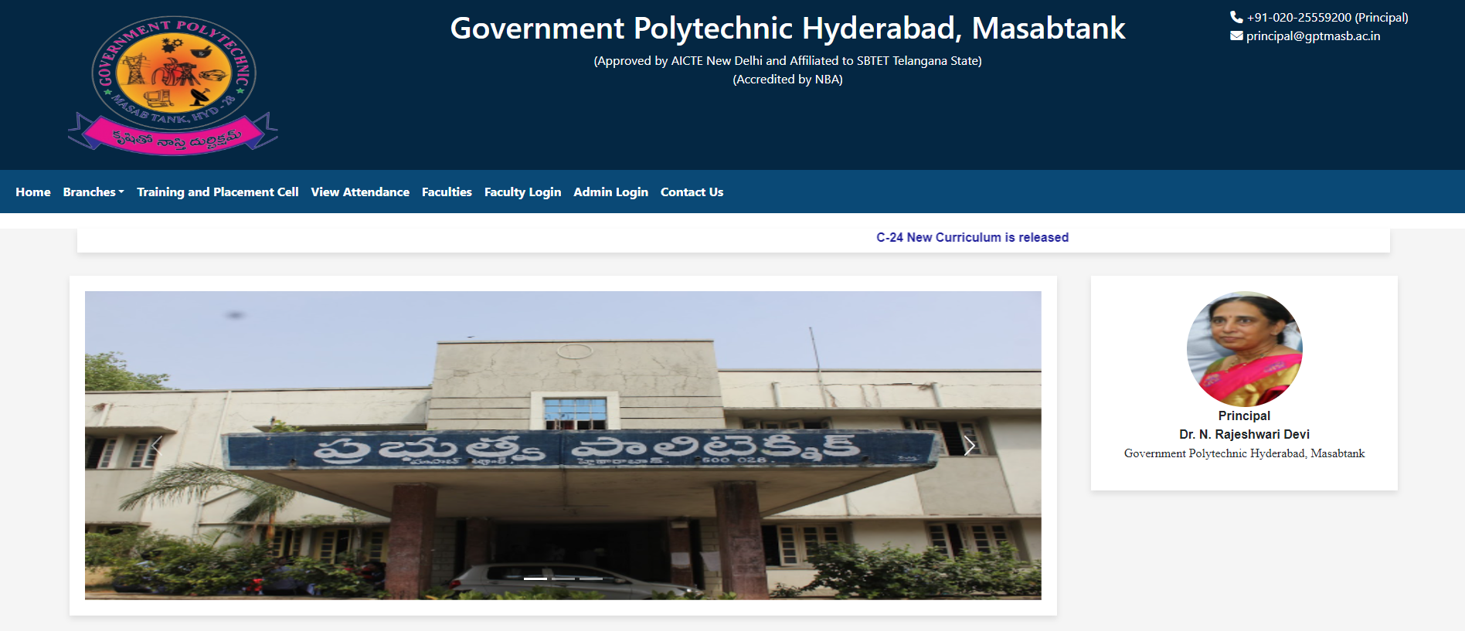
HOME PAGE

Slide 3
MODULES
Student Bio-Data module - 21001-CS-030 - Biradar Omkar
Student Attendance module - 21001-CS-033 - Guddheti Sathwik
- 21001-CS-022 - Sohail Alam
Faculty Bio-Data module - 21001-CS-031 - MD Salman
Facilities and Events module - 21001-CS-034 - Godugu Tejas

Slide 4
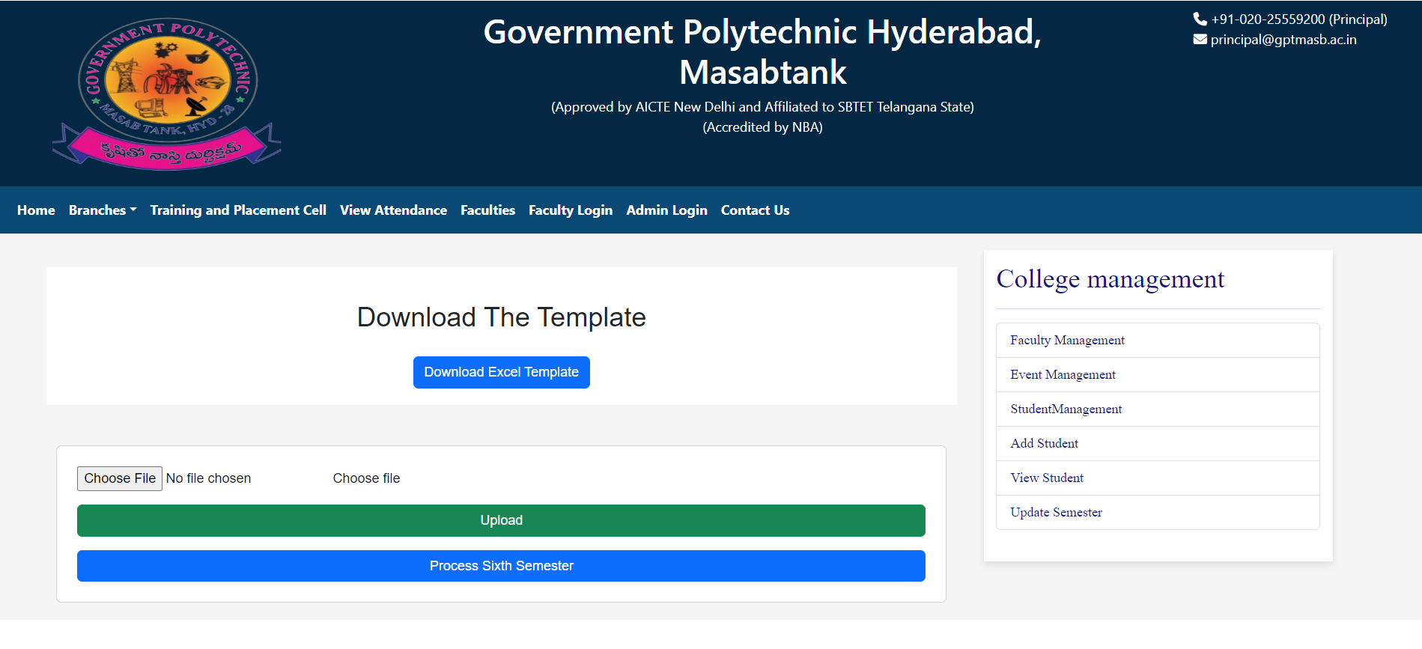
Student Bio Data Module Overview

Slide 5
Student Bio Data Module Overview
Add Student Function:
Collect essential student details.
Generate a unique student identifier.
Ensures a seamless onboarding experience.
Confirmation message with Student ID.
Edit Student Function:
Update existing student information.
Flexibility in modifying details.
Confirmation message for successful updates.

Slide 6
Student Bio Data Module Overview (continued..)
Remove Student Function:
Delete outdated or redundant records.
Streamlined process with student ID.
Confirmation message for successful removal.
Safeguards against unintended deletions.
View Student Function:
Read-only access to stored information.
Dual purpose for administrators and students.
Targeted retrieval using student ID.
Comprehensive display of relevant details.

Slide 7
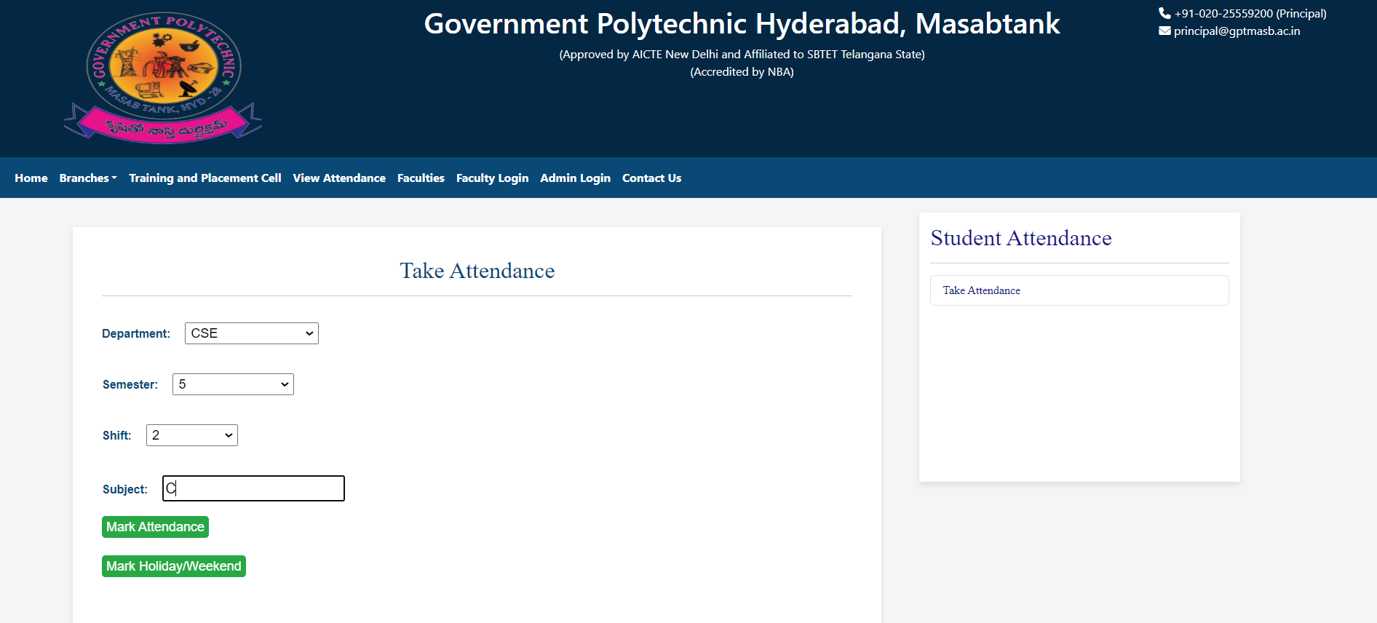
Student Attendance Module Overview

Slide 8
Student Attendance Module Overview
Add Attendance Function:
Record attendance for a date.
Select class/course.
Mark present/absent with notes.
Confirmation message for recording.
2. View Attendance Function:
Comprehensive tool for administrators.
Review attendance based on criteria.
Filter by date, class, or course.
Display list with attendance status.

Slide 9
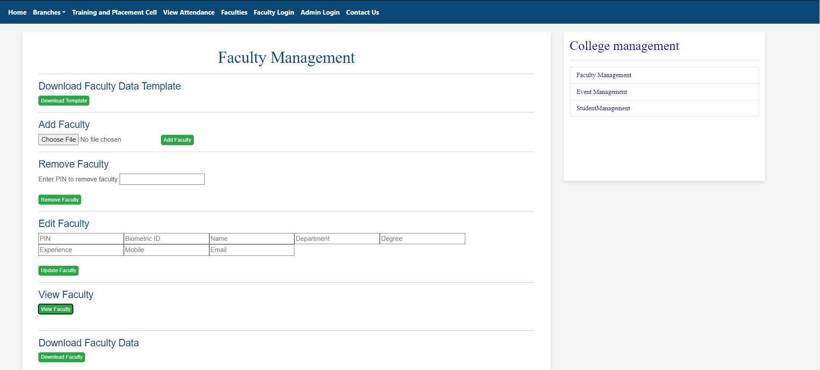
Faculty Bio Data Module Overview

Slide 10
Faculty Bio Data Module Overview
Add Faculty Function:
Collect and store faculty details.
Generate a unique Faculty ID.
Input fields: Full Name, Contact Information, etc.
Confirmation message for successful addition.
Edit Faculty Function:
Modify existing faculty information.
Input Faculty ID for identification.
Choose fields to be edited.
Confirmation message for successful editing.

Slide 11
Faculty Bio Data Module Overview (continued..)
Remove Faculty Function:
Delete a faculty record from the system.
Input Faculty ID for identification.
Confirmation message for successful removal.
View Faculty Function:
Display detailed information about faculty.
Input Faculty ID for identification.
Display faculty details (Full Name, Contact Information, etc.).

Slide 12
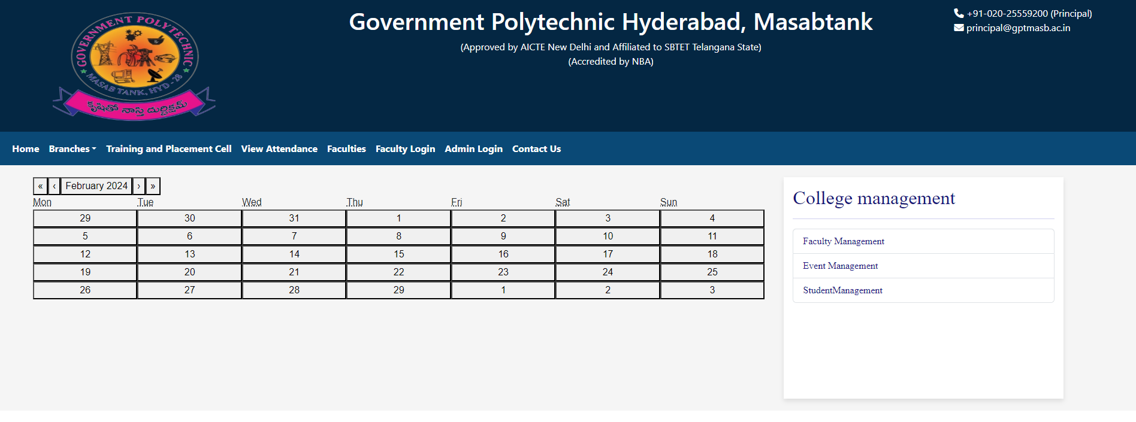
Facilities and Events Module Overview

Slide 13
Facilities and Events Module Overview
Add Facility/Event Function:
Seamless integration of new facilities/events.
Capture details: name, description, location, date, time.
Option to attach images/documents.
Confirmation message upon successful addition.
Edit Facility/Event Function:
Ensure information accuracy and currency.
Modify existing details: description, location, date, time.
Track changes with a timestamp.
Confirmation message upon successful modification.

Slide 14
Facilities and Events Module Overview (continued..)
3. Remove Facility/Event Function:
Periodic deletion with confirmation step.
Archive/log removed facilities/events.
Confirmation message upon successful removal.
Archived/logged information for reference.

Slide 15
Thank You!

