Slide 1

GOVT. POLYTECHNIC MASABTANK WEBSITE

Slide 2
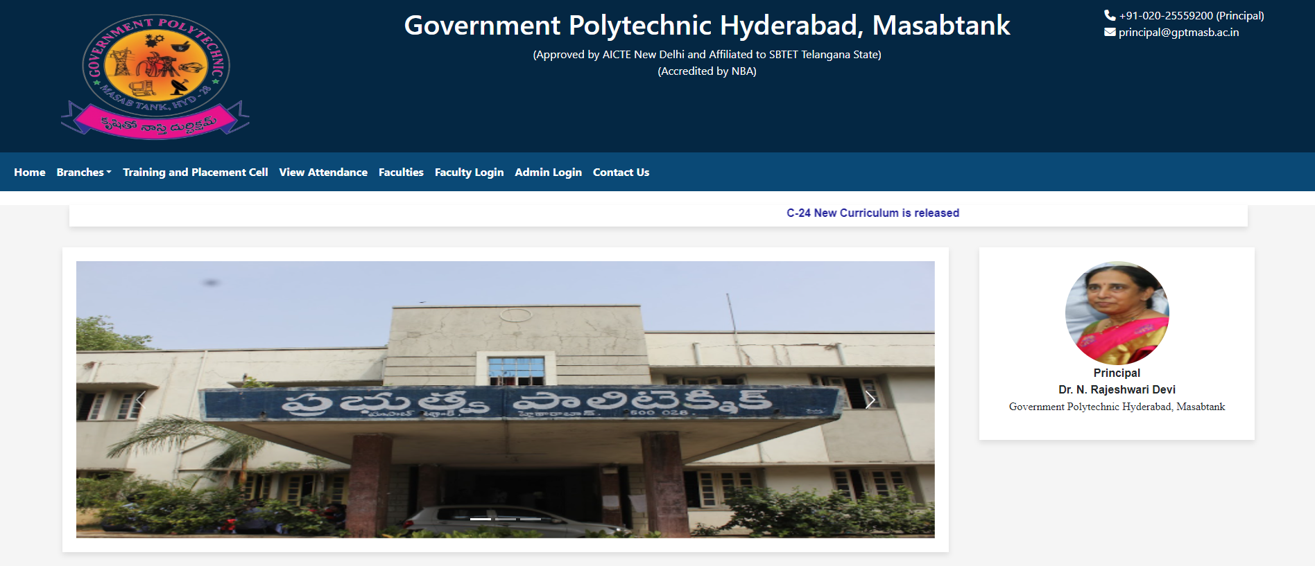
HOME PAGE

Slide 3
MODULES
Student Bio-Data module - 21001-CS-030 - Biradar Omkar
Student Attendance module - 21001-CS-033 - Guddheti Sathwik
- 21001-CS-022 - Sohail Alam
Faculty Bio-Data module - 21001-CS-031 - MD Salman
Facilities and Events module - 21001-CS-034 - Godugu Tejas

Slide 4
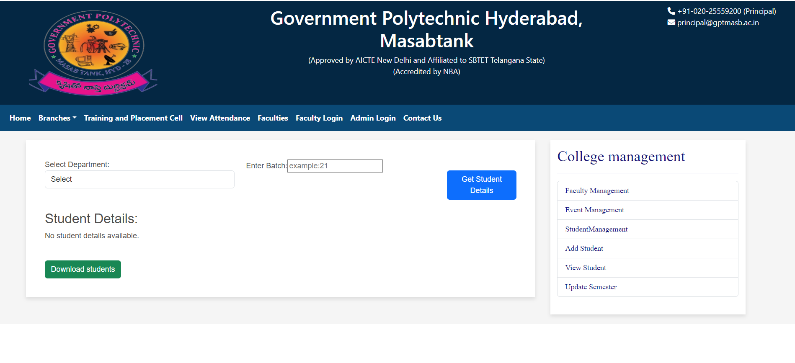
Student Bio Data Module Overview

Slide 5
Student Bio Data Module Overview (continued..)
Remove Student Function:
Delete outdated or redundant records.
Streamlined process with student ID.
Confirmation message for successful removal.
Safeguards against unintended deletions.
View Student Function:
Read-only access to stored information.
Dual purpose for administrators and students.
Targeted retrieval using student ID.
Comprehensive display of relevant details.

Slide 6
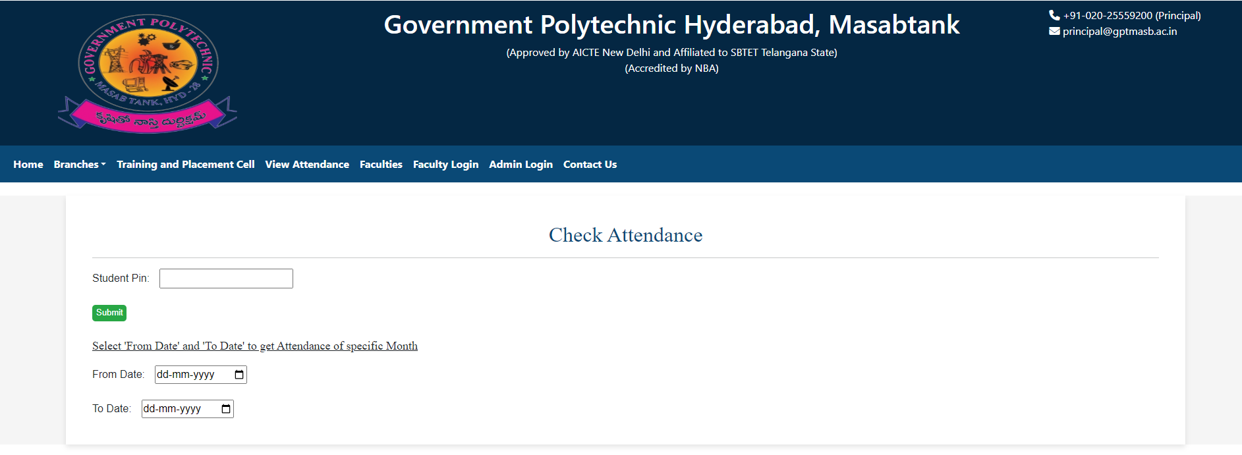
Student Attendance Module Overview

Slide 7
Student Attendance Module Overview
2. View Attendance Function:
Comprehensive tool for administrators.
Review attendance based on criteria.
Filter by date, class, or course.
Display list with attendance status.

Slide 8
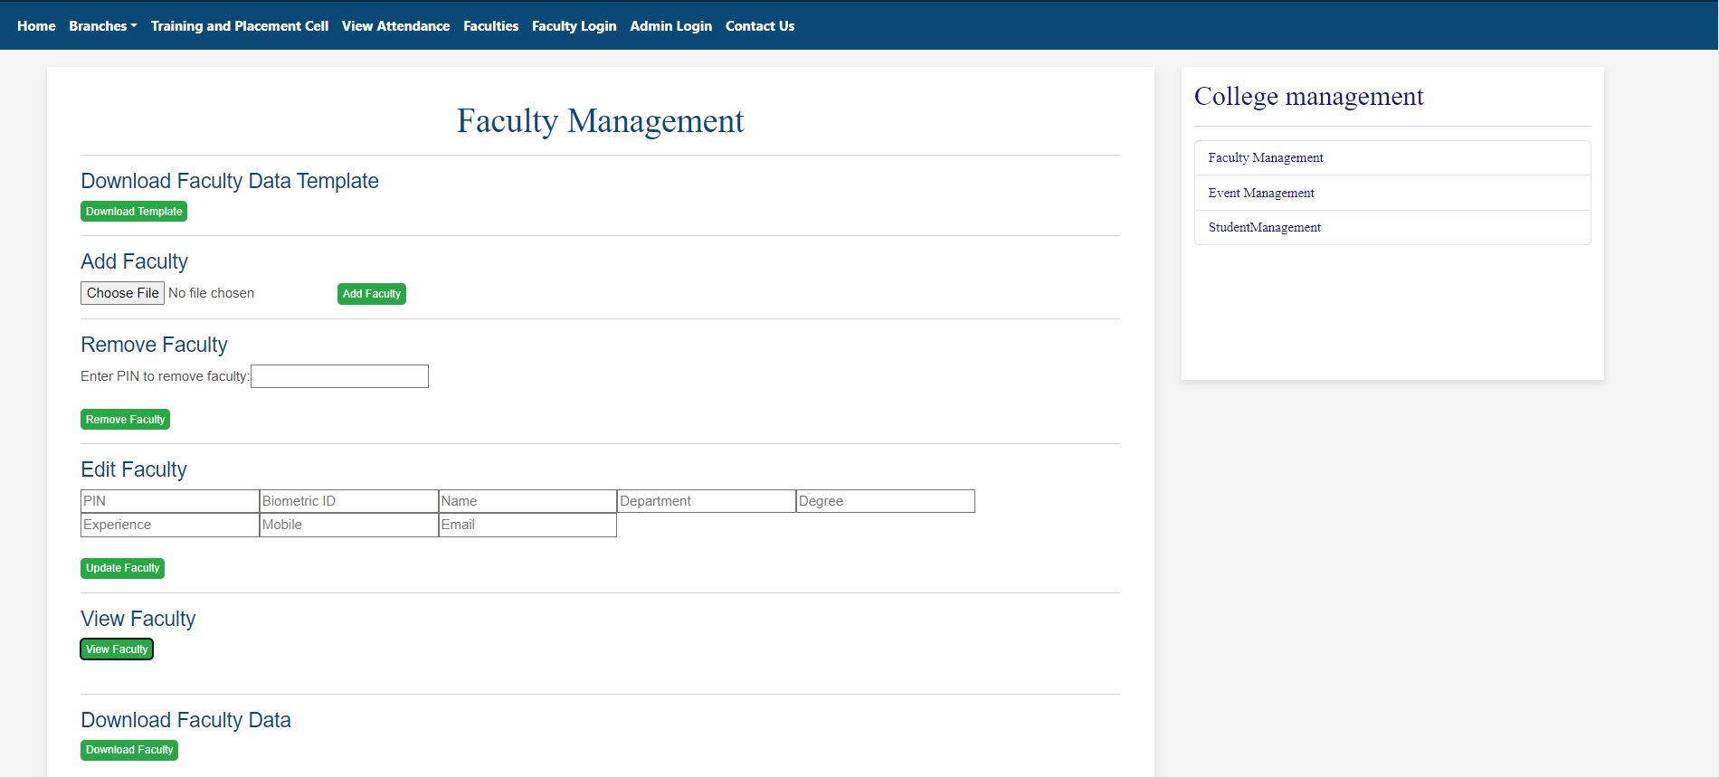
Faculty Bio Data Module Overview

Slide 9
Faculty Bio Data Module Overview (continued..)
Remove Faculty Function:
Delete a faculty record from the system.
Input Faculty ID for identification.
Confirmation message for successful removal.
View Faculty Function:
Display detailed information about faculty.
Input Faculty ID for identification.
Display faculty details (Full Name, Contact Information, etc.).

Slide 10
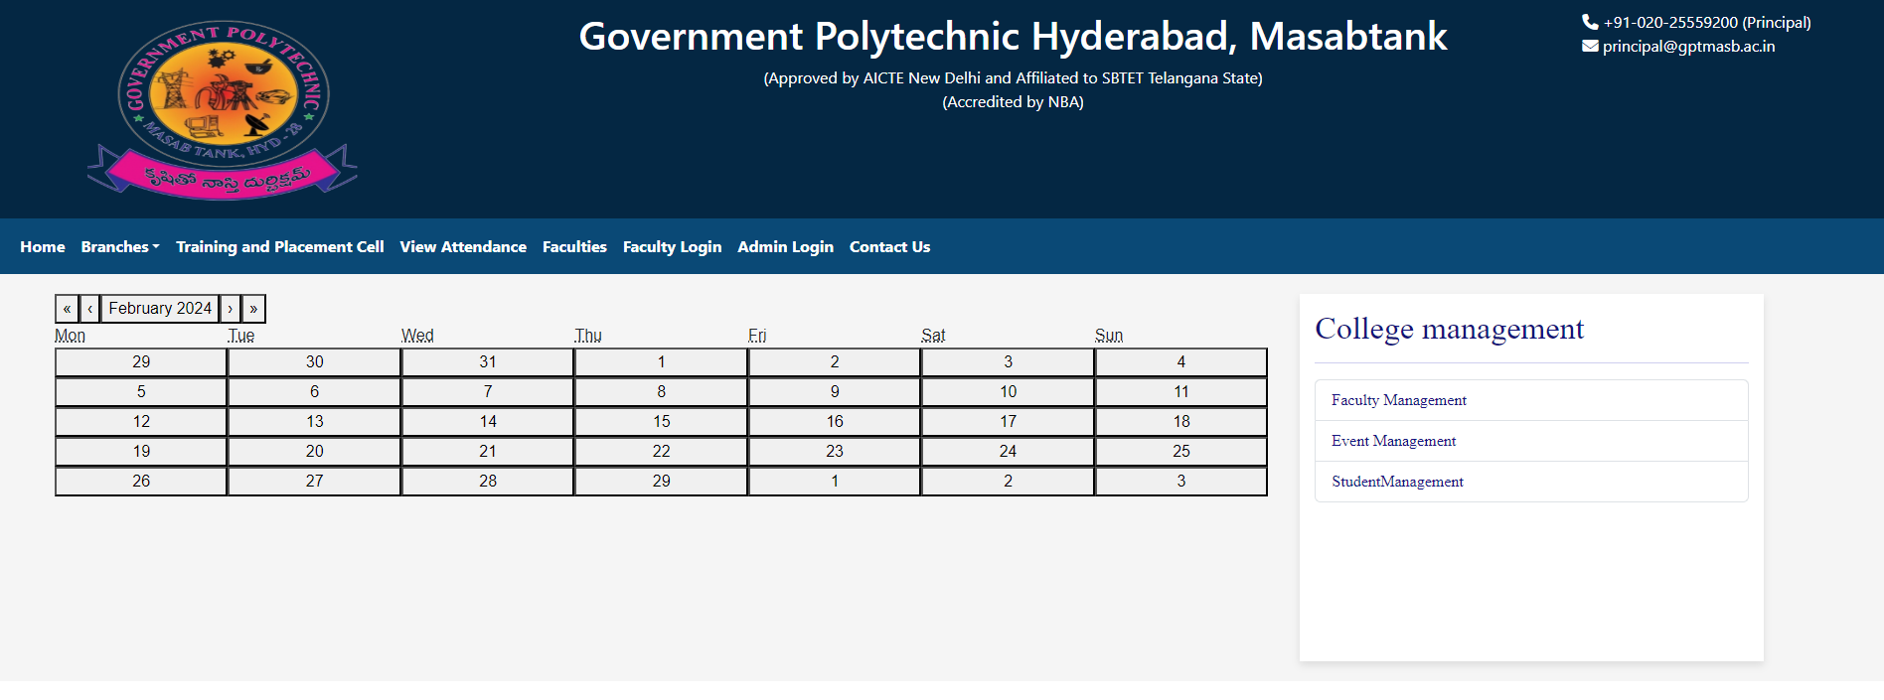
Facilities and Events Module Overview

Slide 11
Facilities and Events Module Overview (continued..)
3. Remove Facility/Event Function:
Periodic deletion with confirmation step.
Archive/log removed facilities/events.
Confirmation message upon successful removal.
Archived/logged information for reference.

Slide 12
Thank You!

