Slide 1

Customer Churn Prediction Analysis
AI-Powered Strategy for Telecom Retention
Name → Md Salman Farsi
Internship → Elevate Labs
Project ID → 6

Slide 2
Project Objective
Goal → To predict customer churn (users likely to leave) and derive actionable strategies to retain them in a competitive telecom market.
Problem Statement → Acquiring a new customer is 5x more expensive than retaining an existing one. Identifying high-risk customers early is crucial.
Solution → An ML-powered web application that flags risky customers and suggests retention offers.

Slide 3
Tools & Technologies
Programming Language → Python
Data Processing → Pandas, NumPy, SQL
Machine Learning → Scikit-Learn (Classification Model)
Web Framework → Streamlit (For Interactive Dashboard)
Visualization → Matplotlib / Built-in Streamlit Charts

Slide 4
Methodology
Data Collection → Aggregated customer data including Tenure, Monthly Charges, and Demographics.
Preprocessing → Cleaned data, handled missing values, and scaled numerical features.
Modeling → Trained a Binary Classification Model to predict ‘Churn' (1) vs 'No Churn' (0).
Deployment → Built a user-friendly interface using Streamlit for real-time predictions.

Slide 5
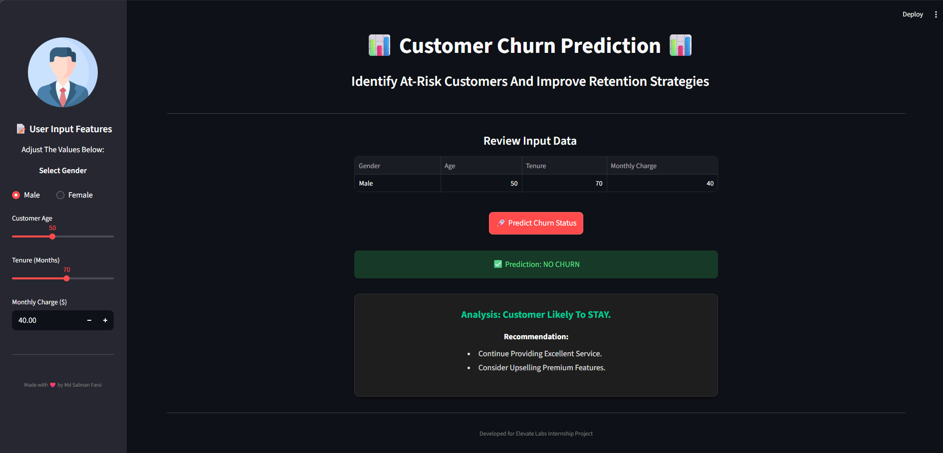
The Solution
Input Features → User inputs Gender, Age, Tenure and Monthly Charges.
Real-Time Analysis → The model processes inputs instantly.
Outcome :
🟢Green Signal: Safe (Loyal) → Suggests Upselling

Slide 6
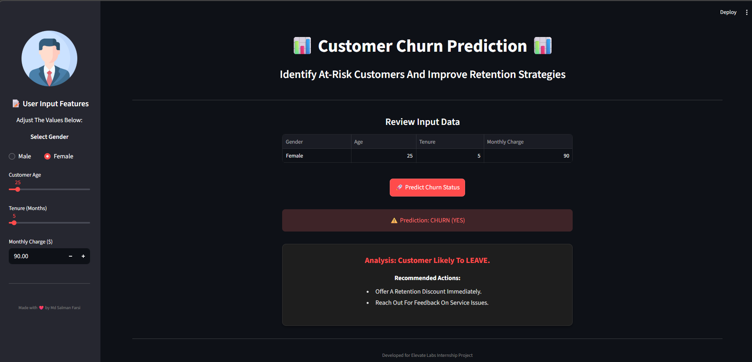
Input Features → User inputs Gender, Age, Tenure and Monthly Charges.
Real-Time Analysis → The model processes inputs instantly.
Outcome :
🔴 Red Alert: High Risk (Churn) → Suggests Discounts

Slide 7
Key Insights & Analysis
High Churn Factors:
Low Tenure → New customers (1-5 months) are at highest risk.
High Monthly Charges → Customers paying >$80/month churn more often.
Customer Segments:
At Risk → New users with high bills.
Loyal → Users with >50 months tenure (Low Churn Probability).

Slide 8
Final Recommendations
For High-Risk Customers → Implement automated "Retention Discounts" for users with <6 months tenure and high bills.
For Loyal Customers → Introduce loyalty rewards or family plan upgrades to increase lifetime value.
Service Improvement → Investigate feedback from “Senior Citizens" as they showed unique churn patterns.

Slide 9
Conclusion
This project successfully demonstrates how AI can solve business problems.
The tool empowers the marketing team to take proactive action rather than reactive measures.
Result → Potential reduction in churn rate and increased revenue.

Slide 10
Thank You

