Slide 1
High Performance Computing
Professor : Dr. Maryam S. Hosseini
TEAM_KS3
Keerthi Yenumula
Sunavya Varagani
Saqlain Mohammed
Saaketh Garlapati

Slide 2
Contents of this template
Introduction | what is High Performance Computing
Background of HPC | What Background does it has and why?
Research Methodology & Scalability | You must keep it so that proper credits for our design are given
Parallelism and concurrency | All the colors used in this presentation
Algorithm Design & Optimization | These can be used in the template, and their size and color can be edited
Conclusion | You can edit the master slides easily. For more info, click here

Slide 3
01
Introduction
High-Performance Computing (HPC) refers to the use of supercomputers and parallel
processing techniques for solving complex computational problems rapidly and
efficiently.
Impact in Diverse Fields
Scientific Advancements
Engineering Efficiency
Research Acceleration

Slide 4
Background of HPC
High-performance computing (HPC) can be traced back to the mid-20th century, when early computing machines such as ENIAC (1940s) laid the groundwork for advancements in computational capability.
Historical Evolution
High-performance computing (HPC) is utilized across a wide range of fields, including but not limited to weather forecasting, climate simulation, molecular dynamics modeling, seismic exploration, and pharmaceutical research.
Diverse Application Domains
Background
High-performance computing (HPC) has transformed scientific inquiry by enabling extensive simulations, such as modeling protein folding, analyzing climate change trends, and simulating intricate physical processes.
Impact on Scientific Advancements
Businesses utilize high-performance computing (HPC) for tasks like computational fluid dynamics in automotive engineering, finite element analysis in aerospace, and high-frequency trading in the financial sector.
Industrial and Commercial Importance

Slide 5
Research Methodology
Research Approach
Literature Review
Despite being red, Mars is actually a cold place. It’s full of iron oxide dust
Venus has a very beautiful name and is the second planet from the Sun
Case Studies
Simulations and Modeling
Mercury is the closest planet to the Sun and the smallest one in the Solar System
Neptune is a ig planet. It is the fourth-largest planet by diameter in the Solar System

Slide 6
Scalability
01
02
03
04
05
Definition of Scalability in HPC
Challenges in Scaling Algorithms and Architectures
Difficulties in Handling Larger Workloads
Strategies for Achieving Scalability
Efficient Task Allocation

Slide 7
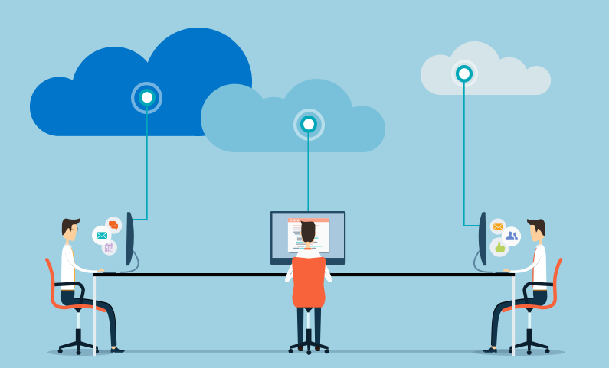
HPC AS A SERVICE ON CLOUD COMPUTING

Slide 8
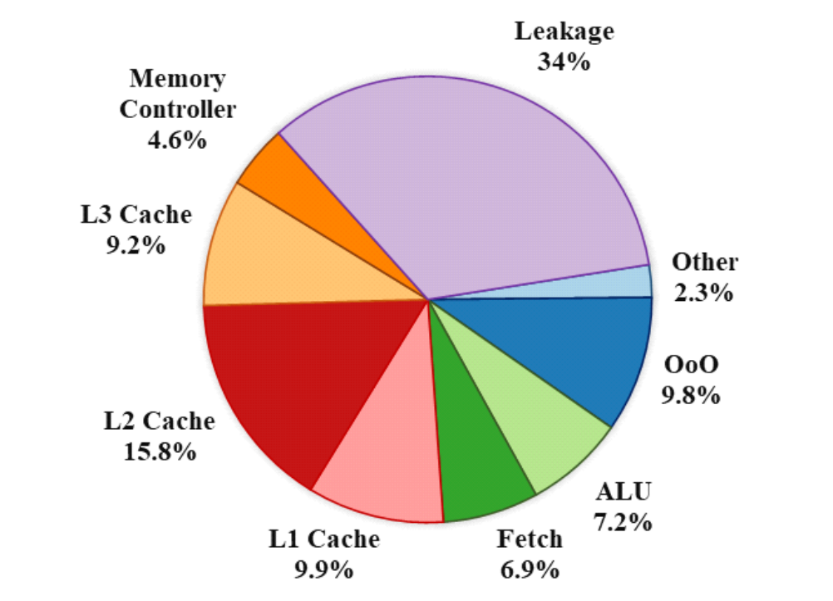
ENERGY DEMAND

Slide 9
Parallelism and Concurrency
Importance of Parallel Processing in HPC
Challenges in Designing Algorithms for Parallel Execution
Managing Concurrency and Efficient Communication
Strategies for Enhancing Parallelism: Task Parallelism
Strategies for Enhancing Parallelism: Data Parallelism and Synchronization

Slide 10
Software Challenges
Challenges in Exploiting HPC Architectures
Optimizing Code for Parallel Execution
Ensuring Portability Across
Different Architectures
Managing Software Complexity
Solutions: Performance-Oriented Software Design
Solutions: Abstraction Layers and Domain-Specific Languages

Slide 11
Algorithm Design and Optimization
Importance of Efficient Algorithms in HPC
Challenges in Designing and Optimizing Algorithms for Diverse Architectures
Approaches: Algorithmic Refinement
Approaches: Adaptive Algorithms
Approaches: Domain-Specific Optimizations

Slide 12
Conclusion
Summary of Key Challenges Discussed
Emphasizing the Importance of Addressing Challenges
Highlighting Future Research Directions
Call to Action

