Slide 1


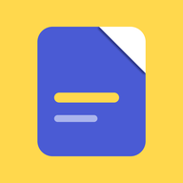
FINAL-YEAR PROJECT
NoteNest
Everything you study, in one place — and it works offline.
Md. Sarowar Hossain
Student ID
0272320005101135
Supervisor
Jannatul Fardoss
Submission date
25/10/2026
Department
Computer Science & Engineering
01 / 12
Notes:
Good morning. This is NoteNest, my final-year project. Its idea fits in one sentence: everything you study, in one place, and it works offline. The icon beside the name is the real launcher icon from the Android project. The animation on the right is the app's own opening: the page arrives, the corner folds, the line you meant to revise is marked, and the app opens underneath. I built it alone, and I will walk you through the real application.

Slide 2
02 · THE PROBLEM
Exam week should be for studying.
Handwritten notes, typed notes, slides as PDFs, whiteboard photos, a recording — all for one lecture.
None of these four places knows the items belong to the same lecture.
Camera roll
Chat apps
So exam week is spent searching instead of studying.
Downloads folder
Paper
02 / 12
Notes:
A student's material for one lecture is scattered: handwritten and typed notes, slides as PDFs, photos of the whiteboard, sometimes a recording. They end up in the camera roll, in chat apps, in a downloads folder and on paper. None of those four places knows the items belong to the same lecture. So exam week is spent searching instead of studying. I have deliberately not put a survey figure here; there is a blank where a cited statistic can go.

Slide 3
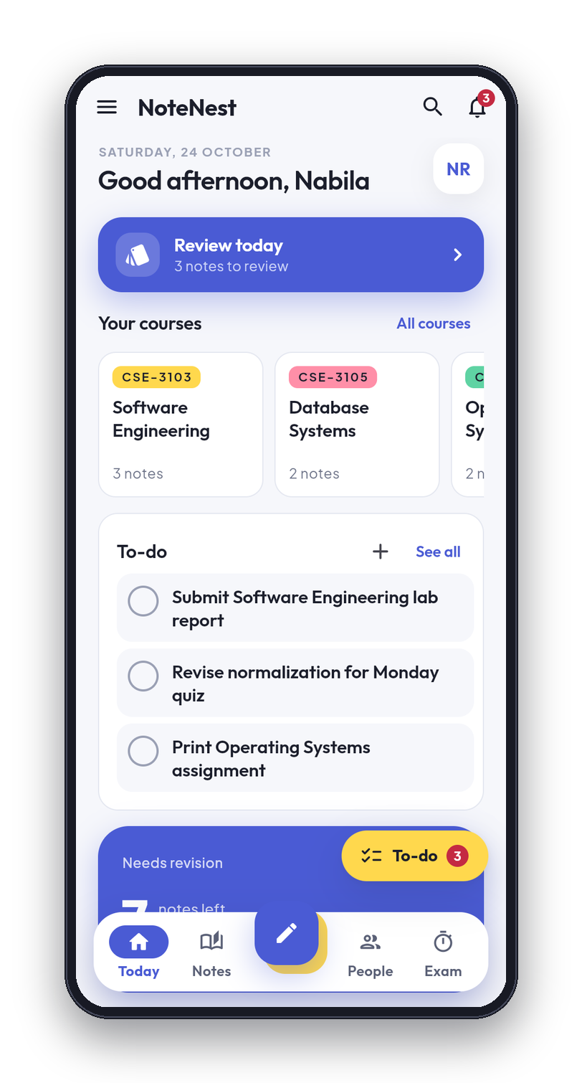
03 · THE SOLUTION
One notebook, even offline.
Semester
›
Course
›
Note
Every note belongs to a course, every course to a semester. No connection needed.
WHAT MAKES IT DIFFERENT
Organised by the academic calendar, not by folders
The device is the source of truth, not a server
03 / 12
Notes:
The idea is one app where every note belongs to a course and every course belongs to a semester, and the whole notebook works with no connection. Two things make it different from the apps students use now. First, it is organised by the academic calendar rather than by folders, so the home screen is built around today, this semester and the next exam. Second, the phone is the source of truth, not a server, so being offline is the normal state and not a failure. This is the Today screen, running on real data.

Slide 4
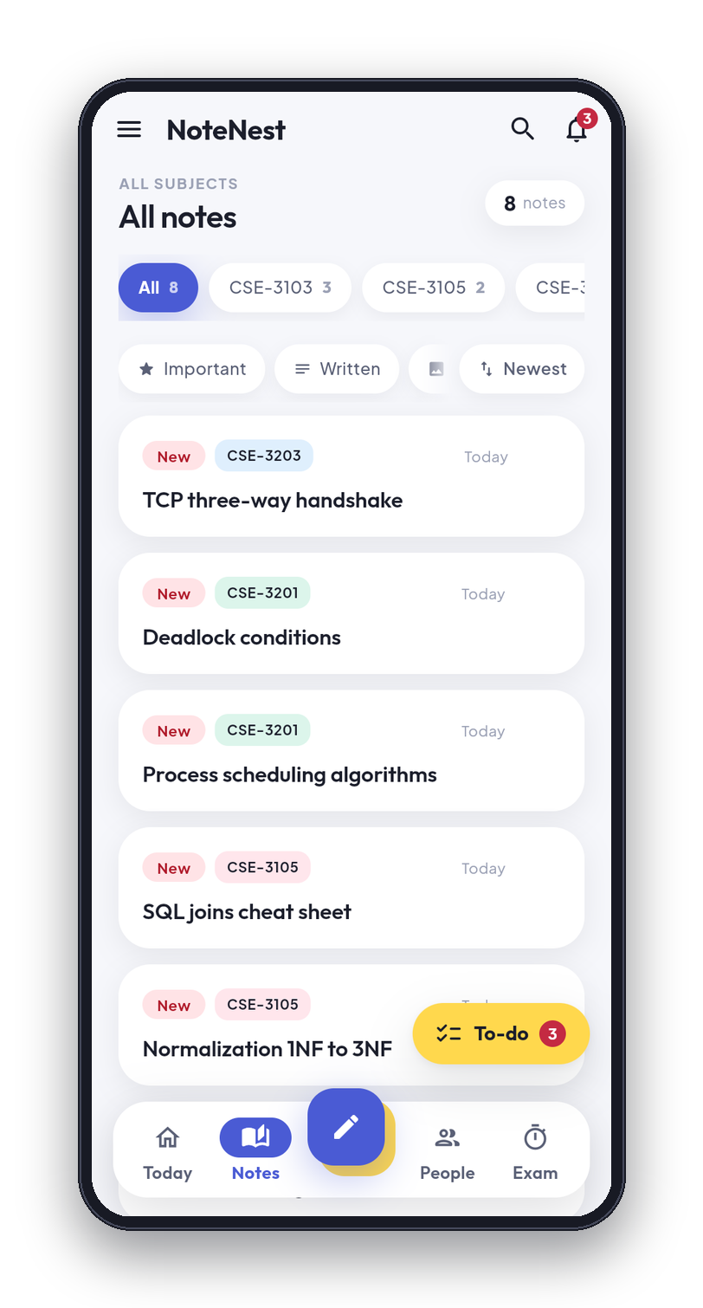
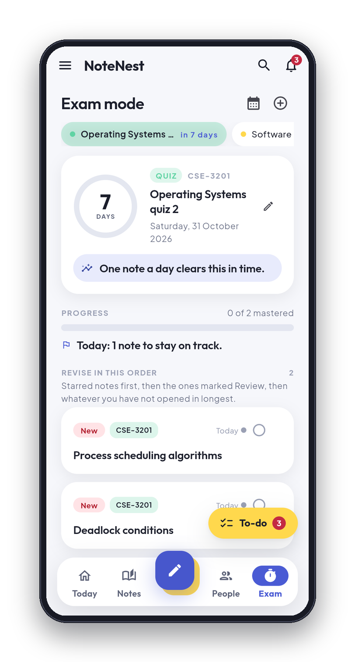
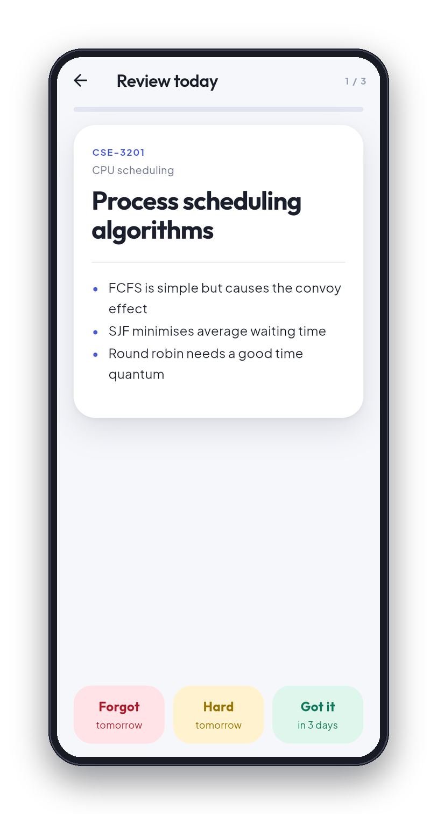
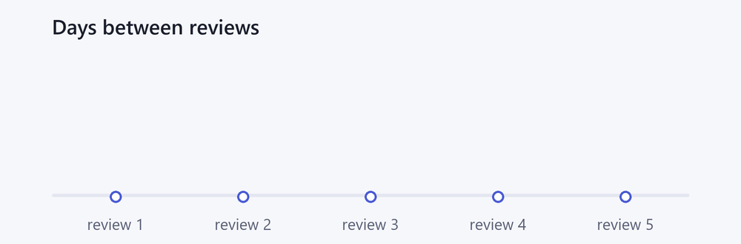
04 · KEY FEATURES
What it does.
Notes filed under courses
Word and PDF conversion
Photos, PDFs and voice on one note
Share a note with a classmate
Search that reaches inside PDF text
Group chat and classes
Spaced revision
Backup to your own Google Drive
Exam countdown and to-dos
PIN and fingerprint lock
Cover-page generator
Bangla and English, light and dark
Spaced revision: 1, 3, 7, 14, then 30 days
04 / 12
Notes:
Here is everything the app does, in plain language. Notes are filed under courses. A note can carry photos, PDFs and voice recordings, and search reaches inside the text of a PDF. Revision is spaced: the animation below the phones shows the gap growing, one day, three, seven, fourteen and thirty, and a note you forget goes back to one day. There is an exam countdown and a to-do page, a cover-page generator, Word and PDF conversion, and you can share a note with a classmate. Classes and group chat are there too. Backup goes to the student's own Google Drive, there is a PIN and fingerprint lock, and the app speaks Bangla and English in light and dark.

Slide 5
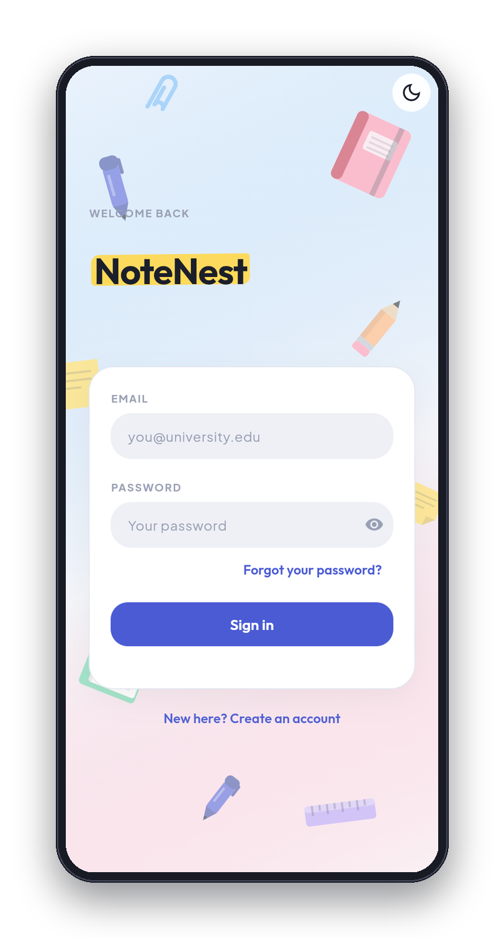
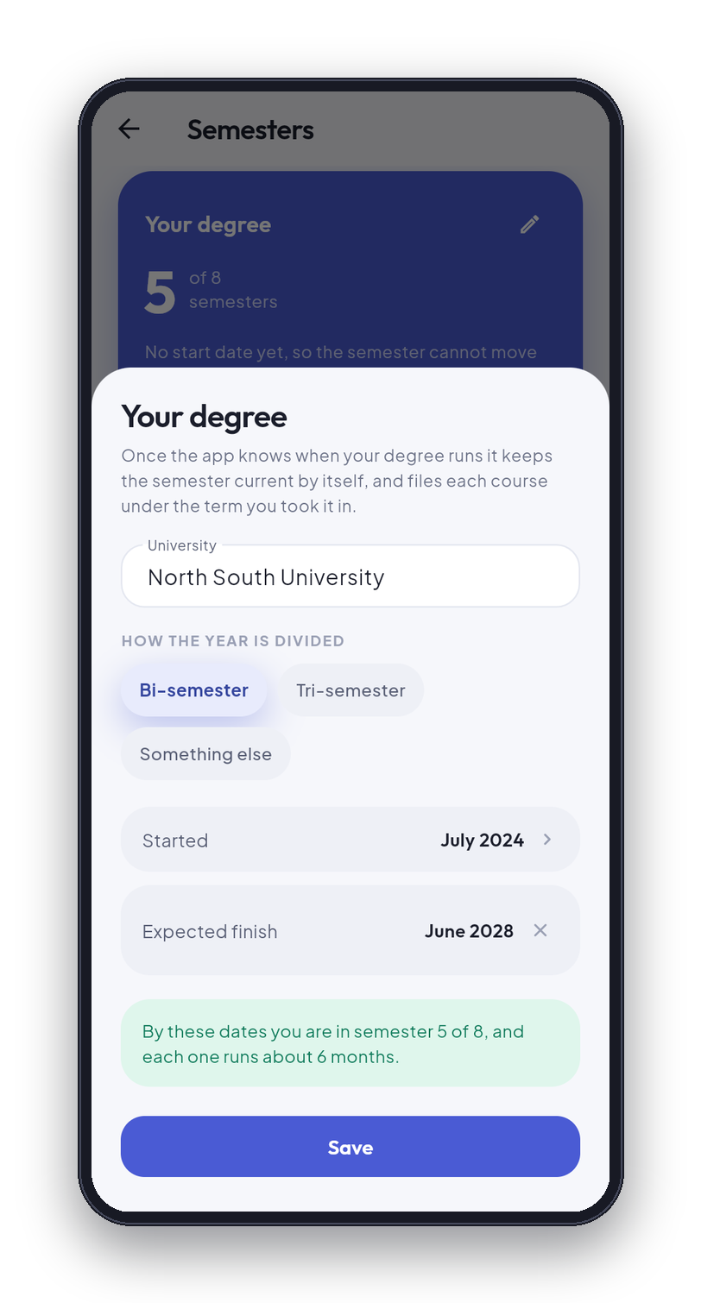
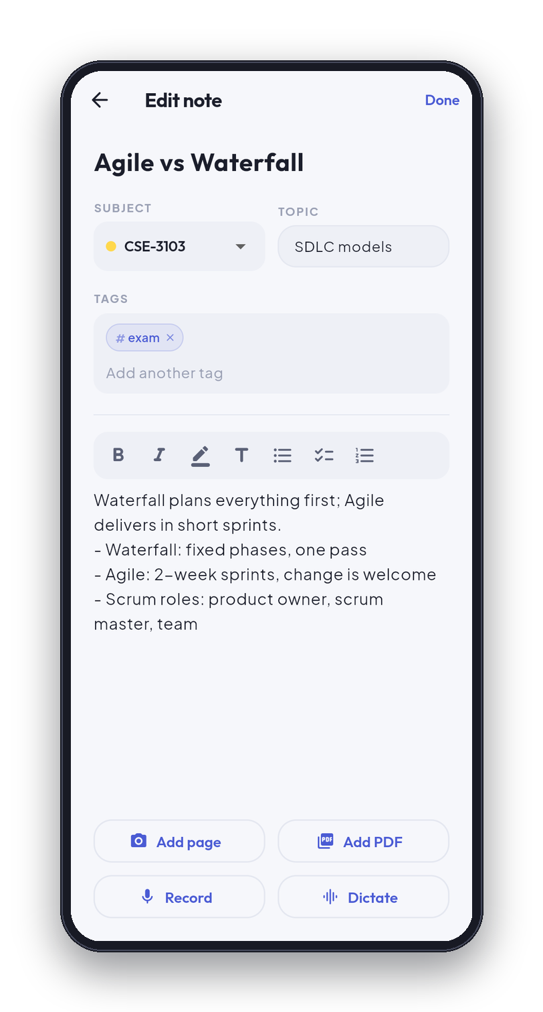
05 · HOW IT WORKS
Five screens, start to finish.
1
Sign in
2
Degree setup
3
Today
4
Note editor, with attach bar
5
Review
1
2
3
4
5
05 / 12
Notes:
This is the journey, and the numbers match the badges under each phone. One: sign in. Two: tell the app about your degree once, and it works out the semester. Three: the Today screen. Four: the note editor, with the photo, PDF, voice and dictation buttons along the bottom, which is where attachments are added. Five: the review screen, where a note you are about to forget comes back. Everything on these screens is real data from the running app.

Slide 6
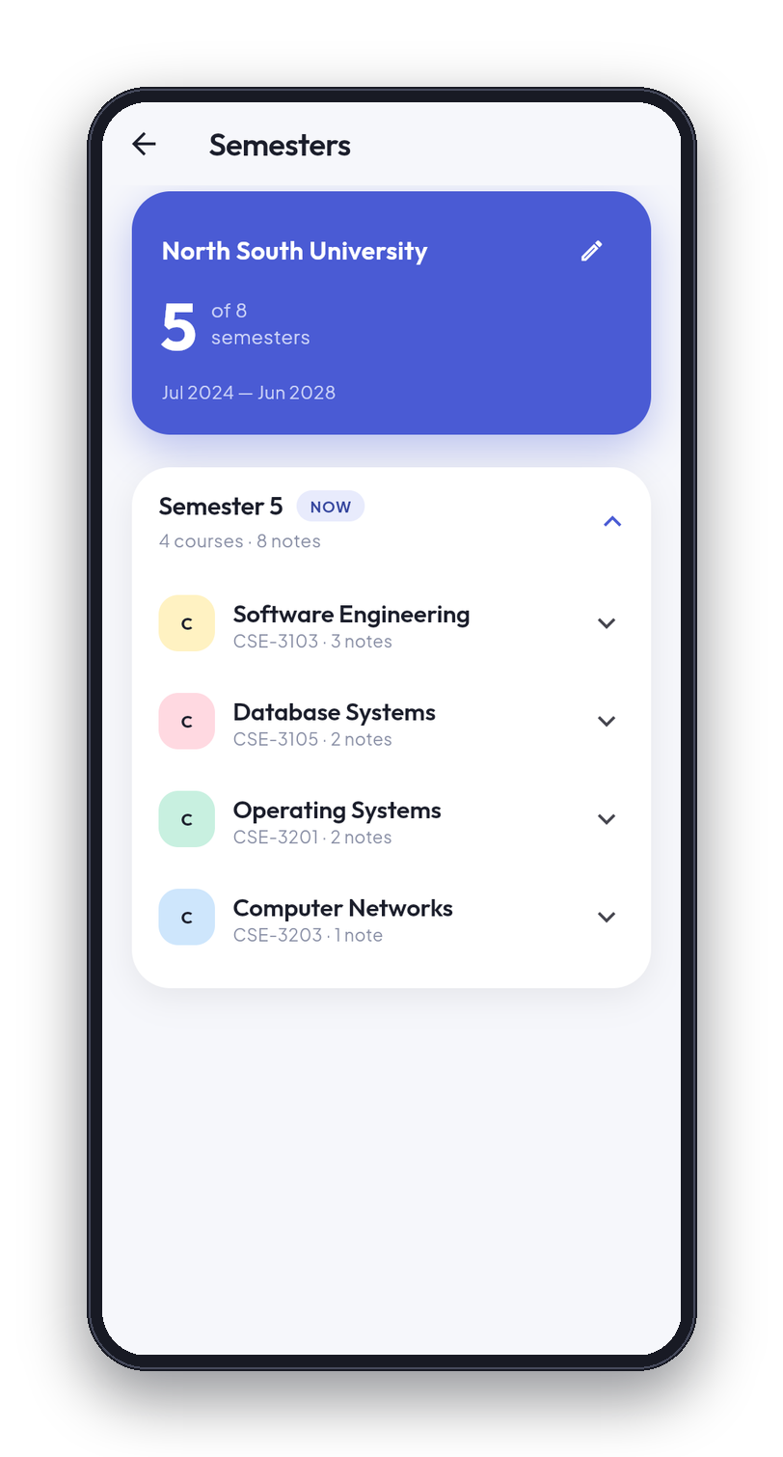
06 · TARGET USERS
Who it is for.
PRIMARY
University students who take notes on a phone and study for scheduled exams.
SECONDARY
Teachers, through the class feature.
WHY THESE USERS
The app is built around semesters and exams, which only matter to people on an academic calendar.
06 / 12
Notes:
The primary user is a university student who takes notes on a phone and studies for scheduled exams. The secondary user is a teacher, who can run a class from the same app. I chose these users because the app is built around semesters and exams, and those only matter to people on an academic calendar. The phone shows the semester page. I have left the market size blank on purpose: the number of students should be cited from the University Grants Commission or university statistics, and I will not guess it.

Slide 7
07 · TECHNOLOGY
How it is built.
ON THE STUDENT'S PHONE
Firebase · free Spark plan
Flutter and Dart
One codebase
accounts, chat, classes
Authentication
Firestore
Cloud Messaging
Optional: the app opens without it
SQLite through sqflite
12 tables · schema version 14
Foreign keys on
The source of truth
The student's own Google Drive
files, backup
Attachments and backup
drive.file scope only
There is no server of our own, so the Firestore security rules carry all of the authorisation.
07 / 12
Notes:
NoteNest is written in Flutter and Dart, one codebase. On the phone there is a SQLite database through sqflite: twelve tables, schema version fourteen, foreign keys switched on. That database is the source of truth. Firebase on the free Spark plan is optional: Authentication, Firestore and Cloud Messaging carry accounts, chat and classes, and the app opens normally when it cannot be reached. Files go to the student's own Google Drive, using the drive.file scope. The point to remember is that there is no server of our own. That means the Firestore security rules carry all of the authorisation, which is why I wrote a test suite for them.

Slide 8
08 · COMPARED WITH WHAT EXISTS
Compared with what exists.
PRODUCT
DOES WELL
WHY IT DOES NOT SOLVE THIS
Google Keep
Fast, simple notes with colour and labels
Organised by colour and label, with no idea of a course or an exam.
Evernote
Powerful search, built for professional work
Made for professional work; the free plan has limits.
Notion
Flexible pages and databases
Built online-first; working offline is limited.
Google Classroom
Teachers post work, students hand it in
A teacher's tool, not a notebook for the student's own notes.
Paper notebook
No battery, no signal
Cannot be searched, and holds no PDF or recording.
1 Organised by the academic calendar
2 Offline is the normal state, not a failure
08 / 12
Notes:
I compared NoteNest with what a student could use today, and I describe only what these products publicly do. Google Keep is quick and simple, but it is organised by colour and label and has no idea of a course or an exam. Evernote is built for professional work and its free plan has limits. Notion is flexible but built online first, and working offline is limited. Google Classroom is a teacher's tool, not a notebook for the student's own notes. A paper notebook needs no signal, but it cannot be searched and holds no PDF or recording. NoteNest's two differences are at the bottom: it is organised by the academic calendar, and offline is the normal state, not a failure.

Slide 9
09 · COST AND SUSTAINABILITY
Free, and cheap to run.
THE REAL LIMITS OF THE FREE (SPARK) PLAN
No Cloud Storage.
No Cloud Functions; the push-notification function in the project needs the paid plan.
Daily Firestore quotas.
Free to use: no advertising, no subscription.
Firebase's free plan carries accounts, chat and classes.
IF IT EVER OUTGREW THE FREE PLAN
The next step would be the paid Blaze plan.
Attachments go to each student's own Google Drive, so the storage cost does not grow as users are added.
09 / 12
Notes:
This slide is about engineering, not revenue. The app is free, with no advertising and no subscription. It is designed to cost almost nothing to run: Firebase's free plan carries accounts, chat and classes, and attachments go to each student's own Google Drive rather than to storage I pay for, so the storage cost does not grow as users are added. The free Spark plan has real limits: no Cloud Storage, no Cloud Functions, and daily Firestore quotas. If the app ever outgrew it, the next step would be the paid Blaze plan. I have left the cost blank because I have not measured it and will not estimate it.

Slide 10
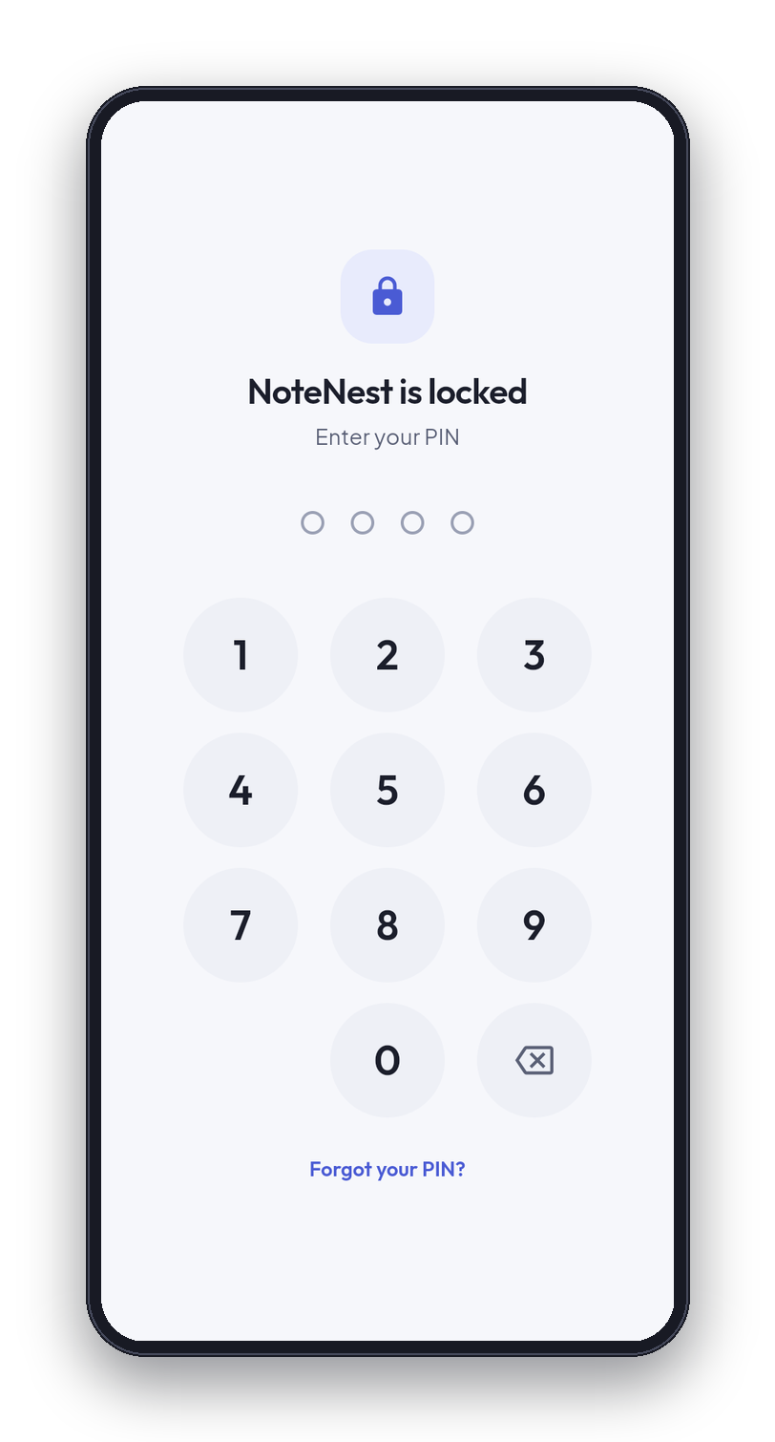
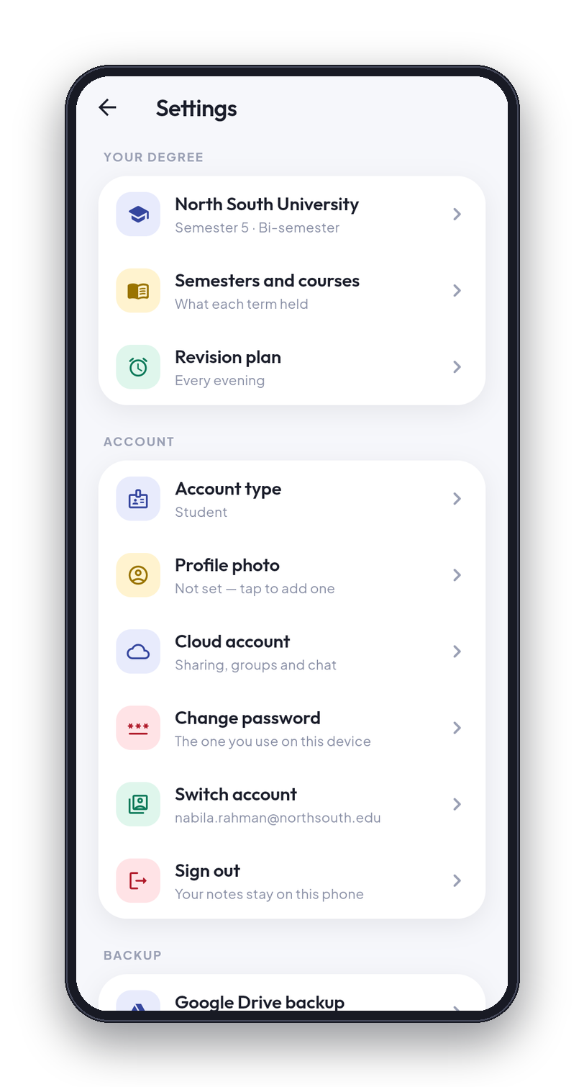
10 · SECURITY AND PRIVACY
Security and privacy.
PASSWORDS
Never stored. Only a salted PBKDF2-HMAC-SHA256 hash, 120,000 rounds.
ACCOUNTS APART
Every row of study data carries its owner, and every query filters on it. Two accounts on one phone cannot see each other.
GOOGLE DRIVE
drive.file: the app sees only files it created. The rest of the Drive is invisible.
AUDIT
My own code, audited before release: nine findings fixed, including a user-directory leak and the weak password hash.
PLAY REQUIREMENTS
A privacy policy is published and account deletion is built in.
10 / 12
Notes:
Passwords are never stored. Only a salted PBKDF2-HMAC-SHA256 hash is kept, at 120,000 rounds, with a different salt for every account. Two accounts on one phone cannot see each other: every row of study data carries its owner, and every query filters on it. The Google Drive permission is drive.file, which means the app sees only the files it created, and the rest of the student's Drive is invisible. Before release I audited my own code and fixed nine findings, among them a leak of the user directory and the weak password hash. A privacy policy is published and account deletion is built in, as Google Play requires. The phones show the PIN lock and Settings.

Slide 11
11 · WHERE IT STANDS
50,152
283
Where it stands, and what is next.
lines of Dart in 141 files
automated tests, all passing
12 · v14
9
STATUS
Built, signed with an upload key, version 1.0.2. Not yet published on the Play Store.
tables · schema version
audit findings fixed
NOT DONE YET
ROADMAP
Notes do not sync between phones.
Android only.
No field testing with real users.
The 34 Firestore rules tests are run by hand, not automatically.
Sync notes between devices
Run the rules tests automatically
Publish on Google Play
An iOS build
Measure performance and accessibility
11 / 12
Notes:
Here is where it honestly stands. The code is about fifty thousand lines of Dart in 141 files, counted in the lib folder. There are 283 automated tests and all of them pass. The database has 12 tables at schema version 14, and the audit fixed nine findings. The app is built, signed with an upload key, at version 1.0.2, but it is not yet published on the Play Store. What is not done: notes do not sync between phones, it is Android only, and there has been no field testing with real users. The Firestore rules have 34 tests that run against a local emulator, but I run them by hand rather than automatically. Next: sync notes between devices, run the rules tests on every change, publish on Play, build for iOS, and measure performance and accessibility. I am not asking for funding.

Slide 12

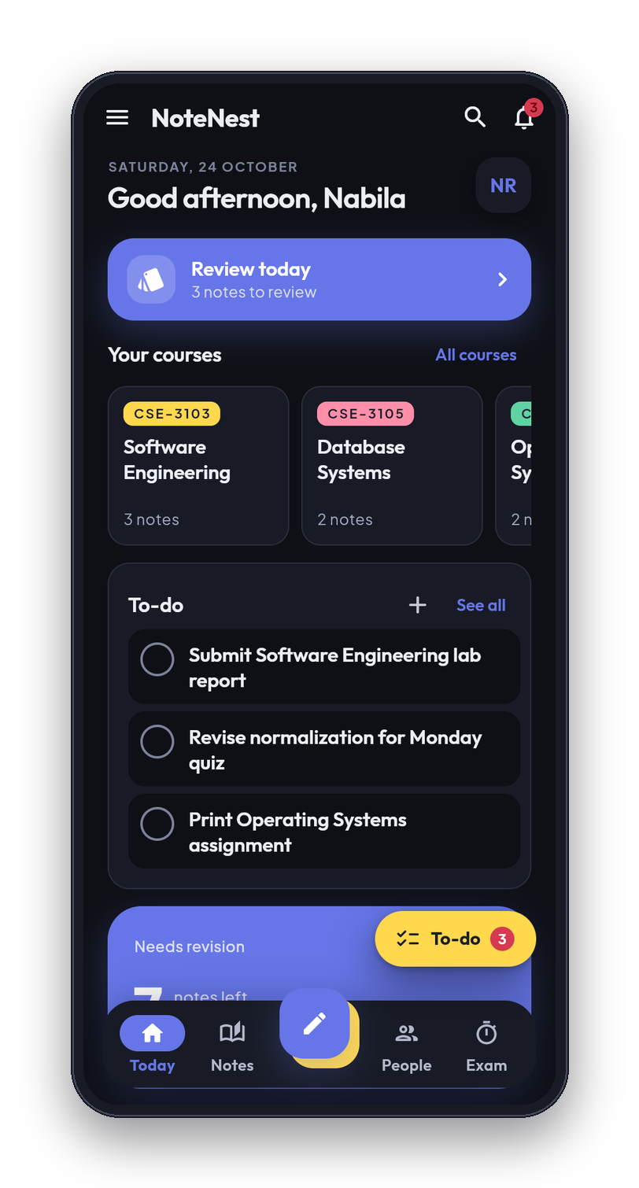
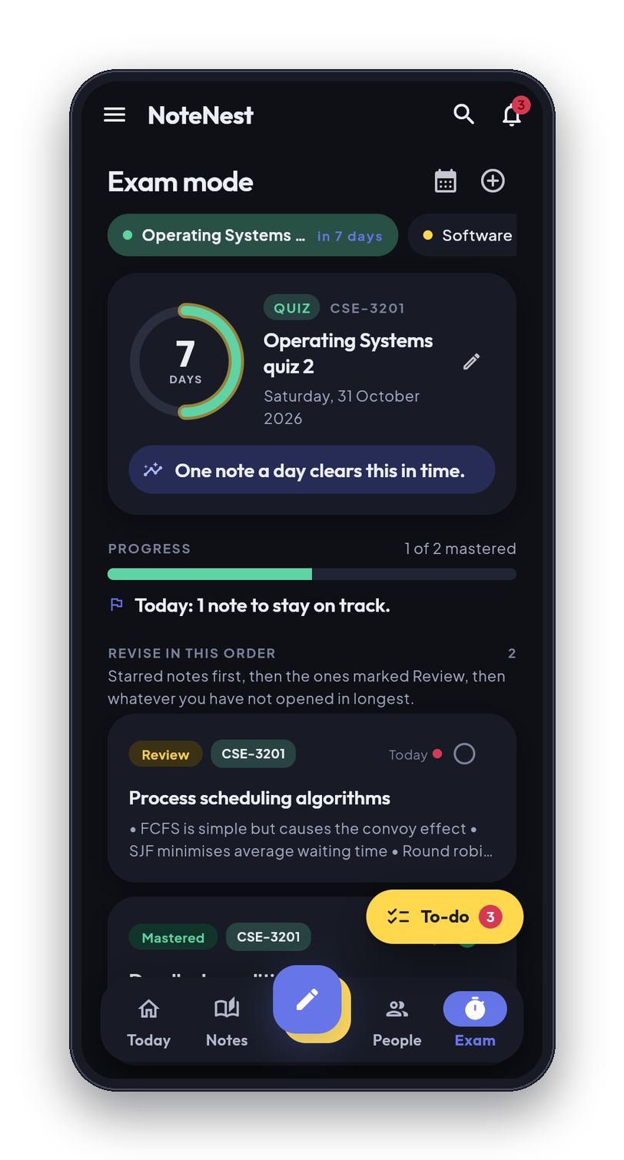
12 · CONCLUSION AND CONTACT
NoteNest keeps a student's work in one place, organised by course, and it works whether or not there is a signal.
Thank you
seyamhossain12@gmail.com
Email
01758962971
Phone
GitHub
https://github.com/mdsarowarofficial/notenest
Designed and built by Md. Sarowar Hossain
12 / 12
Notes:
To close: NoteNest keeps a student's work in one place, organised by course, and it works whether or not there is a signal. The phones show the dark theme and the PIN lock. I designed and built it myself. Thank you, and I am happy to take questions.

