Slide 1


FINAL-YEAR PROJECT
NoteNest
Notes, filed by course. Revision that finds you.
Md Sarowar
Supervisor review · 2026
01 / 12
Notes:
Good morning. This is NoteNest, my final-year project: a notebook for students that files every note under its course and brings back the ones you are about to forget. The animation on the right is the app's own opening, drawn the same way as in the code: the page arrives, the corner folds, the line you meant to revise is marked, and the app opens underneath. I will walk through the real application, screen by screen, starting where a student starts: the sign-in screen.

Slide 2
02 · THE PROBLEM AND THE IDEA
Exam week should be for studying.
Camera roll
NoteNest
Chat apps
Organised by course.
Works with no connection.
Downloads
Paper
02 / 12
Notes:
A student's material is scattered. Photos of the board are in the camera roll, slides arrive in chat apps, PDFs sit in downloads, and some of it is still on paper. So exam week is spent searching instead of studying. NoteNest puts all of it in one place, organised by course, and it works with no connection at all.

Slide 3
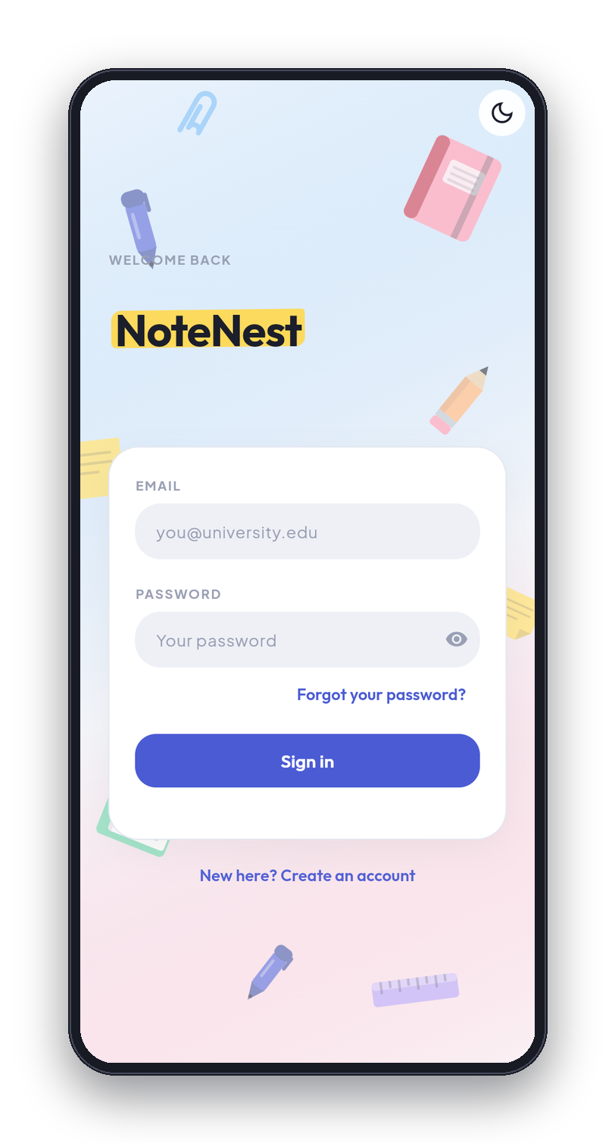
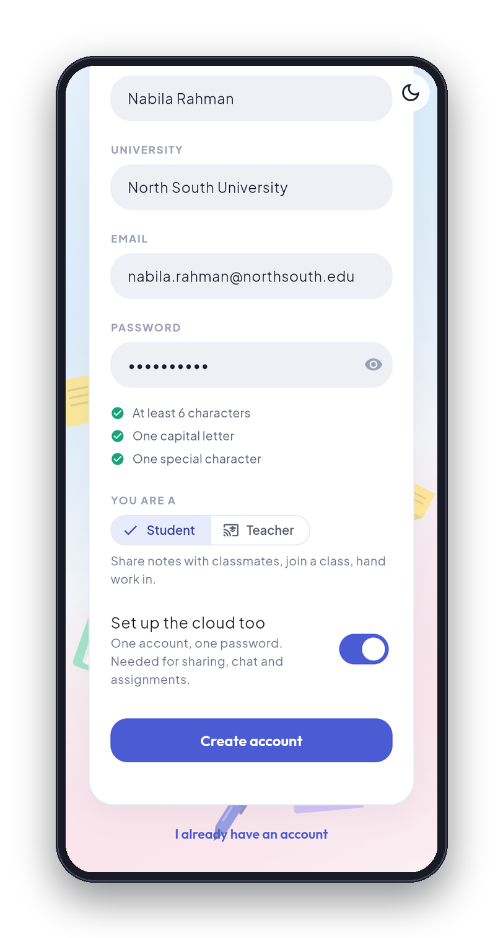
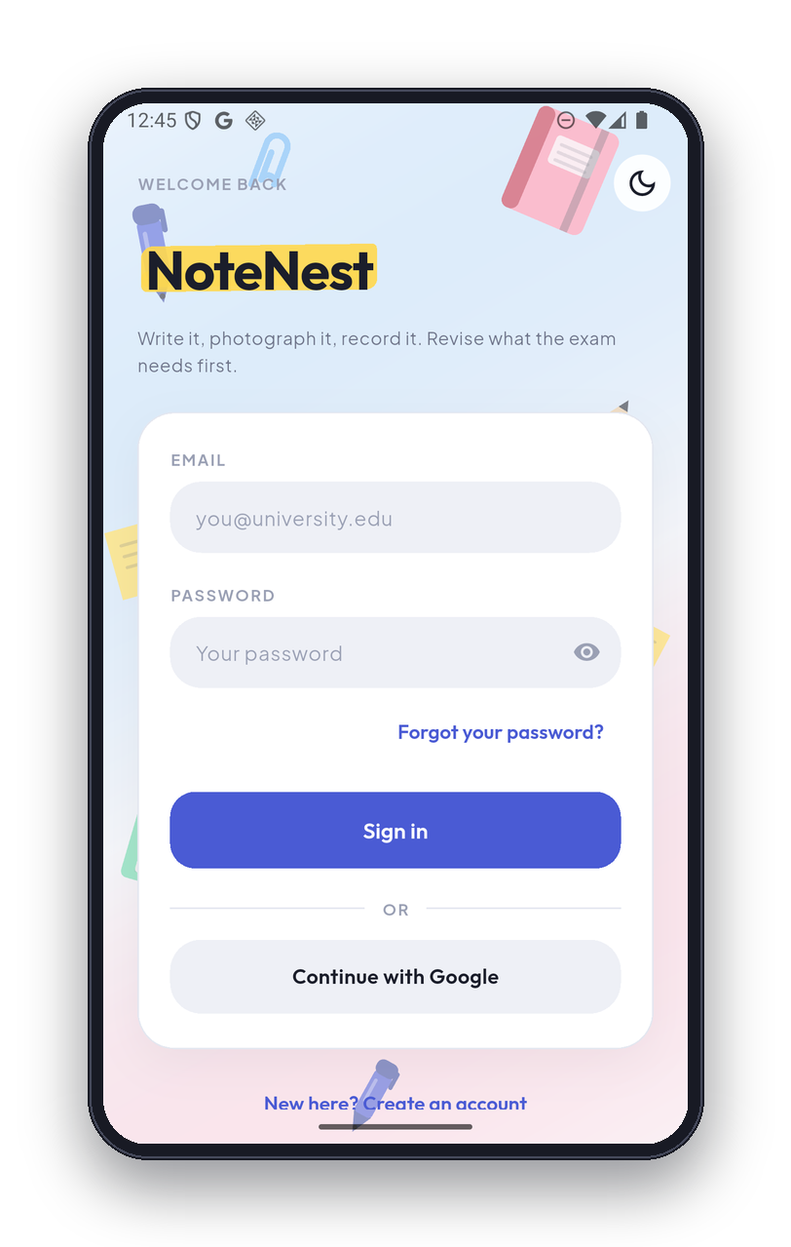
03 · GETTING IN
Sign in with email or Google.
Email and password
Or one tap with Google
An account works offline too
1
2
3
03 / 12
Notes:
Phone one is the sign-in screen. Phone two is creating an account: the password checklist ticks as you type, and there is a switch for the cloud. Phone three is the same screen on the Android phone, with the Continue with Google button. An account works offline too. The notebook lives on the phone, and the cloud account is an extra for sharing, chat and classes.

Slide 4
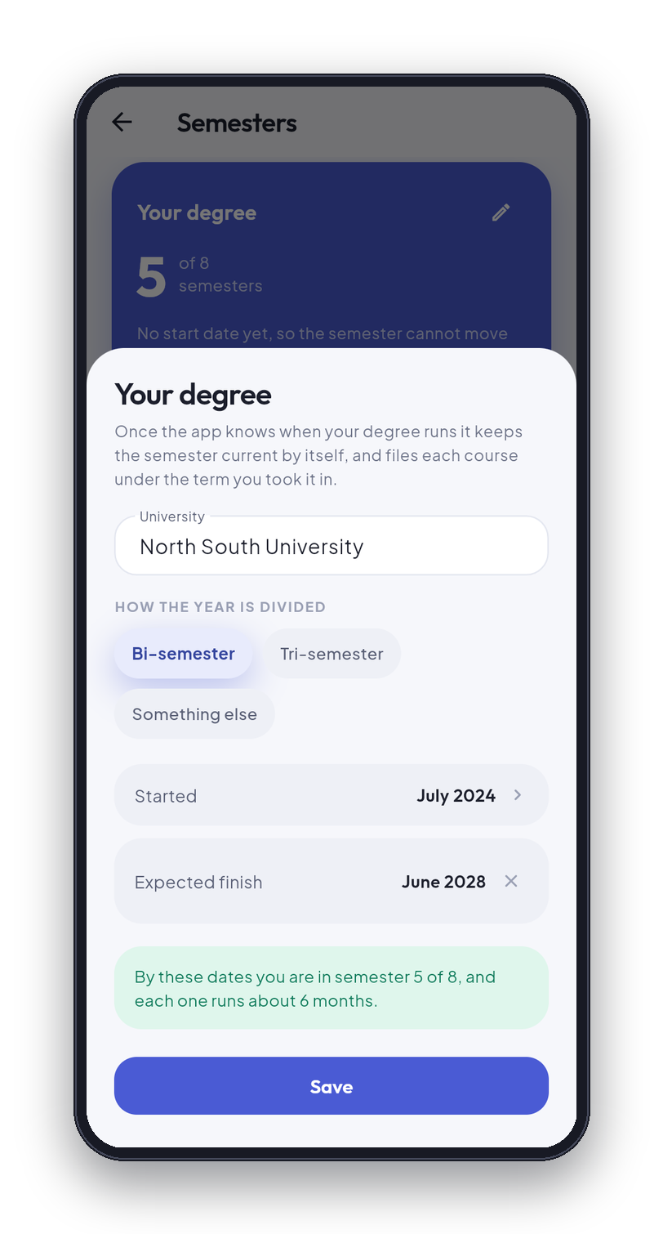
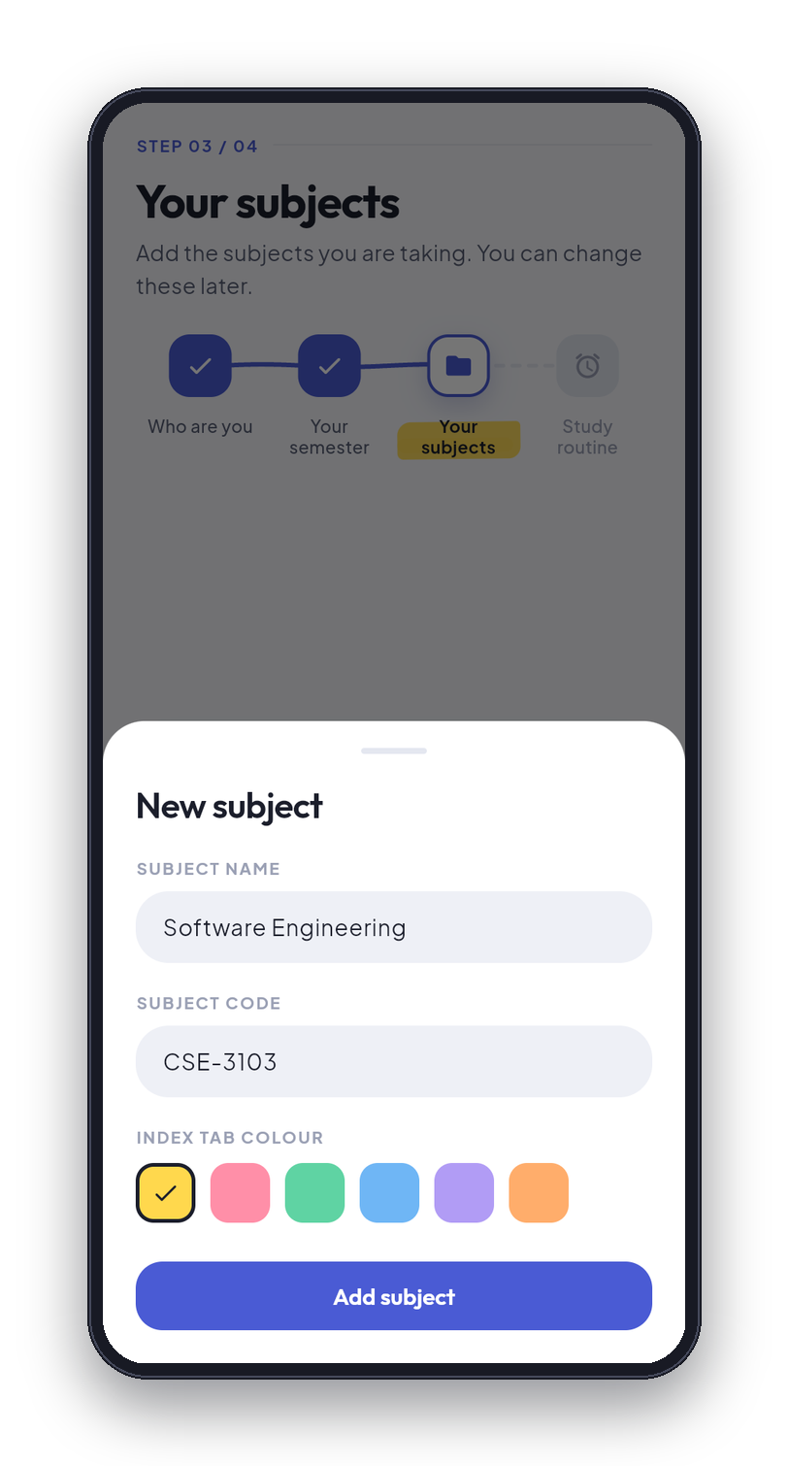
04 · SETTING UP, ONCE
Tell it your degree once.
Start and finish dates
It works out your semester
Courses keep their semester
1
2
04 / 12
Notes:
Phone one is the degree sheet. The student says how the year is divided, when the degree started and roughly when it finishes, and the app works out which semester today falls in: here, semester five of eight. Phone two is adding the first course. A course is stamped with the semester it was made in, so when a semester ends it becomes history by itself.

Slide 5
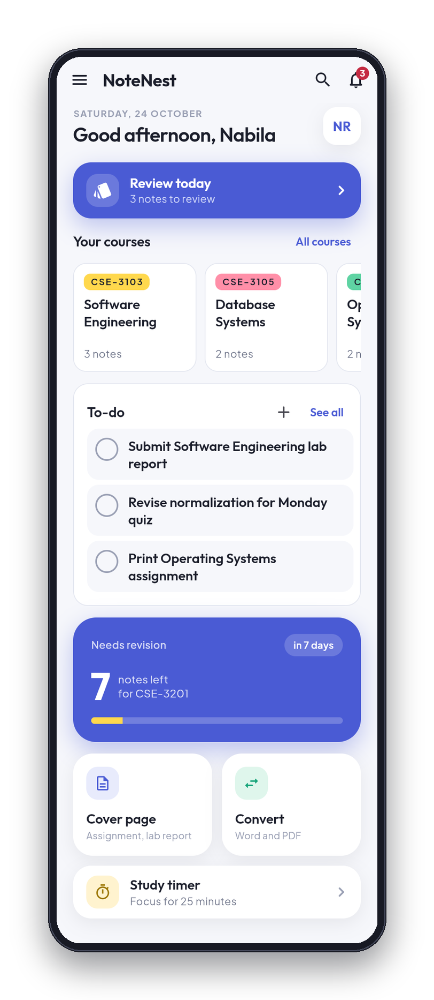
05 · TODAY
Today, at a glance.
1
Revision card
1
2
2
Course row
Tap any card to go straight in.
3
3
To-do card
4
Tools
4
Timer
5
5
05 / 12
Notes:
This is the home screen with real data in it. One: the revision card says how many notes are due today and opens the review. Two: the course row, one card per course with its note count. Three: today's to-do list, on the same screen. Four: the tools, a cover page for assignments and a Word and PDF converter. Five: the study timer, a 25-minute focus session.

Slide 6
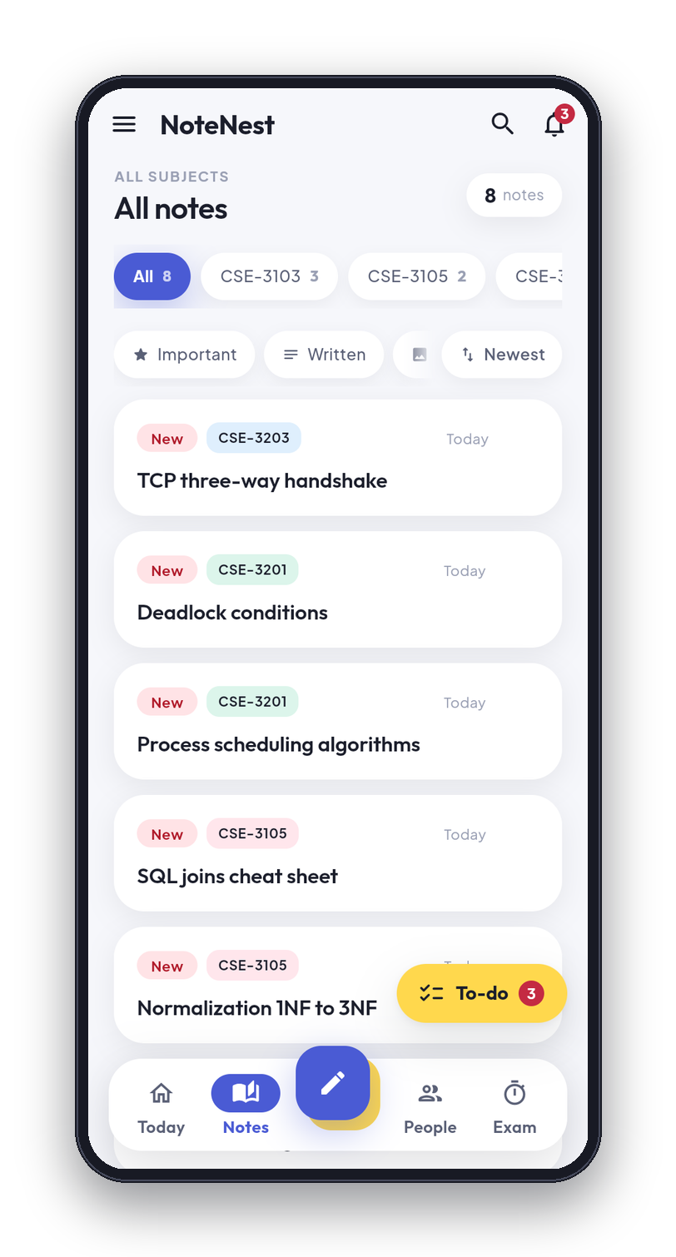
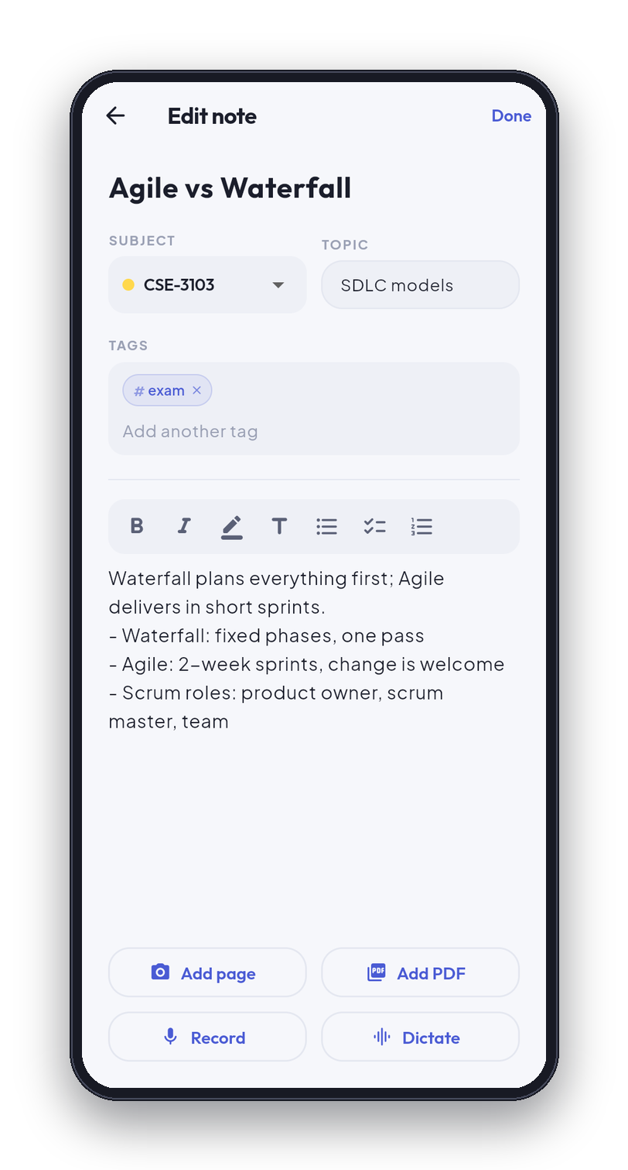
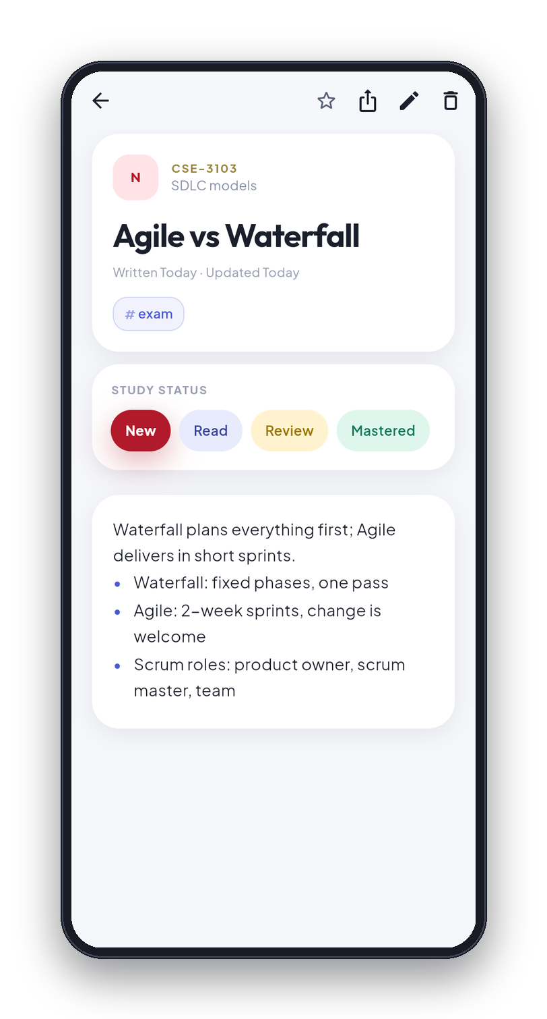
06 · WRITING A NOTE
Write it. File it. Mark it.
Title, course, topic, tags
Bold, highlight, lists
New, Read, Review, Mastered
1
2
3
06 / 12
Notes:
Phone one is the Notes tab, filtered by course, with the newest first. Phone two is the editor: a title, the course, a topic, tags, and a formatting bar for bold, highlight, headings and lists. It saves as you type. Phone three is the note as you read it back, with the study status: New, Read, Review or Mastered. That status is what drives revision.

Slide 7
07 · MORE THAN TEXT
Photo, PDF and voice. On the note.
1 Photo
2 PDF
Attached to the note itself
3 Voice
PDF text is read on the phone
4 Dictation
Search finds words inside slides
1
2
3
4
07 / 12
Notes:
A note is not only text. At the bottom of the editor are the four ways to add more: photograph a page of handwriting, add a PDF, record the lecture, or dictate and let it become text. The photo, the PDF and the voice recording live on the note itself, not in a separate gallery. PDF text is extracted on the phone, so the search finds words printed inside a slide, not only words you typed.

Slide 8
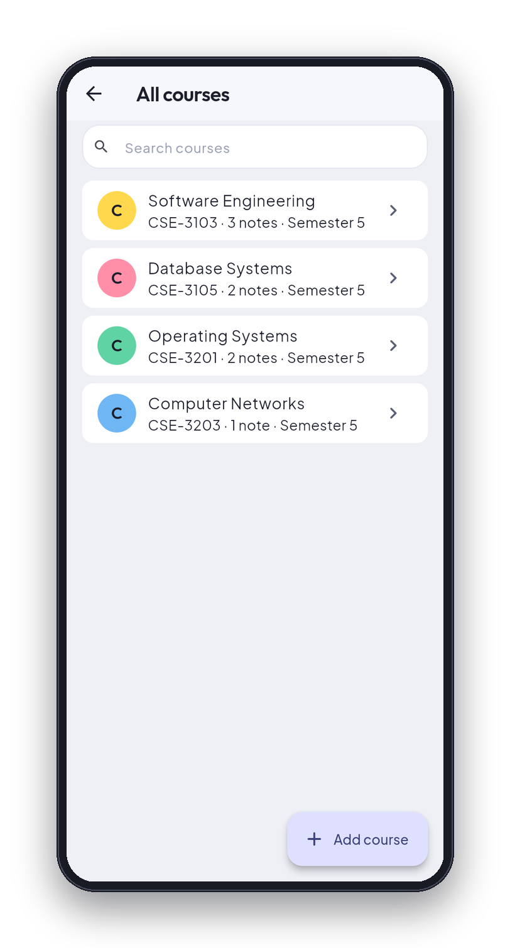
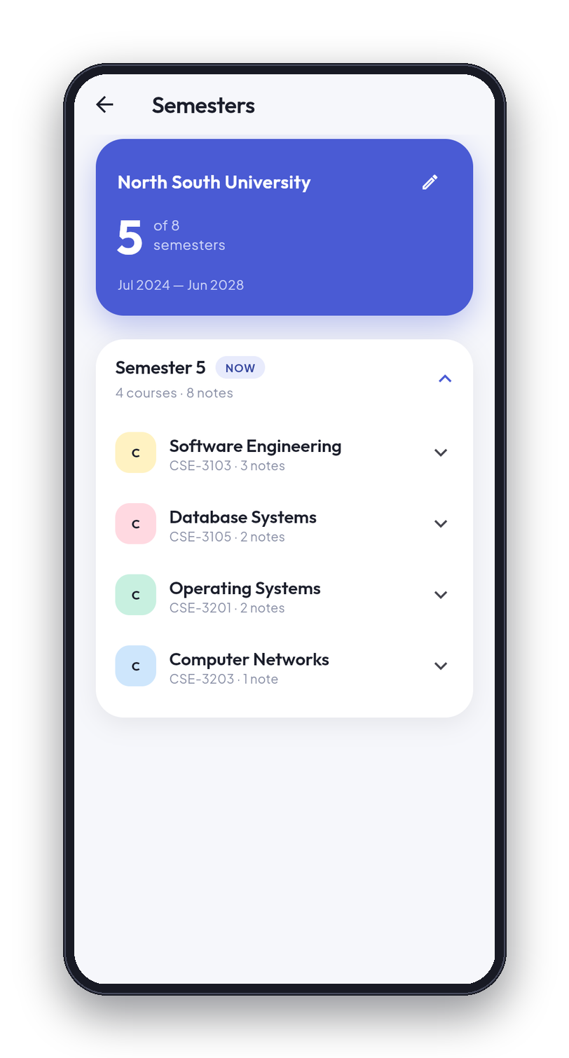
08 · COURSES AND SEMESTERS
Each semester becomes history.
Courses filed by semester
Finished terms close themselves
Files sit with their course
1
2
08 / 12
Notes:
Phone one is the course list: every course with its code, note count and semester. Phone two is the semester page, which shows the degree, semester five of eight, and the four courses that belong to it. When a semester finishes it becomes history by itself and its courses move under it. Files that belong to a course, like slides and past papers, sit with that course.

Slide 9
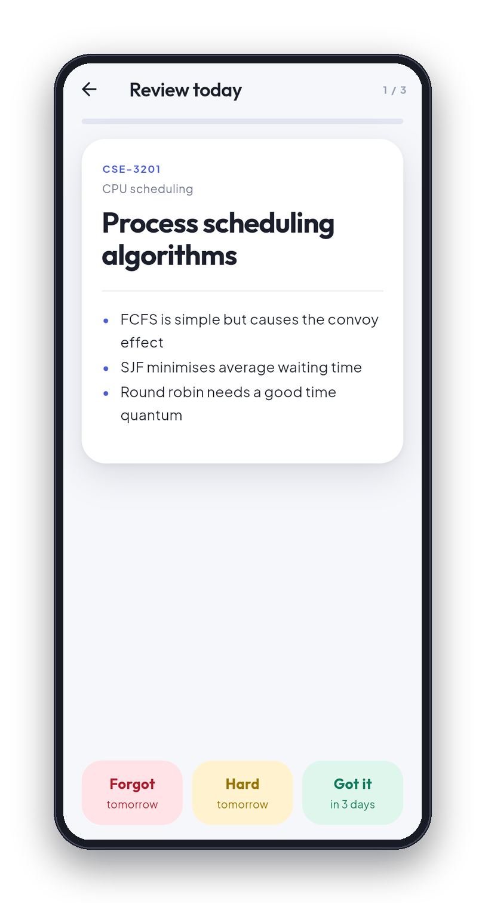
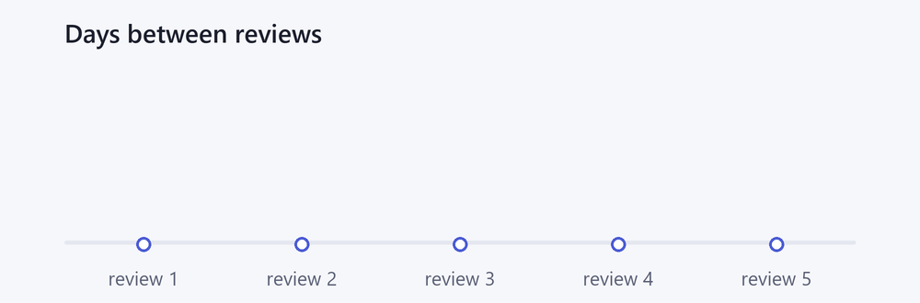
09 · REVISION THAT WORKS
A few notes a day.
Forgot: back to 1 day.
Got it: the gap grows.
1, 3, 7, 14, then 30 days
1
09 / 12
Notes:
This is the Review today screen. The app shows the title and asks you to remember what the note says, then you show it and answer honestly: Forgot, Hard or Got it. Each button says when the note will come back. Forgot puts it back to one day. Got it makes the gap longer: one day, then three, seven, fourteen and thirty, and after that the note counts as mastered. The animation shows the gaps growing. So revision is a few notes a day, each one just before you would forget it.

Slide 10
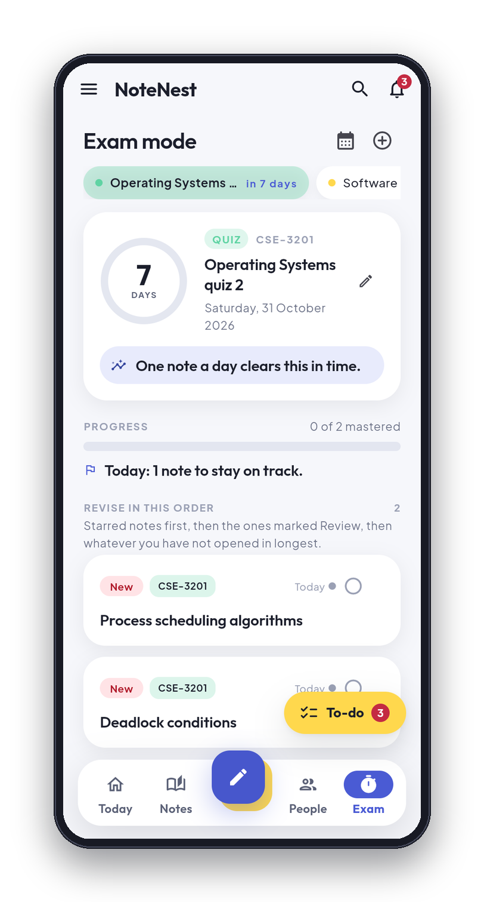
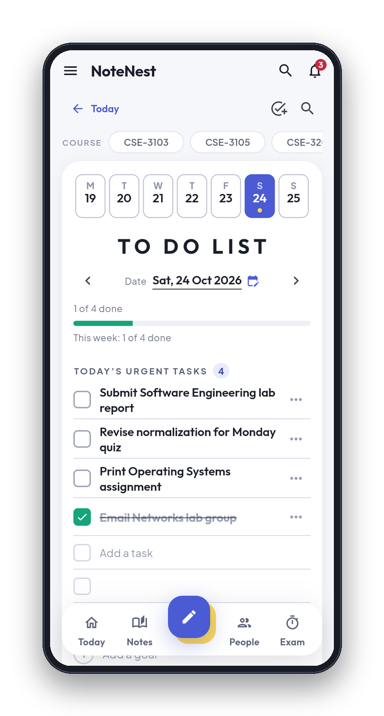
10 · EXAMS AND TO-DOS
Count the days. Do the work.
Exam countdown, in days
Notes still not mastered
A to-do page for the week
1
2
10 / 12
Notes:
Phone one is exam mode. A date is added once, as an exam, a quiz or an assignment, and the ring counts the days down. Beside it the app says how many notes for that course are still not mastered, here none of two, and it lists them in the order to revise. Phone two is the to-do page: a week strip, today's list on ruled paper, and tasks that can be ticked off.

Slide 11
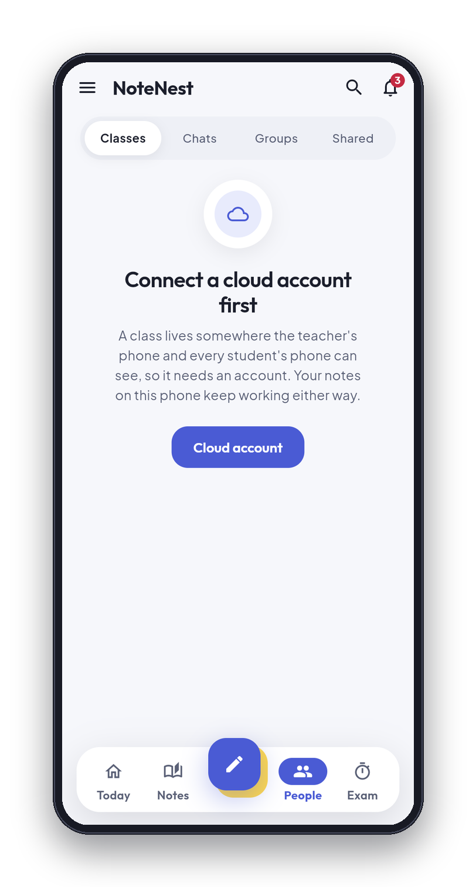
11 · CLASSMATES AND CLASSES
Share a note. Run a class.
Send a note by exact email
They accept. Your name stays
Group chat, and teacher classes
1
11 / 12
Notes:
The People tab is the cloud side, and it is optional. A student sends a note to a classmate by their exact email address. The other person has to accept it, and the sender's name stays on the note. There are group chats, and a teacher can run a class and post work. The screen shown is the People tab with no cloud account connected: it asks the student to connect one first, because everything here needs an account. Nothing else in the app depends on it.

Slide 12

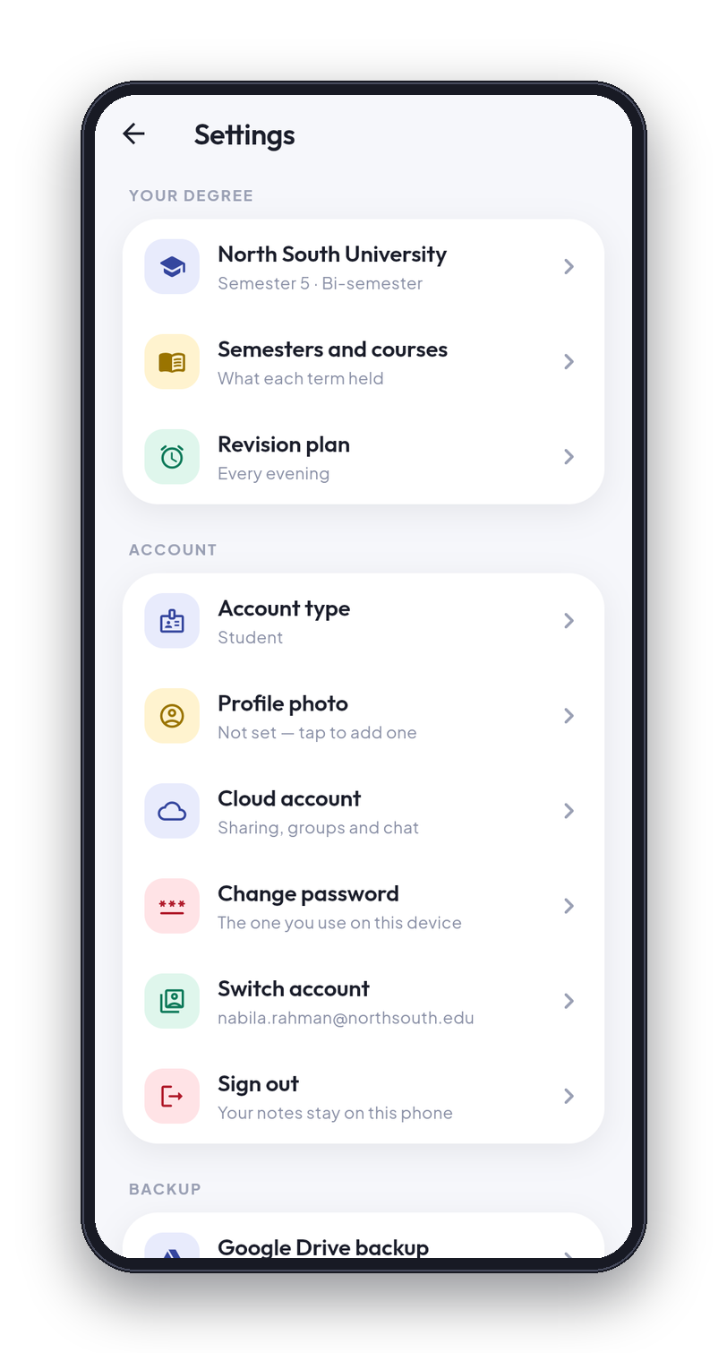
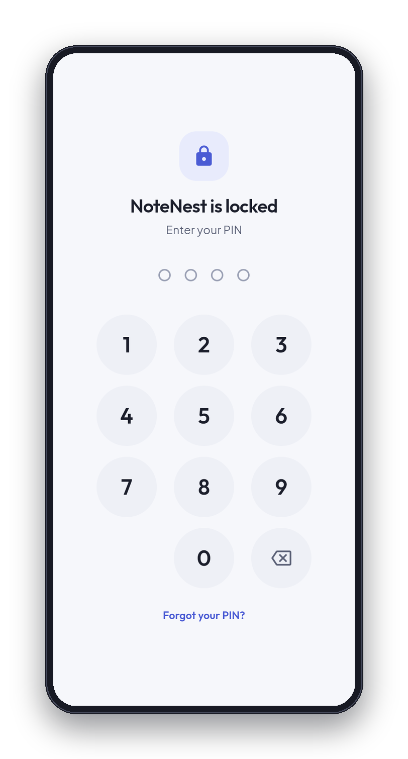
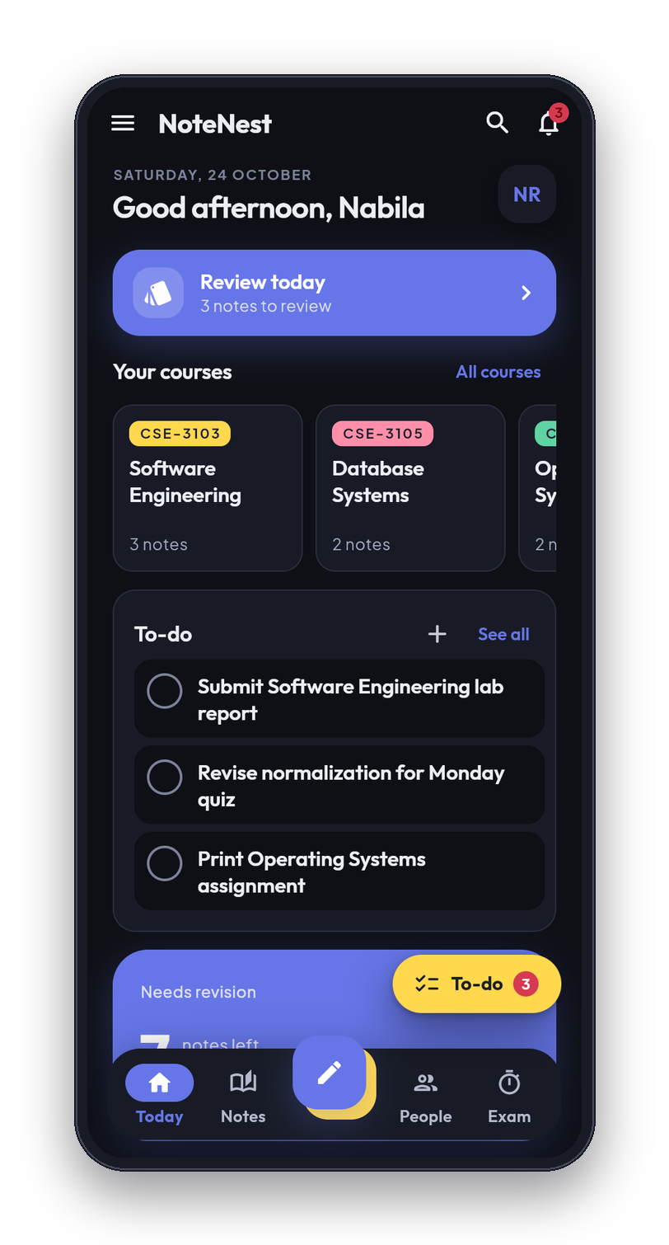
12 · SAFETY, AND WHERE IT STANDS
50,152
283
lines of Dart in 141 files
automated tests, all passing
12
7
tables, schema v14
security-audit findings fixed
Not yet: sync between phones. Rules tested by hand. Android only. Unpublished.
1
2
Thank you
3
12 / 12
Notes:
Safety first. Phone one is Settings. Phone two is the app lock: a four-digit PIN, and a fingerprint on phones that have one. Phone three is the dark theme. Backup goes to the student's own Google Drive. Now where it stands. About fifty thousand lines of Dart in 141 files, 283 automated tests and all of them pass, a database of 12 tables at schema version 14, and the October security audit fixed seven findings. To be honest about the limits: notes do not sync between phones yet, the Firestore security rules were tested by hand and not by an automated suite, it is Android only, and it is not yet published. Thank you. I am happy to take questions.

