Slide 1
Python Network Programming

Slide 2
Agenda
Network programming
Common Terminologies
Socket programming Introduction
Client and server Architecture
Socket Python module
Real time application:
Chat application

Slide 3
Network programming
“Writing programs that communicate with other programs across a computer network “
Socket Programming
It’s subset of network programming
Way of connecting two nodes on a network to communicate with each other

Slide 4
Common Terminologies
Internet Protocol -
Packet
Transport layer protocol
TCP
UDP
Routing

Slide 5

Socket Programming Introduction
Socket Programming
“Way of connecting two nodes on a network to communicate with each other”
Socket:
An interface between application and transport layer.
Application process can send and receive the message from/to another application process via socket.
Socket Address
Combination of an IP address and port number
192.168.1.1:8000

Slide 6
Socket types and families
Check /usr/include/sys/socket.h file for interface & family details.
AF_* => Address family
PF_* => Protocol Family
Socket and subsequent attributes defined based on Address family

Slide 7
Address Family
Socket types
socket.SOCK_STREAM
socket.SOCK_DGRAM¶
socket.SOCK_RAW
socket.SOCK_RDM
socket.SOCK_SEQPACKET
socket.AF_UNIX
socket.AF_INET
socket.AF_INET6
=> Above mentioned family and types will be defined as constants in socket module. These constants are represented as arguments in socket function.
=> Many Linux constants are defined in socket module also.

Slide 8
Socket Address
sock=socket.socket(socket.AF_INET,socket.SOCK_STREAM,0)
sock
<socket.socket fd=444, family=AddressFamily.AF_INET, type=SocketKind.SOCK_STREAM, proto=0>
sock.bind(('127.0.0.1',1111))
set protocol to 0 to have socket choose the correct protocol based on type
sock
<socket.socket fd=444, family=AddressFamily.AF_INET, type=SocketKind.SOCK_STREAM, proto=0, laddr=('127.0.0.1', 1111)>

Slide 9

Server Socket Methods | Client Socket Method | General Socket Method
Socket_obj.bind() | Socket_obj.connect() | Socket_obj.send()
Socket_obj.listen() |  | Socket_obj.sendto()
Socket_obj.accept() |  | Socket_obj.recv()
 |  | Socket_obj.recvfrom()
 |  | Socket_obj.close()
 |  | Socket.gethostname()
For More socket method, Please visit https://docs.python.org/3/library/socket.html

Slide 10
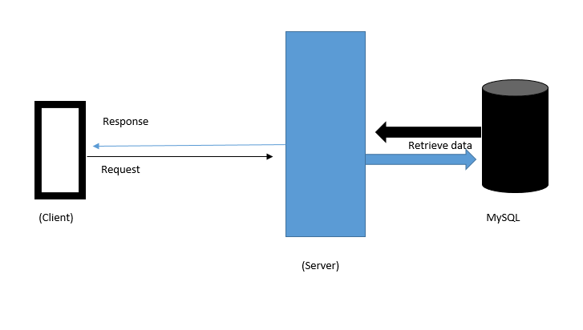
Client and server Architecture

Slide 11
Real time Application
Chat Application
Going to test with echo server and client
Interaction with web host
FTP
Network sniffer

Slide 12
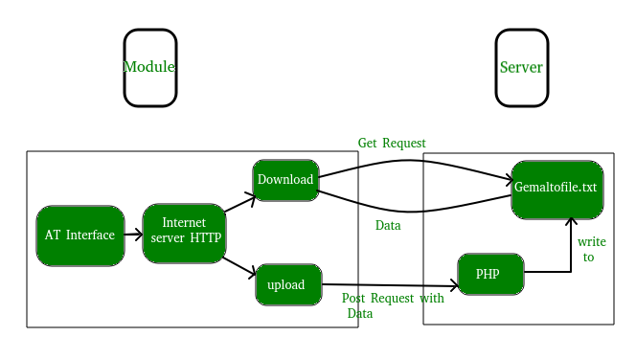
Interaction with web Host

Slide 13
Web Reference:
https://stackoverflow.com/questions/10600235/a-python-socket-client-that-outputs-the-source-code-of-a-website-why-isnt-this
https://www.geeksforgeeks.org/get-post-requests-using-python/

Slide 14
FTP
https://docs.python.org/3/library/ftplib.html

Slide 15
Network sniffing
Scapy python lib

Slide 16
Reference
https://realpython.com/python-sockets/
https://www.csd.uoc.gr/~hy556/material/tutorials/cs556-3rd-tutorial.pdf
http://home.iitk.ac.in/~chebrolu/ee673-f06/sockets.pdf
https://www.quora.com/Whats-the-difference-between-the-AF_PACKET-and-AF_INET-in-python-socket

