Slide 1
Documentation for
HB Medical
Name: Aftab Islam Shaikh
Class: TYBBA(CA)
Seat-No: 13158
Project: Proj - Ⅱ

Slide 2
Features of Medical Shop Management System
User can search details of the Sells, Medical Shop, Medicines, Inventory.
Medical Shop Management System is an online application, from which user can easily manage Medical Shop details, Company details, Stocks details
Admin can track all the information of Medical Shop, Sells, Company etc
Admin can edit, add, delete and update the records of Stocks, Medicines, Inventory
Manage the information about of Company, Medicines, Medical Shop

Slide 3
Modules of the Medical Shop
Management System
These are the main modules of the project:
Medical Shop Module :
We can create, read, update and delete Medical Shop from this module
Sells Module :
All the operations related to Sells, is managed by this module
Company Module :
Company Module is used to manage the Company
Stocks Module :
It has been developed for managing the Stocks

Slide 4
:
Medicines Module :
It manages the Medicines
Inventory Module :
Inventory operations will be managed by Inventory module

Slide 5
Technologies used in Project
HTML
CSS
JS
PHP
MYSQL

Slide 6
Introduction
Introduction This project concerned about developing a Pharmacy Management System that will be used for retail and wholesale pharmacies. The purpose of this project is to manage all data derived for a pharmacy to maintain their business through the system rather than recording their data manually which is more risk to the business to maintain and to avoid loss. According to my feasibility study of different pharmacies in Zanzibar and Main Land I have reached different pharmacies and recognized that most of them they recording their data manually through book of accounts. This type of recording data it makes them to incurred more loss and they are not able to determine if they incurred loss or not for those who having a large stock of medicine. There are a lot of discrepancies of items in the stock, it is hard for them even to recognise their all customer’s records; they cannot have even their weekly, monthly or a yearly report easily because of recording manually. Due to this challenges which cause to minimize a business profit I became with solution on how they can reduce risk and maximize their profit through Pharmacy management system.

Slide 7
Background Of the study Pharmacy management system
is a system that consists of data entry, retrieval and monitoring stock, sale, customer records, debtor’s and management administrator’s records and determination of minimum quantity of each drug. String searching technique also applied in this system. This technique is referring by drugs name, drug code and description of drugs. Besides that, the system also provides two types of methods which are Quantity and Expire date of drugs. This system always checking the date to remind the sales man if the certain drug was expired and will be triggered to remind the sale man if the certain of the drugs reached the minimum quantity. This system enable administrator to control and monitor the drugs stock effectively. Due to the size and quantity service of the pharmacy, the pharmacy has a very large customer base. The number of customers is quickly increases due to the increase of demand of drugs in many areas. This situation makes the pharmacist to be busy and use a lot of time to manage and control their business records. Meanwhile the pharmacist has to insure satisfaction in services to keep their records effectively at a reasonable time.

Slide 8
Problem statement Improving performance and efficiency in pharmacy
is a system that consists of data entry, retrieval and monitoring stock, sale, customer records, debtor’s and management administrator’s records and determination of minimum quantity of each drug. String searching technique also applied in this system. This technique is referring by drugs name, drug code and description of drugs. Besides that, the system also provides two types of methods which are Quantity and Expire date of drugs. This system always checking the date to remind the sales man if the certain drug was expired and will be triggered to remind the sale man if the certain of the drugs reached the minimum quantity. This system enable administrator to control and monitor the drugs stock effectively. Due to the size and quantity service of the pharmacy, the pharmacy has a very large customer base. The number of customers is quickly increases due to the increase of demand of drugs in many areas. This situation makes the pharmacist to be busy and use a lot of time to manage and control their business records. Meanwhile the pharmacist has to insure satisfaction in services to keep their records effectively at a reasonable time.

Slide 9
Objective of the project
is a system that consists of data entry, retrieval and monitoring stock, sale, customer records, debtor’s and management administrator’s records and determination of minimum quantity of each drug. String searching technique also applied in this system. This technique is referring by drugs name, drug code and description of drugs. Besides that, the system also provides two types of methods which are Quantity and Expire date of drugs. This system always checking the date to remind the sales man if the certain drug was expired and will be triggered to remind the sale man if the certain of the drugs reached the minimum quantity. This system enable administrator to control and monitor the drugs stock effectively. Due to the size and quantity service of the pharmacy, the pharmacy has a very large customer base. The number of customers is quickly increases due to the increase of demand of drugs in many areas. This situation makes the pharmacist to be busy and use a lot of time to manage and control their business records. Meanwhile the pharmacist has to insure satisfaction in services to keep their records effectively at a reasonable time.

Slide 10
Planning
It is the process of identifying problems, opportunities, and objectives. This phase required the analysts to look honestly at what is occurring in a business. Then, together with other organizational members, the analyst pinpoints problems. Identifying objectives is also an important component of the first phase. The analyst first discovered what the business is trying to do. Then the analyst was able able to see whether some aspect of information systems applications can help the business reach its objectives by addressing specific problems or opportunities
Activities in this phase consist of interviewing user management Summarizing the knowledge obtained Estimating the scope of the project and Documenting the results The output of this phase is a feasibility report containing a problem definition and summarizing the objectives. Management must then make a decision on whether to proceed with the proposed project

Slide 11
System Analysis
It is a process of collecting factual data, understand the processes involved, identifying problems and recommending feasible suggestions for improving the system functioning. This involves studying the business processes, gathering operational data, understand the information flow, finding out bottlenecks and evolving solutions for overcoming the weaknesses of the system so as to achieve the organizational goals
System Analysis also includes subdividing of complex process involving the entire system, identification of data store and manual processes. 3.4 System Design It is the most crucial phase in the developments of a system. The logical system design arrived at as a result of systems analysis is converted into physical system design. Normally, the design proceeds in two stages

Slide 12
System Design
It is the most crucial phase in the developments of a system. The logical system design arrived at as a result of systems analysis is converted into physical system design. Normally, the design proceeds in two stages
System Design also includes subdividing of complex process involving the entire system, identification of data store and manual processes. 3.4 System Design It is the most crucial phase in the developments of a system. The logical system design arrived at as a result of systems analysis is converted into physical system design. Normally, the design proceeds in two stages

Slide 13
DFD Level 2 - Administrator
Data Flow diagram
User
1.1 Customer
1.3 Product
Supplier
1.2 Supplier
Supplier
ID
Customer Details
Product
Details
Supplier
Details
Customer
Product
Supplier

Slide 14
DFD Level 2 - Purchase
Product Details
Purchase Details
3.1
Create
Purchase
Bill
User
Bill Details
Product
Details
Bill Details
3.2
Purchase
To Supplier
3.3
Purchase
By Customer
Bill Details
Bill
Purchase Details
Purchase Details
Customer

Slide 15
Purchase Details
CONTEXT LEVEL
Manager
Customer
Purchase Order Info
0
Sales Order Item
Ordered To Purchase
Bill Info
Purchase Info
Medical
Management System
Received Item
Bill Info
Bill Info
Pay Bill
Purchase Info
Automation
Sales Item
Agency
Bill Info

Slide 16

Use Case Diagram
Aftab Medical Management System Use Case Diagram
Register User
Login To System
Store data about the customer
Administrator
Store data about supplier
Medicine Info
User
Sales Invoice
Sales Report
Retrieve Store data
Update stored data

Slide 17
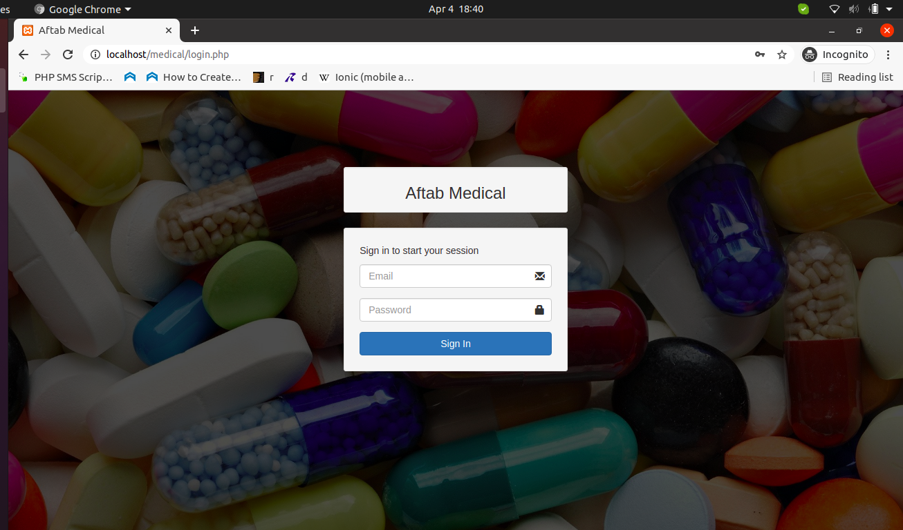
Diagram of Aftab Medical Web Portal
Login
Page

Slide 18
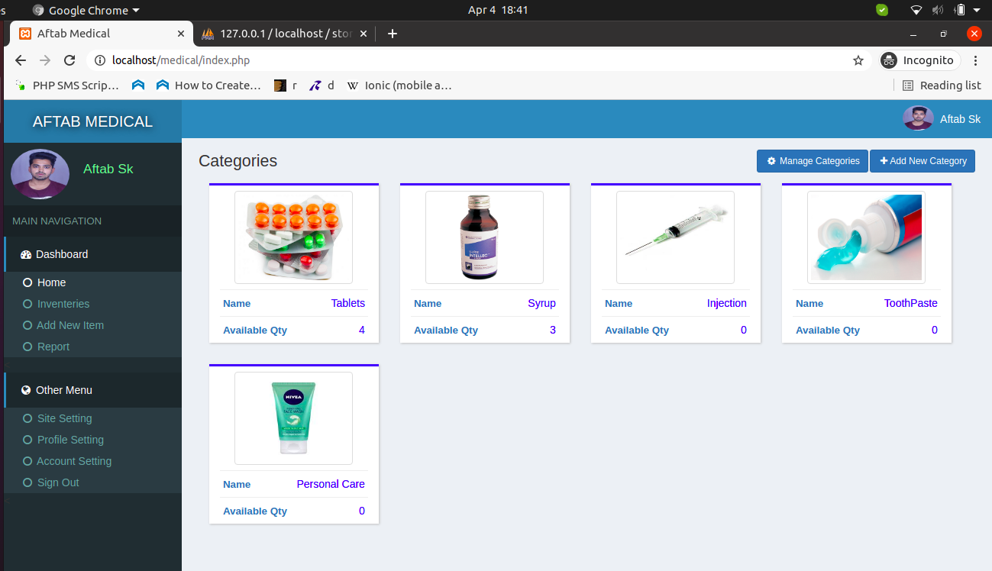
DashBoard

Slide 19
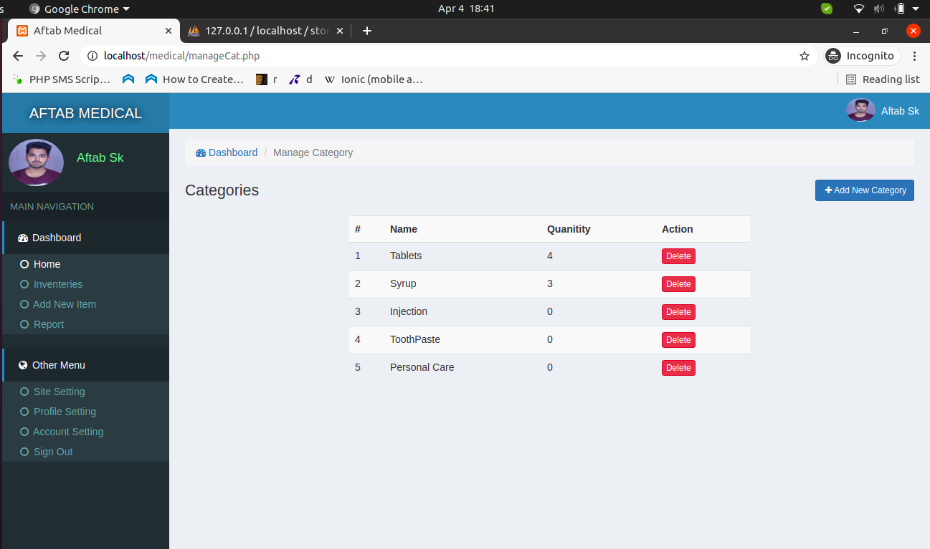
Manage Categories

Slide 20
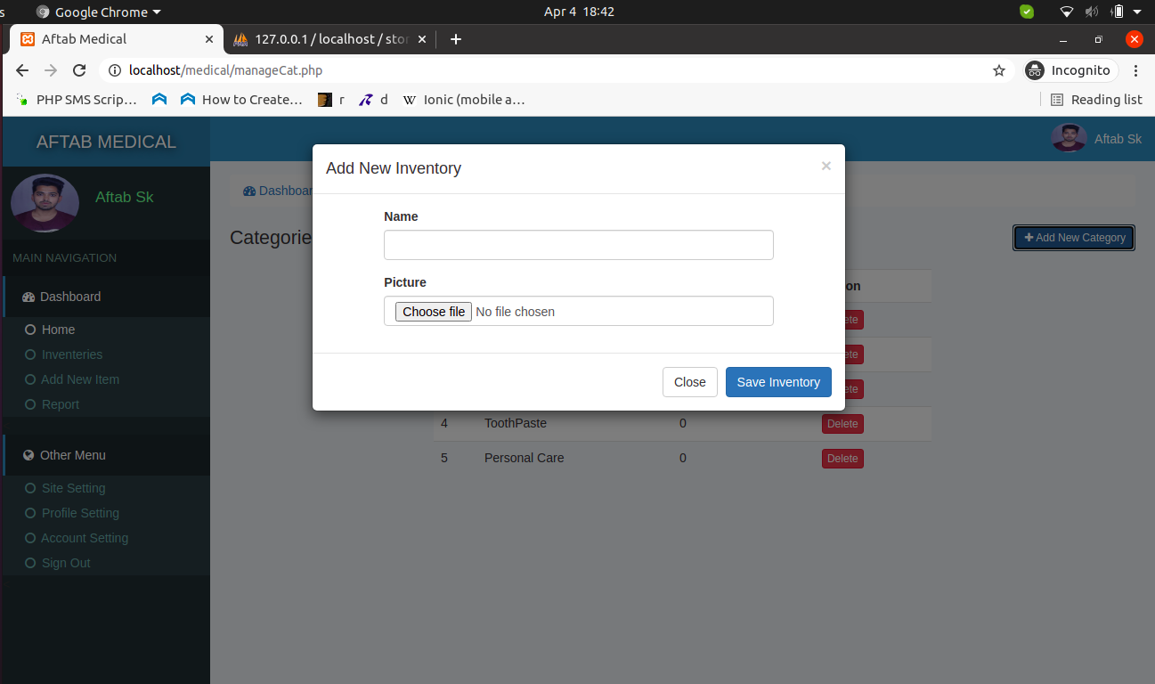
Add Categories

Slide 21
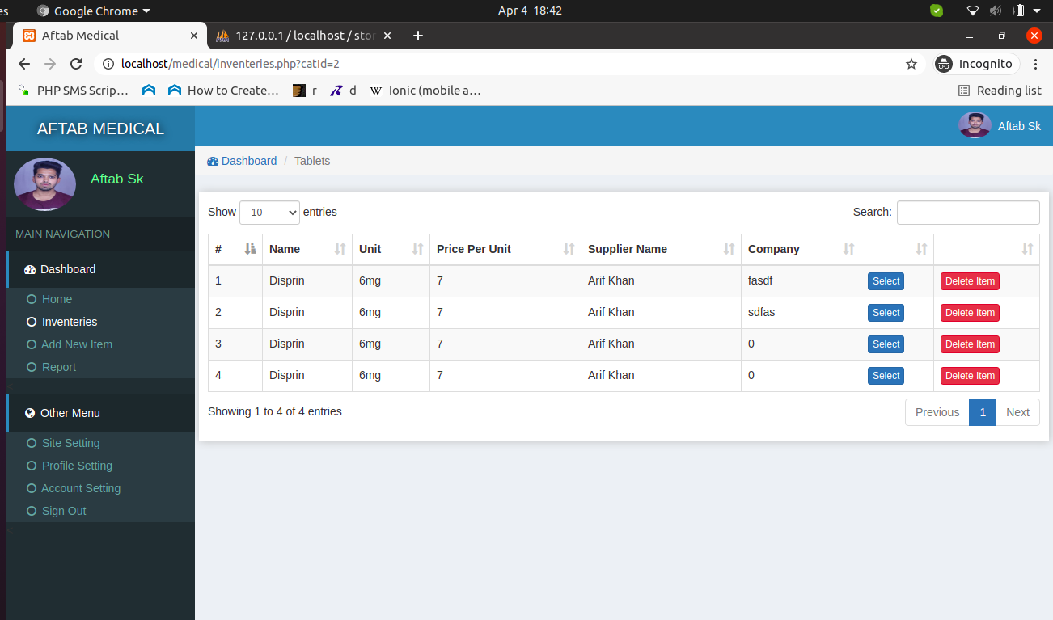
Inside Categories

Slide 22
Manage Categories

Slide 23
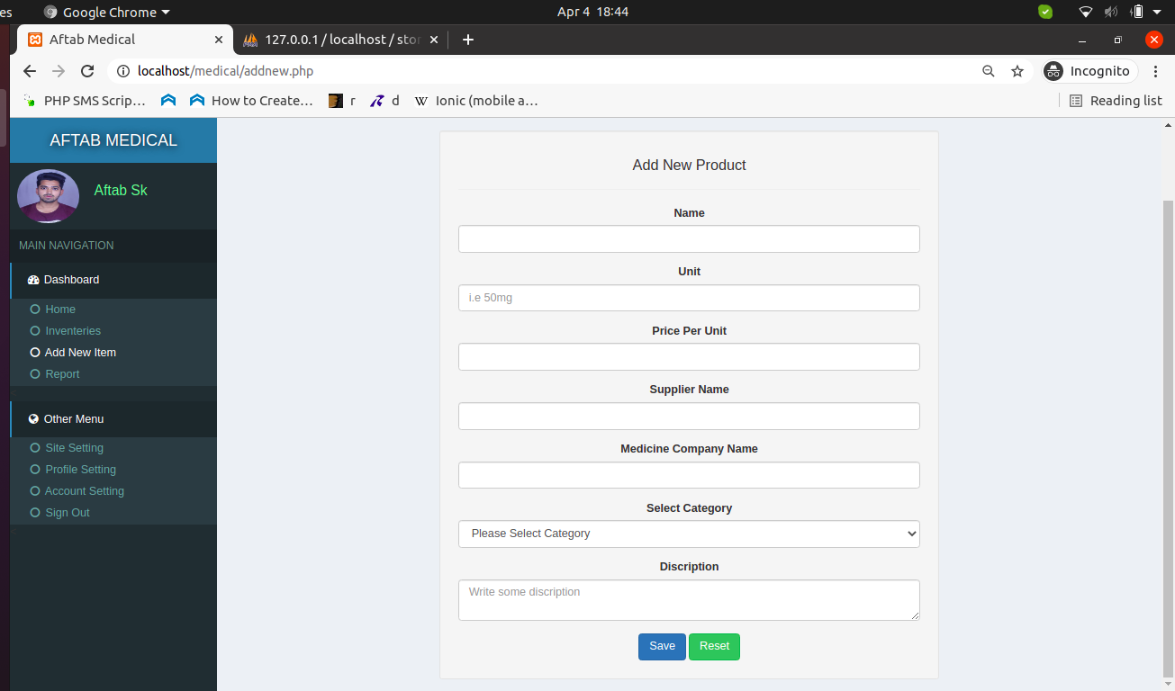
Add Item

Slide 24
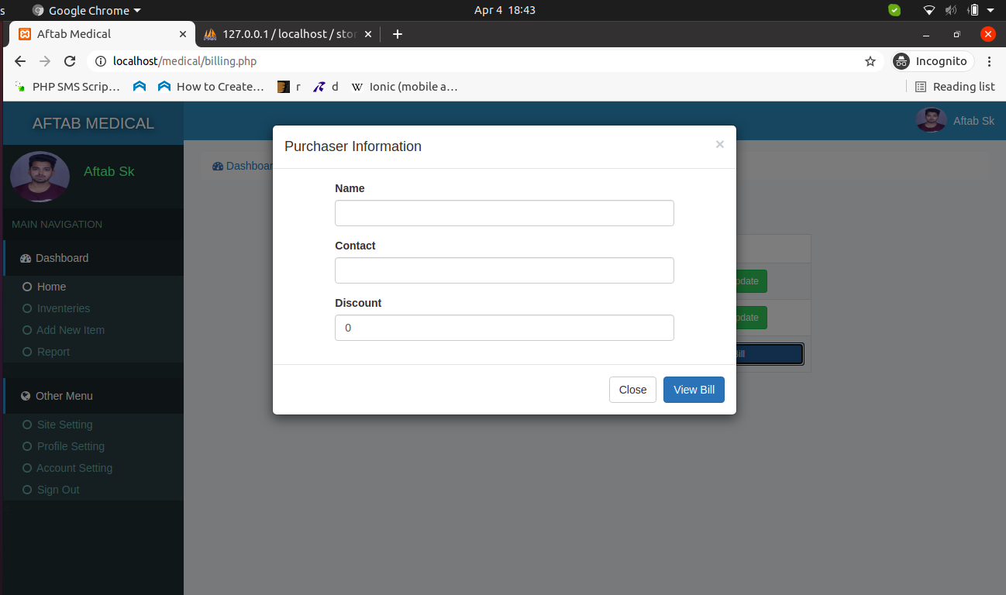
Add Bill

Slide 25
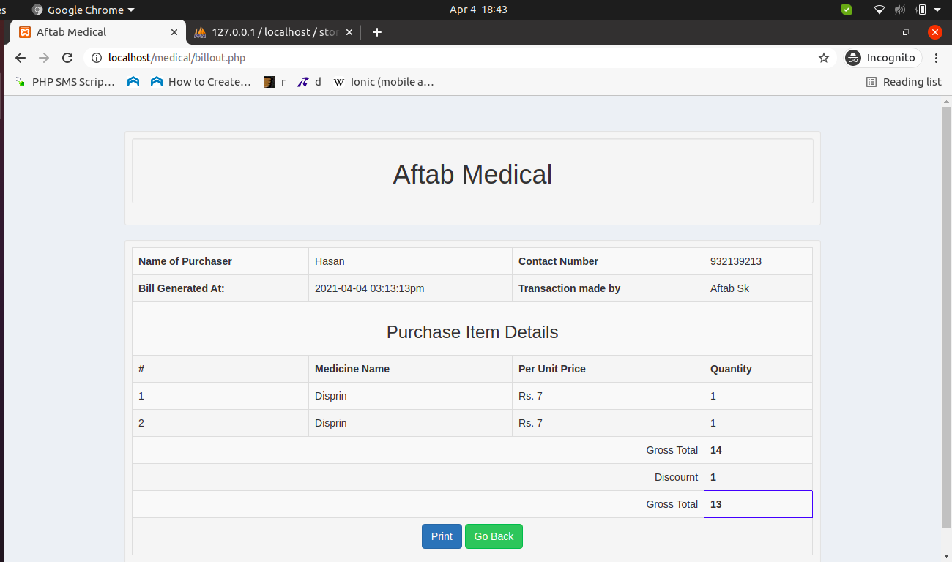
View Bill

Slide 26
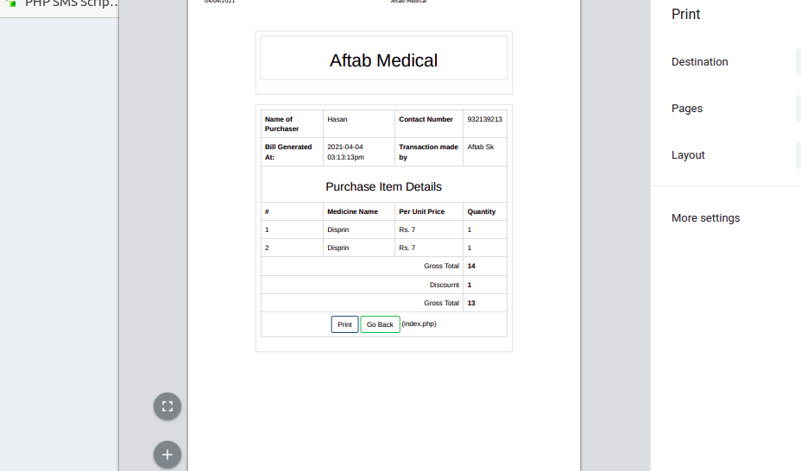
Print Bill

Slide 27
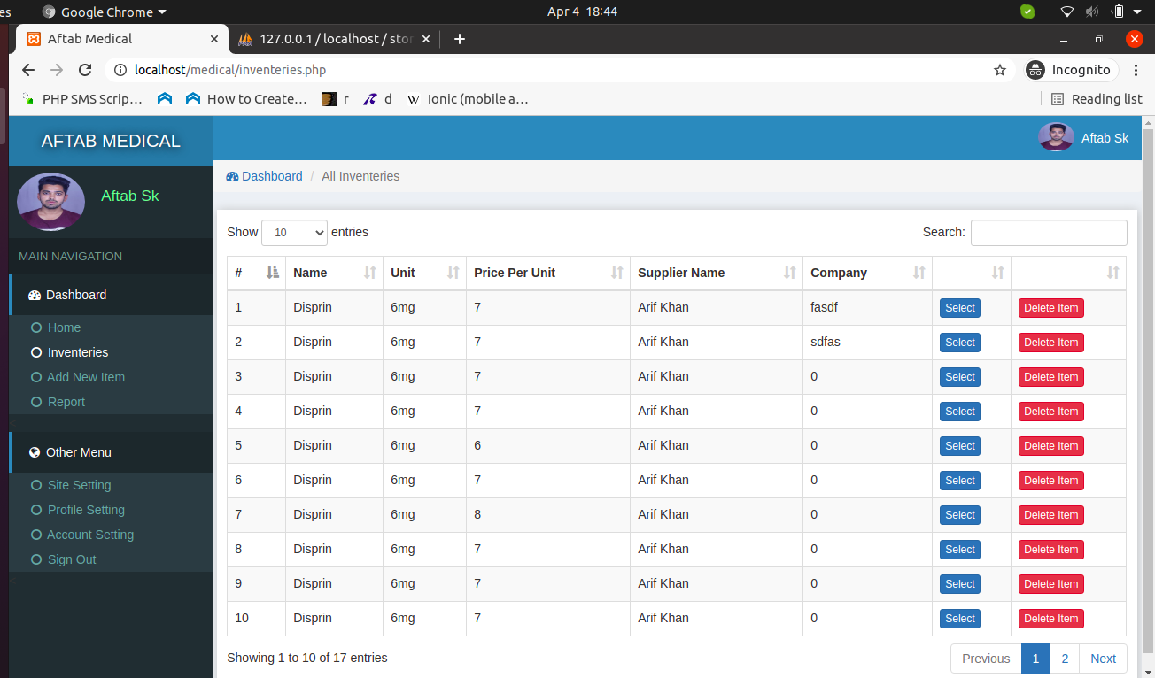
Inventory Page

Slide 28
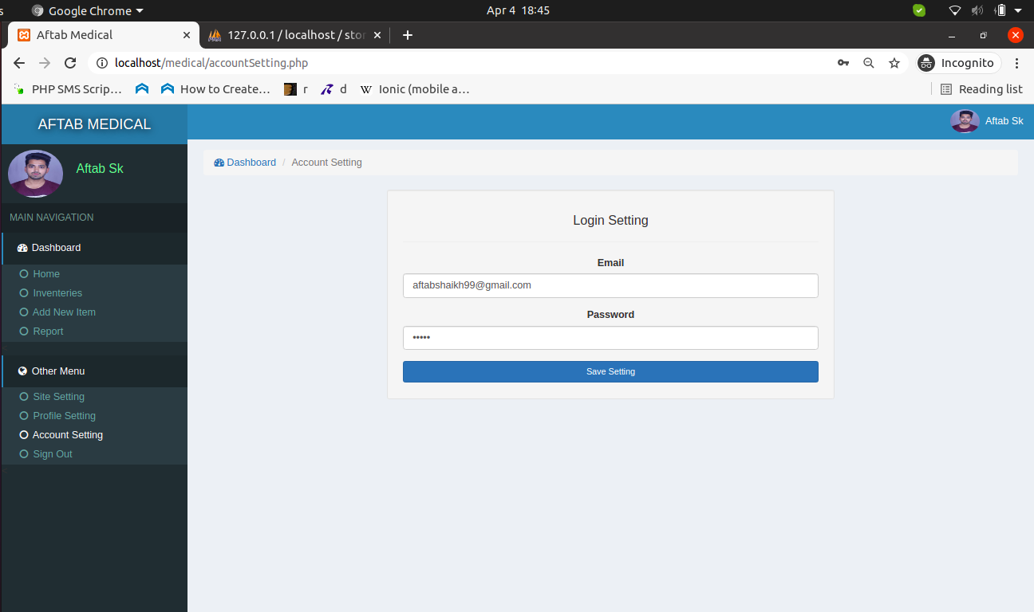
Account Setting

Slide 29
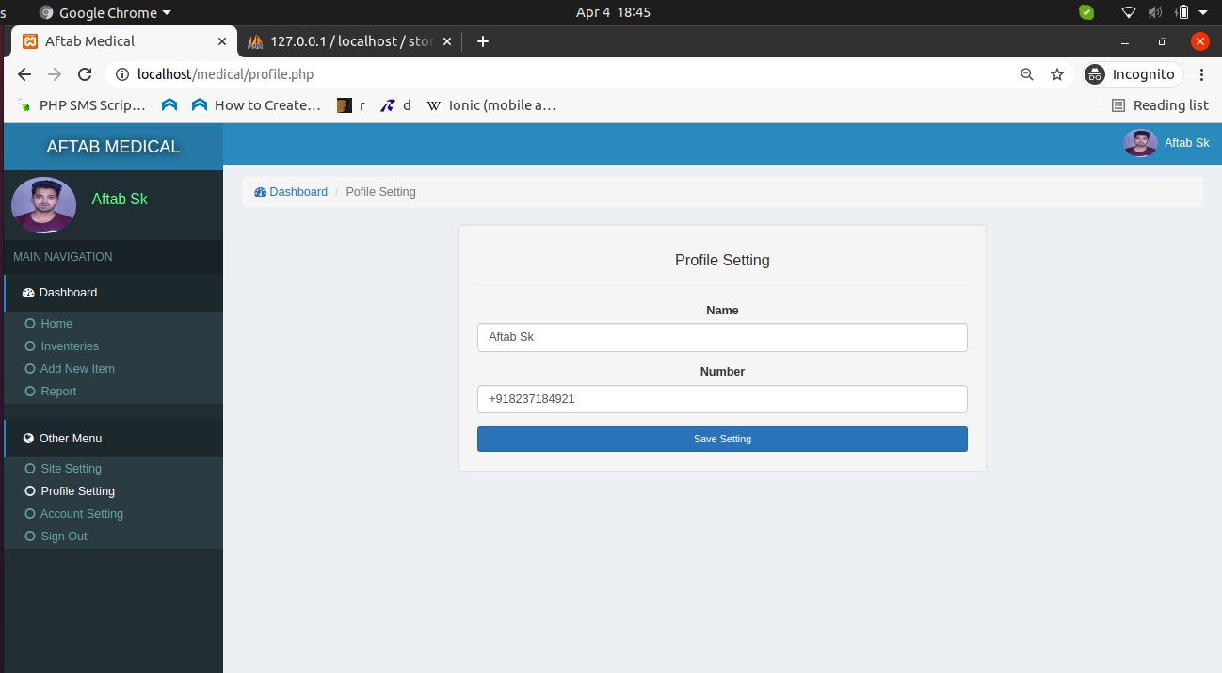
Profile Page

Slide 30
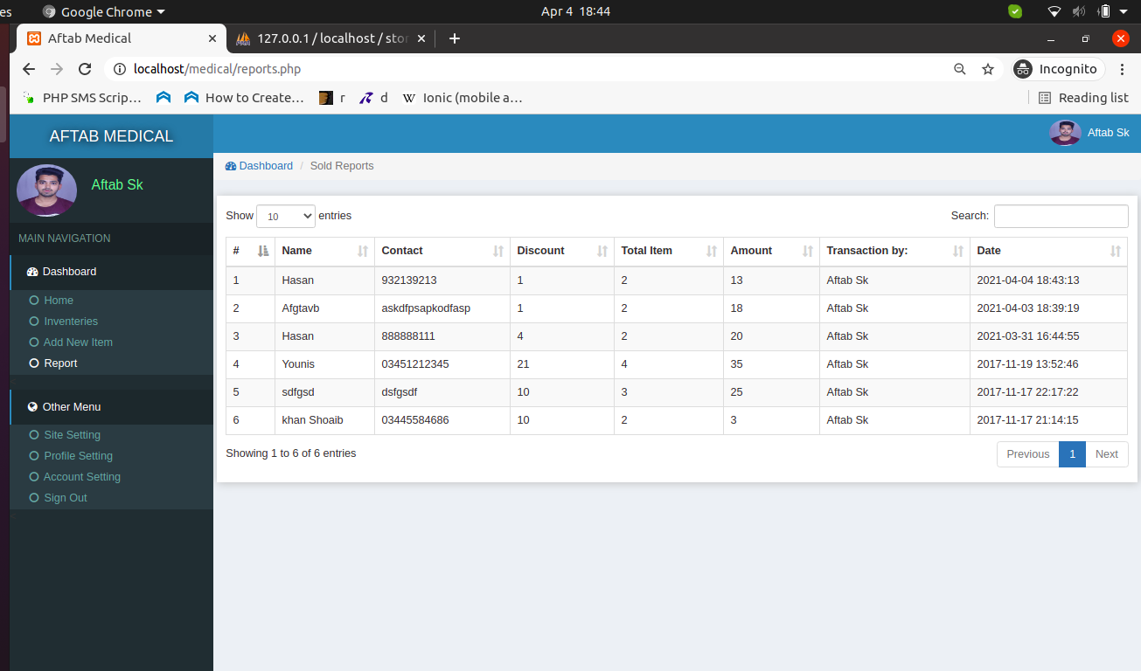
Report Page

Slide 31
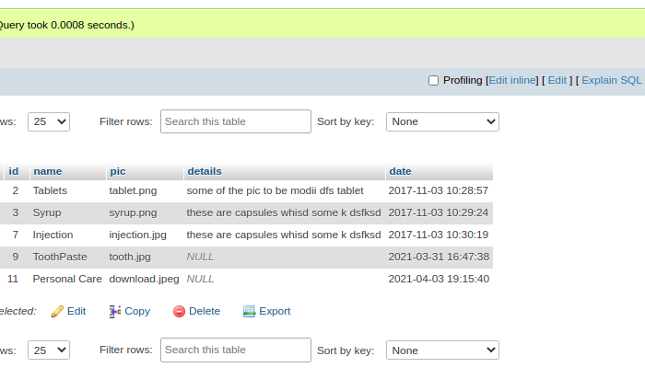
Data Directories - categories

Slide 32
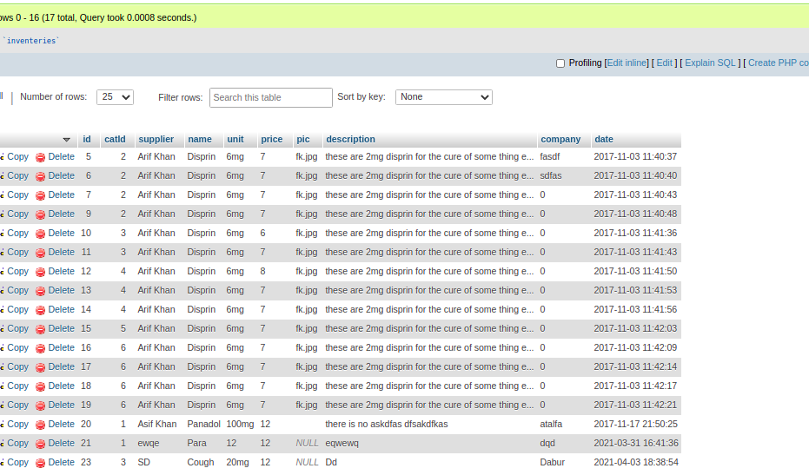
Data Directories - inventory

Slide 33
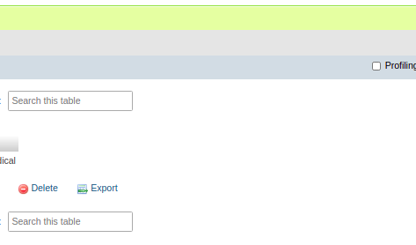
Data Directories - Site

Slide 34
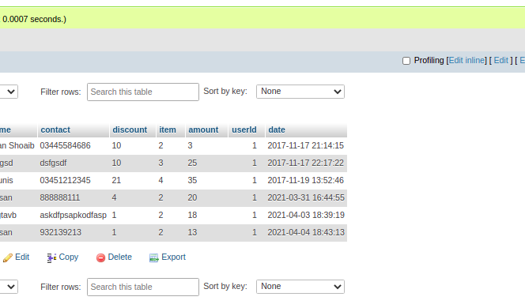
Data Directories - Sold

Slide 35
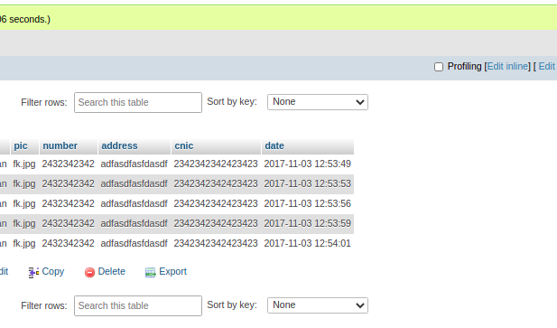
Data Directories - Suppliers

Slide 36
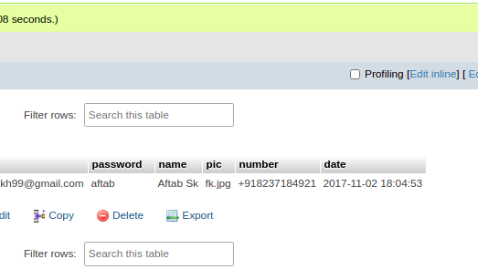
Data Directories - Users

