Slide 1
Socialize GPS Application
Team 02
Dylan Kehres & Michael Schott

Slide 2
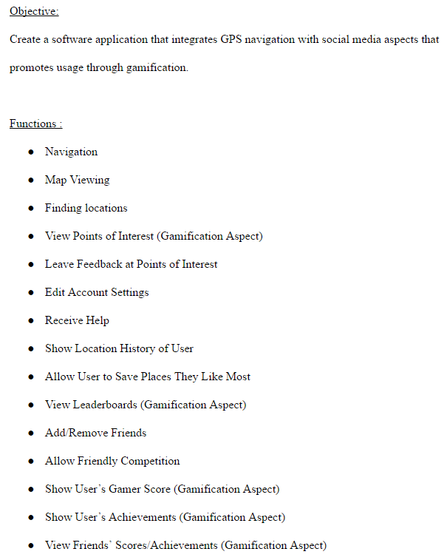
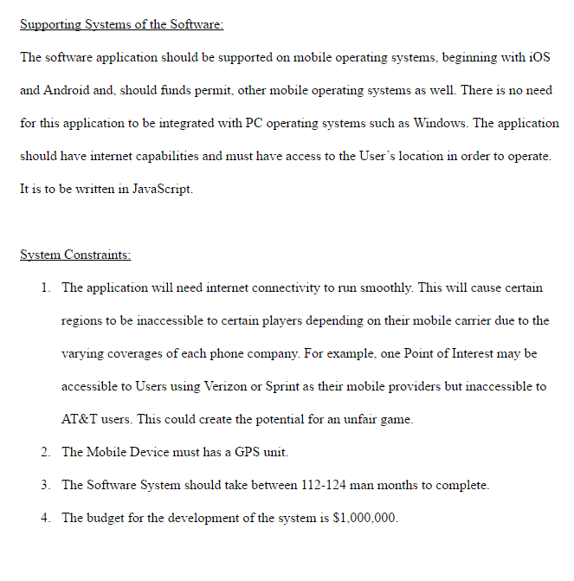
Customer Requirements

Slide 3
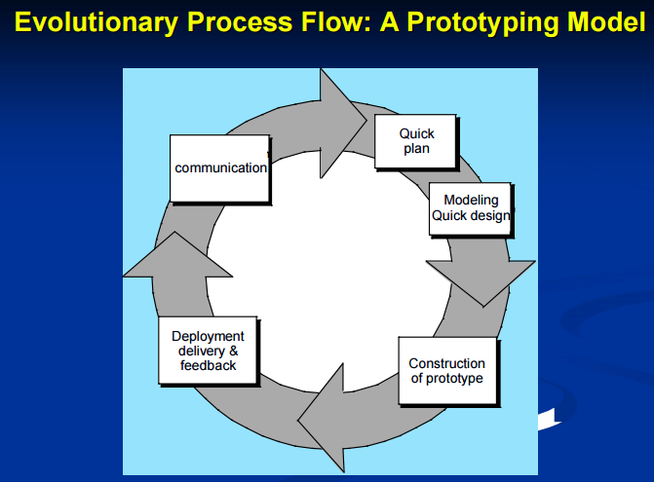
Software Engineering Process Model
Our software is blending social media and GPS navigation with a gaming aspect; therefore it is critical that the User is enjoying the product.
Users will be able to provide us with important feedback on aspects of our application such as the GUI; which is critical as our application must be user friendly.
Users will also be able to let us know what features need to be added in future updates of the application that will enhance the User’s experience.

Slide 4
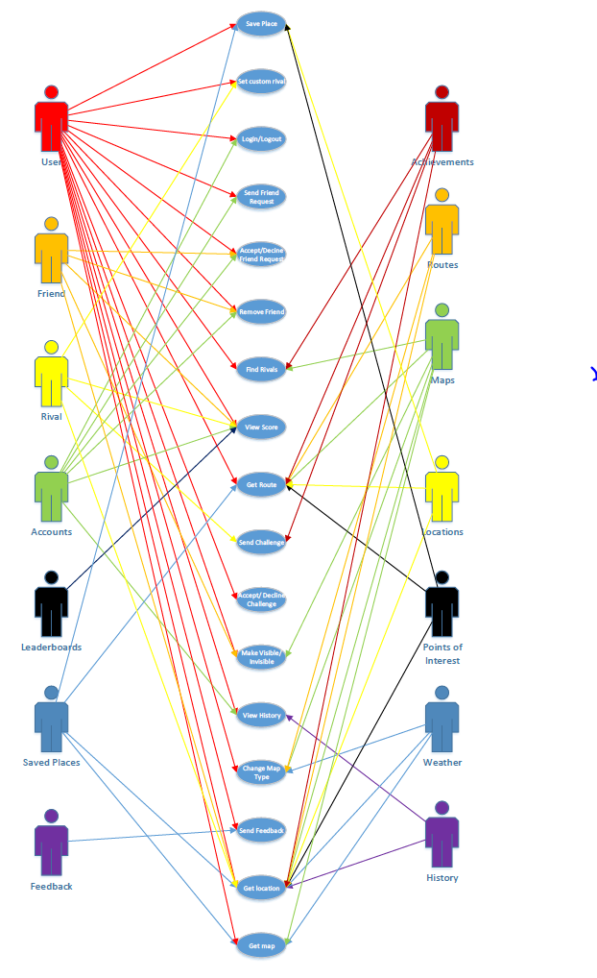
Use Case Diagram

Slide 5
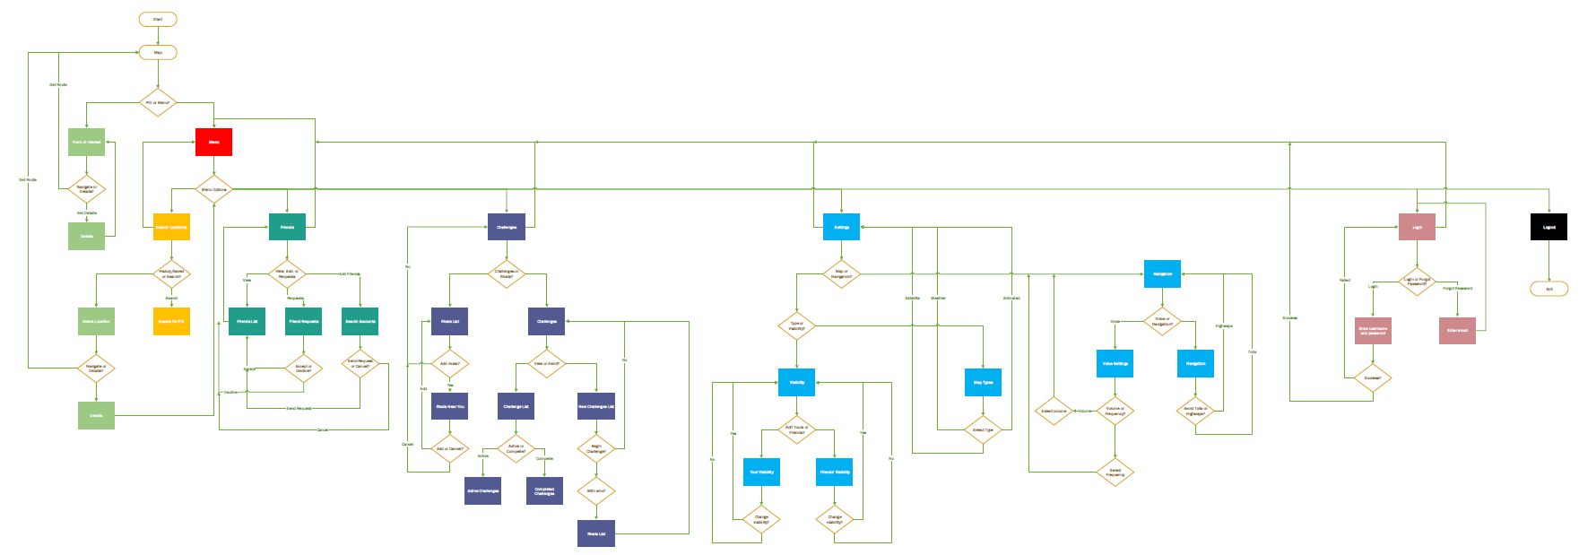
Activity Diagram

Slide 6
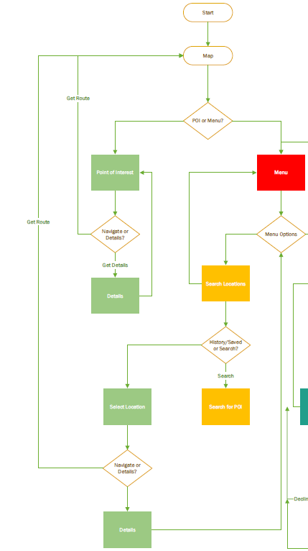
Activity Diagram Part 1

Slide 7
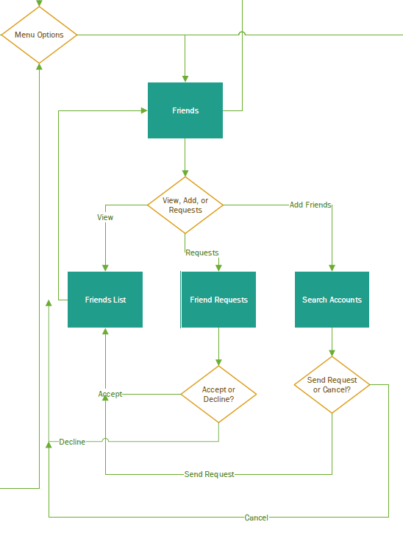
Activity Diagram Part 2

Slide 8
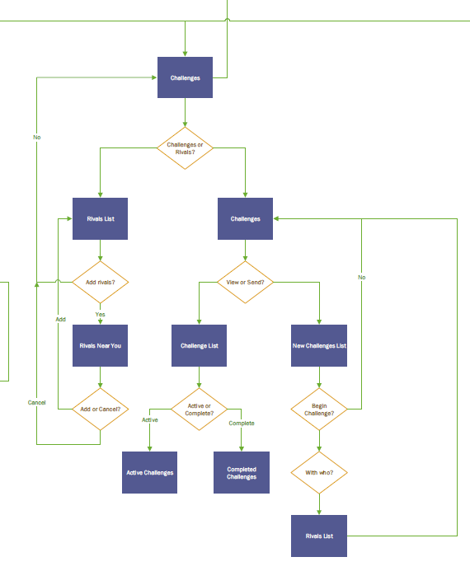
Activity Diagram Part 3

Slide 9
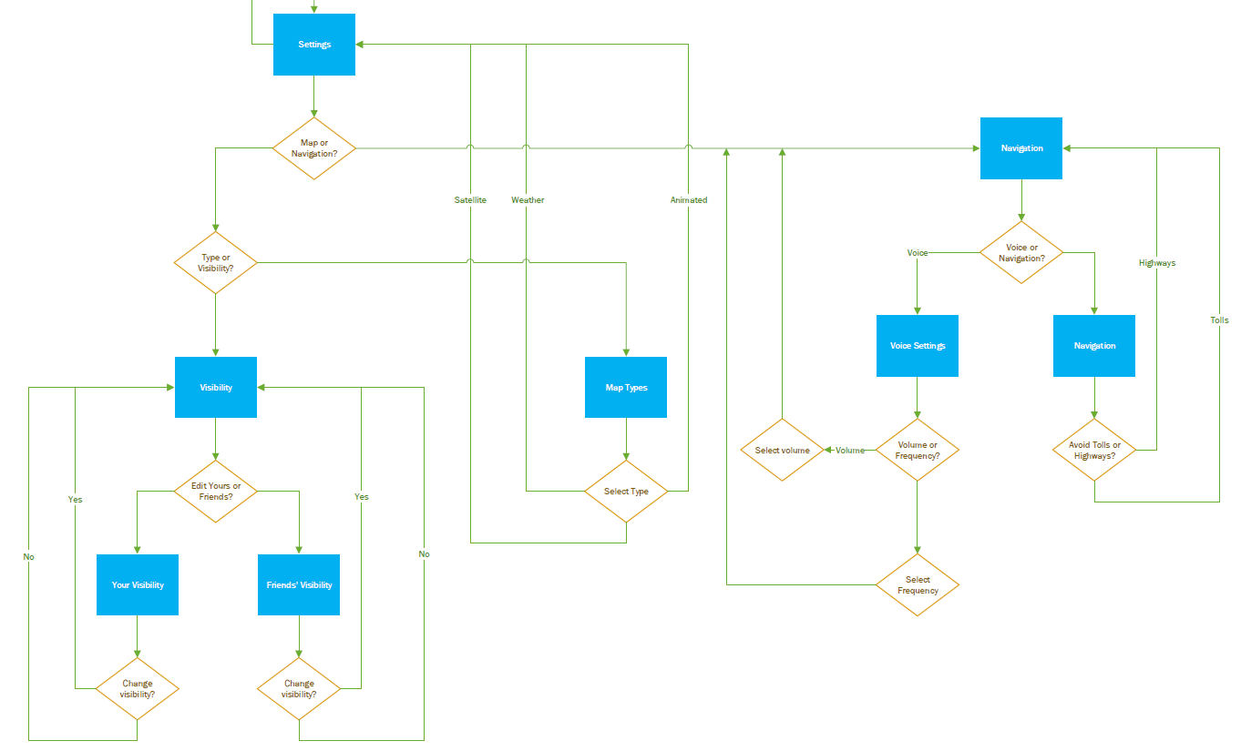
Activity Diagram Part 4

Slide 10
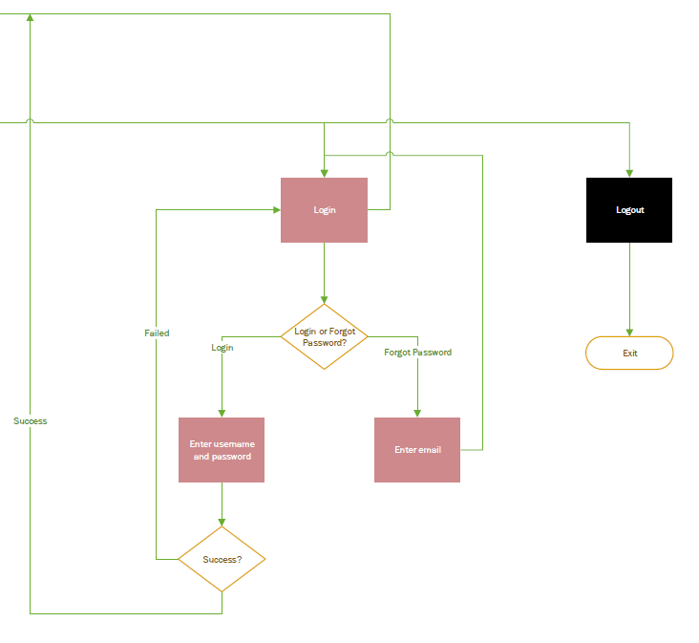
Activity Diagram Part 5

Slide 11
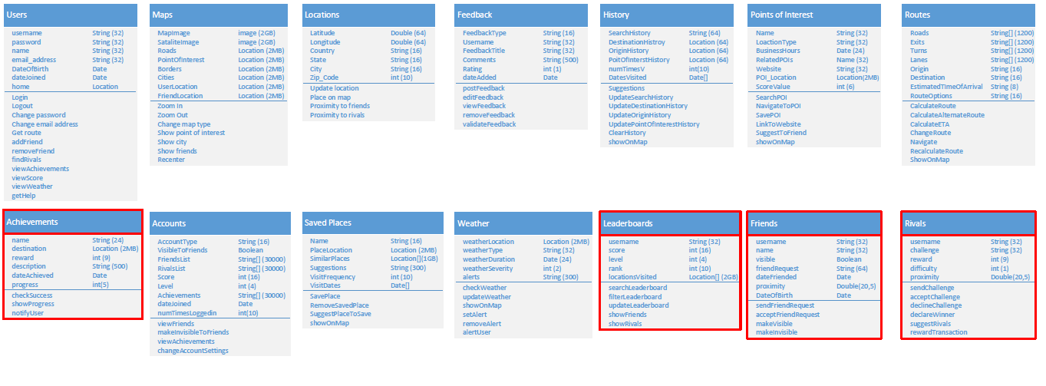
Class Object Diagram

Slide 12
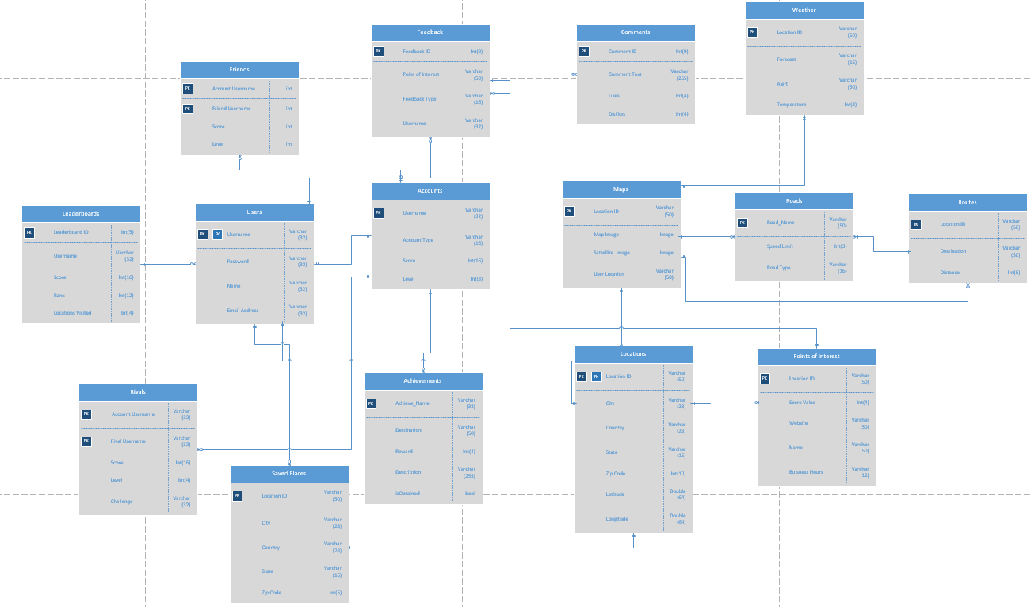
Optional ERD

Slide 13
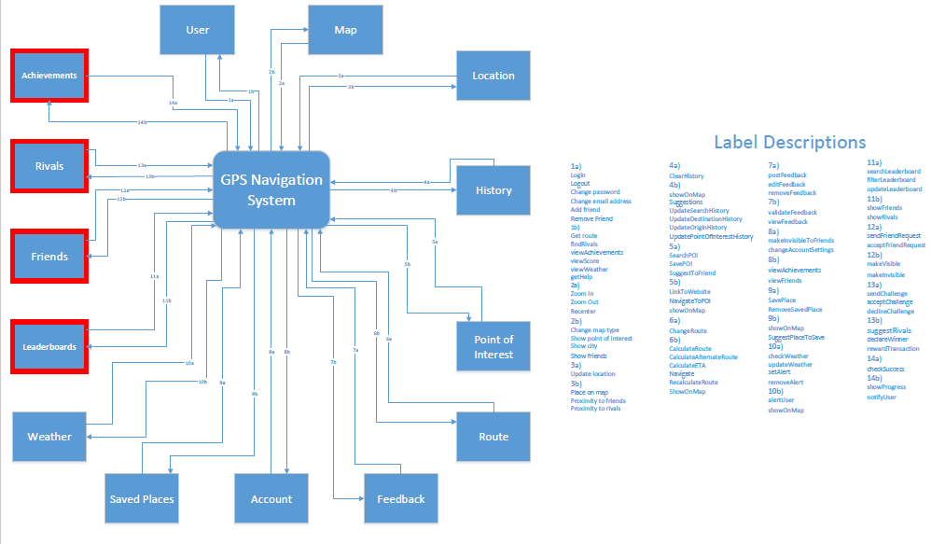
Context Dataflow Diagram

Slide 14
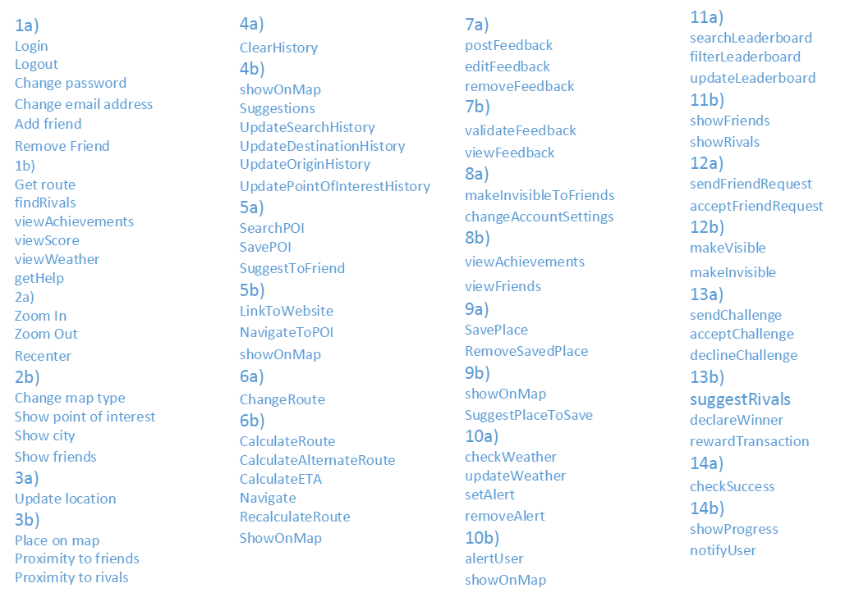
Context DFD Label Descriptions

Slide 15
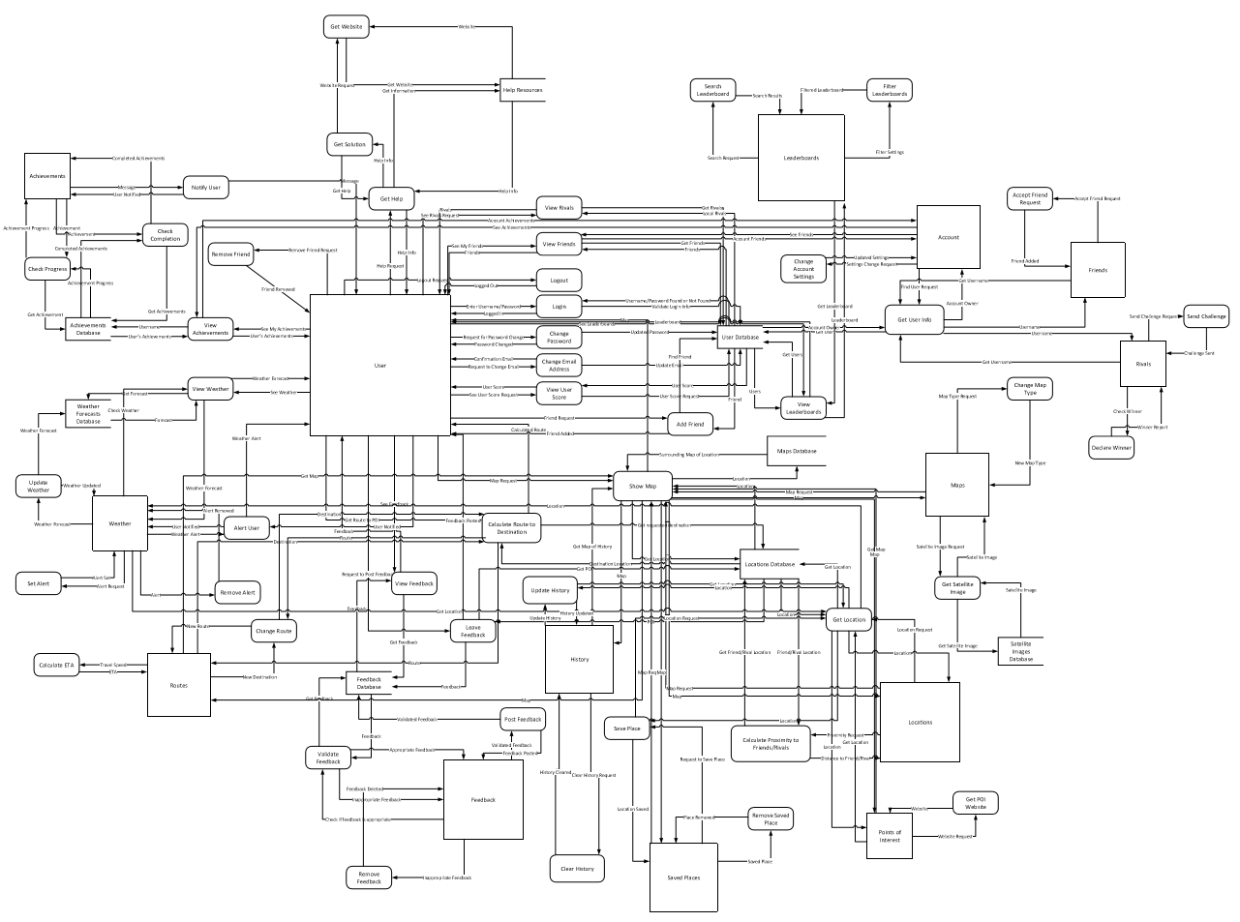
Level-0 Data Flow Diagram
1.
2.
3.
4.

Slide 16
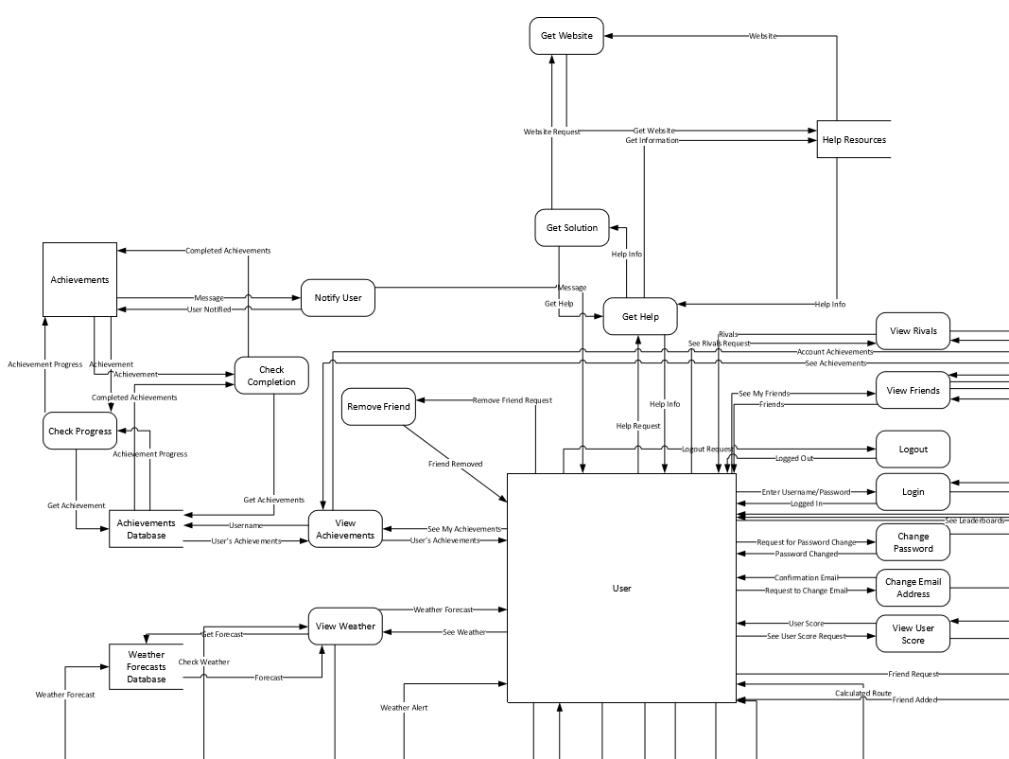
Level-0 DFD Section 1

Slide 17
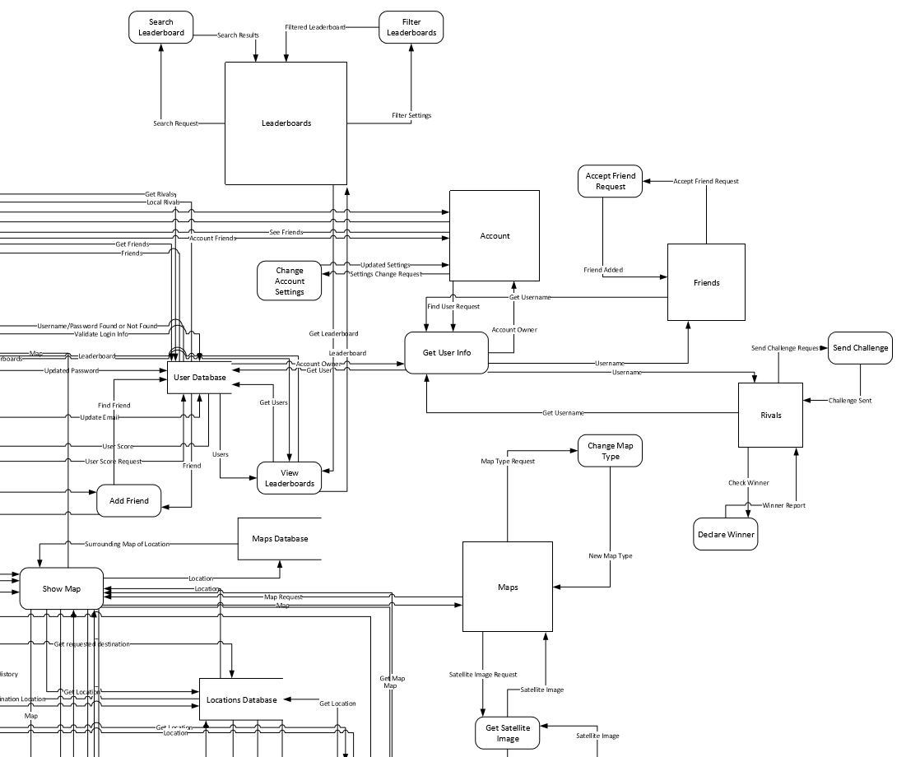
Level-0 DFD Section 2

Slide 18
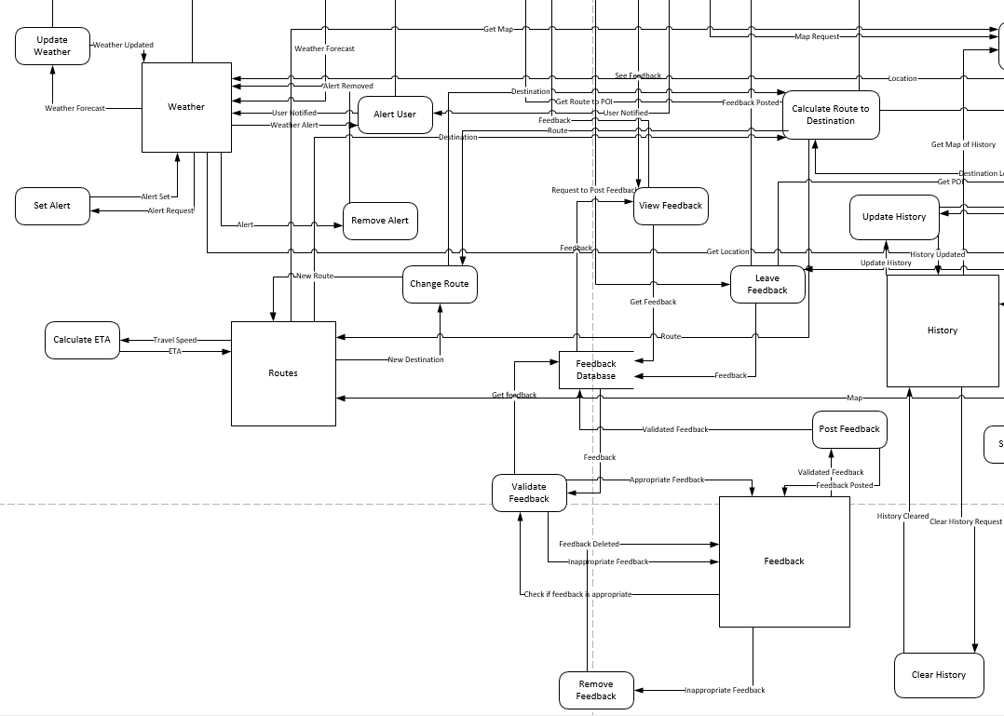
Level-0 DFD Section 3

Slide 19
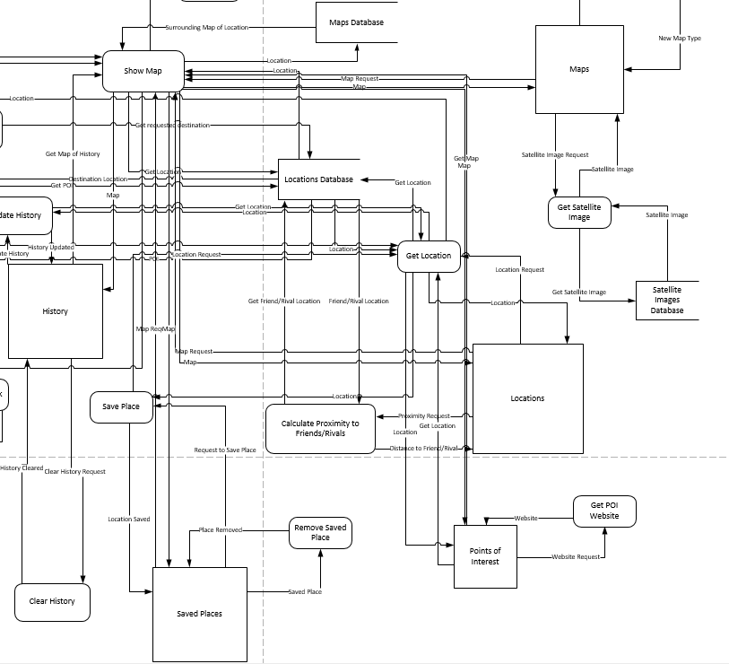
Level-0 DFD Section 4

Slide 20
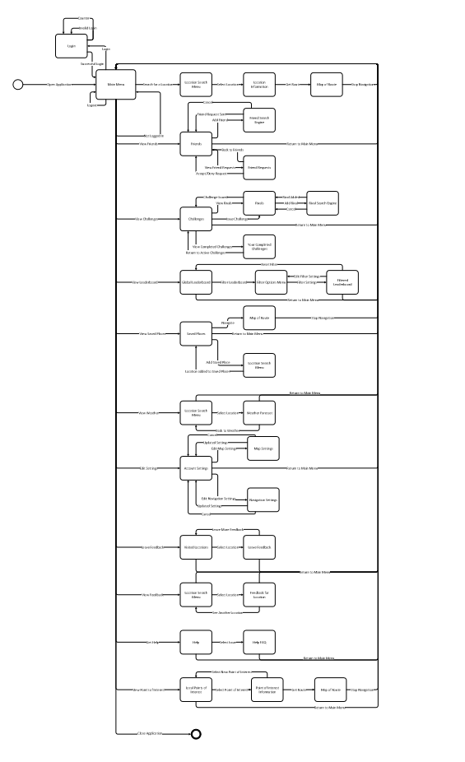
State Transition Diagram
1.
We decided to allow users to access the navigation system without having to log in. In doing so it allows the user to not have their location displayed to their friends and/or rivals that are also using the app; without the user having to change their account settings each time they would like to use the GPS feature in an incognito mode.
2.
3.
4.

Slide 21
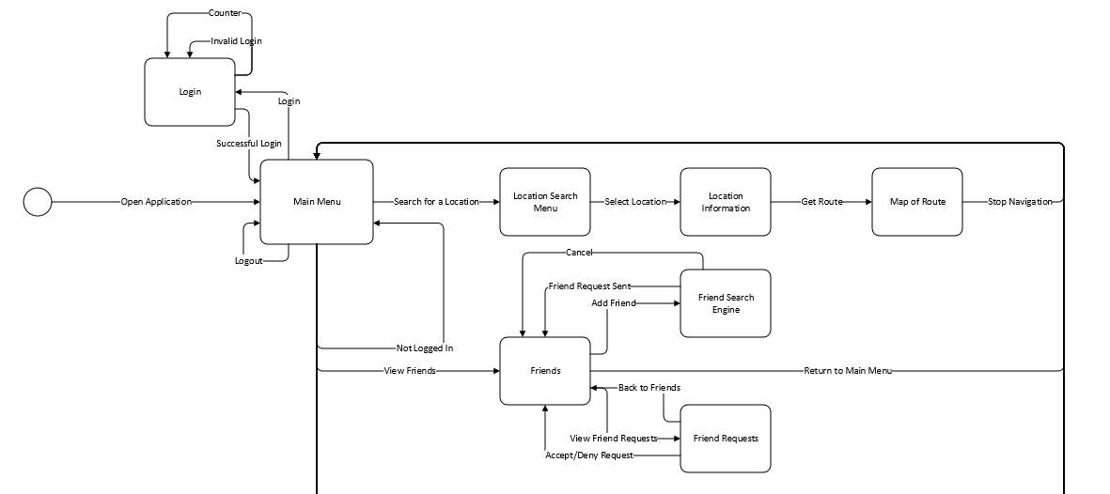
STD (Section 1)

Slide 22
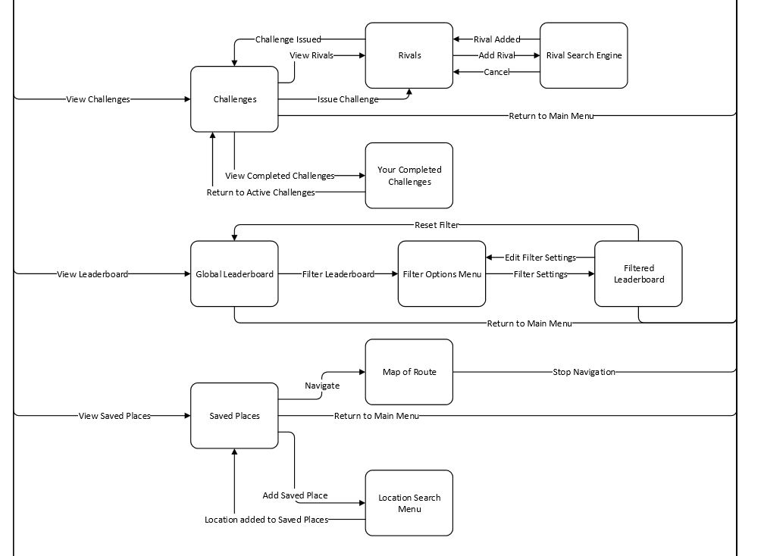
STD (Section 2)

Slide 23
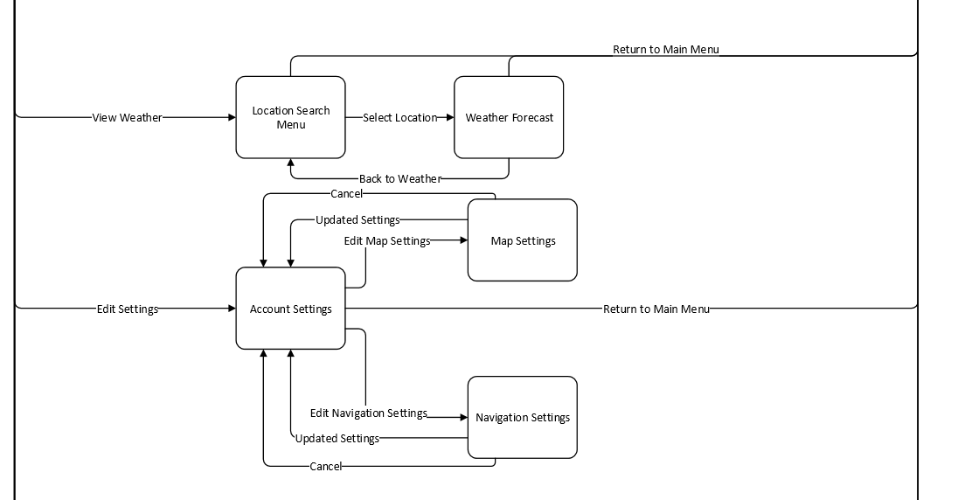
STD (Section 3)

Slide 24
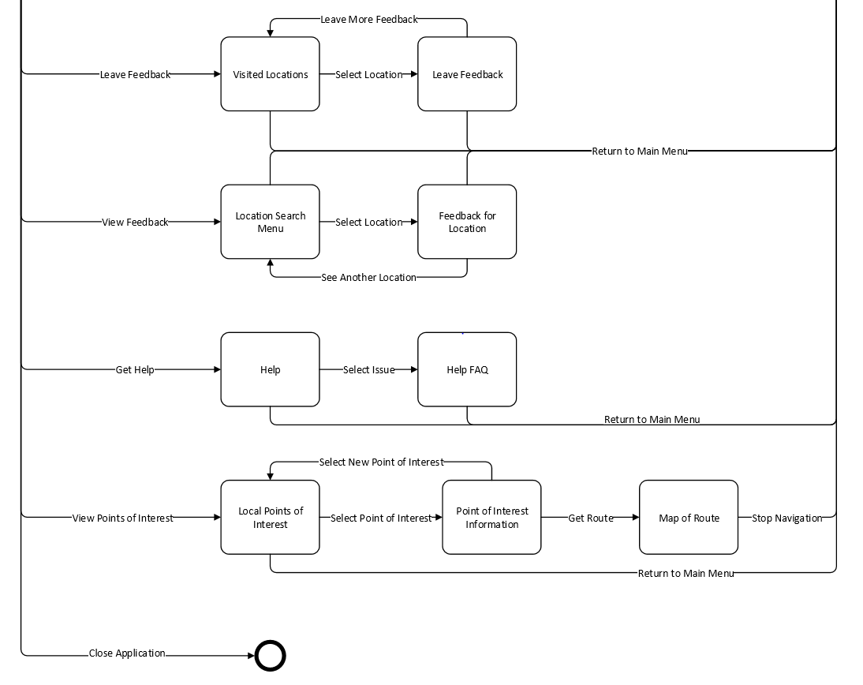
STD (Section 4)

Slide 25
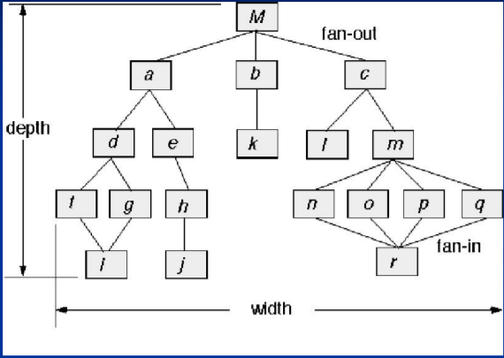
Software Architectural Model
Call and Return Model
User inputs address to obtain route which is then passed into a subfunction.
User searches for locations or friends in a data base, and that data is then handled by sub functions.

Slide 26
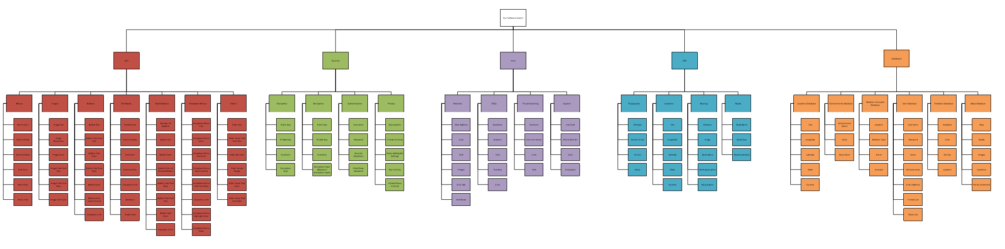
Hierarchical Model (System Architecture)
1.
2.
3.
4.
5.
Contains the software system’s subsystems, the subsystems’ components, and then finally details for each component of the subsystems.

Slide 27
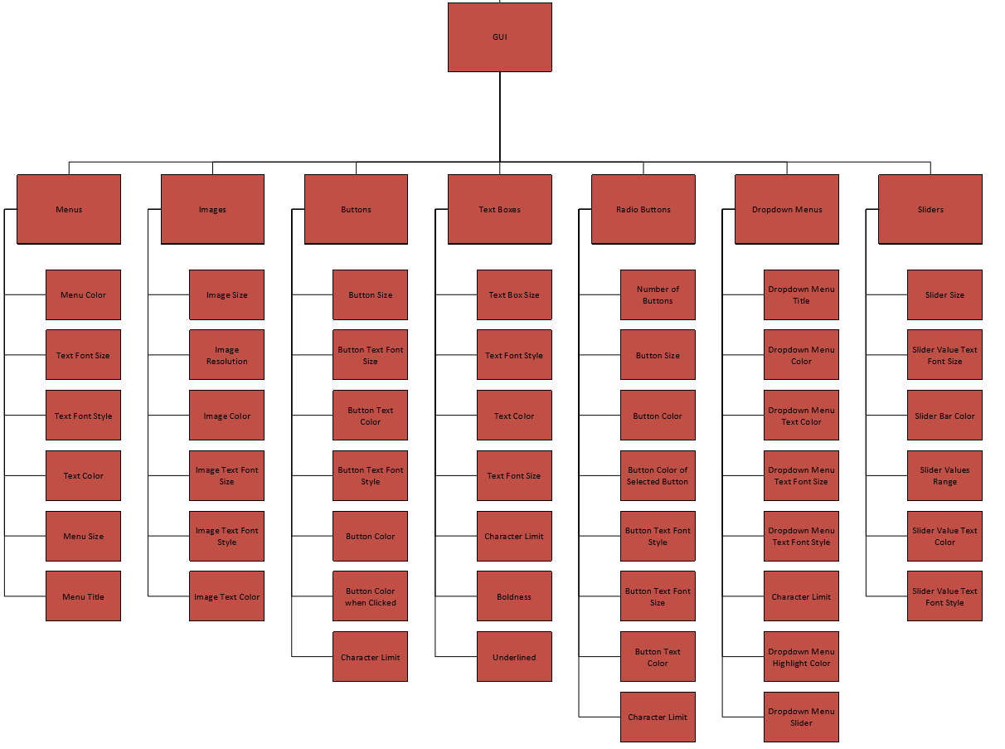
GUI Subsystem (1)

Slide 28
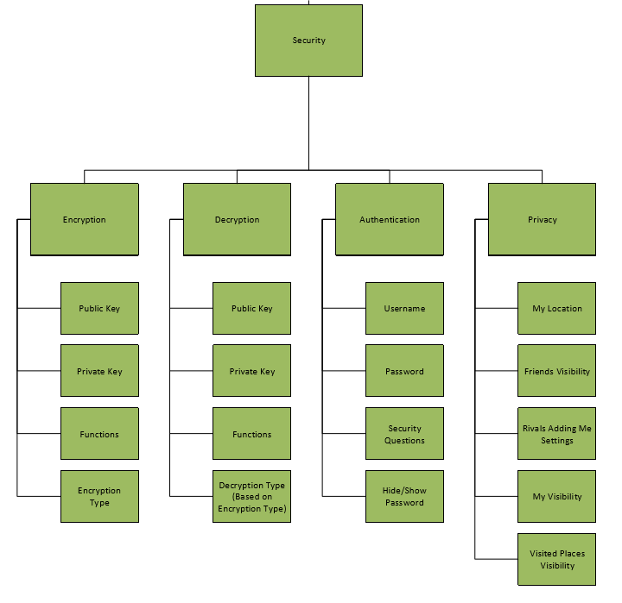
Security Subsystem (2)

Slide 29
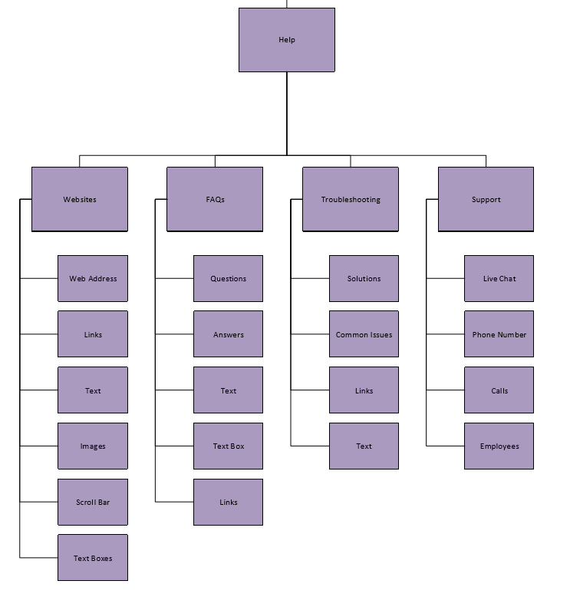
Help Subsystem (3)

Slide 30
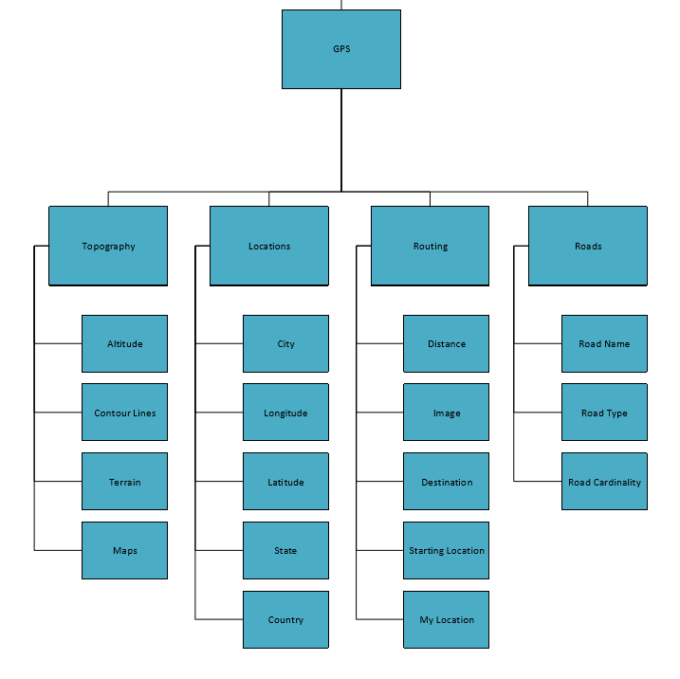
GPS Subsystem (4)

Slide 31
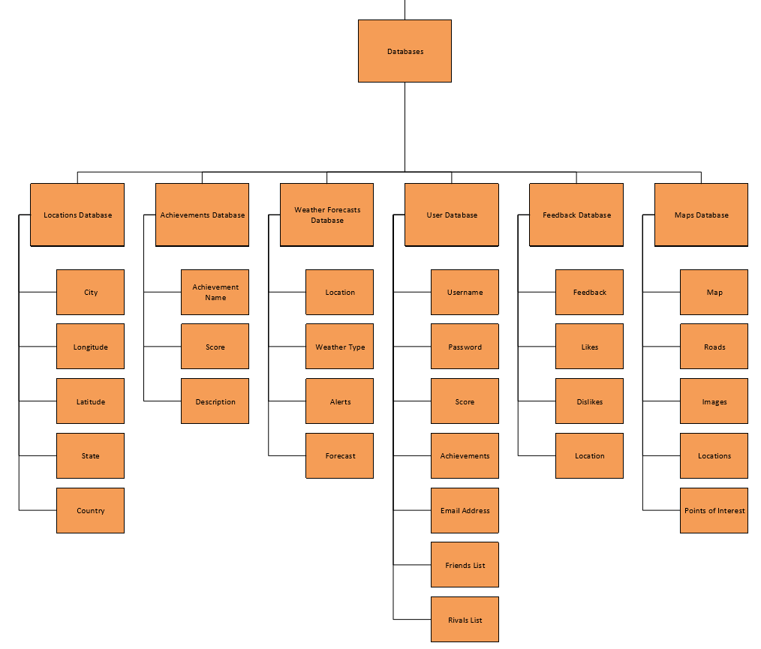
Databases Subsystem (5)

Slide 32
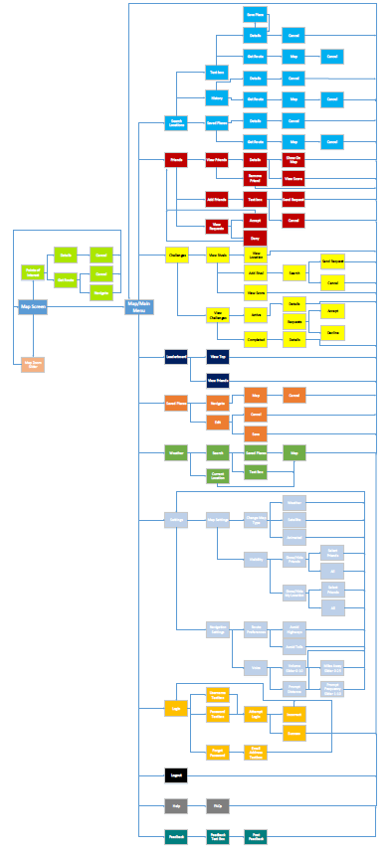
GUI Functional View

Slide 33
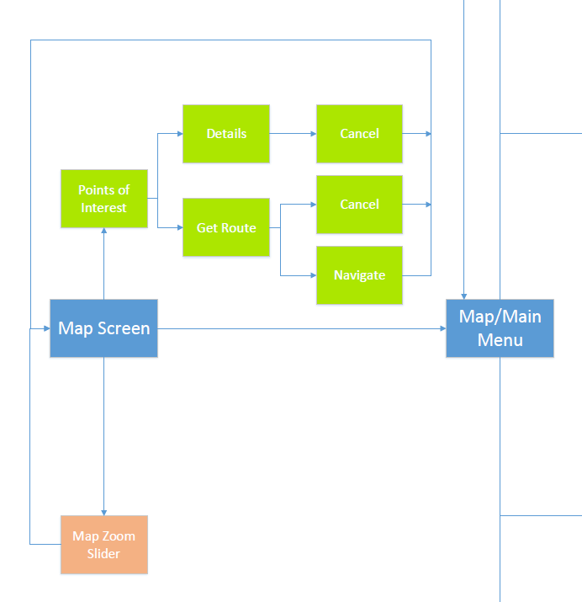
GUI Functional View Part 1

Slide 34
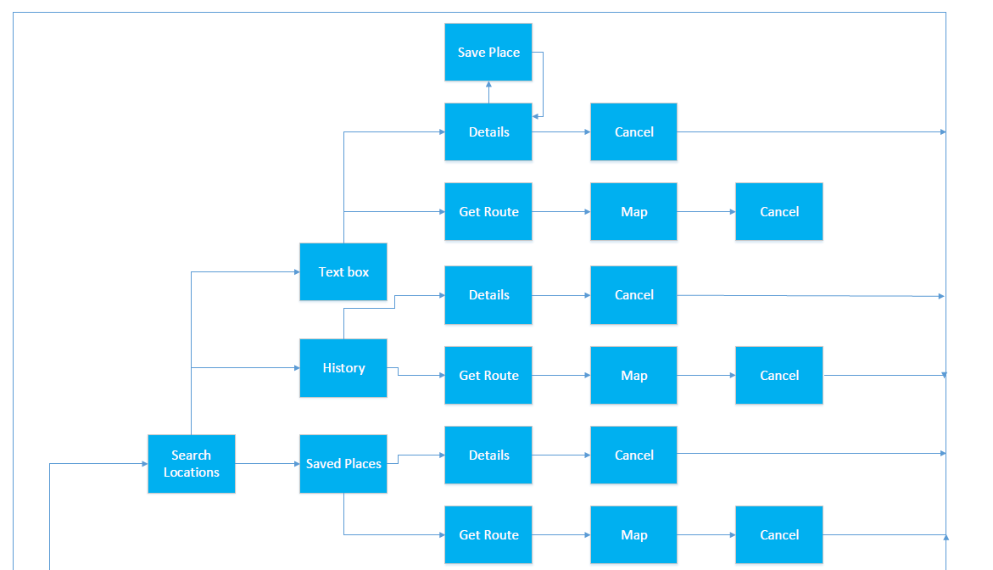
GUI Functional View Part 2

Slide 35
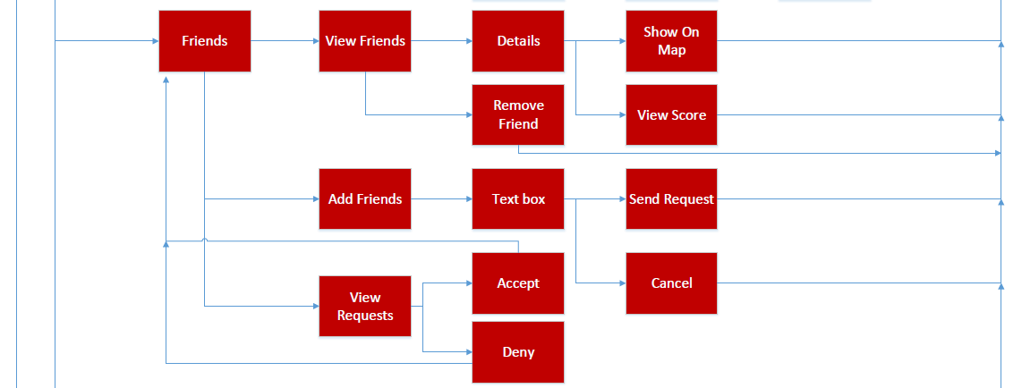
GUI Functional View Part 3

Slide 36
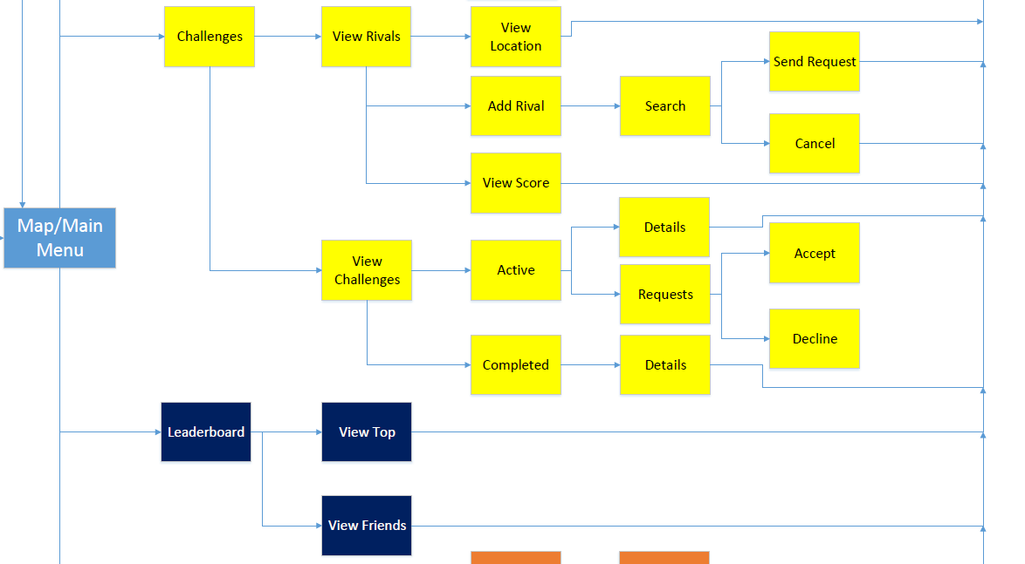
GUI Functional View Part 4

Slide 37
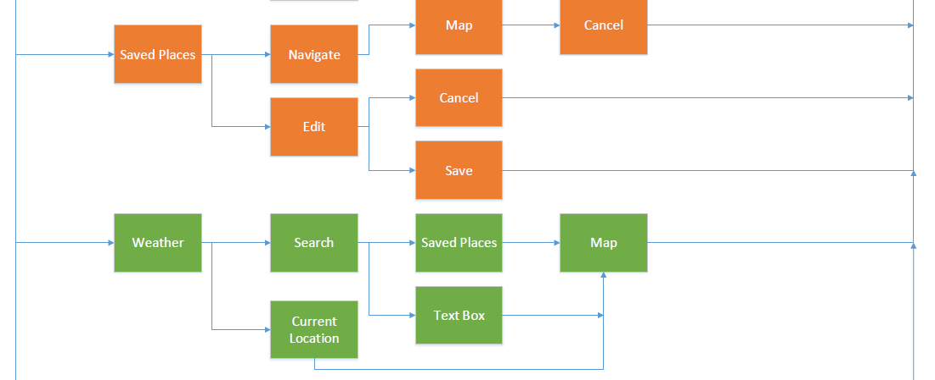
GUI Functional View Part 5

Slide 38
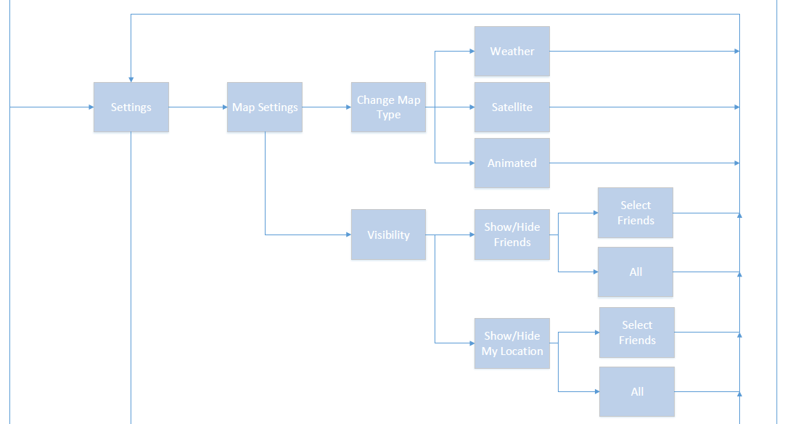
GUI Functional View Part 6

Slide 39
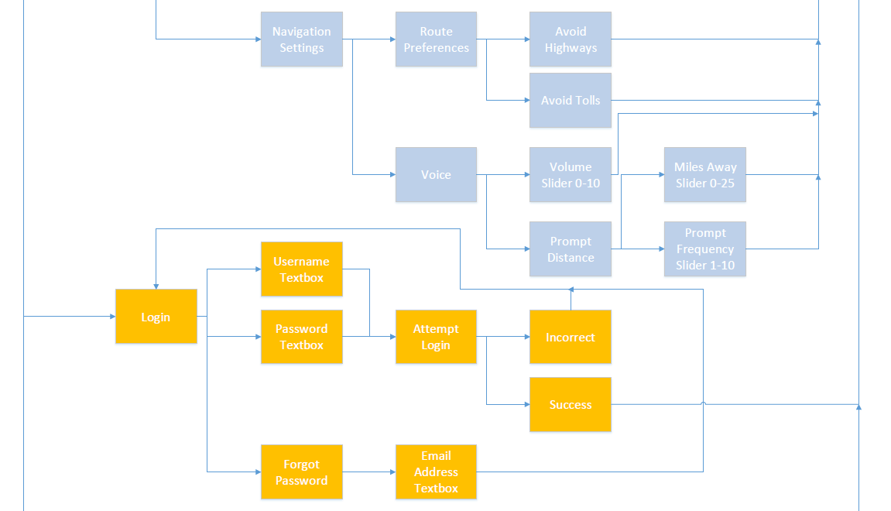
GUI Functional View Part 7

Slide 40
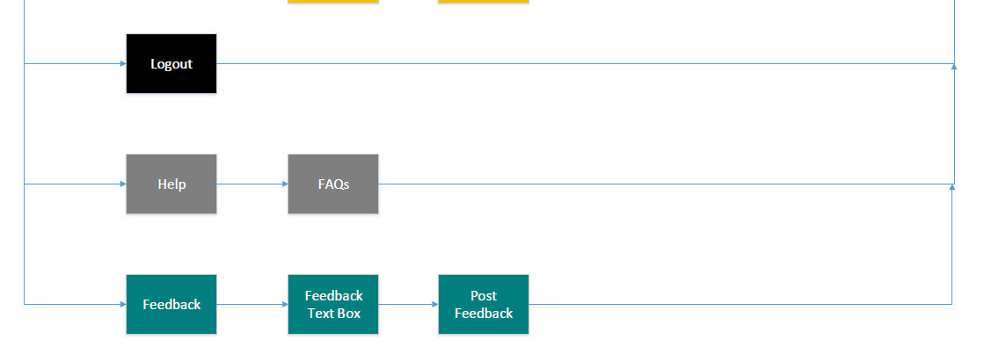
GUI Functional View Part 8

Slide 41
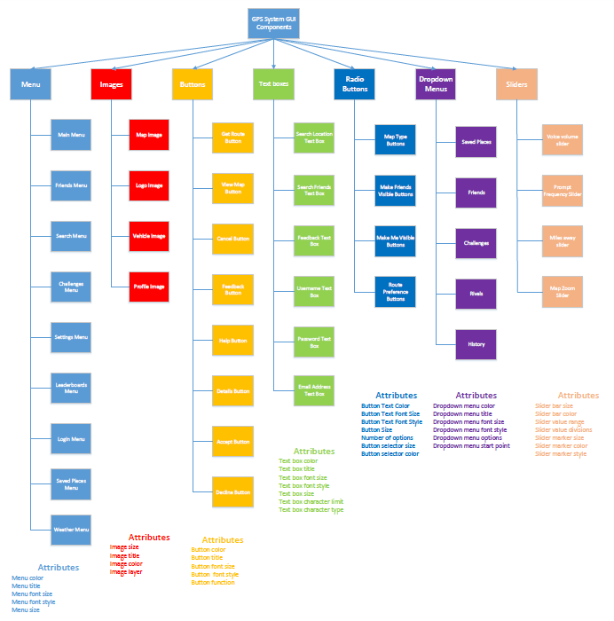
GUI Component View

Slide 42
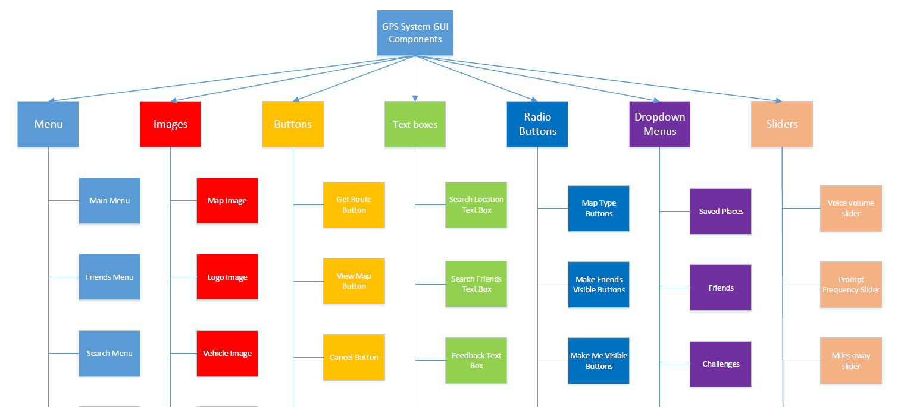
GUI Component View Part 1

Slide 43
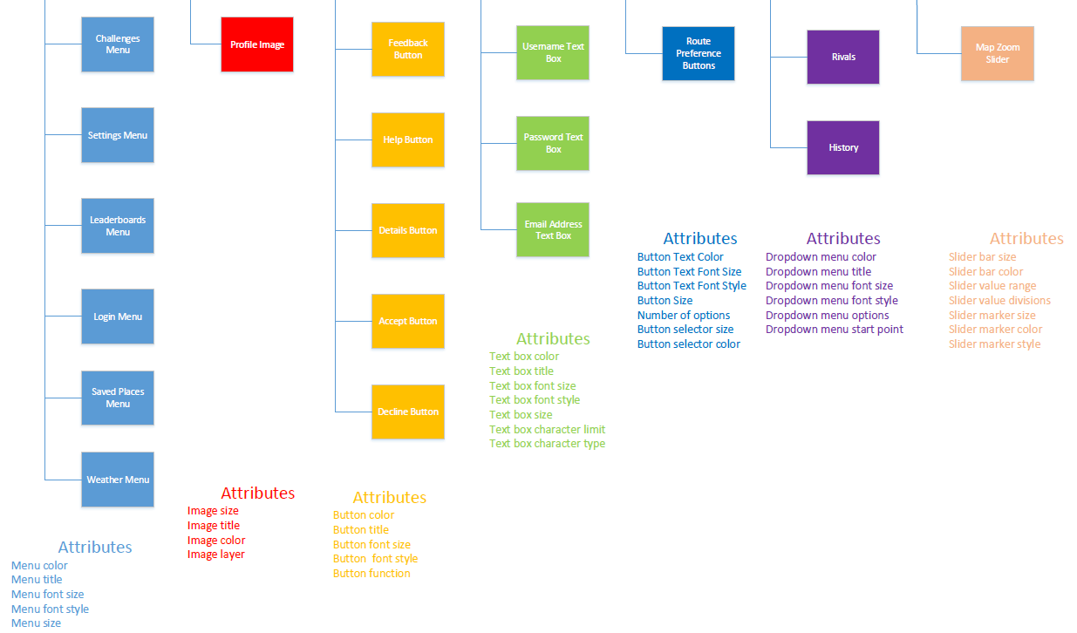
GUI Component View Part 2

Slide 44
FP-Based Estimation
Information Domain Value | Optimal | Most Likely | Pessimistic Estimation | Estimated Count | Weight | FP-Count
Number of inputs | 45 | 60 | 75 | 60 | 4 | 240
Number of outputs | 35 | 50 | 80 | 50 | 8 | 400
Number of inquiries | 10 | 15 | 25 | 15 | 3 | 45
Number of files | 8 | 12 | 18 | 12 | 6 | 72
Number of external interfaces | 4 | 6 | 8 | 6 | 8 | 48
Total |  |  |  |  |  | 805

Slide 45
FP- Based Estimation
Number of Function Points: 805
Average productivity: 6.5 FP/month
Burdened Labor Rate: $8000/month
The project will take 124 man months and cost $992,000 to produce.

Slide 46
LOC-Based Estimation
Function System | Estimated LOC
User Interface | 5,000
Route Calculation | 35,000
Location Calculation | 20,000
Database Management | 10,000
Gamification | 10,000
Total Estimate | 70,000
Lines of code: 70,000
Average productivity: 620 LOC/month
Burdened Labor Rate: $8000/month
The project will take 113 man months and cost $904,000 to produce.

Slide 47
Thank You! Are there any questions?
Team 02
Dylan Kehres & Michael Schott

