Slide 1

A DEEP LEARNING APPROACH FOR BINARY IMAGE CLASSIFICATION OF CATS AND DOGS USING TRANSFER LEARNING WITH MOBILENETV2
PRESENTED BY
Md. Al Baki Akon - CSE 02707390
Shanto Dey - CSE 02707422
Nur Mohammad Fahim - CSE 02707471
Md. Shahadat Hossen - CSE 02807528
SUPERVISED BY
Mrs. Manoara Bagum
Assistant Professor & Chairman
Department of CSE
Port City International University

Slide 2
TABLE OF CONTENT
Introduction
Problem Statement
Motivation
Required Tools
Literature Review
Dataset
Methodology
Result & Performance
References

Slide 3
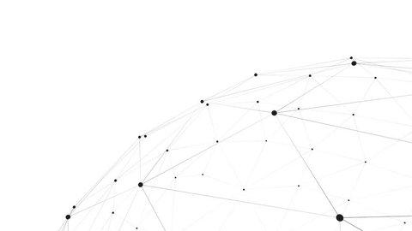
INTRODUCTION
Our project focuses on building a deep learning model for binary classification of images for cats and dogs. This project represents classical computer vision challenge involving feature extraction, generalization, and computational efficiency. To address these challenges, the model leverages transfer learning using the pre-trained MobileNetV2 architecture as a feature extractor, combined with a custom classification head. Data augmentation techniques were applied to improve robustness and minimize overfitting, while training and validation were performed on the cats vs dogs dataset from TensorFlow datasets.

Slide 4
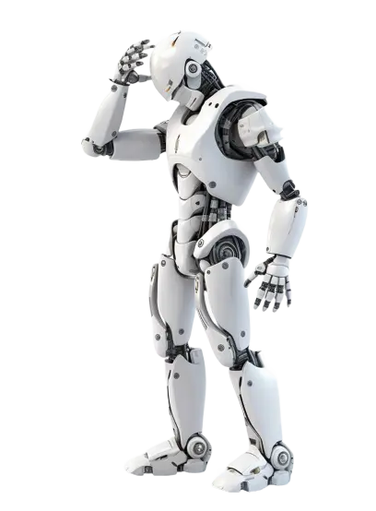
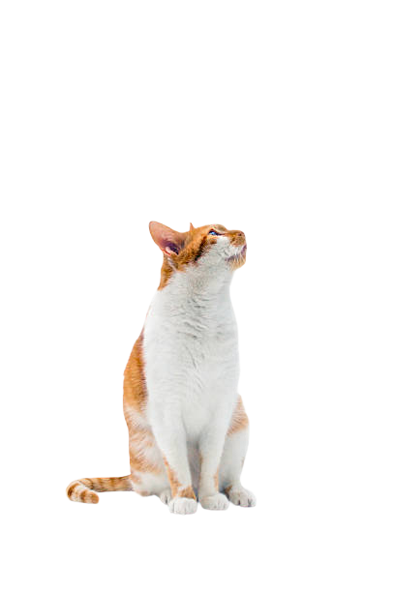
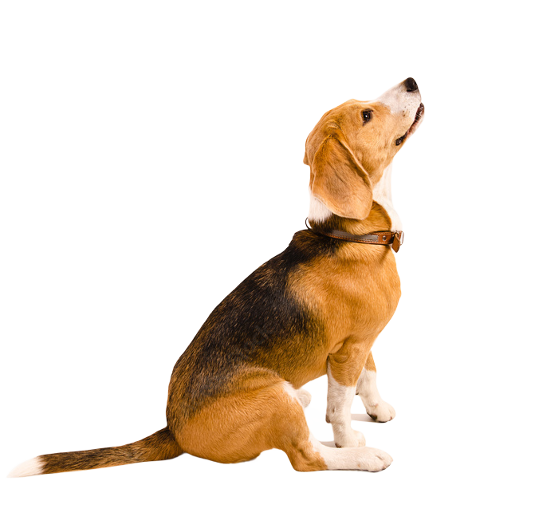
PROBLEM STATEMENT
Classifying images of cats and dogs may appear straightforward to humans, but it presents significant challenges for computer vision systems. Raw images contain high variability in pose, lighting, background, size, and quality, which makes feature extraction complex. Traditional machine learning approaches struggle to generalize well under these conditions. Furthermore, training deep learning models from scratch requires massive datasets and computational resources, which may not always be feasible. Therefore, there is a need for an efficient, accurate, and resource-friendly approach that can leverage pre-trained models and advanced augmentation strategies to achieve high performance in binary image classification tasks such as distinguishing between cats and dogs.

Slide 5
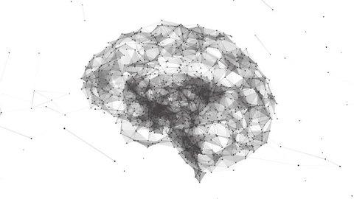
MOTIVATION
Image classification is a fundamental task in computer vision with applications ranging from healthcare to autonomous systems. The cats vs dogs problem, though simple, serves as a benchmark for testing modern deep learning techniques and evaluating their ability to handle real-world challenges such as variability in image quality and features. Developing an efficient and accurate model not only demonstrates the effectiveness of transfer learning but also provides a practical framework that can be extended to more complex classification problems. This project is motivated by the need to create a robust, resource-friendly solution that achieves high performance while maintaining scalability and adaptability.

Slide 6




REQUIRED TOOLS

Slide 7
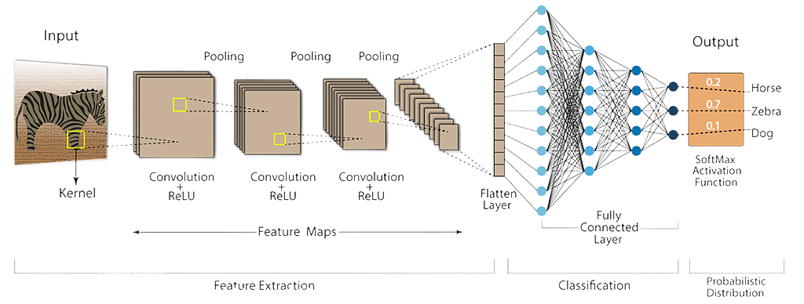
LITERATURE REVIEW
Deep learning has revolutionized image classification by enabling models to automatically extract and learn hierarchical features directly from raw images. Among various architectures, convolutional Neural Networks (CNN) is the most widely used for visual recognition tasks. CNN consist of convolutional layers that detect local features such as edges, corners, and textures; pooling layers that reduce dimensionality while preserving important information; and fully connected layers that combine learned features to perform the final classification. By learning hierarchies of features through backpropagation, CNN eliminate the need for manual feature engineering and provide high accuracy in image recognition tasks. In this project, CNN concepts along with Transfer Learning via MobileNetV2 are directly applied to classify images into two categories — cats and dogs — making CNN the core deep learning technique behind the model’s success.

Slide 8
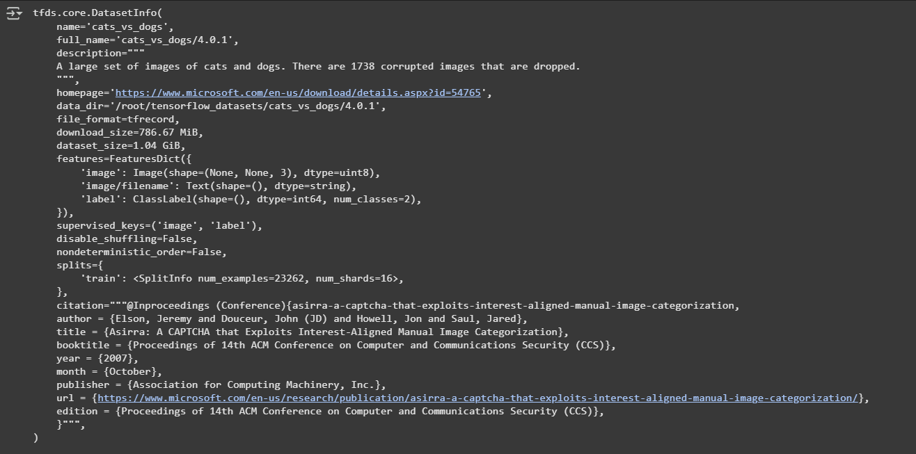
DATASET
The dataset was retrieved from TensorFlow which comprised 23,262 images of cats and dogs, exhibiting high intra-class variability in terms of pose, lighting, background, and resolution. This heterogeneity posed a robust challenge for the model’s generalization. An 80/20 split was adopted, ensuring that evaluation was performed on images unseen during training.

Slide 9
METHODOLOGY
Data Acquisition: Cats vs dogs dataset from TensorFlow datasets, providing direct online access for efficient usage.
Preprocessing & Augmentation: Resized to 320×320, applied rescalings, rotations, flips, distortions, brightness changes and shifts for better and accurate training.
Model Backbone: MobileNetV2, a pretrained CNN architecture on imagenet for transfer learning has been integrated for increasing model efficiency.
CNN Custom Classification Head: Global Average Pooling → Dense(256, ReLU) → Dropout(50%) → Sigmoid output.
Training Setup: Adam optimizer (LR=1e-5), Binary Cross-Entropy loss, 80/20 train-validation split, using callbacks such EarlyStopping & ReduceLROnPlateau to avoid overfitting.
Evaluation & Deployment: Metrics used such accuracy, precision, recall, F1-scores for evaluation of model’s performance and deployed to GitHub for easing further direct model integration.

Slide 10
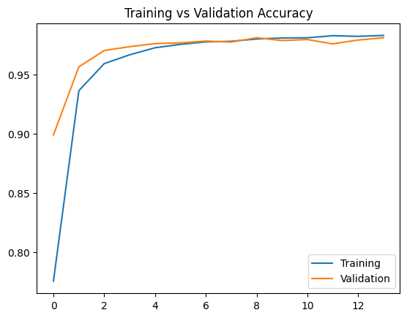
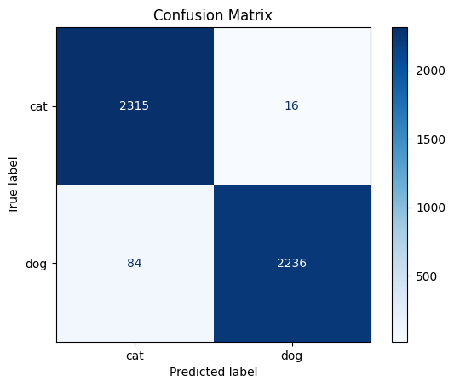
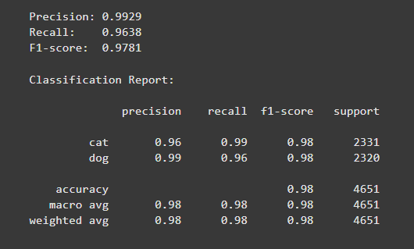
RESULT & PERFORMANCE
The proposed model achieved nearly 98% validation accuracy, closely matching training performance and showing no signs of overfitting. Out of 4,651 validation images, it correctly classified 4,551 (97.8%), with only 100 errors. Evaluation metrics confirmed strong performance, with a precision of 0.993, recall of 0.964, and an F1-score of 0.978. The model demonstrated balanced performance across classes, achieving a recall of 0.99 for cats and a precision of 0.99 for dogs. Overall, the weighted F1-score of 0.98 highlights the model’s robustness, reliability, and strong generalization to unseen data.

Slide 11
REFERENCES
Alzubaidi, L., et al. (2021). "Review of deep learning: concepts, CNN architectures, challenges, applications, future directions." Journal of big Data 8(1): 53.
Datasets, T. (2019). "Cats vs. Dogs." Retrieved August 22, 2025, from https://www.tensorflow.org/datasets/catalog/cats_vs_dogs.
Dong, K., et al. (2020). MobileNetV2 model for image classification. 2020 2nd International Conference on Information Technology and Computer Application (ITCA), IEEE.
Weiss, K., T. M. Khoshgoftaar and D. Wang (2016). "A survey of transfer learning." Journal of big Data 3(1): 9.

