Slide 1

Delivery & Courier using rickshaw
Group-10
Group member’s
Shakil, Md Shamim
ID-18-37431-1
Das, Arnab
ID-19-41564-3
Islam, Raima
ID-19-41549-3
Roy, Shithi
ID-19-41545-3

Slide 2
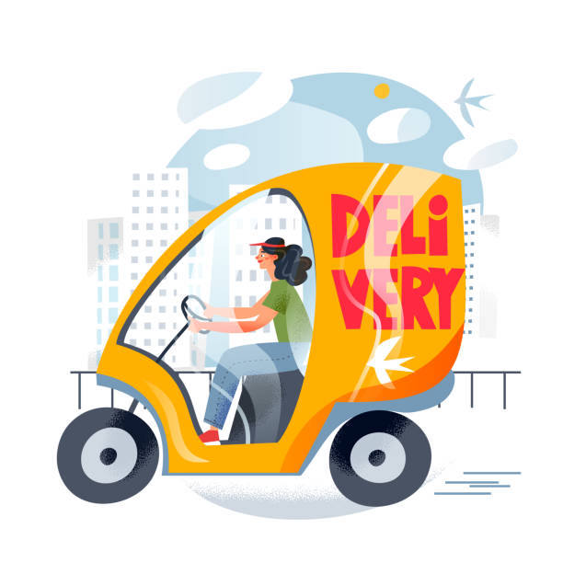
INTRODUCTION
What do you mean by Delivery & Courier using rickshaw ?
Benefits of using the app for Delivery & courier purpose

Slide 3
Does the project have a clear target market or audience?
Our Target is the people who live in residential area .Our main goal is to make connection between These Areas Peoples and Shop Owners and rickshaw pullers.Also make their any kind of movement easier.

Slide 4
Understand the problem and need’s of the customers.
Our Project have a clear target market and audience.
Nowadays home delivery and parcel system makes our life easier. Our project make this delivery and parcel system more easier and less time consuming ,also it is cost friendly.

Slide 5
Is the project’s purpose and basic functionality easily understood?
The project “Delivery & Courier using rickshaw” begins with a purpose of making life easier, make budget and time friendly delivery environment for people of Residential area.

Slide 6
Feature
Home Menu
User login
1-Registration
2-Login
User profile.
Seeking Services.
Place Orders.
Refer To request services side.
Products Tracking
Products delivery and payment.
Discount and offers

Slide 7
Functionalities
Our functionalities have been kept simple to be involved with Those are summarized below in an easy way to understand.
Our Users need to be registered with their addresses and contact information first.
We Will give User profile to Our user for getting all our services
User will seeking essential services and place order Request .
After getting Request we will implement our task and Deliver Services to Our User.
Our User Can Track his Producs/services .
We will Provide offers and Discounts To our User based on their activities.

Slide 8
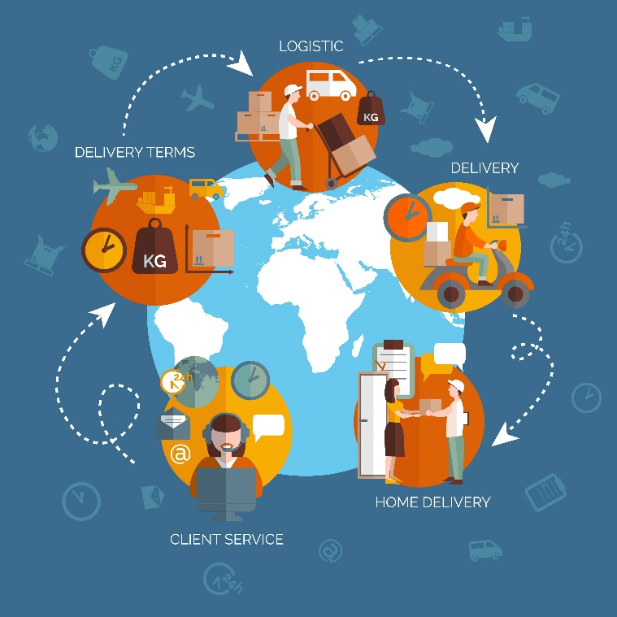
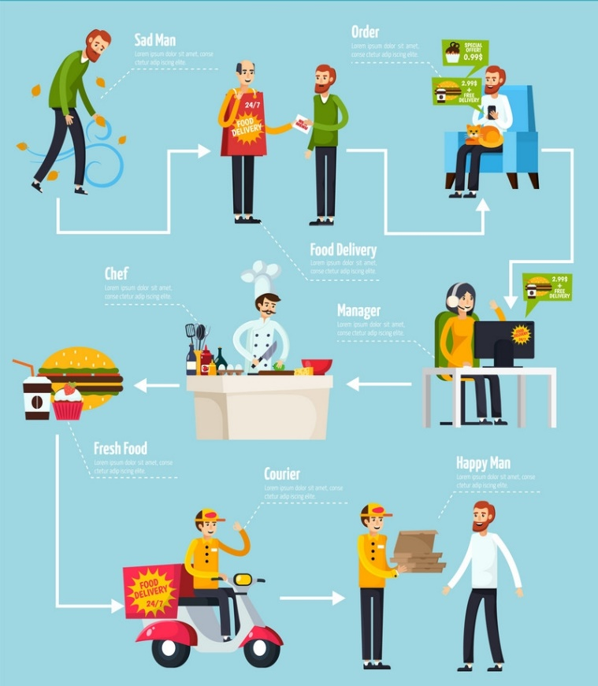
Basic and Easy functionally of the app

Slide 9
Conclusion

Slide 10
THANK YOU

